Slide 1
SAPIENZA UNIVERSITY OF ROME • A.A. 2025/2026
Energy Security Data Warehouse
Analyzing Geopolitical Risk and Energy Resilience in Europe
Data Management
Instructors: Prof. Domenico LEMBO, Prof.ssa Antonella POGGI, Prof. Roberto Maria DELFINO
Candidates: Francesco Gallo (Matr. 2162128) & Daniele Zito (Matr. 1985455)

Slide 2

01 | BACKGROUND & MOTIVATION
The 2022 Energy Shock & Geopolitical Vulnerability
The Geopolitical Shock of 2022
• Unprecedented Market Volatility: The outbreak of the Russo-Ukrainian war triggered historic disruptions in natural gas flows, causing TTF gas prices and electricity tariffs to increase across Europe.
• Asymmetric Exposure: European member states experienced divergent economic strains based on their baseline reliance on Russian pipeline infrastructure vs LNG alternatives.
• Decision-Making Gridlock: Policy-makers faced severely fragmented data: intelligence, market tariffs, and strategic reserves were trapped in isolated institutional silos.
• Analytical Goal: Build a unified, time-aware Data Warehouse to quantify the transmission dynamics of international geopolitical risk into real economic energy resilience.
Sapienza Università di Roma — Data Management (2025/2026) | Francesco Gallo & Daniele Zito
Slide 2 / 12

Slide 3
02 | ANALYTICAL CHALLENGE
Core Research Question & Native Granularities
CORE RESEARCH QUESTION
“To what extent, and through what temporal dynamics, do international geopolitical tensions co-vary with consumer energy prices, national import dependencies, and strategic oil stockpiles across European nations?”
GEOPOLITICAL RISK
Source: Federal Reserve (Caldara & Iacoviello)
Native Grain: Monthly (1985–2026)
Observations: 499 monthly global rows
Nature: Continuous text-mined news threat index
ENERGY TARIFFS (GAS & ELECTRICITY)
Source: Eurostat (nrg_pc_202..205)
Native Grain: Half-Yearly (2007–2025)
Observations: 38 semester snapshots per country
Complexity: Household (D1-D3) & Industrial (I1-I6)
DEPENDENCY & OIL STOCKS
Sources: Eurostat nrg_ind_id & nrg_stk_oem
Native Grains: Annual (Dep.) & Monthly (Stocks)
Horizons: 1990–2024 & 2013–2026
Key Rule: Stock days semi-additive, rates non-additive
Sapienza Università di Roma — Data Management (2025/2026) | Francesco Gallo & Daniele Zito
Slide 3 / 12

Slide 4
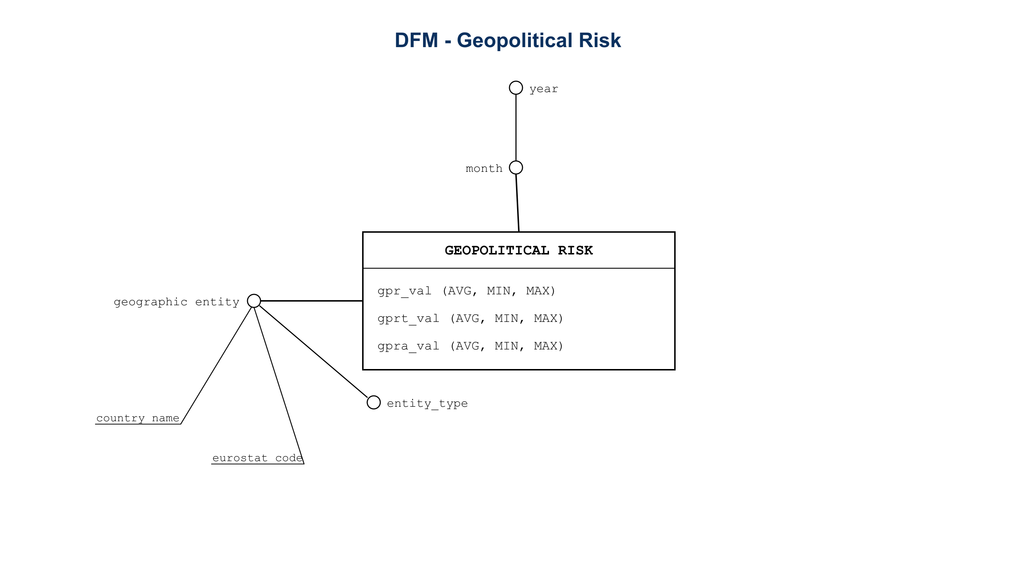
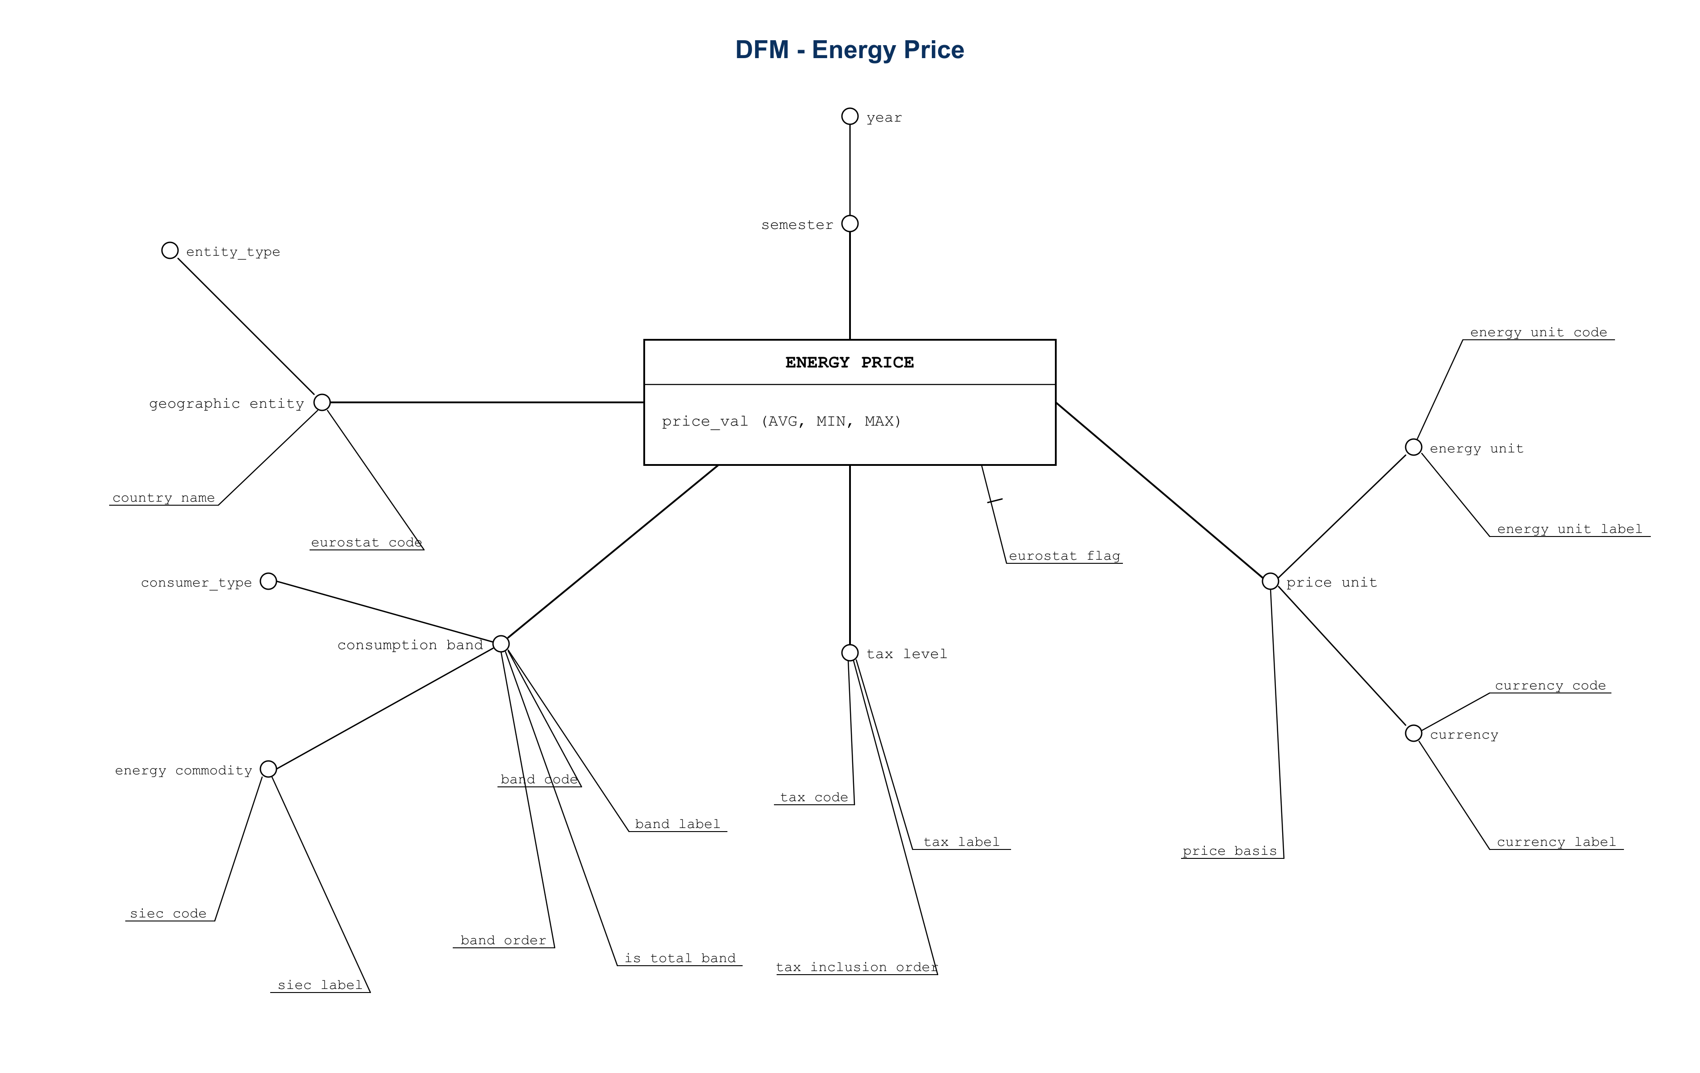
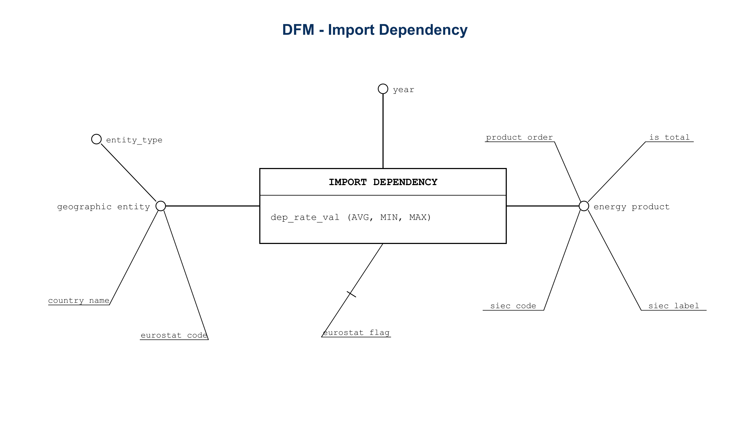
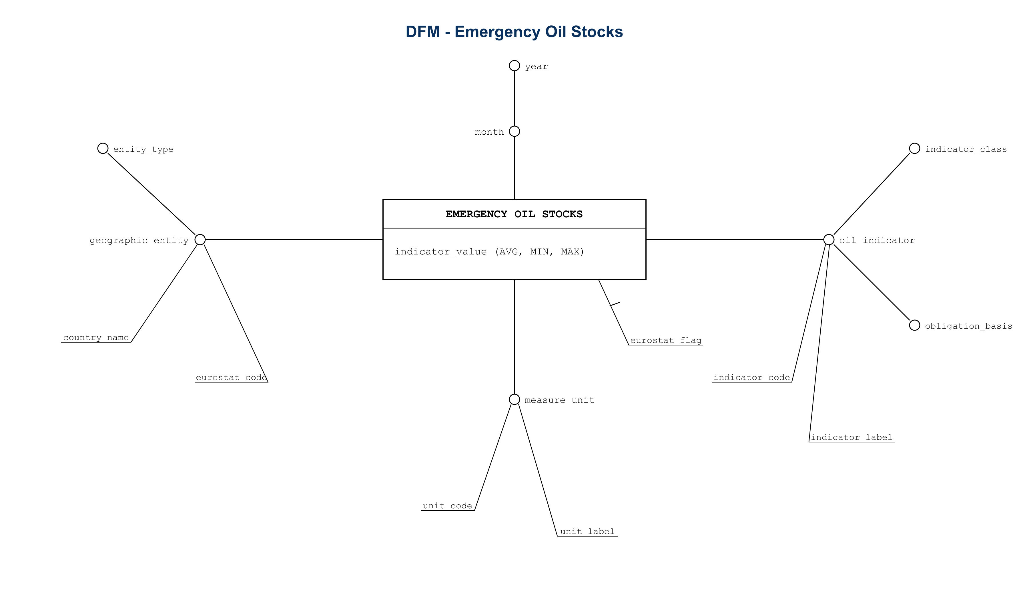
03 | CONCEPTUAL DESIGN
The 4 Dimensional Fact Schemes (DFM)
FACT_GPR (Monthly Grain)
FACT_ENERGY_PRICE (Half-Yearly Grain)
FACT_IMPORT_DEPENDENCY (Annual Grain)
FACT_OIL_STOCKS (Monthly Grain)
Sapienza Università di Roma — Data Management (2025/2026) | Francesco Gallo & Daniele Zito
Slide 4 / 12

Slide 5
04 | THEORETICAL FOUNDATION
Formal Algebra of Measures: Inmon and Dimensional Modeling Principles
1. NON-ADDITIVE MEASURES (UNIT / RATIO QUANTITIES) — SUM IS STRICTLY PROHIBITED
• Applies to: Retail electricity & gas prices (€/kWh), Energy Import Dependency Rate (%), Geopolitical Risk Index (GPR).
• Theoretical Rule: Summing unit prices over semesters or summing percentage rates across nations produces not relevant values.
• Permitted Operations: Only statistical aggregations (AVG, MIN, MAX) or re-computation as ratio of underlying sums (Σ revenue / Σ volume).
2. SEMI-ADDITIVE MEASURES (STOCK / LEVEL QUANTITIES) — ADDITIVE ACROSS SPACE, NEVER ACROSS TIME
• Applies to: Emergency Oil Stocks autonomy (days) and physical reserves (kt) in FACT_OIL_STOCKS.
• Theoretical Rule: Reserves can be summed across member states to obtain the total EU buffer, but summing over 12 months is an exam trap.
• Permitted Operations: Over time, only annual averages (AVG), year-end closing levels (LAST), or stress-test minimums (MIN) are mathematically sound.
3. ADDITIVE MEASURES (FLOW QUANTITIES) — UNRESTRICTED SUMMABILITY
• Applies to: Absolute net imports, physical consumption gigajoules, and total financial revenues.
• Theoretical Rule: Fully additive across all spatial, temporal, and categorical dimensions using standard SUM operators.
Sapienza Università di Roma — Data Management (2025/2026) | Francesco Gallo & Daniele Zito
Slide 5 / 12

Slide 6
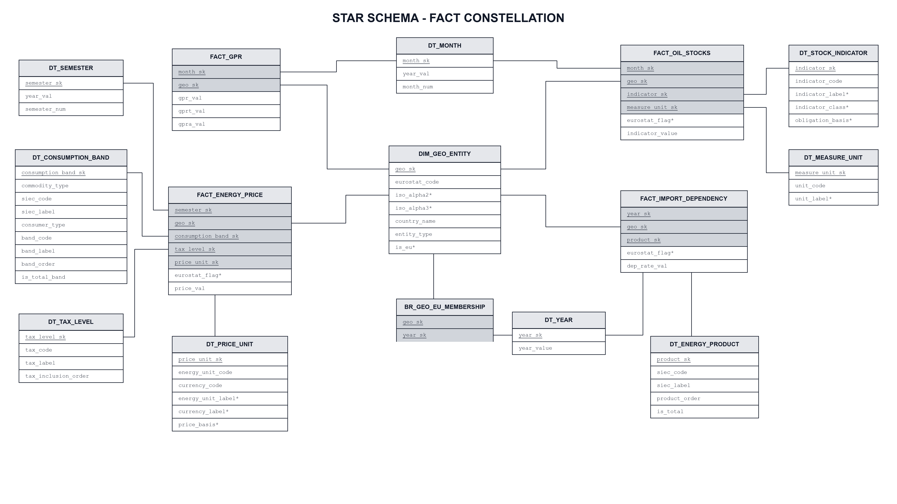
05 | LOGICAL ARCHITECTURE
Planar Fact Constellation Schema
Architecture Rationale
• Why Fact Constellation? A single Star Schema would force either artificial replication of annual data or destructive pre-aggregation of monthly risk.
• Conformed Dimensions: Unified DIM_GEO_ENTITY enables cross-fact drill-across.
• Surrogate Keys: Every dimension uses integer surrogate keys for maximum join efficiency, completely decoupled from source IDs.
Sapienza Università di Roma — Data Management (2025/2026) | Francesco Gallo & Daniele Zito
Slide 6 / 12

Slide 7
06 | HISTORICAL MODELING
Handling Boundary Evolution: Dynamic EU Membership Bridge
The Static Attribute Trap
• Changing Borders: The EU is not a static set of nations. It expanded to 28 members (Croatia in 2013) and shrank with Brexit (UK exit in 2020).
• SCD Type 1 Flaw: Storing a simple boolean flag 'is_eu_member' in DIM_GEO_ENTITY would either incorrectly retrodate Brexit to 2010 or falsely include the UK in 2024.
• Analytical Bias: Comparing historical EU totals across decades requires tracking the exact legal composition of the union year by year.
The Temporal Bridge: BR_GEO_EU_MEMBERSHIP
• Bridge Structure: A dedicated associative table: (geo_sk, year_sk, is_member, accession_year, exit_year).
• Dual Query Capability: Analysts can query either the 'EU composition as it was in year T' or the 'constant EU-27 cohort' over time.
• Example — United Kingdom: is_member = TRUE for all year_sk <= 2019; is_member = FALSE from 2020.
• Zero Cartesian Explosion: Joins directly with fact tables on conformed (geo_sk, year_sk) keys without multiplying measure rows.
Sapienza Università di Roma — Data Management (2025/2026) | Francesco Gallo & Daniele Zito
Slide 7 / 12

Slide 8
07 | INGESTION & AUTOMATION
Production ETL Pipeline & 12 Automated Integrity Checks
7 MODULAR LOADERS
• Wide-to-Long: Eurostat composite headers unpivoted to normalized atomic rows.
• Metadata Flags: Flags preserved as descriptive attributes, keeping metrics numeric.
• Negative Prices: NL/CZ subsidies audited as legal tax credits, not ingestion bugs.
IDEMPOTENT UPSERT
• ON CONFLICT Logic: Loaders can be interrupted and rerun safely without duplicate rows or key errors.
• Transaction Safety: ACID commits and automatic rollbacks on exception.
• Universal Runners: One-click automation scripts provided for both macOS/Linux (run_etl.sh) and Windows (run_etl.ps1).
12 INTEGRITY AUDITS
After each ETL run, verify_final_dw.sql checks key uniqueness, referential integrity, valid value domains, and completeness of the EU-membership bridge.
These routine checks help identify incomplete loads or transformation issues before running analytical queries.
Sapienza Università di Roma — Data Management (2025/2026) | Francesco Gallo & Daniele Zito
Slide 8 / 12

Slide 9
08 | MULTIDIMENSIONAL NAVIGATION
Guided 6-Step Didactic OLAP Walkthrough
1. BASE QUERY
Atomic price cell (Country, Semester, Band) -> 1,373 rows
2. ROLL-UP
Ascending hierarchy: Semester -> Year (averaging S1 & S2) -> 701 rows
3. DRILL-DOWN
Introducing consumer type (Household vs Industrial) -> 1,388 rows
4. SLICE
Hyperplane projection fixing Country = 'Italy' (2D plane) -> 36 rows
5. DICE
Bounding box: {Italy, Germany} x [2021, 2023] x Households -> 6 rows
6. DRILL-ACROSS
Joining Energy Price + Import Dependency on Conformed Year & Country
Sapienza Università di Roma — Data Management (2025/2026) | Francesco Gallo & Daniele Zito
Slide 9 / 12

Slide 10
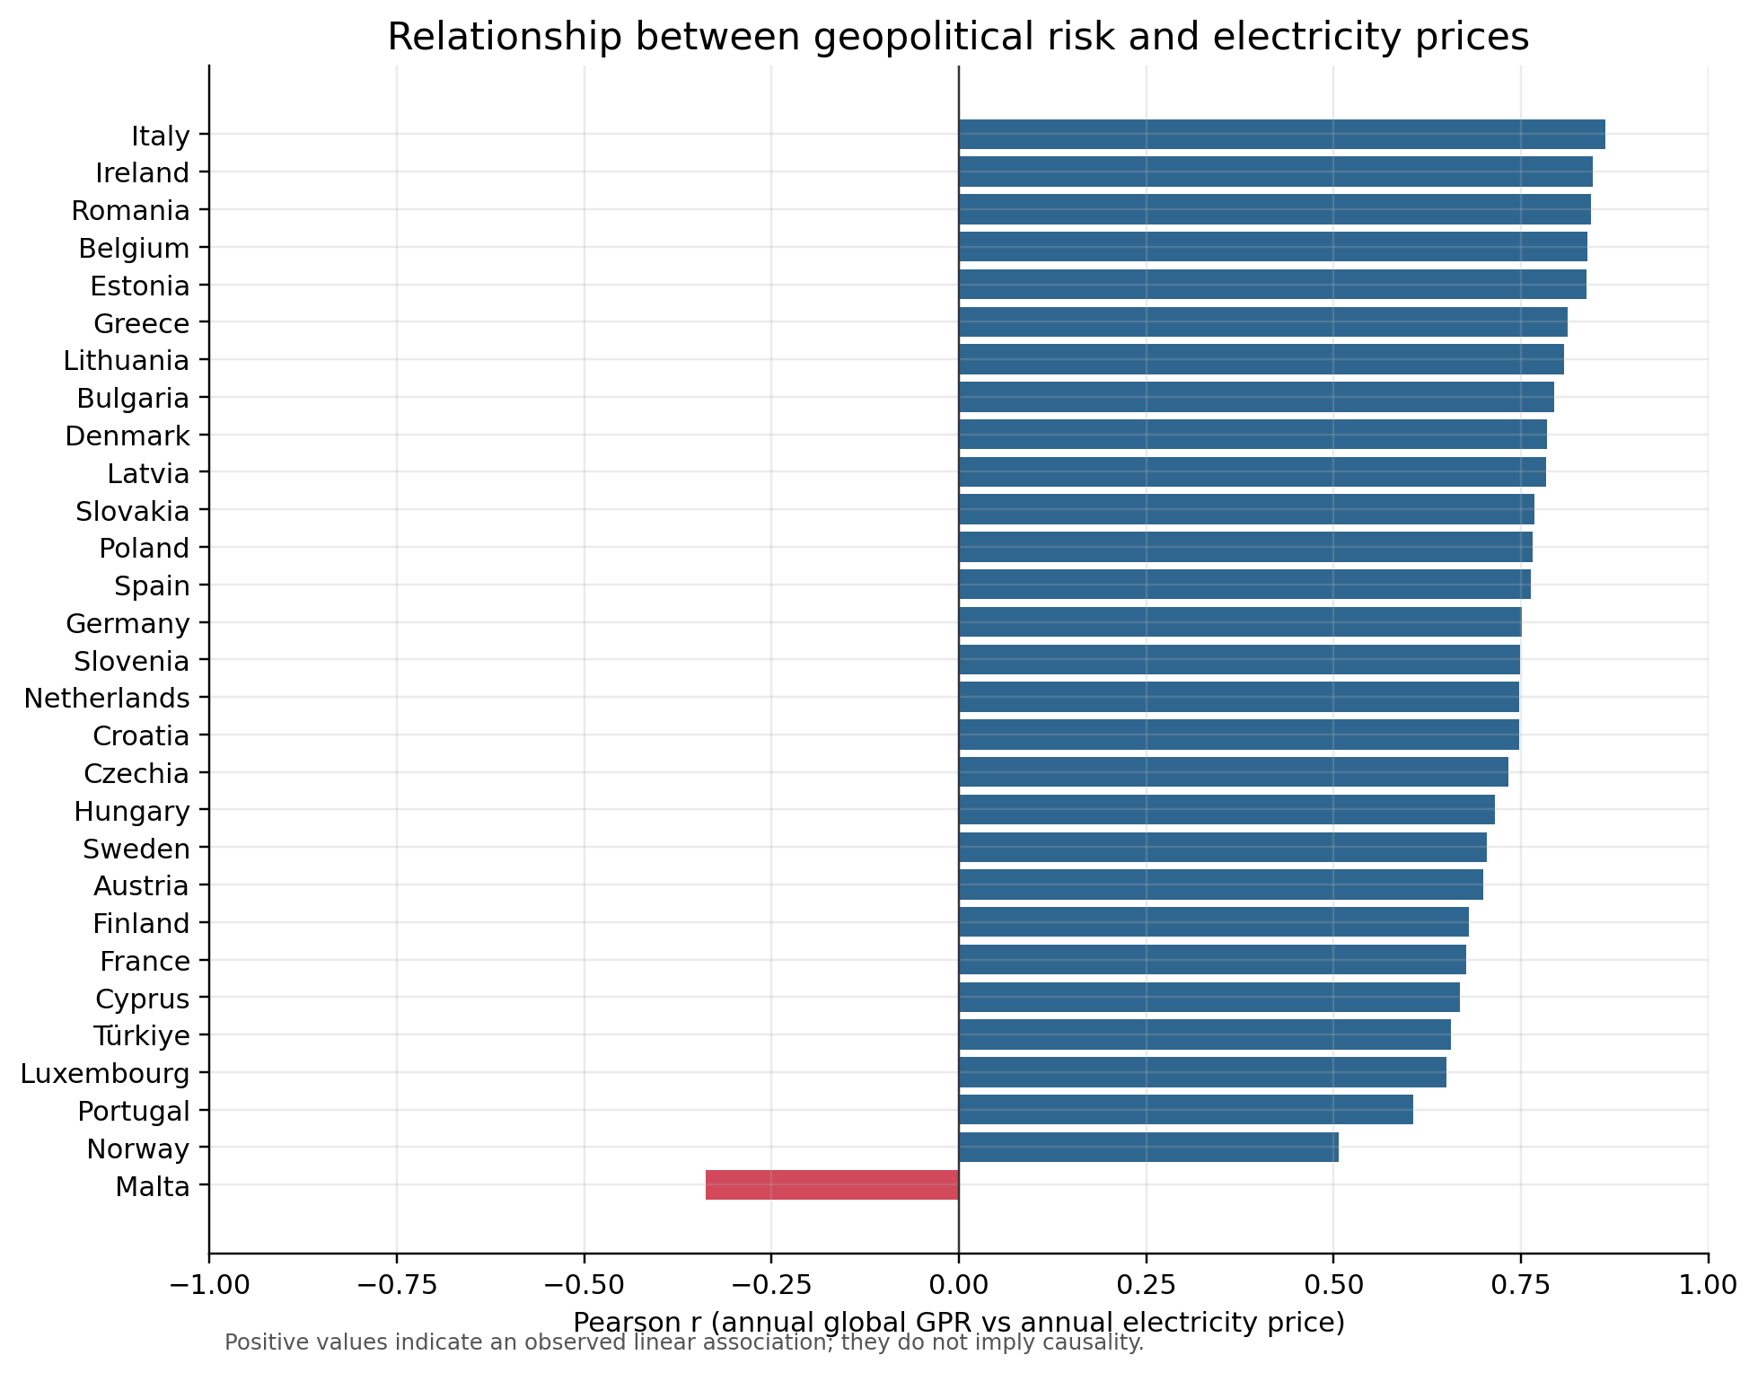
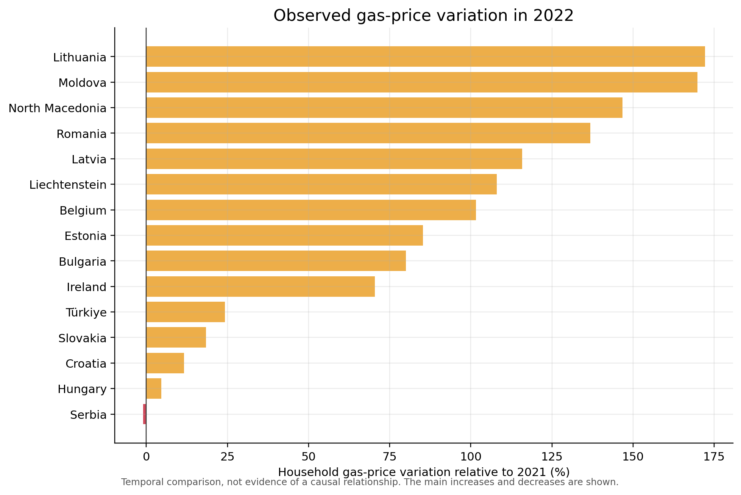
09 | EMPIRICAL INSIGHTS
Transmission of Geopolitical Tension into Consumer Prices
Query 1: GPR vs Industrial Electricity Correlation
Strong positive correlation across major economies (Italy r=0.863, Germany r=0.751). Peak tension anticipates retail price peaks by 4–6 months.
Query 5: The 2022 Natural Gas Price Shock
Asymmetric impact of GPR +92% surge: Netherlands (+109%) and Italy (+34%) spiked, while Spain contained increases via Iberian exception and LNG.
Sapienza Università di Roma — Data Management (2025/2026) | Francesco Gallo & Daniele Zito
Slide 10 / 12

Slide 11
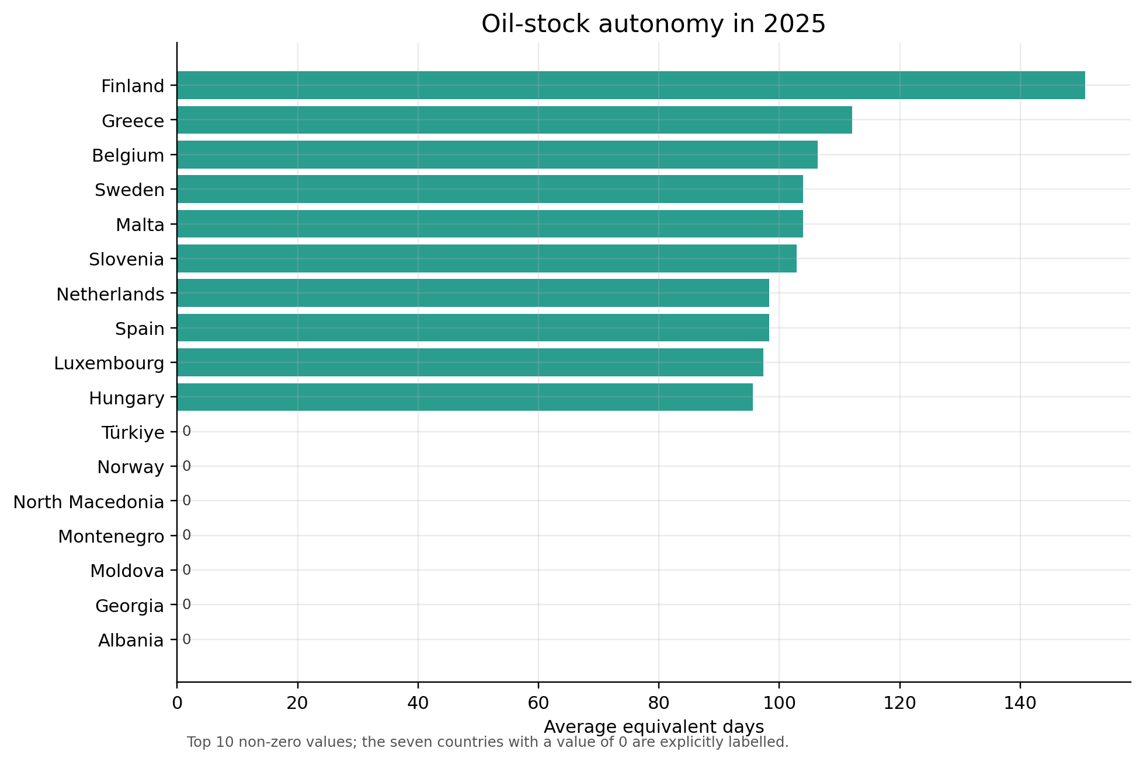
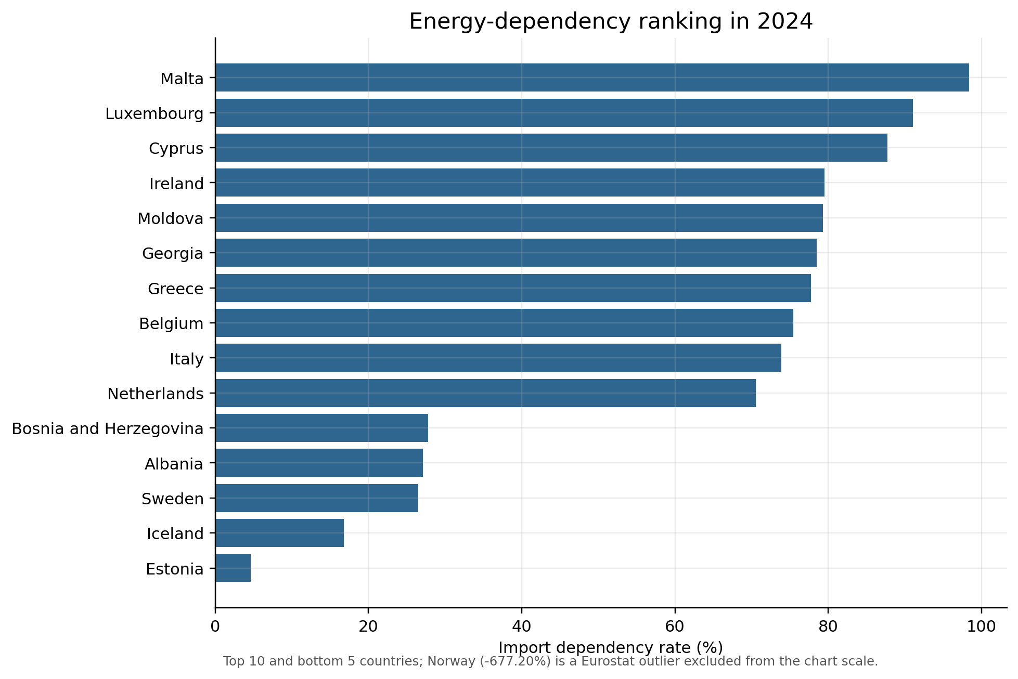
10 | SUPPLY SECURITY
Import Dependency Ranking & Oil Stock Autonomy
Query 2: 3-Month Moving Average on Strategic Oil Stocks
Smooths logistic tanker unloads. For Italy in 2022, the average was 86.5 days and MIN() recorded 82.0 days, below the 90-day IEA threshold.
Query 6: 2024 Import Dependency Ranking (DENSE_RANK)
Highlights stark divide: Malta (98.4%) and Luxembourg (91.0%) top vulnerability rankings, contrasted with Norway as net exporter (-677%).
Sapienza Università di Roma — Data Management (2025/2026) | Francesco Gallo & Daniele Zito
Slide 11 / 12

Slide 12
11 | SYNTHESIS & DEFENSE
Conclusions, Methodological Limitations & Future Work
KEY ACHIEVEMENTS
• Rigorous DFM: Four fact schemes applying the Golfarelli and Rizzi DFM formalisms.
• Measure Discipline: Strict adherence to non-additive and semi-additive rules.
• Fact Constellation: Zero-crossing planar schema uniting 4 business processes.
• 13 OLAP Queries: Complete coverage from didactic drill-across to window analytics.
METHODOLOGICAL DEFENSE
• Correlation != Causality: Italy shows r = 0.863; this describes temporal co-variation, not causation.
• Market Mechanics: Merit-order electricity dispatch and take-or-pay gas contracts act as transmission mediators.
• Granularity Integrity: Preserving native time frequencies avoided synthetic disaggregation traps.
LIMITS & FUTURE EXTENSIONS
• Eurostat Latency: Official annual energy balances are released with a 9–12 month lag.
• High-Frequency Feeds: Architecture is ready to integrate daily wholesale power exchange data.
• Predictive Views: Materialized views can feed machine-learning models for early-warning energy price forecasting.
Sapienza Università di Roma — Data Management (2025/2026) | Francesco Gallo & Daniele Zito
Slide 12 / 12

