Slide 1
impacts

Slide 2
Data download
Population weights
Aggregation

Slide 3
Data download
import intake
query = dict(experiment_id=['historical'], table_id='Amon', source_id=['CMCC-CM2-HR4', 'CanESM5', 'CanESM5-CanOE', ], variable_id='pr', grid_label=['gn'])
Pangeo
Download at runtime
Loaded onto memory
All members of ensemble
Copernicus Data Store
Need to store on disk
One variable at the time
1 member of ensemble (it seems)
import cdsapi
query = { 'format': 'zip', 'temporal_resolution': 'daily', 'experiment': 'ssp1_2_6', 'variable': 'precipitation', 'model': 'cmcc_esm2', 'area': [ 70, 0, 20, 30, ], 'level': 'single_levels', 'date': '2020-01-01/2025-12-31', }

Slide 4
logic
Download dataset(s). For each dataset:
Harmonize using ad hoc Python package (https://github.com/jbusecke/xmip)
Population weights
Extract the lat-lon grid.
Compute total population per grid cell
Add population weights and ISO code to the dataset
Aggregated over Member of ensemble / Space [with pop weights] / Time
Mean, median, std, var, max, min, quantile. [range needed?]
As of now: order is M-S-T. Time is last b/c memory limits.

Slide 5
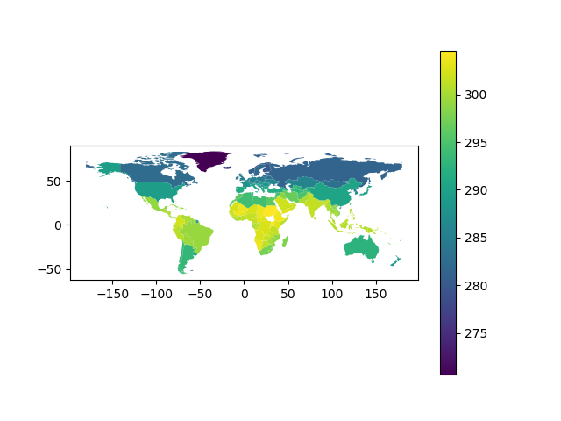
Visual sanity check

