Slide 1
impacts

Slide 2
Data download
Population weights
Aggregation

Slide 3
Data download options
import intake
query = dict(experiment_id=['historical'], table_id='Amon', source_id=['CMCC-CM2-HR4', 'CanESM5', 'CanESM5-CanOE', ], variable_id='pr', grid_label=['gn'])
Through APIs
Pangeo
Download at runtime, need not store on disk
Download multiple models, variables, at once
All members of ensemble
Copernicus Data Store
Need to store on disk
One variable at the time
1 member of ensemble (it seems)
import cdsapi
query = { 'format': 'zip', 'temporal_resolution': 'daily', 'experiment': 'ssp1_2_6', 'variable': 'precipitation', 'model': 'cmcc_esm2', 'area': [ 70, 0, 20, 30, ], 'level': 'single_levels', 'date': '2020-01-01/2025-12-31', }

Slide 4
logic
Download dataset(s). For each dataset:
Harmonize using an ad hoc Python package (https://github.com/jbusecke/xmip)
Population weights
Extract the lat-lon grid.
Compute total population per grid cell [intersection with country borders]
Add population weights and ISO code to the dataset
Aggregated over Member of ensemble / Space [with pop weights] / Time
Mean, median, std, var, max, min, quantile. [range needed?]
As of now: order is M-S-T. Time is last b/c memory limits.

Slide 5
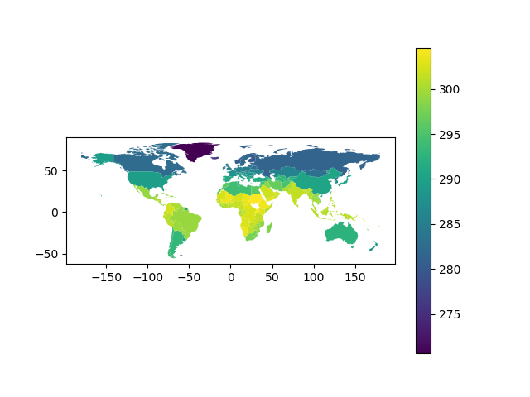
Visual sanity check

