Slide 1
Impacts meeting
20/10/2022

Slide 2
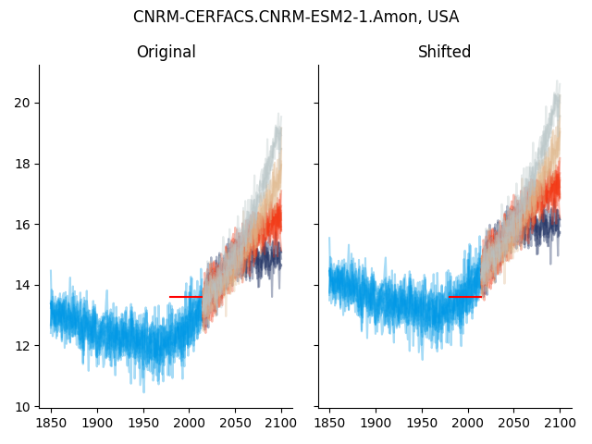
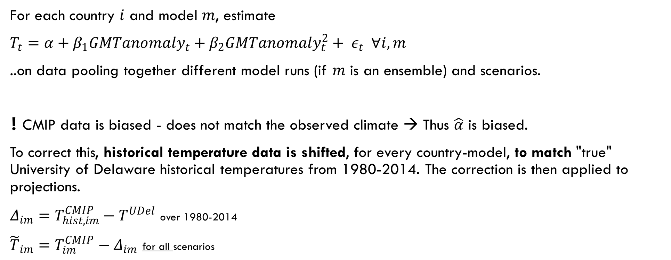

For each country $i$ and model $m$, estimate
$T_{t}=α+β_{1}GMTanomaly_{t}+β_{2}{GMTanomaly}_{t}^{2}+ ε_{t} ∀i,m$
..on data pooling together different model runs (if $m$ is an ensemble) and scenarios.
❗ CMIP data is biased - does not match the observed climate → Thus $\overset{̂}{α}$ is biased.
To correct this, historical temperature data is shifted, for every country-model, to match "true" University of Delaware historical temperatures from 1980-2014. The correction is then applied to projections.
$Δ_{im}=T_{hist,im}^{CMIP}−T^{UDel}$ over 1980-2014
${\overset{̃}{T}}_{im}=T_{im}^{CMIP}−Δ_{im}$ for all scenarios
Example
$$T^{UDel}$$

Slide 3
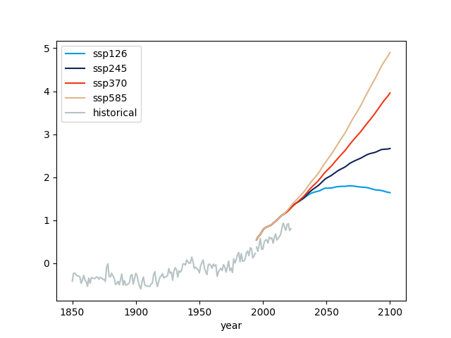
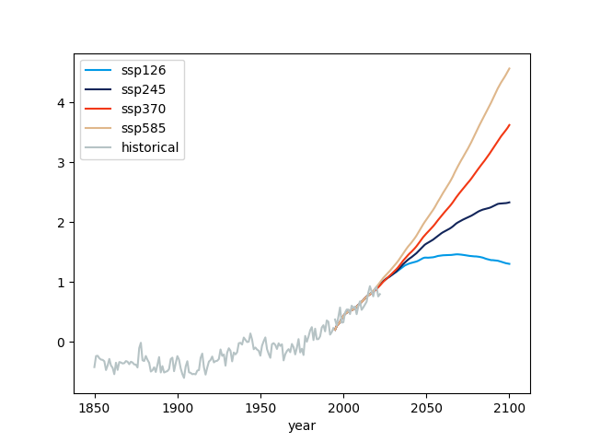
GMT anomaly
To match the GMT anomaly of WITCH as close as possible, I used:
HadCRUT5 for historical data.
MAGICC7 for SSPs
Since they are discontinuous, I'm shifting the GMT anomaly from MAGICC7 to match the HadCRUT5 (historical) over 1995-2014. MAGICC7 GMT anomaly is the same across SSP from 1995 until 2014 (observed data).

