Slide 2
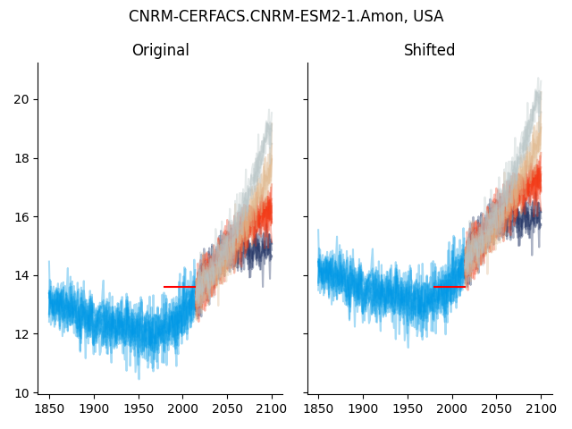
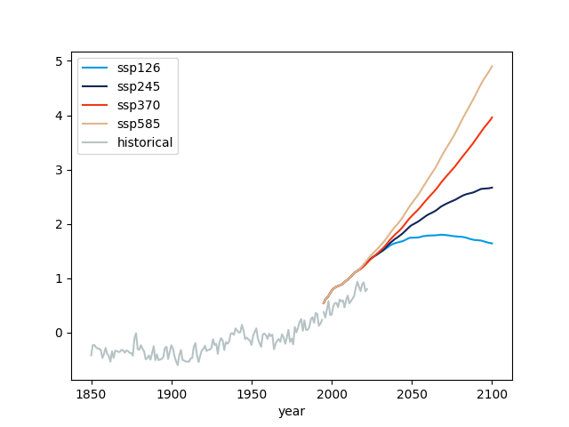
All members of ensemble → Within-model variability
Debias:
Rescaled time series to match U of Delaware GMT over 1980-2010
Alters the intercept
GMT anomaly:
HadCRUT5 (historical) + MAGICC7 (SSPs)
MAGICC7 shifted (downward) to match HadCRUT5 over 1995-2014

Slide 3
T_t = a + bGMTa_t + e_t
T_t: CMIP data shifter to match U of Del temperaure data (country by country)
GMT anomaly = HadCRUT5 + MAGICC7
Regression by country-model. Variation from
Multiple SSPs
Multiple members of ensemble (within-model variability)

