Slide 1
mesmer
20/09/2022

Slide 2
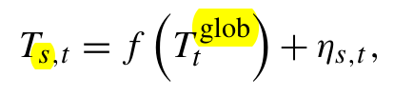
Mesmer
Emulator of Earth-System Models.
"produces realizations which closely resemble initial-condition ensemble members of the considered ESMs.“
bilinearly interpolated 2.5◦ ×2.5◦ grid
40 CMIP5 climate models, 180ì70-2100
Trained on a single run per climate model

Slide 3
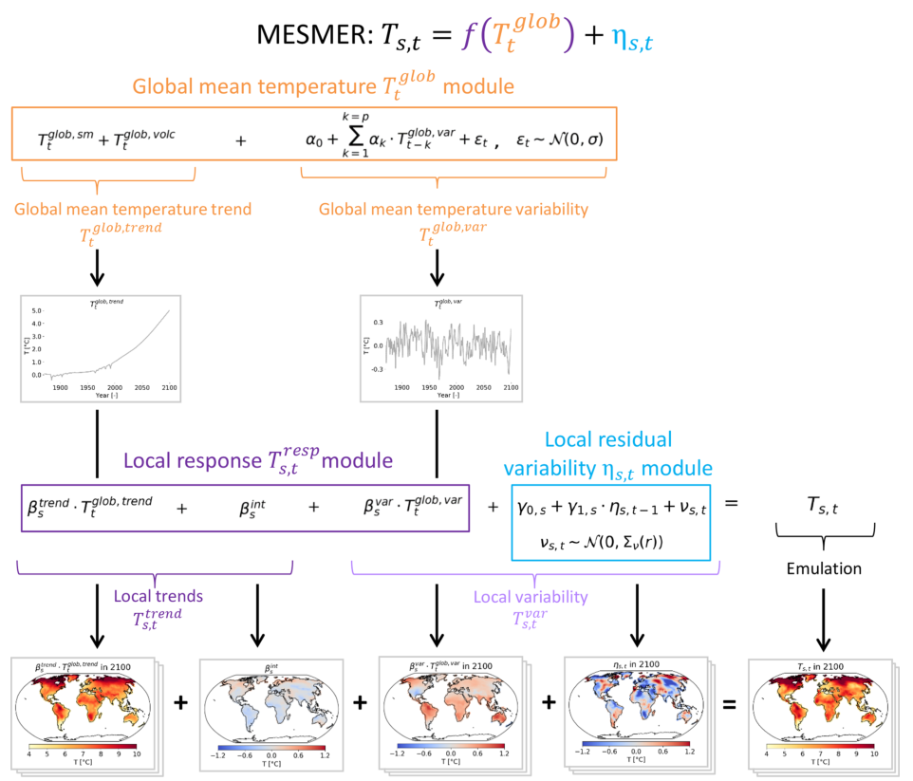
calibration
Local Temperature is linear function (OLS) of (smoothed) global temperature

Slide 4
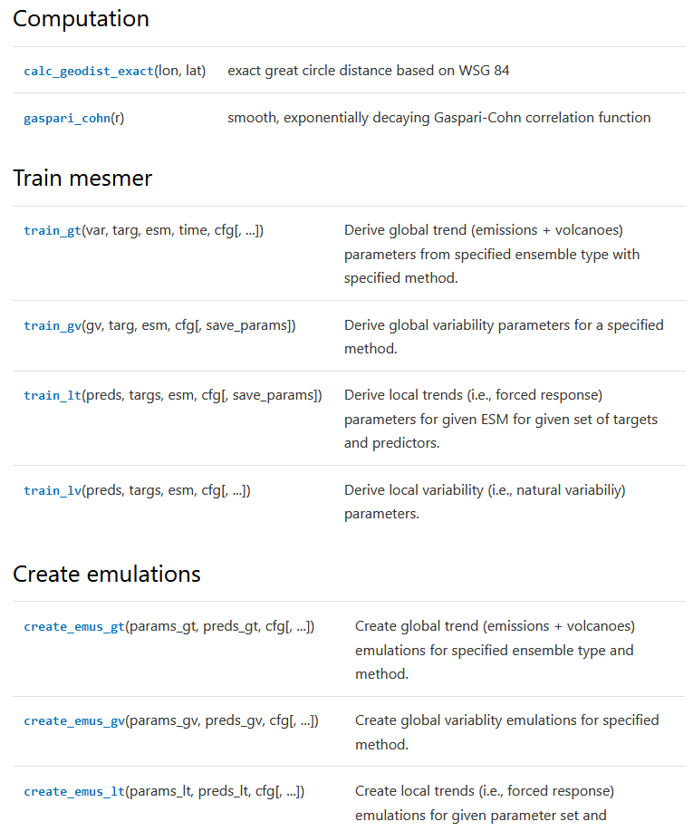
Python package
For training – does not provide parameters

