Slide 1
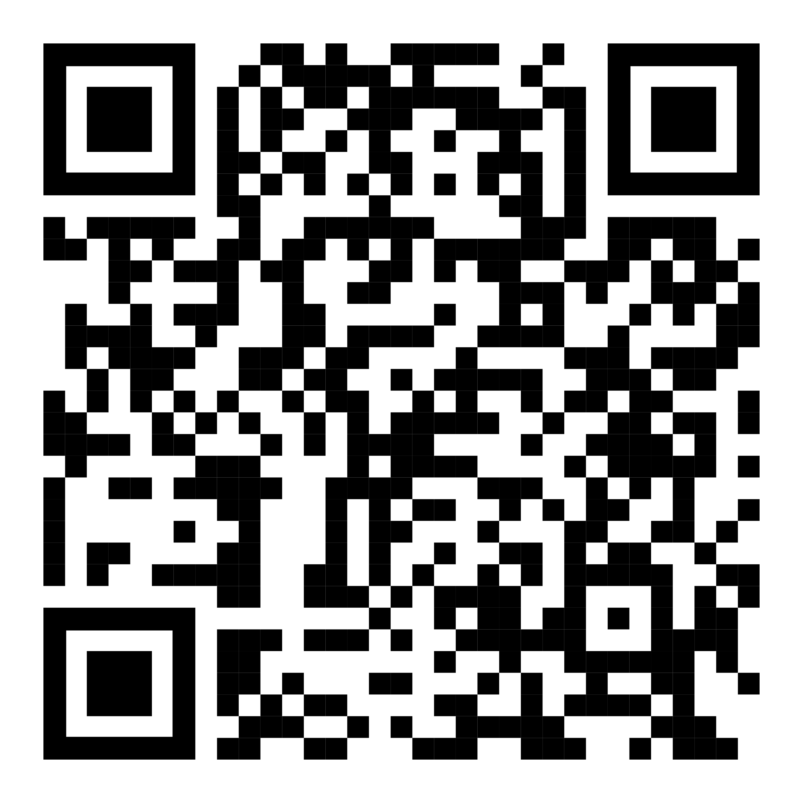
Event studies and Synthetic Control Methods
Francesco Granella
| RFF-CMCC European Institute on Economics and the Environment |
| francescogranella.github.io |

Slide 2
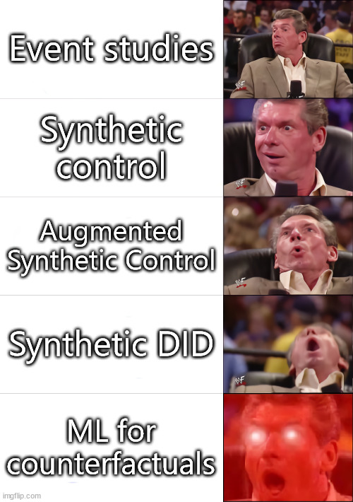
The plan
Overview of a few methods
Light on the math
Focus on the assumptions
Be at ease and ask questions!

Slide 3
Synthetic control methods
Abadie, Diamon & Heinmueller (2010) and Abadie, Diamond & Heinmueller (2014)

Slide 4
Synthetic control methods (SCM)
“Arguably the most important innovation in the policy evaluation literature in the last 15 years”
Athey and Imbens (2017)
Few untreated units and only one treated unit
Example: California passes anti-tobacco legislation. Effect on tobacco use?
Comparative case studies
Handpick comparison units. Great deal of contextual knowledge, theory, qualitative evidence.
Selection of comparison units is crucial: if not sufficiently similar to the unit of interest, one might mistake underlying differences with the effects of the treatment.
SCM: builds an average of comparison units, selected and weighted in a systematic way based on preintervention observables.

Slide 5
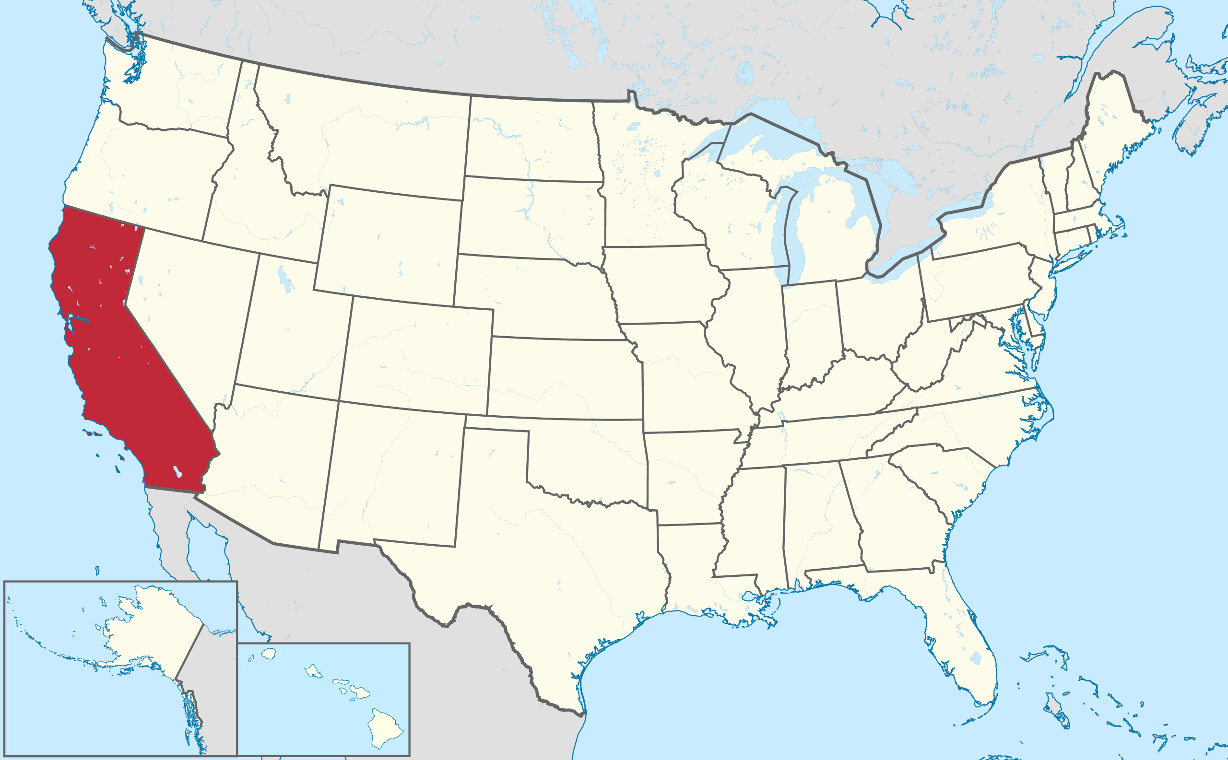
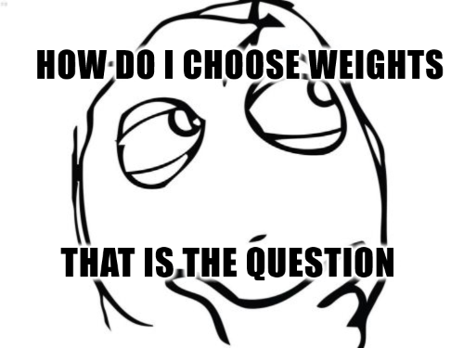


Intuition
Find a set of potential comparison units (“donor pool”)
Other US States
Weighted average of the outcome of comparison units $\hat{Y}=∑w∗Y^{C}$ based on preintervention observables: the synthetic counterfactual
Compare observed and synthetic counterfactual posttreatment. $TE_{t}=Y_{t} −{\hat{Y}}_{t}$

Slide 6
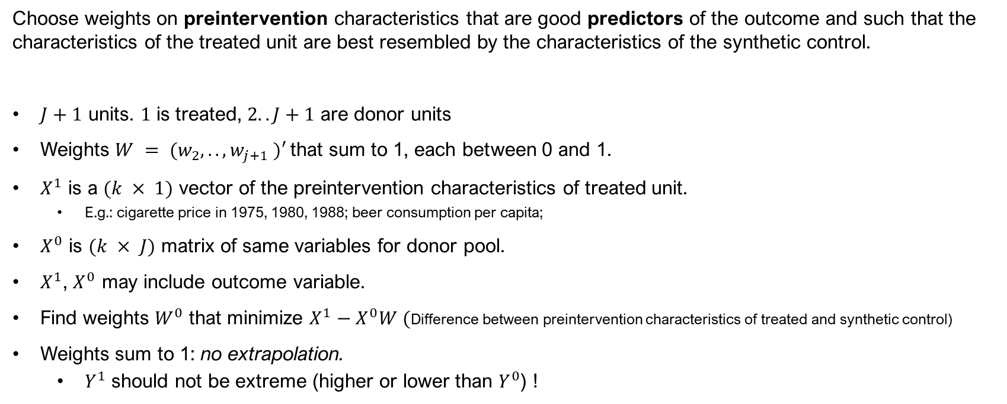
Choosing weights
Choose weights on preintervention characteristics that are good predictors of the outcome and such that the characteristics of the treated unit are best resembled by the characteristics of the synthetic control.
$J+1$ units. $1$ is treated, $2..J+1$ are donor units
Weights $W = (w_{2}, . . , w_{j+1} )′$that sum to 1, each between 0 and 1.
$X^{1}$ is a $(k × 1)$ vector of the preintervention characteristics of treated unit.
E.g.: cigarette price in 1975, 1980, 1988; beer consumption per capita;
$X^{0}$ is $(k × J)$ matrix of same variables for donor pool.
$X^{1}$, $X^{0}$ may include outcome variable.
Find weights $W^{0}$ that minimize $X^{1}−X^{0}W ($Difference between preintervention characteristics of treated and synthetic control)
Weights sum to 1: no extrapolation.
$Y^{1}$ should not be extreme (higher or lower than $Y^{0}$) !

Slide 7
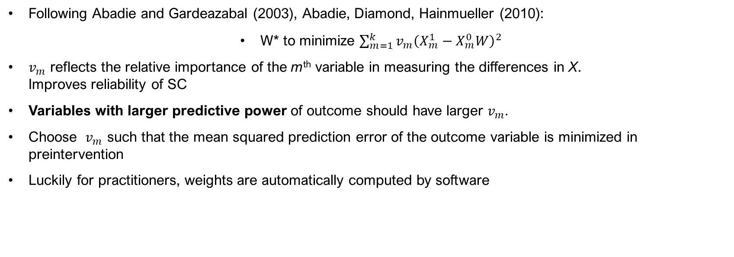
Choosing weights
Following Abadie and Gardeazabal (2003), Abadie, Diamond, Hainmueller (2010):
W* to minimize $\sum_{m=1}^{k}{v_{m}{\left(X_{m}^{1}−X_{m}^{0}W\right)}^{2}}$
$v_{m}$ reflects the relative importance of the m^{th} variable in measuring the differences in X. Improves reliability of SC
Variables with larger predictive power of outcome should have larger $v_{m}.$
Choose $v_{m}$ such that the mean squared prediction error of the outcome variable is minimized in preintervention
Luckily for practitioners, weights are automatically computed by software

Slide 8
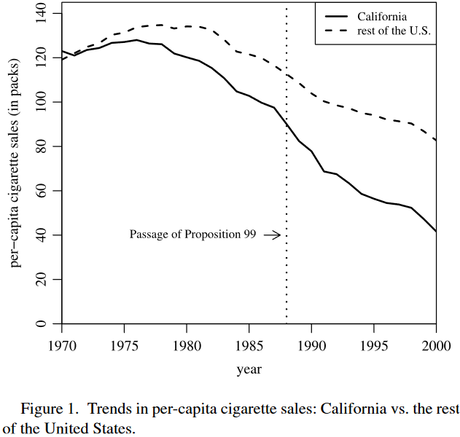
California’s Proposition 99
In 1989, California passes “Proposition 99” to reduce tobacco consumption
Increase cigarette excise tax by 25 cents per pack and earmark revenues for anti-tobacco projects
ADH (2010) build a SC to estimate the effect of P99 on cigarette consumption.

Slide 9
California’s Proposition 99
Data:
Cigarette sales (in packs) 1970-2000
Donor pool: US states that did not pass anti-tobacco legislation in 1989-2000
Predictors:
Average retail price of cigarettes
Per capita state personal income (logged)
Percentage of the population age 15–24
Per capita beer consumption.

Slide 10
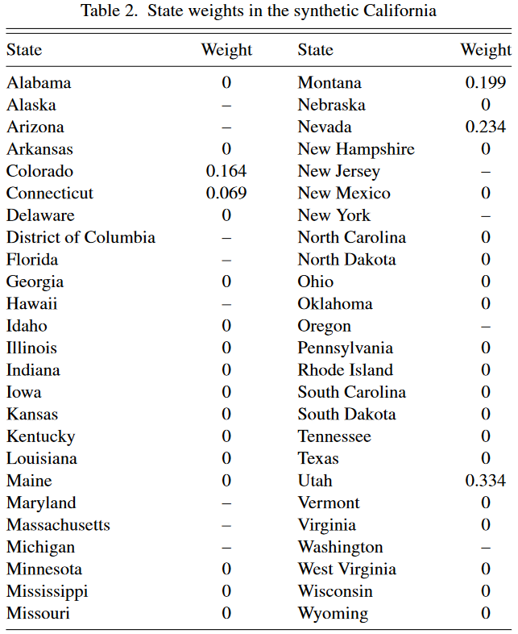
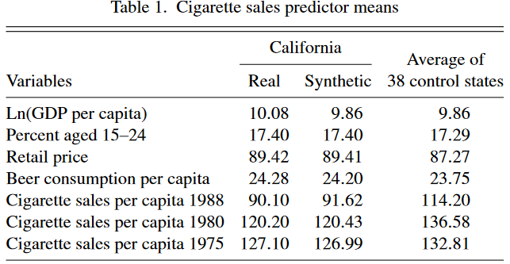

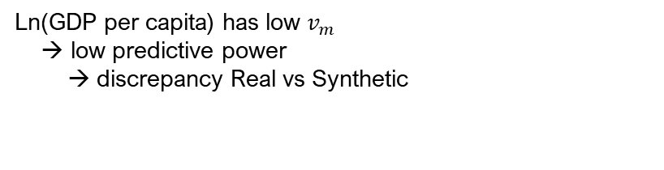
Predictors and Weights
Excluded because passed anti-tobacco legislation
(affected by similar treatment)
Ln(GDP per capita) has low $v_{m}$ → low predictive power → discrepancy Real vs Synthetic

Slide 11
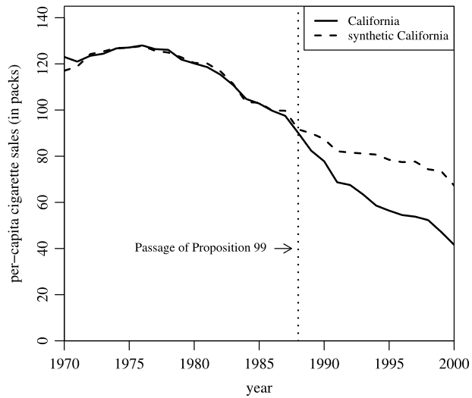
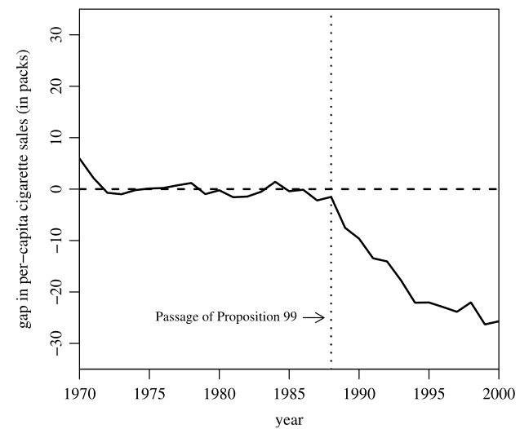
Results

Slide 12
Assumptions
1. No spillover onto donor units
Californians buying cigarettes in Nevada What if Proposition 99 increased beer price in Nevada? Is it a violation?
2. No anticipation
Californians stockpile cigarettes before the tax
3. No other treatments (parallel trends)
Smoking suddenly unfashionable in Montana

Slide 13
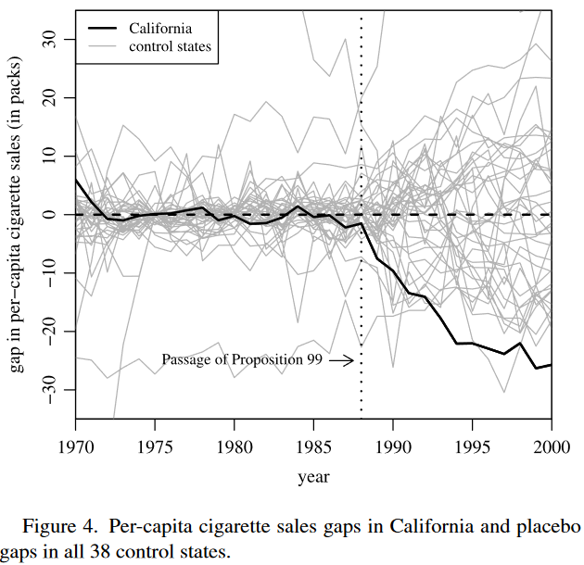
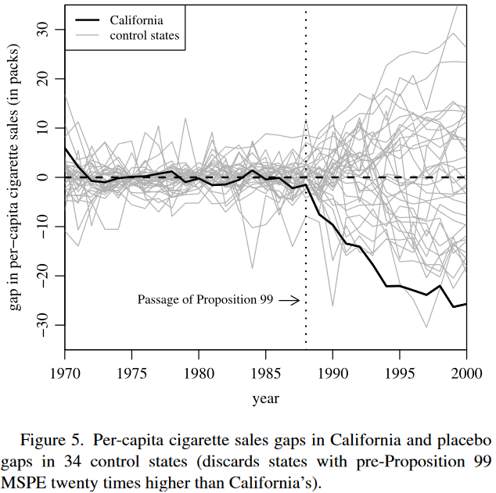
Inference
Could results be driven by chance?
Placebo studies.
Apply the SCM to states that did not apply anti-tobacco policies
If the gap estimated for California is unusually high, it’s evidence of a negative effect of P99

Slide 14
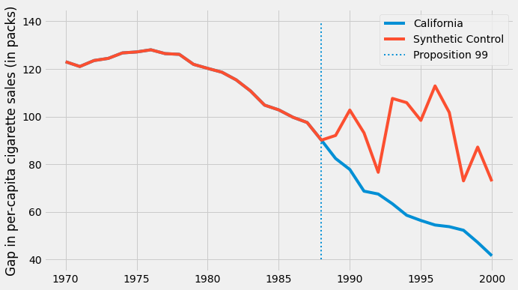
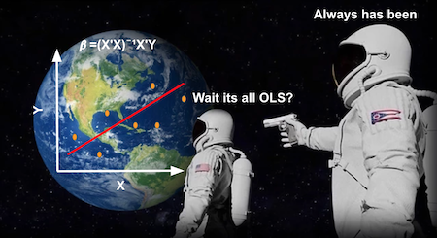
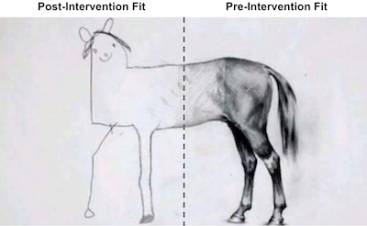
Like a regression, better than a regression
A regression-based estimator can also be expressed as weighted average of comparison units with weights summing to 1.
But regression weights are not restricted to be between 0 and 1 → Extrapolation, overfitting to idiosyncrasies.
Even if X1 cannot be approximated, regression weights extrapolate to produce a perfect fit.
Source: https://matheusfacure.github.io/python-causality-handbook/15-Synthetic-Control.html

Slide 15
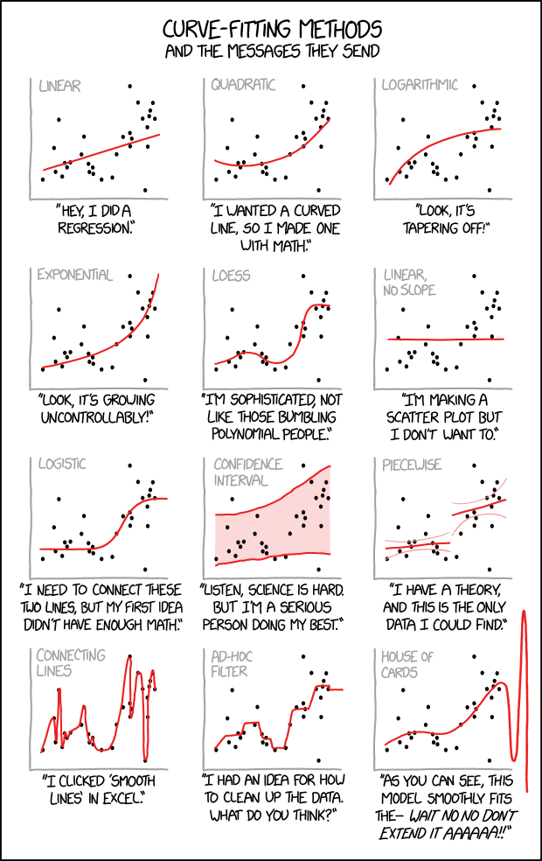
Which one is probably overfitting?

Slide 16
?
What if a good pre-treatment matching isn’t feasible?

Slide 17
Augmented synthetic control method
Ben-Michael et al. (2021)

Slide 18
ASCM
Hybrid between SCM and a regression:
Differently from SCM, ASCM admits negative weights (i.e. extrapolation) to improve pre-treatment fit but parametrizes (= controls) the level of extrapolation by penalizing the distance from SCM weights.
Controlled trade-off between
bias (due to poor pre-treatment fit) and variance (overfitting in pre-treatment and poor prediction post-treatment)

Slide 19
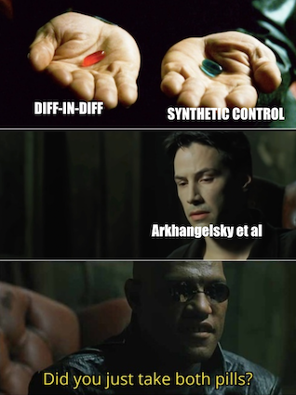
Synthetic Difference-in-Differences
Not today.. but now you know.
Reference: Arkhangelsky et al. (2021)

Slide 20
Event studies in finance

Slide 21
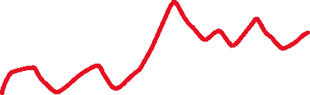
Setup
An event happening at some point in time
We want to estimate the causal effect on some treated units
Calendar time, Event time
Time
Notes:
As the name says, this is a type of study design that revolves around an event happening at a point in time, after which some units are treated and some others are not.
Our goal is to study the evolution of some outcome variables over time, comparing treated and untreated, and make inference that has a interpretation as causal as possible. To put that in other words, we want to estimate unbiased treatment effects.
Events that we study (let’s call them treatment from now on, although it could be really anything) need not happen all at the same time. Consider the following question: what is the effect of having a child on the gender wage gap, also called the child penalty? In this case, people have children at different moments, so calendar time does not coincide with event time. Calendar time is the time as we record it, years, months, days. Event time is time relative to the event or treatment. This plot comes from a paper that estimates precisely the child penalty in Denmark; it shows an event study for women and an event study for men, comparing women when they give birth to women who don’t, but are otherwise comparable after accounting for observable and some fixed effects. Same for men. Not relevant to the understanding of event studies, but just look how massive the penalty is.

Slide 22
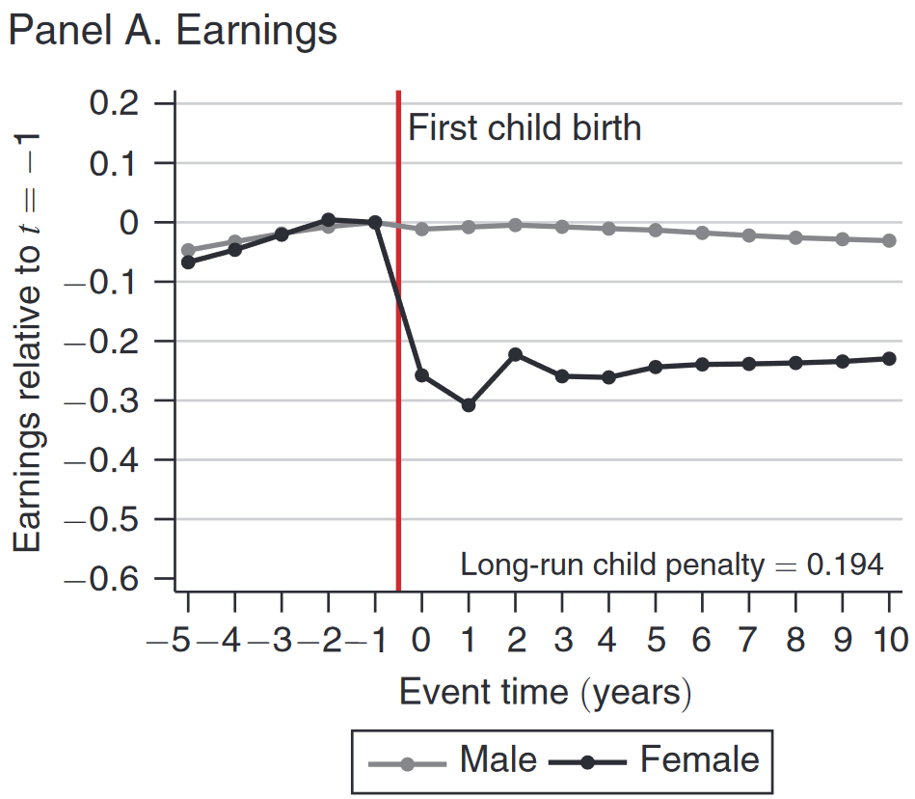
Event time vs Calendar time
What is the effect of having a child on the gender wage gap, also called the child penalty?
Event time: time relative to having a child
Notes:
Consider the following question: what is the effect of having a child on the gender wage gap, also called the child penalty? In this case, people have children at different moments, so calendar time does not coincide with event time. Calendar time is the time as we record it, years, months, days. Event time is time relative to the event or treatment. This plot comes from a paper that estimates precisely the child penalty in Denmark; it shows an event study for women and an event study for men, comparing women when they give birth to women who don’t, but are otherwise comparable after accounting for observable and some fixed effects. Same for men. Not relevant to the understanding of event studies, but just look how massive the penalty is.

Slide 23
Event studies in finance
What is the effect of event E on stock price of firm f?
Intuition.
Estimate the pre-event correlation of treated firms with the market
Predict returns
Pre-event, abnormal returns (errors) are mean zero
If post-event abnormal returns are not mean zero → Evidence of an effect
We are building a model of treated firms using nontreated firm data
The model gives us the counterfactual
Assumptions?
Notes:
As the name says, this is a type of study design that revolves around an event happening at a point in time, after which some units are treated and some others are not.
Our goal is to study the evolution of some outcome variables over time, comparing treated and untreated, and make inference that has a interpretation as causal as possible. To put that in other words, we want to estimate unbiased treatment effects.
Events that we study (let’s call them treatment from now on, although it could be really anything) need not happen all at the same time. Consider the following question: what is the effect of having a child on the gender wage gap, also called the child penalty? In this case, people have children at different moments, so calendar time does not coincide with event time. Calendar time is the time as we record it, years, months, days. Event time is time relative to the event or treatment.

Slide 24

Diamonds, wars, stock prices Guidolin & La Ferrara (2007)
Angola is a diamond-producing country and was ravaged by civil war for more than 25 years.
On February 22, 2002, the Angolan civil war suddenly and unexpectedly ended with the death of the rebels’ leader, Jonas Savimbi.
What is the value brought by peace to diamond mining companies?
Study the movement of stock prices of mining companies that have concessions in Angola vs have not and are comparable

Slide 25
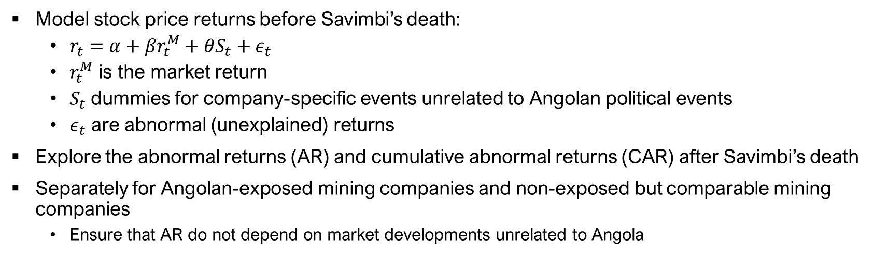
Methodology
Model stock price returns before Savimbi’s death:
$r_{t}=α+βr_{t}^{M}+θS_{t}+ε_{t}$
$r_{t}^{M}$ is the market return
$S_{t}$dummies for company-specific events unrelated to Angolan political events
$ε_{t}$ are abnormal (unexplained) returns
Explore the abnormal returns (AR) and cumulative abnormal returns (CAR) after Savimbi’s death
Separately for Angolan-exposed mining companies and non-exposed but comparable mining companies
Ensure that AR do not depend on market developments unrelated to Angola

Slide 26
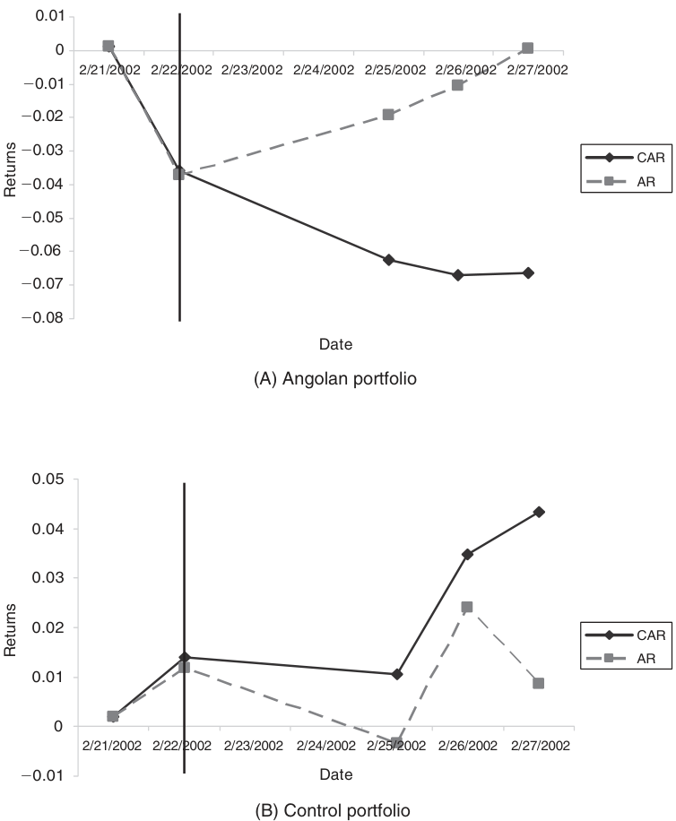
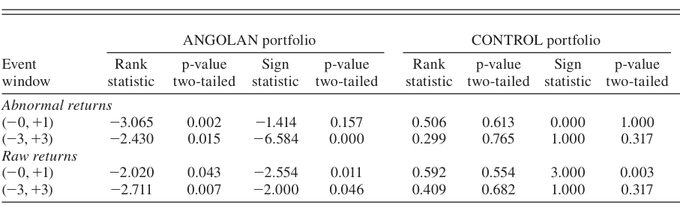
Results
AR and CAR are significantly lower than zero for Angola-exposed companies
Peace is bad news for mining companies in Angola
Hypothesis: conflict is a barrier to entry, protects incumbents
No significant effect on mining companies not exposed to Angola

Slide 27
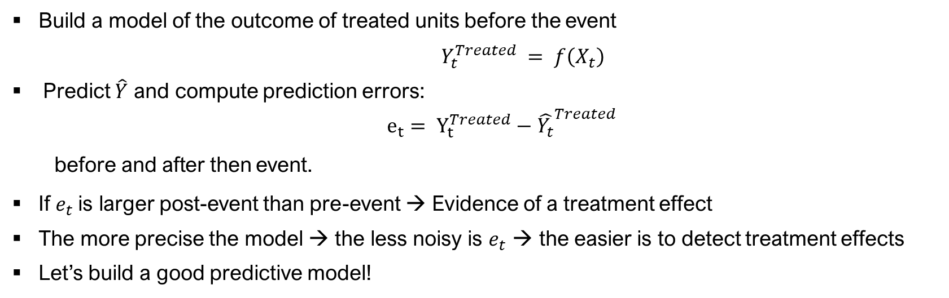
Back to the intuition
Build a model of the outcome of treated units before the event
$Y_{t}^{Treated} = f\left(X_{t}\right)$
Predict $\hat{Y}$ and compute prediction errors:
$e_{t}= Y_{t}^{Treated}−{\hat{Y_{t}}}^{Treated}$
before and after then event.
If $e_{t}$is larger post-event than pre-event → Evidence of a treatment effect
The more precise the model → the less noisy is $e_{t}$ → the easier is to detect treatment effects
Let’s build a good predictive model!

Slide 28
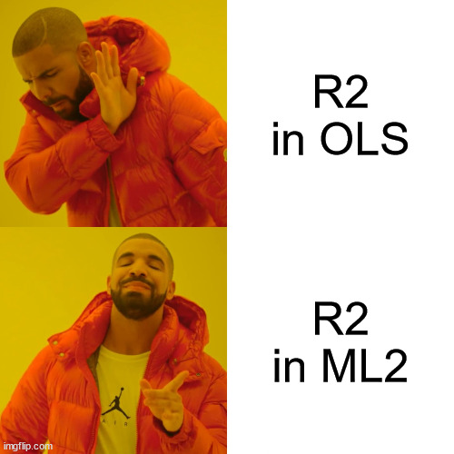
Machine learning for building counterfactuals
Machine learning is great for predictions
Often black box algorithms..
..but we don’t care as long as the model is precise, and the assumptions are satisfied.

Slide 29
COVID-19 lockdown and air pollution Granella et al. (2021)
Lombardy is one of the most polluted regions in OECD countries
Reasons: geography, density, productive activities and agriculture
Formation, transport, and dispersion of pollutants are complex phenomena: not easy to know how reducing emissions of pollutants would translate to reduction of concentrations.
COVID-19 lockdown can provide insights
What was the effect of the lockdown on air pollution?
But: pollution highly dependent on weather
Cannot compare before vs during or 2019 vs 2020
Exploit instead this dependency

Slide 30
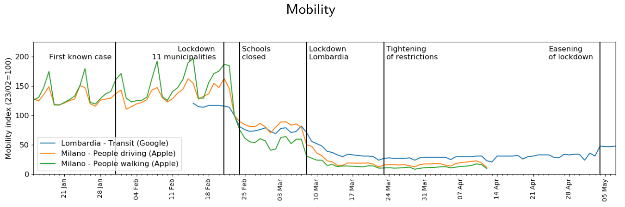
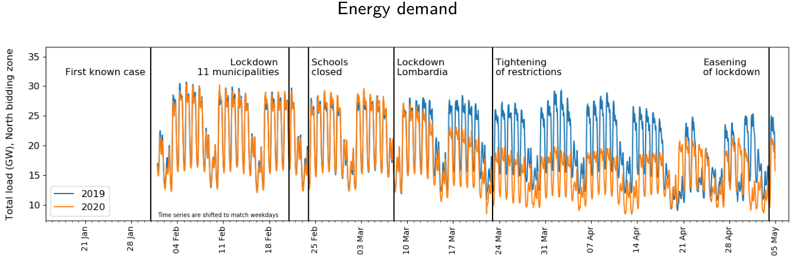

Slide 31
Data
PM2.5, NO2 Daily avg at 79 monitors in 64 municipalities
Weather Daily T max, T min, wind speed and direction, relative humidity, precipitation, atmospheric sounding. Contemporaneous & lagged
Also: Year, month, week, day-of-week, season, ratio PM2.5/PM10 to account for transboundary dust (desert dust)

Slide 32
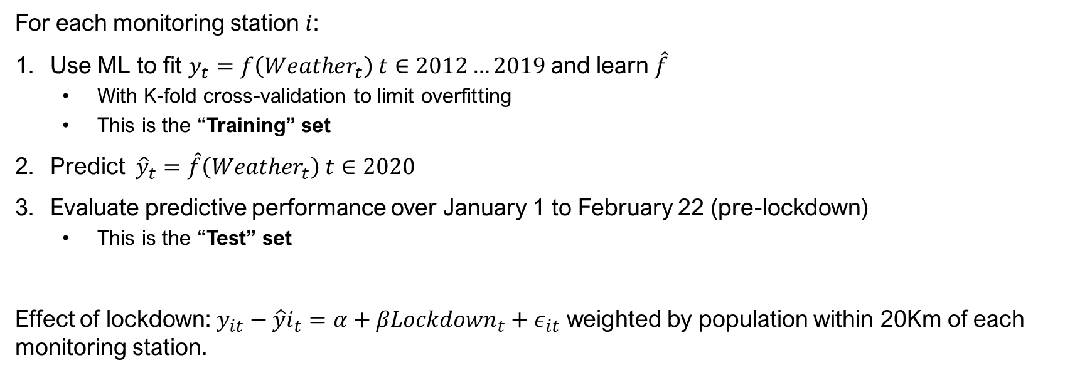
Methodology
For each monitoring station $i$:
Use ML to fit $y_{t}=f\left(Weather_{t}\right) t∈2012…2019$and learn $\hat{f}$
With K-fold cross-validation to limit overfitting
This is the “Training” set
Predict ${\hat{y}}_{t}=\hat{f}\left(Weather_{t}\right) t∈2020$
Evaluate predictive performance over January 1 to February 22 (pre-lockdown)
This is the “Test” set
Effect of lockdown: $y_{it}−{\hat{y}i}_{t}=α+βLockdown_{t}+ε_{it}$ weighted by population within 20Km of each monitoring station.

Slide 33
Assumptions
X not affected by treatment
No other treatments
f(.) is stable over time
No anticipation

Slide 34
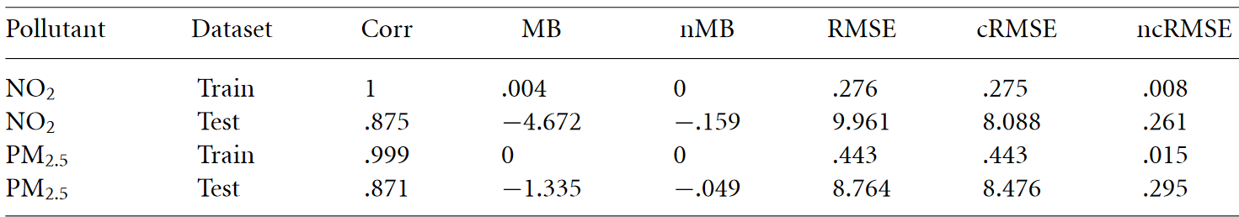
Predictive performance

Slide 35
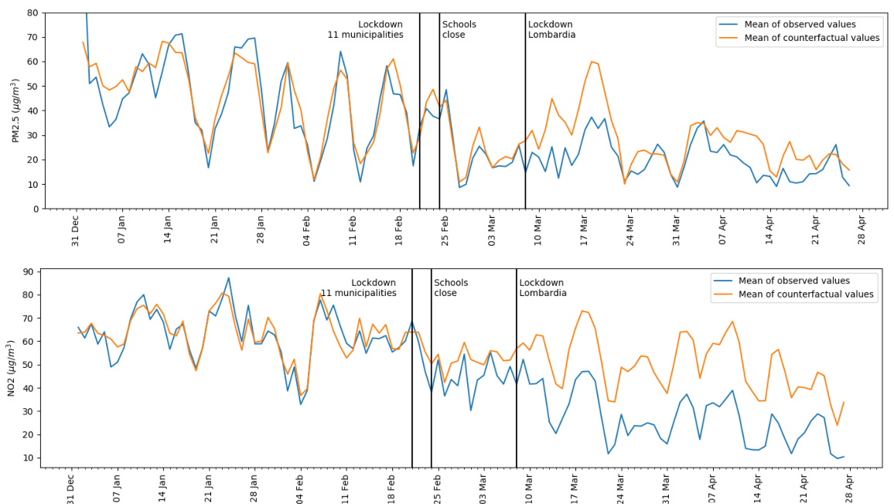
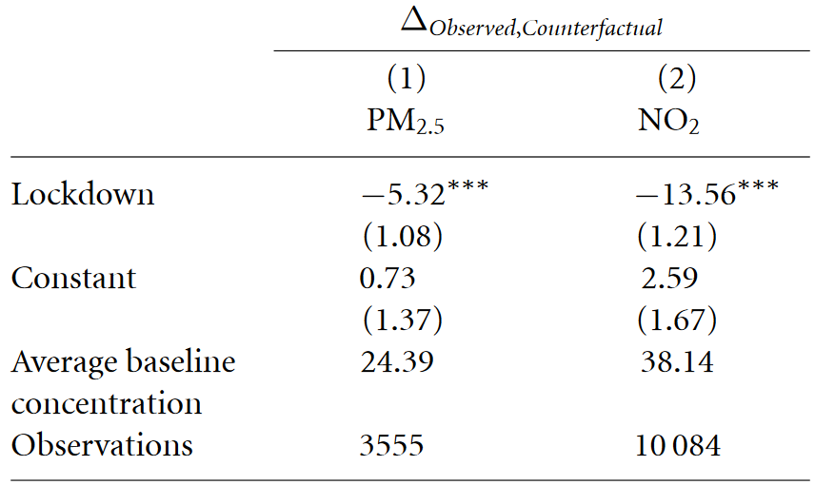
Results Population weighted

Slide 36
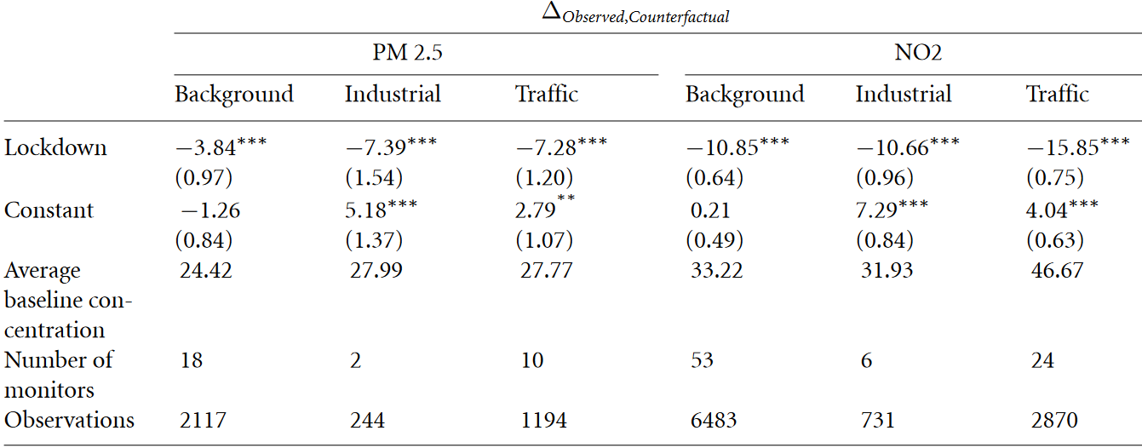
Results Different types of locations

Slide 37
Recap and rules of thumb
Many treated units, many control units: DID
One (or few) treated unit, few control units: SCM
One (or many) treated units, no control: ML + event study
Final words
Make sure to understand assumptions methods depend on!
Always use multiple methodologies when possible

Slide 38
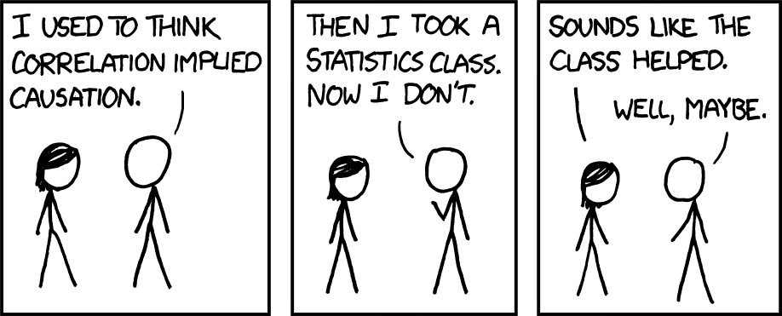
Thank you
You can reach me at
francesco.granella@cmcc.it

