Slide 1
Loan eligibility prediction model: a neural net approach
Deep Learning with applications, University of Milan
a.y. 2022/2023
Francesco Grienti

Slide 2
Introductory analysis
Context of the problem
Dataset

Slide 3
Neural Net Specifications
Hyperparameter selection
Optimizer
Loss function
Metrics
Hyperparameter tuning

Slide 4
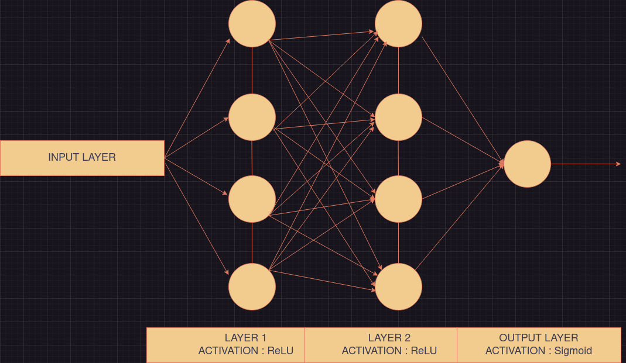
Neural Net Architecture

Slide 5
RESULTS

Slide 6
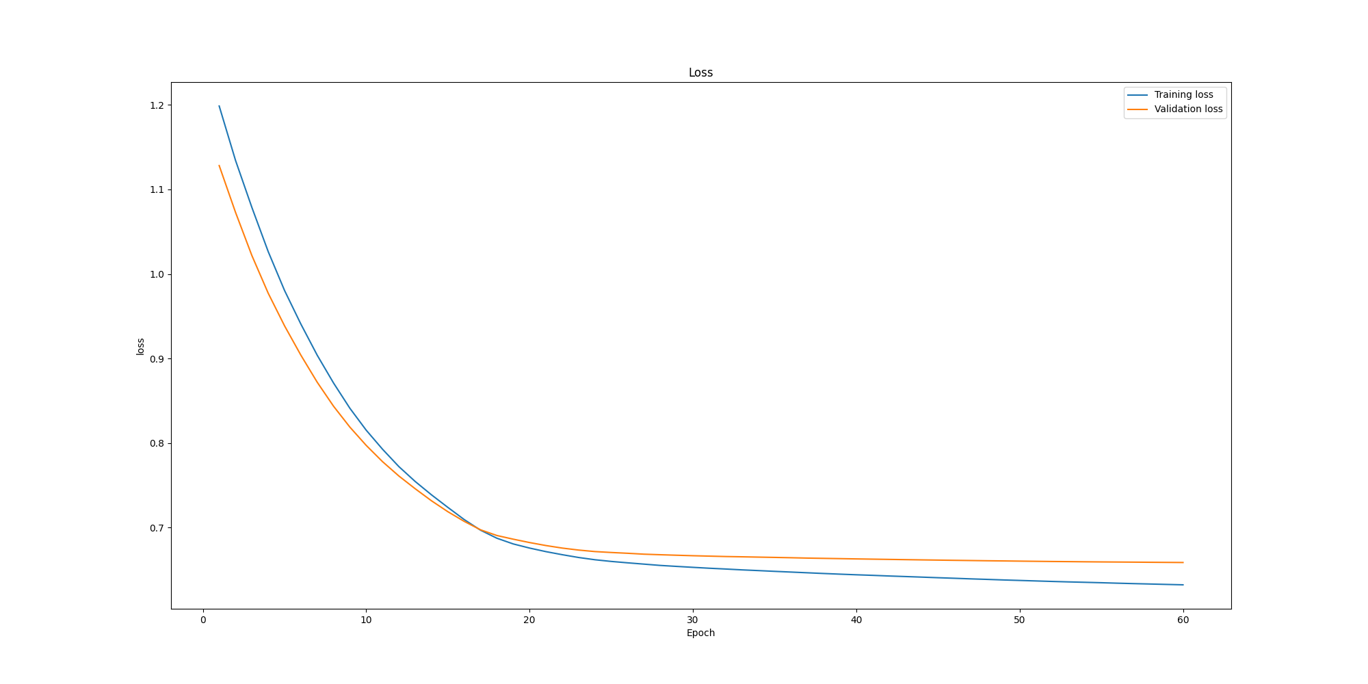

Slide 7
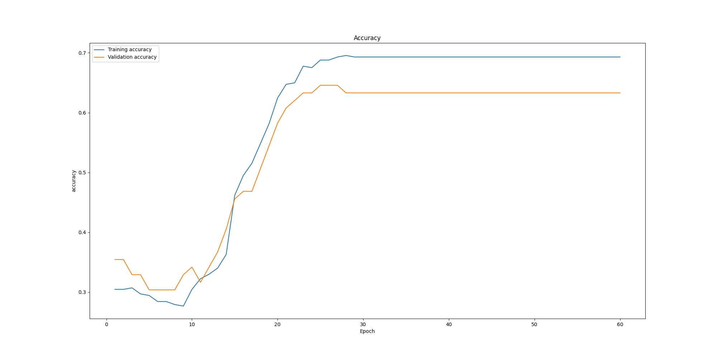

Slide 8
Different approaches
Accuracy score achieved with NN model (tuned hyperparameters) ~ 82%
Accuracy score with Logistic Regression ~ 81%
Accuracy score with Decision Tree Classifier ~ 71%
https://github.com/francescogrienti/LoanEligibilityDeepLearningProject

