Slide 1
Dilation Algorithm - Java
Computer Vision Project - Part I
Marinelli Francesco & Tagliani Fabio

Slide 2
Features and behavior
The algorithm performs dilation on a given image
The image is provided by the user at launch
The image is binarized and converted into a matrix
For every set pixel the eight neighbors are set too
The process is repeated as many times as specified by the user, if no number is specified the image is dilated just one time
The result is given back to the user

Slide 3


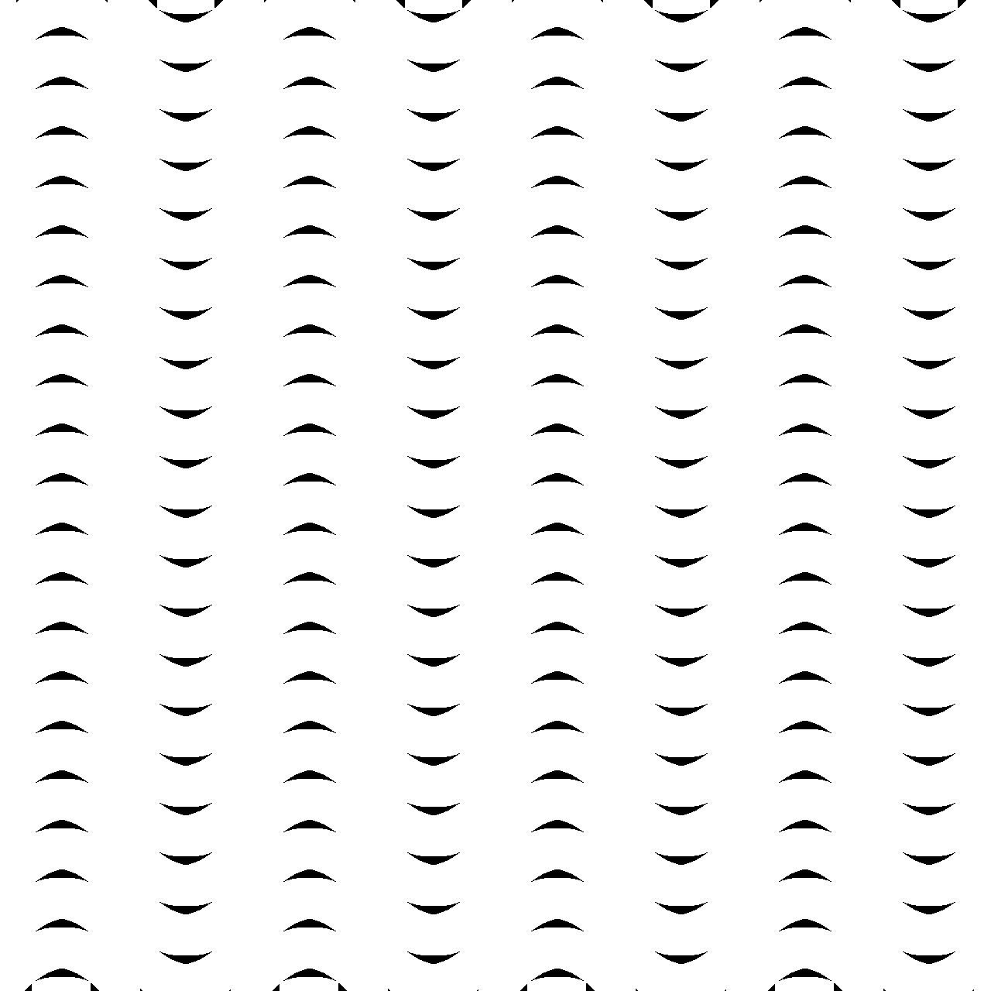

The code
for (i = 0; i < width; i++)
for (j = 0; j < height; j++)
try {
if(src[i][j] == 255) {
dst[i-1][j-1] = 255;
dst[i-1][j] = 255;
dst[i-1][j+1] = 255;
dst[i][j-1] = 255;
dst[i][j] = 255;
dst[i][j+1] = 255;
dst[i+1][j-1] = 255;
dst[i+1][j] = 255;
dst[i+1][j+1] = 255;
}
} catch (IndexOutOfBoundsException ex) {
//There is no need to take action, we just reached a border
}

Slide 4
Maze Solver - C++
Computer Vision Project - Part II
Marinelli Francesco & Tagliani Fabio

Slide 5
Features
Resolving 2-wall grey-scale maze
Resolving only 1-1 entrance-exit maze
Orientation independent
Wall width independent
Library used: OpenCV
Parallel implementation is also available on GitHub (openMPI required) https://github.com/theblackoreo/ACA-Project

Slide 6
HOW TO SOLVE A MAZE
Using serial code

Slide 7
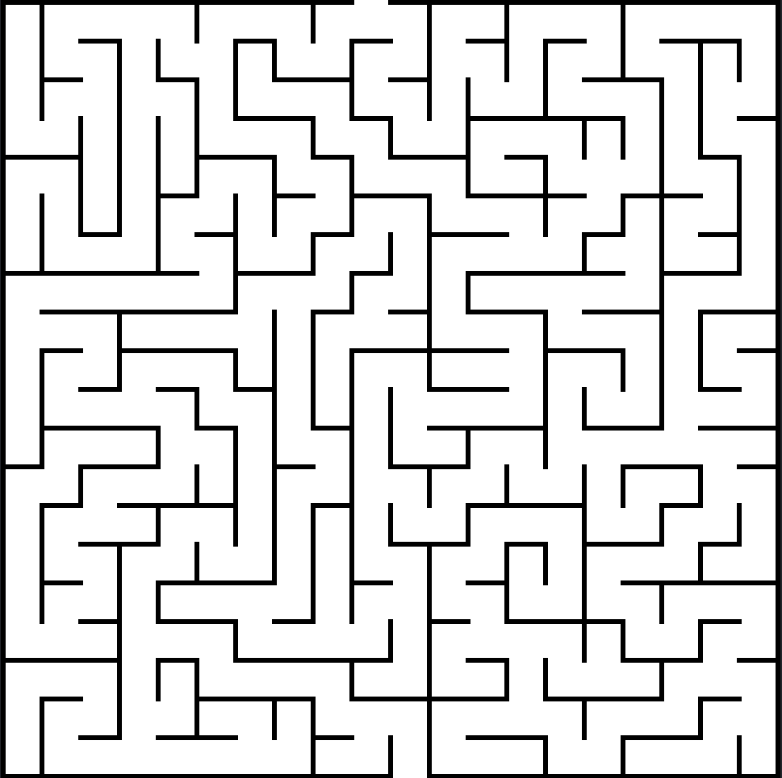
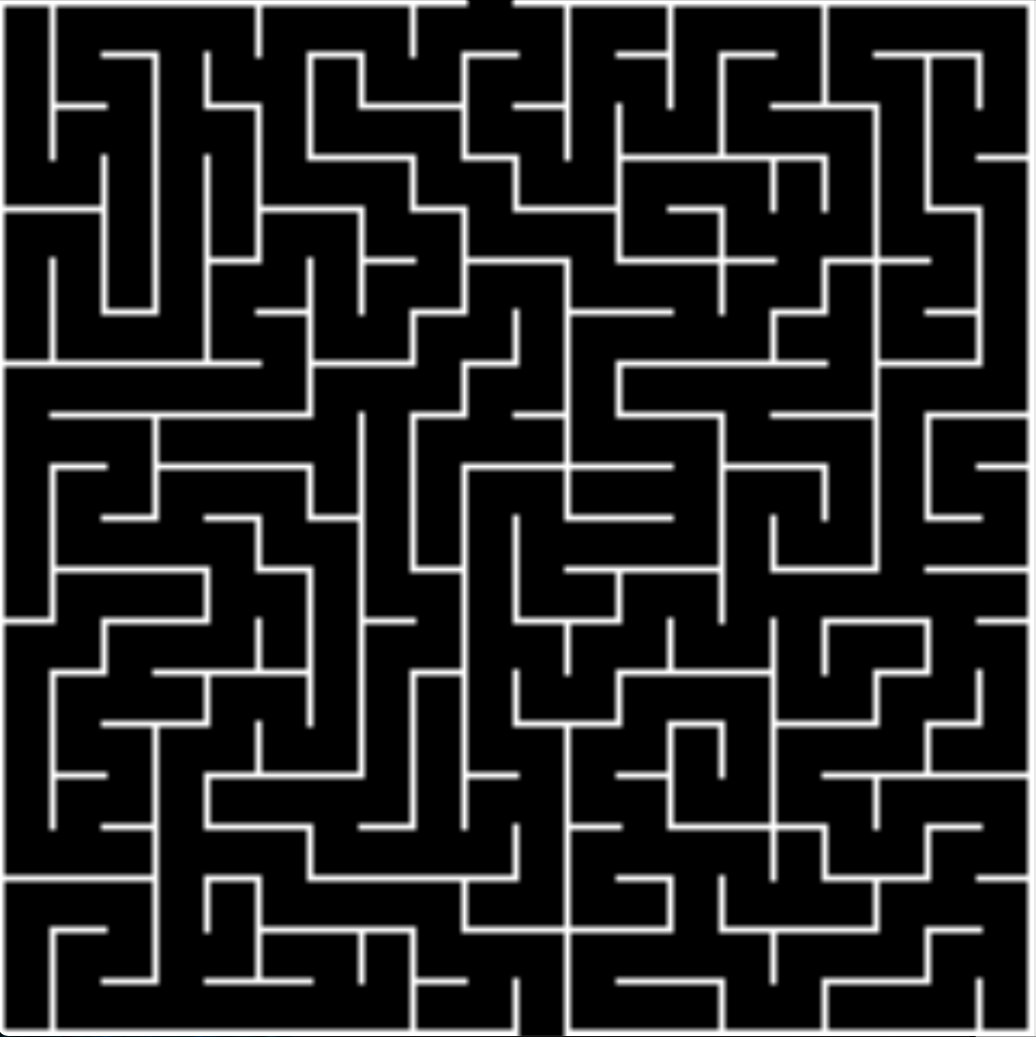
Threshold & Complement
The grey scale input image is transformed in a binary image.
Then the binary image is complemented, so black pixels become white and white become black

Slide 8
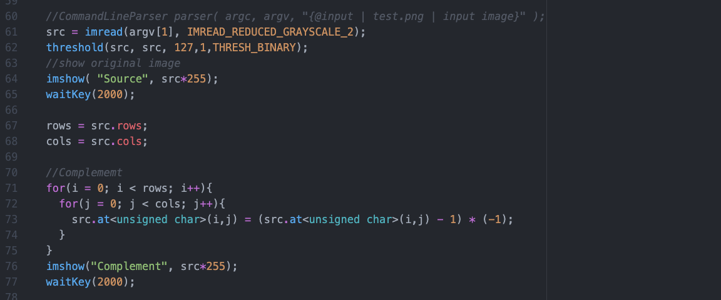

Slide 9
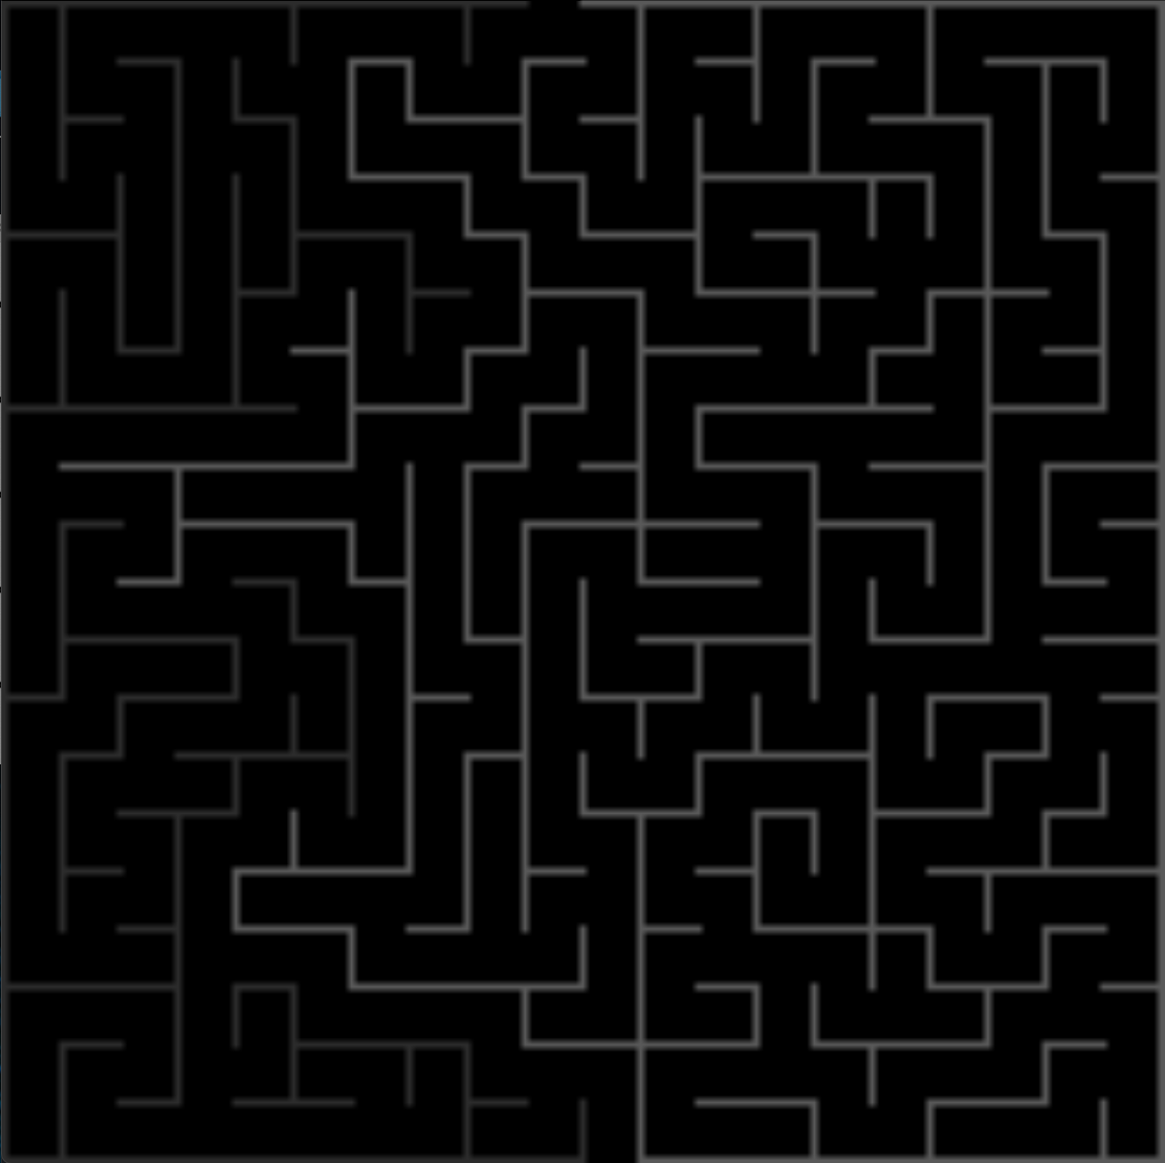
Labelling
Now the complemented image is labelled using connected components technique.
Useful to separate the side that contains correct track from the rest.

Slide 10
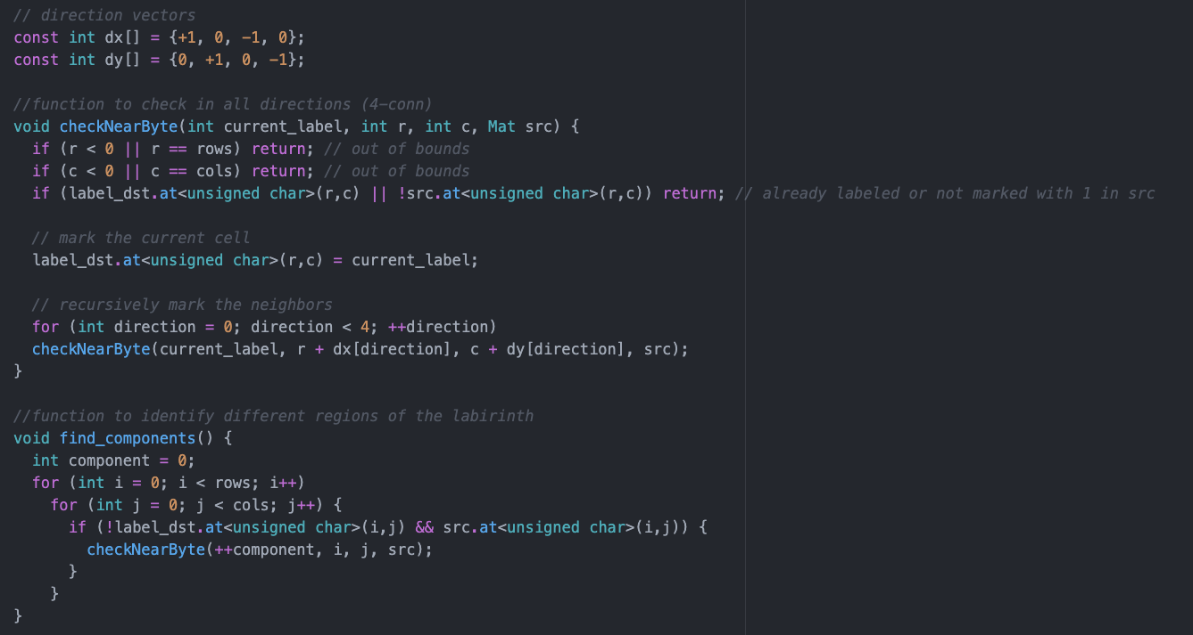

Slide 11
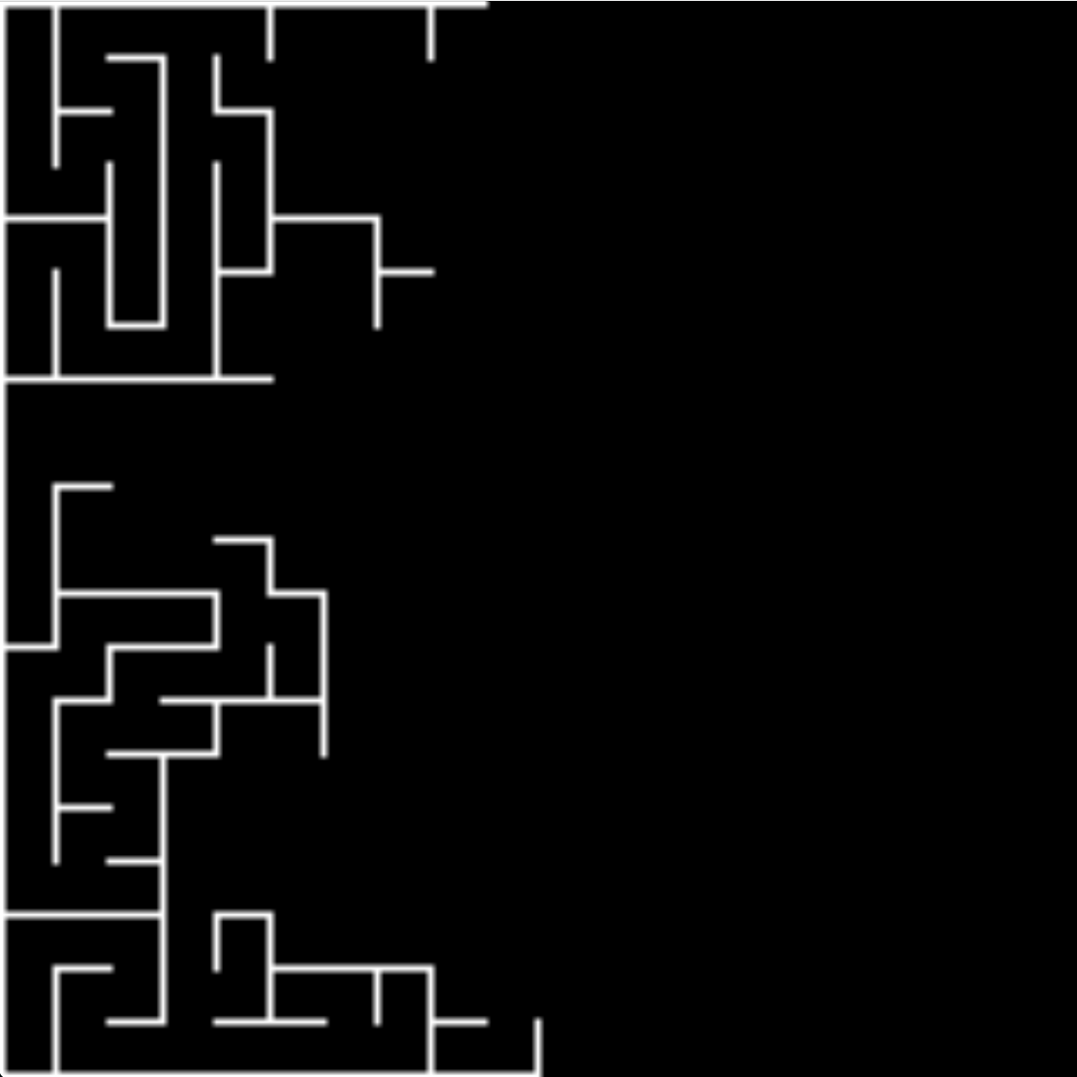
Selection
Select correct track to follow removing wrong parts

Slide 12
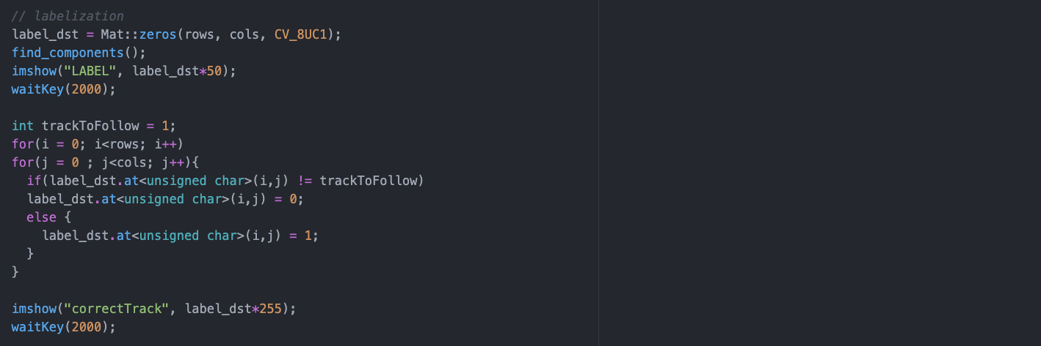

Slide 13
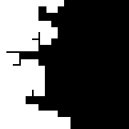
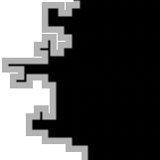
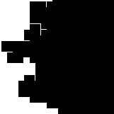
Dilation & Erosion

Slide 14
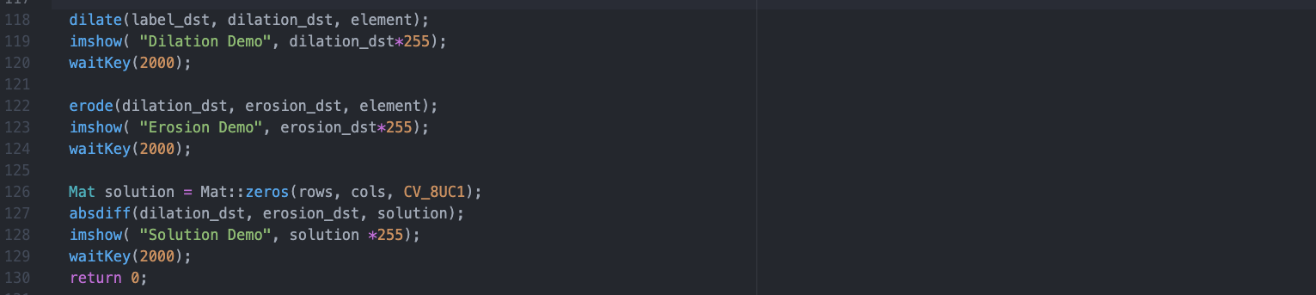

Slide 15
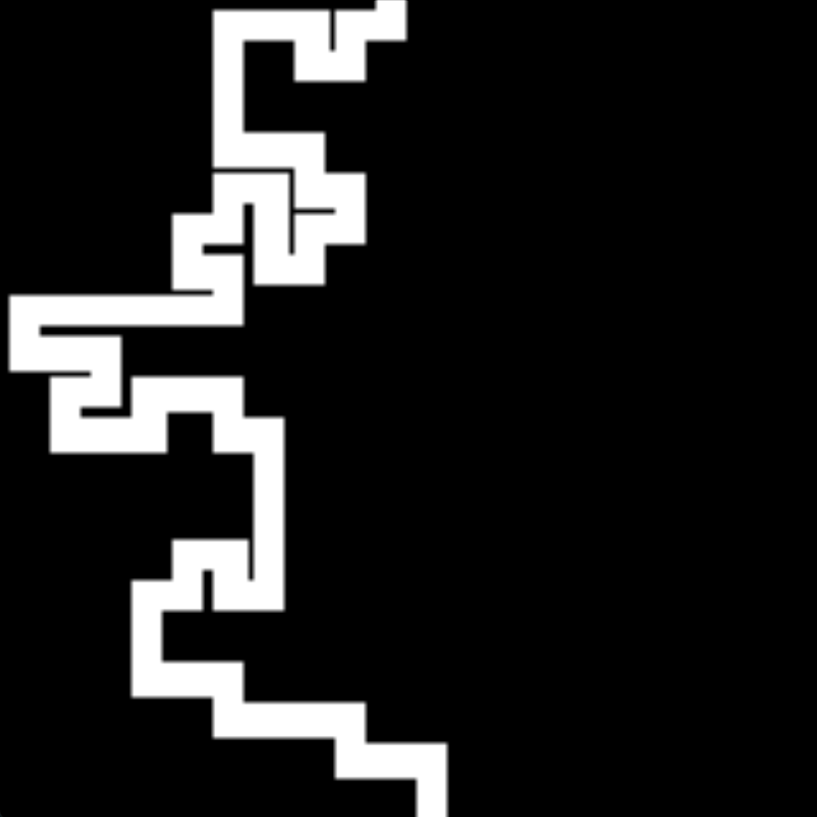
Final Solution
Difference between Dilation and Erosion gives the maze solution

