Slide 1

Solar Filament Segmentation
A convolutional model for H-alpha images of the solar disk
Francesco Peluso · IE22700088 · team 2026_MLrec_gr02
Machine Learning project work · A.Y. 2025/2026
Kaggle challenge: filament-segmentation-2026

Slide 2
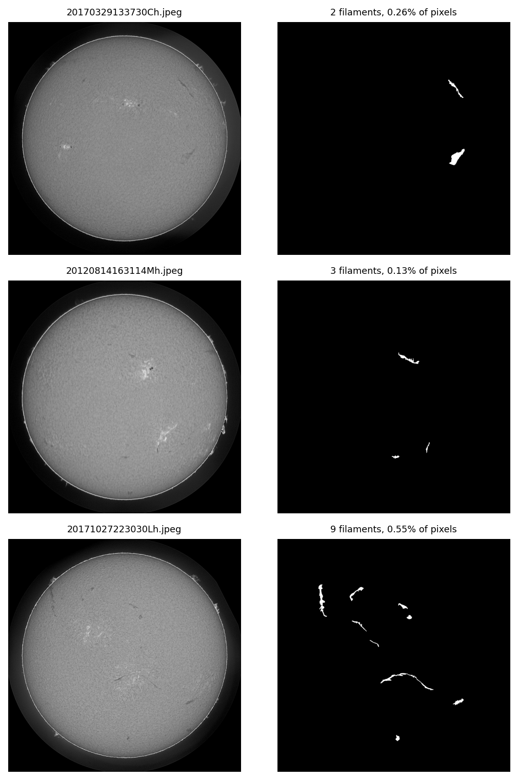
Task and dataset
2048 × 2048 H-alpha observation → one binary mask per filament (COCO RLE)
707 observations, 1154 annotator records, 8199 annotated filaments
Each record is one annotator's view: the same image appears up to 3 times with different polygons
Masks are drawn by hand — omissions and errors included, not a perfect ground truth
Filaments are small and rare: median instance 1230 px, only 0.4% of pixels are positive
Inter-annotator Dice = 0.62 — a practical ceiling: above it a model fits one expert's style, it does not segment better
H-alpha image (left) and one annotator's mask (right)
2

Slide 3
Metrics
Two scores, tracked everywhere, that disagree in an informative way
Mean Dice — the project work score, our primary metric.
Dice = 2 |P ∩ G| / (|P| + |G|) · pure pixel overlap
Panoptic Quality — the Kaggle leaderboard metric.
PQ = SQ × RQ · instances matched at IoU > 0.5
SQ = mask quality of matched pairs · RQ = how many instances are found
A fragmented or noisy prediction barely moves Dice and destroys RQ
The official PQ is re-implemented and verified against the organisers' code to 3·10⁻⁸
We optimise Dice for the delivery, and separately maximise PQ for the Kaggle leaderboard
3

Slide 4
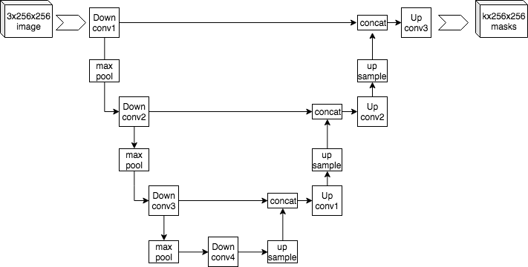
Why a U-Net
Segmentation needs one decision per pixel, not one per image
A classification CNN discards spatial location to decide what the image is
A plain decoder cannot undo it: by the bottleneck a thin filament is already gone, and no upsampling reinvents it
Skip connections copy each encoder stage into the decoder stage at the same resolution: fine detail travels around the bottleneck
For dark, thin, elongated filaments the skips are not a refinement — they are why the prediction exists
4

Slide 5
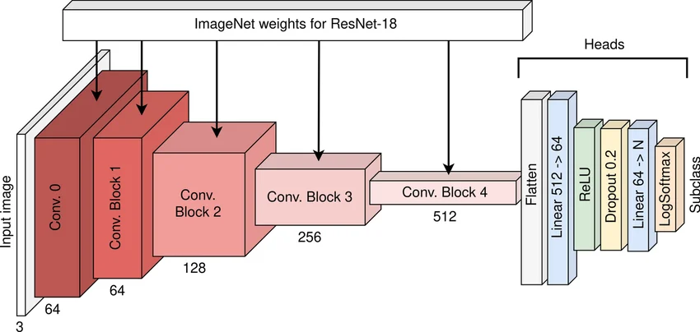
Encoder: ResNet18 pre-trained on ImageNet
Fewer than 500 training observations — learning edges from scratch wastes the data
Classification head discarded; the four convolutional blocks feed the U-Net decoder through the skips
The RGB stem and ImageNet normalisation are algebraically folded into an equivalent single-channel convolution
Not used, with reasons: Mask R-CNN rebuilds masks from a 28×28 grid inside a box — hopeless for objects a few px wide and hundreds long (verified: a YOLOv8x detector gives Dice 0.632 vs our 0.68)
Bigger encoders / transformers: mask quality never moved across capacities, so capacity is not the constraint
5

Slide 6
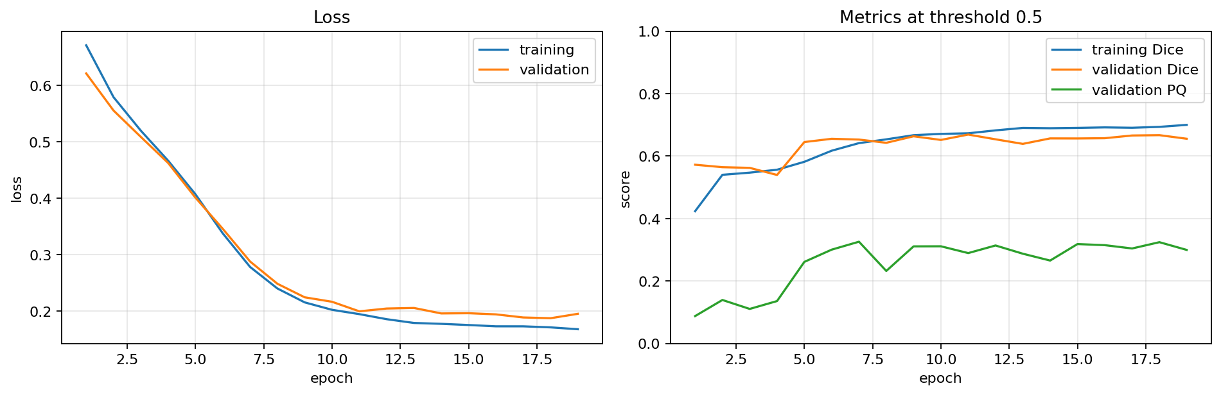
Training protocol
Identical in every run, so each comparison isolates one variable
Split on file names, never on annotator records — two annotators of one image describe the same pixels (494 / 106 / 107, seed 22)
Loss: BCE + soft Dice, equally weighted — Dice handles the 0.4% positive rate, BCE keeps probabilities calibrated
AdamW, batch 2, ≤ 20 epochs, early stopping on validation Dice
Augmentation: the 8 square symmetries (filaments have no canonical orientation) + photometric jitter
Peak GPU memory measured, not estimated — the assignment rewards < 5 GB training / < 4 GB inference
Delivered model: loss and metrics per epoch
6

Slide 7
Main experiments
One hypothesis per run, one variable changed, each falsifiable by a single number
Exp. | One variable | Dice | PQ | Outcome
1 | U-Net from scratch, 512² | 0.6415* | — | baseline
2 | ImageNet ResNet18 encoder | 0.6552* | 0.2505* | calibration, +1 pt Dice
3 | topology loss (Tversky + clDice) | 0.4937* | 0.0618* | falsified, instructive
5 | resolution 512 → 1024 | 0.6665 | 0.4022 | largest single gain
8 | → 1536, D4 TTA, confidence gate | 0.6729 | 0.4264 | best PQ (single model)
13 | native 2048, random 1536 windows | 0.6815 | 0.3930 | best Dice — delivered
* threshold 0.5, no post-processing (early protocol)
Also measured and rejected, each with its number: scale jitter, detect-then-refine cascade, soft consensus targets, instance-balanced Dice, BCE positive-class weight, per-component thresholds and dilation, post-hoc merging.
7

Slide 8
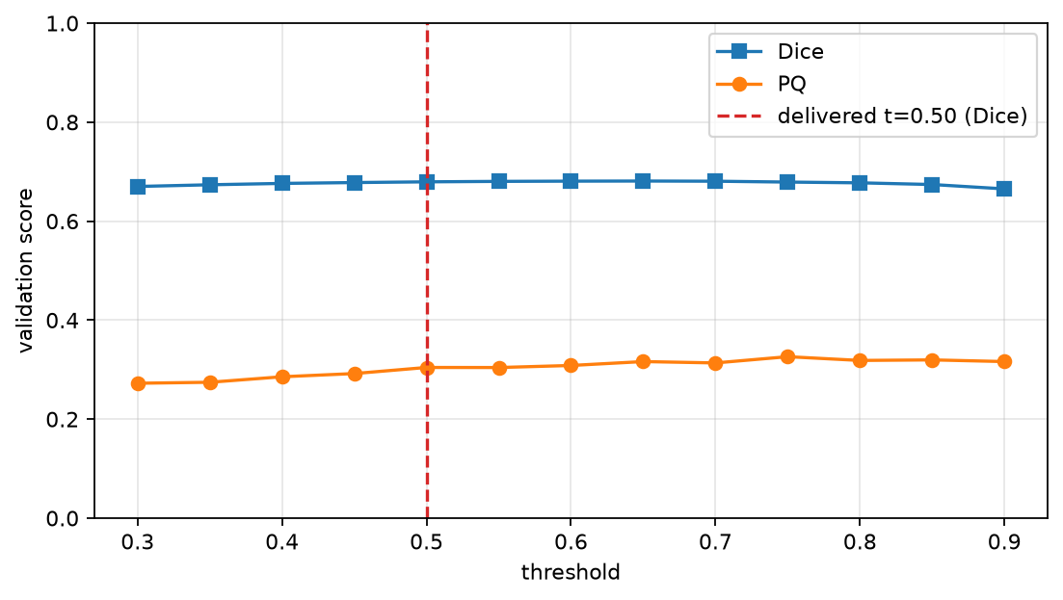
From probabilities to masks: the operating point
Four post-processing hyperparameters, grid-searched jointly on the validation set
threshold (0.50) — a pixel above it is filament, below it is background
closing (1) — fills one-pixel gaps: a split filament becomes one component again
minimum size (384 px) — drops small spurious components
confidence gate (0.90) — a component survives only if one of its pixels exceeds it; the threshold alone would decide both which components exist and how large, so raising it thins every real filament too
Scored at native 2048², where the submission is written — worth +0.020 Dice for free
Dice and PQ vs threshold: the two metrics peak at different points
8

Slide 9
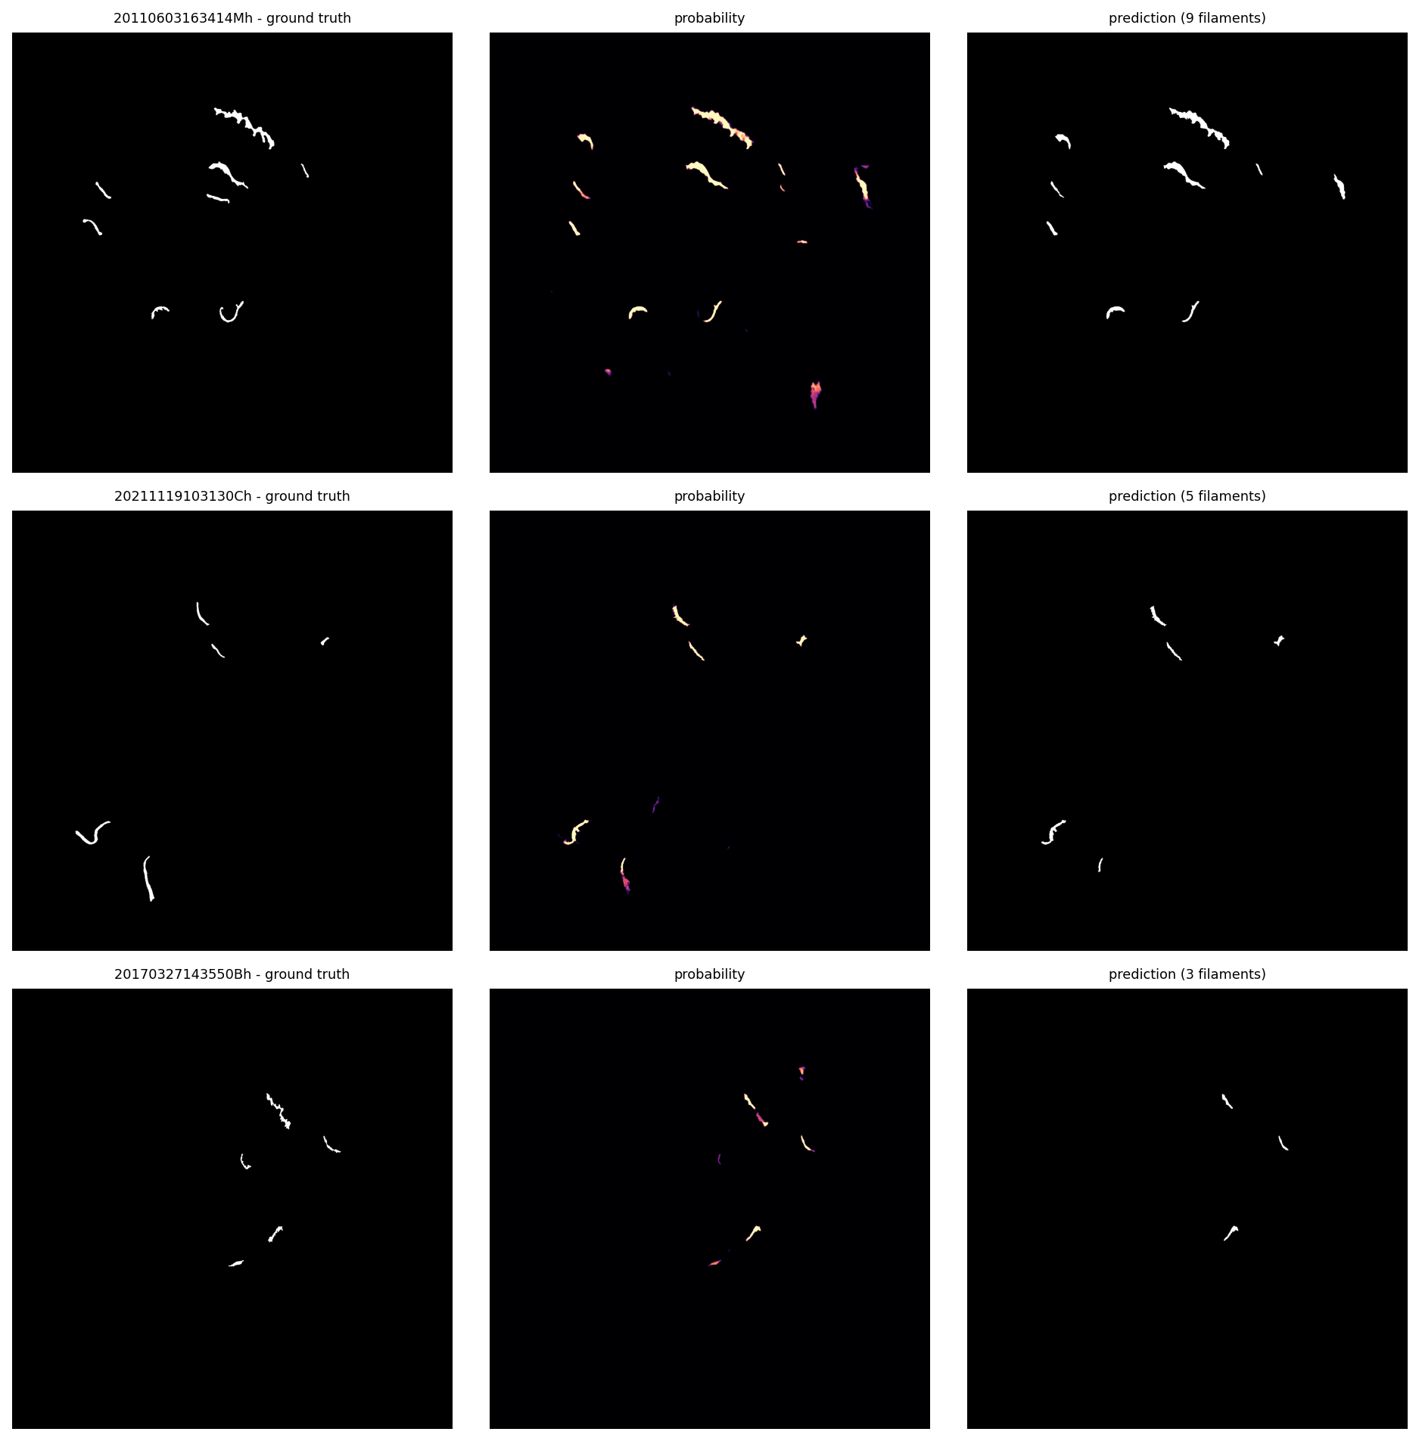
Error analysis
What is left, and why more mask quality would not help
SQ is pinned at 0.66–0.68 across all 15 experiments, against 0.59 agreement between two humans → mask quality is capped by the annotations, not the model
Dice crossed the inter-annotator ceiling at experiment 2 and stayed flat
Instance recall falls with size: 0.31 below 500 px → 0.73 above 5000 px
Errors are missed faint filaments, not fragmentation: splits and merges are 5.4% of all errors
Some "false positives" are real filaments no annotator marked — confirmed by the organisers
Ground truth · predicted probability · final instances
9

Slide 10
The delivered model, and why
Experiment 13 — ResNet18-U-Net trained on random 1536² windows of the native frame
Best Dice of the study: 0.6815 on validation — and Dice is the project work score
Native pixels win on mask quality and lose on recognition (PQ 0.393): the windows give up full-disk context
The only configuration inside both memory bonuses: 3.04 GB training, 2.50 GB inference (limits: 5 / 4 GB)
One model, one checkpoint, one operating point — the submitted notebooks reproduce it end to end
In parallel, for the Kaggle leaderboard we maximised PQ instead: a multi-scale ensemble plus detector rescue reaches PQ 0.4414 on validation and 0.37 on the public leaderboard — but it needs up to 39 GB in training and optimises the metric the assignment does not score.
10

Slide 11
Take-home messages
Measure what the score measures, where it measures it — selecting the operating point at native resolution, against the official metric definition, was worth more than most training changes, and cost no training at all
Pick the metric that sees the failure mode — Dice saturated at experiment 2; every real improvement afterwards was visible only in PQ's recognition term
A falsified hypothesis is not a wasted run — over twenty ideas were measured and rejected, and each rejection redirected the effort. Experiment 3's failure is what exposed resolution as the real variable
Know your noise floor — on 169 validation entries, any gain below ≈ 0.005 is indistinguishable from selection noise
11

