Slide 1

TECNOLOGIE WEB
Proponents
De Vivo Giuseppe (2748)
Mucchetti Giorgio Simone (2809)
Pirozzi Francesco (2860)

Slide 2

E – COMMERCE OF NAUTICAL PRODUCTS
The project focuses on the design and development of a complete website for the management of an e-commerce specialized in the sale of nautical items.
SERVICES
The website offers a complete platform for online sales of nautical products, including catalog management, user management and database management. The goal is to create an intuitive and safe online shopping experience for nautical enthusiasts.
WEBSITE LOGO

Slide 3
PROJECT OBJECTIVES
This project aims to:
Create a responsive and user-friendly user interface for online shoppers;
Implement catalog management with product description and image;
Allow users to add products to the cart;
Create a user management system, with authentication and custom profiles.

Slide 4


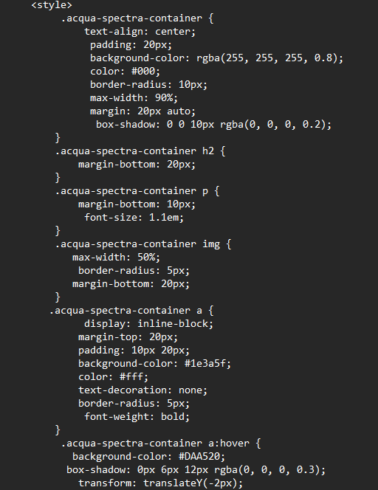
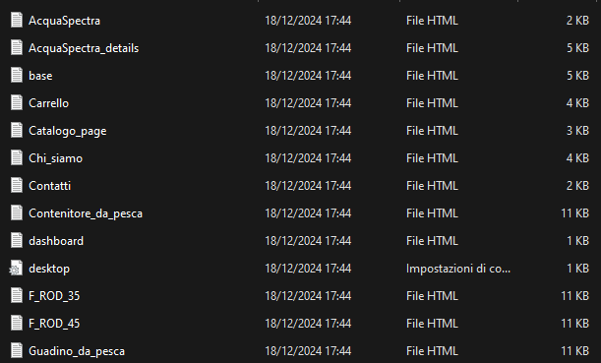
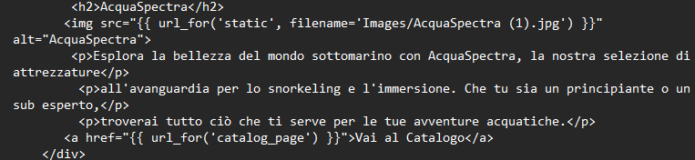
CODE DEVELOPMENT
AND
CSS3 CODE
HTML5 CODE

Slide 5



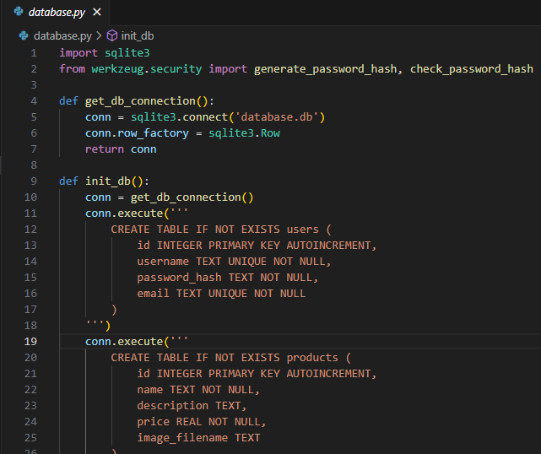
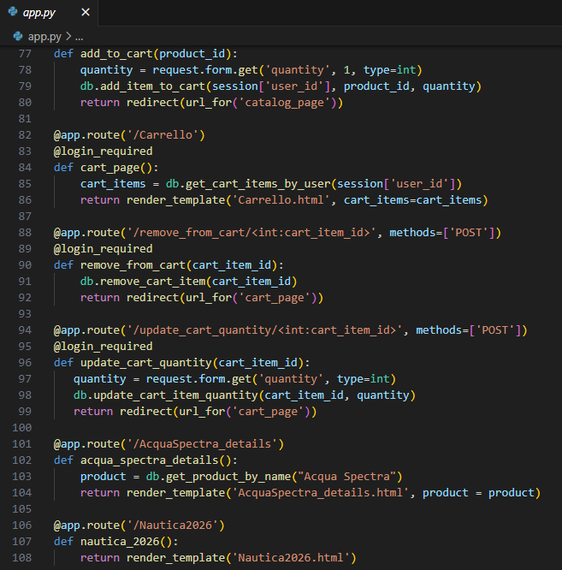
CODE DEVELOPMENT
AND
PYTHON/SQL ALCHEMY CODE
PYTHON/FLASK CODE

Slide 6

TECHNOLOGIES USED
The following technologies were used to carry out this project:

Slide 7
THANKS FOR WATCHING!

