Slide 1
RECOMMENDER SYSTEMS · INDIVIDUAL PROJECT
A Movie Recommender Prototype
From non-personalized baselines to matrix factorization on MovieLens 32M
Francesco Polimeni
Esade · Prof. Marc Torrens

Slide 2
Objective & approach
One prototype, many algorithms, the same evaluation protocol
1
2
3
Build
Compare
Think critically
Every technique becomes a working, reusable module in a single codebase.
All models share one dataset, split and metric set — results are directly comparable.
Accuracy is not enough: we also measure coverage, novelty and popularity bias.
Track chosen: Movies — MovieLens 32M (genres as content metadata).
Recommender Systems — Individual Project
2

Slide 3
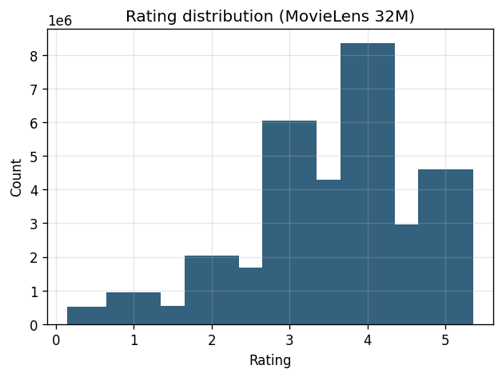
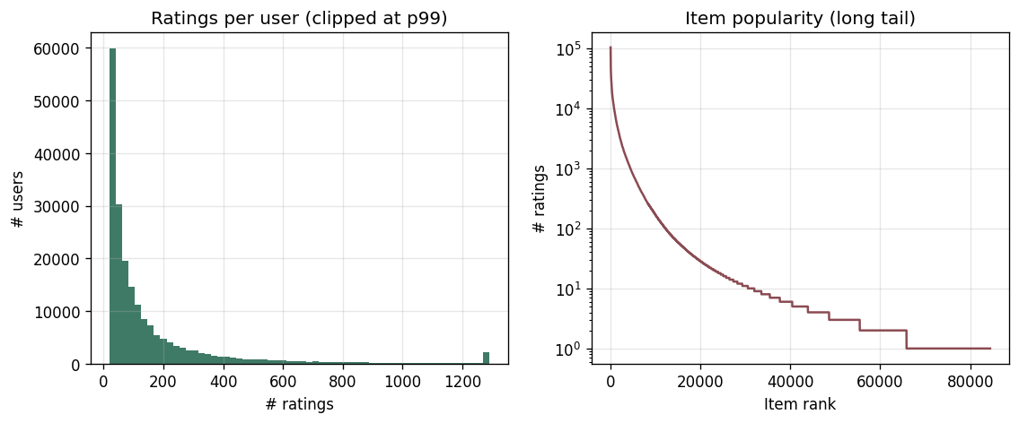
Dataset & exploratory analysis
MovieLens 32M · half-star ratings 0.5–5 · genre metadata
200,948
84,432
32.0M
99.8%
users
rated movies
ratings
sparsity
What the data tells us
Ratings skew positive (mean ≈ 3.5)
Strong long tail: few blockbusters, many niche films
99.8% sparse → cold cells everywhere
Popularity bias will shape results
Recommender Systems — Individual Project
3

Slide 4
Preprocessing & evaluation protocol
Same pipeline for every model — fair comparison
Preprocessing
Metrics
Cap catalog to 3,000 most-popular items + k-core (≥100 / ≥20 ratings)
Sub-sample 10,000 users → dense, fast, responsive prototype
Working set: ~1.34M ratings, cached to disk (float32 → fits free cloud)
Per-user TEMPORAL 80/20 split → no train-on-future leakage
Accuracy: Precision@10, Recall@10, Hit-Rate@10, NDCG@10, MRR
Relevance = held-out rating ≥ 4.0
Beyond-accuracy: catalog coverage & novelty (self-information)
Rating prediction: MAE / RMSE (item-item CF); k & factors tuned
Averaged over a fixed user sample, identical for all models
Recommender Systems — Individual Project
4

Slide 5
Algorithms implemented
Nine models in code, from simple baselines to latent factors
Most Popular
Highest / Bayesian avg
Random
Content-based
Rank items by interaction count. Non-personalized baseline.
Hard min-ratings cutoff vs. IMDb damped mean (course formula).
Lower-bound sanity check / coverage ceiling.
TF-IDF & raw-genre vectors; mean-centered profile; cosine.
Item–Item CF
User–User CF
Matrix Factorization
All share one interface
Adjusted-cosine item similarity, top-k=10 neighbourhood.
Mean-centered user similarity, top-k=40 neighbours.
Truncated SVD (sklearn): R≈U·Vᵀ, dot-product scores, argsort.
fit() then recommend(user, n). Methods are hot-swappable in the pipeline and the UI.
Recommender Systems — Individual Project
5

Slide 6
Results — accuracy vs. beyond-accuracy
Top-10 · temporal split (leakage-free) · 10k users · 95% CI on NDCG
Model | Prec@10 | Rec@10 | NDCG@10 | ±CI | Cov | Novelty
Matrix Factorization (SVD) | 0.101 | 0.108 | 0.138 | 0.022 | 0.135 | 2.35
Most Popular | 0.058 | 0.059 | 0.075 | 0.014 | 0.027 | 1.51
Bayesian Average (IMDb) | 0.038 | 0.045 | 0.058 | 0.013 | 0.015 | 2.38
Item–Item CF (k=10) | 0.030 | 0.037 | 0.037 | 0.008 | 0.410 | 4.36
Highest Average (min 20) | 0.014 | 0.016 | 0.016 | 0.005 | 0.006 | 5.72
User–User CF (k=40) | 0.011 | 0.015 | 0.013 | 0.005 | 0.502 | 4.96
Content-based (TF-IDF) | 0.002 | 0.003 | 0.003 | 0.003 | 0.091 | 12.51
Content-based (raw) | 0.001 | 0.001 | 0.001 | 0.001 | 0.074 | 12.66
Random | 0.000 | 0.000 | 0.000 | — | 0.032 | 13.07
Read it this way
SVD leads significantly — its CI does not overlap popularity's
Temporal split: no train/test leakage
Bayesian (IMDb) avg beats the hard-threshold average
CF covers 41–50% of the catalog; content-based is the most novel
Recommender Systems — Individual Project
6

Slide 7
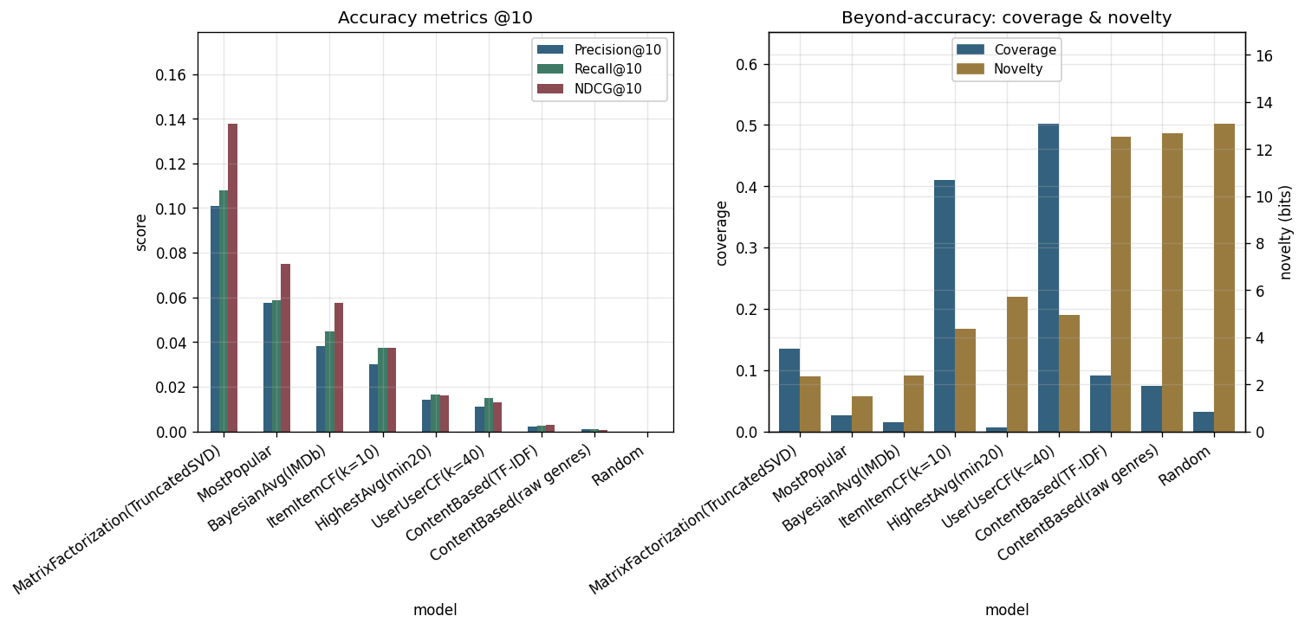
The accuracy–discovery trade-off
Same models, two very different rankings
Recommender Systems — Individual Project
7

Slide 8
Recommendation examples
Same user (id 124204), top-5 by method — the personality of each model
Most Popular
Jurassic Park · Raiders of the Lost Ark · The Usual Suspects · The Dark Knight · Inception
Bayesian Avg (IMDb)
The Usual Suspects · Dr. Strangelove · Spirited Away · 12 Angry Men · Casablanca
Content-based (genres)
King Lear · I Fidanzati · Il Posto · Deepwater Horizon · Queen of Katwe
Item–Item CF (k=10)
Planet Earth II · Lawrence of Arabia · Capturing the Friedmans · The King's Speech
Matrix Factorization (SVD)
Memento · The Usual Suspects · Raiders of the Lost Ark · The Green Mile · Monsters, Inc.
Popularity / Bayesian = mainstream & acclaimed · Content = genre-coherent but obscure · CF & SVD = strongly personalized picks.
Recommender Systems — Individual Project
8

Slide 9
Interactive prototype (UX)
Streamlit app — onboard a new user or explore an existing one
streamlit run app.py
What the demo offers
Recommender
User
61456 ▾
Recommendations
●━━━━━ 10
Algorithms
☑ Most Popular
☑ Content-based
☑ Item–Item CF
☑ Matrix Factor.
Most Popular
Content-based
Matrix Factor.
New-user questionnaire
1. Forrest Gump
1. Bigfoot Lives
1. Planet Earth II
Cold-start onboarding: a few questions build a taste profile and recommend films — no ratings needed.
Comedy · Drama
Documentary
Documentary
Side-by-side comparison
2. Pulp Fiction
2. Kon-Tiki
2. Persuasion
See how each algorithm recommends for the same user — the trade-off made tangible.
Crime · Drama
Adventure · History
Drama · Romance
3. Star Wars IV
3. The Fatal Game
3. Nausicaä
Taste profile + "more like this"
Action · Sci-Fi
Action · Adventure
Animation · Fantasy
Top-rated movies, favourite-genre chart, and content-based similar-movie search.
4. The Matrix
4. Gandhada Gudi
4. Memento
Live & cached
Action · Sci-Fi
Documentary
Mystery · Thriller
Models train once; switching user, method or answers is instant.
Recommender Systems — Individual Project
9

Slide 10
Technical challenges
What was hard, and how it was solved
Scale & speed
Course-aligned MF
32M ratings (877 MB) made naive CF/MF infeasible. Solved with compact dtypes, item-cap + k-core filtering, user sub-sampling and vectorized, cached NumPy scoring.
Followed the course method: sklearn TruncatedSVD on the sparse matrix, dot-product scores, argsort top-N — no fragile native dependencies.
Fair evaluation
Beyond accuracy
Cold users break personalized models. A per-user split guarantees overlap; identical user sample & relevance rule for all models.
Accuracy alone hides popularity bias. Added coverage & novelty to expose the trade-off.
Recommender Systems — Individual Project
10

Slide 11
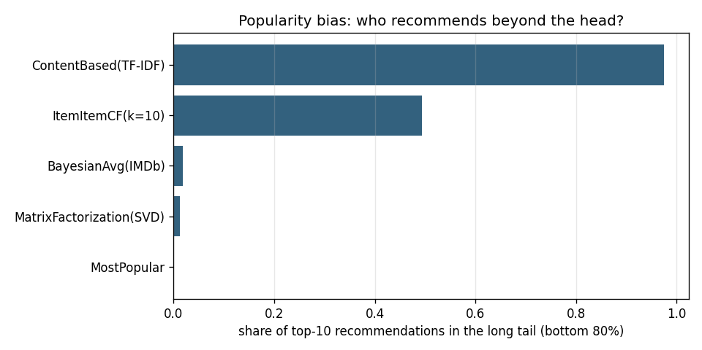
Strengthening the evaluation
Methodological issues identified during review, and how each was addressed
Random split leaked the future
✓
Temporal split → NDCG ≈0.33 → ≈0.14 (realistic)
Who recommends beyond the popular head?
A single point estimate
✓
95% confidence intervals → SVD's lead is significant
Popularity bias was hidden
✓
Long-tail analysis → SVD ~1% tail vs 49% item-CF
No support for brand-new users
✓
Questionnaire onboarding → cold-start solved in the app
SVD imputes missing ratings as 0
✓
Documented as a known explicit-feedback trade-off
Long-tail share of each model's top-10. The SVD "winner" stays on the head; CF and content-based reach the tail.
Recommender Systems — Individual Project
11

Slide 12
Threats to validity & next steps
What the numbers do — and don't — show
Threats to validity
Next steps
Leakage: fixed with a temporal split (SVD NDCG ≈0.33→≈0.14)
Significance: 95% CIs reported — top ranking is real, not noise
Popularity bias: SVD puts only ~1% of recs in the long tail (vs 49% item-CF)
Dense popular subset → optimistic; not vs. published benchmarks
SVD imputes missing = 0; no true cold-start eval
Richer content features (tags, cast, synopsis), not just genres
Hybrid: blend SVD accuracy with content/CF novelty
Explicit diversity & popularity-debiasing in the ranking
A proper cold-start (new user / new item) evaluation
Deploy the Streamlit demo online (already built — see UX slide)
Recommender Systems — Individual Project
12

Slide 13
Conclusions
1.
No single best model.
The right choice depends on the objective — engagement, discovery or coverage.
2.
Accuracy is not the whole story.
The most accurate model (popularity / SVD) is also the most popularity-biased.
3.
Personalization adds value.
Matrix factorization and CF surface relevant items a popularity list would miss.
Thank you. Live demo: movierec-fp.streamlit.app

