Slide 1

Magic 8 Ball Game
By Team Wazzup – also known as team 10

Slide 2

Initial Steps
To enable collaborative working we decided to use GitHub to create a remote repository
Decided to have the three branches main/uat/test
Hourly meetings at least twice a week
Decided to work on logic first and then aesthetic elements
Mob programming (virtually)
Please Note: Document classification is not to be removed.

Slide 3

Tech Stack
Decided to use JavaScript as our scripting language as it works better with web development and works well with both HTML and CSS.
Also, as the team overall had less experience using JavaScript – decided it would be a good learning exercise
We used JavaScript for the main logic of the page and HTML and CSS for the web design aspects
We deployed our web site on GithHub Pages.
VSCode Extensions Utilised:
Go Live – Used to open live page
Git Graph – Visual aid for collaboration

Slide 4
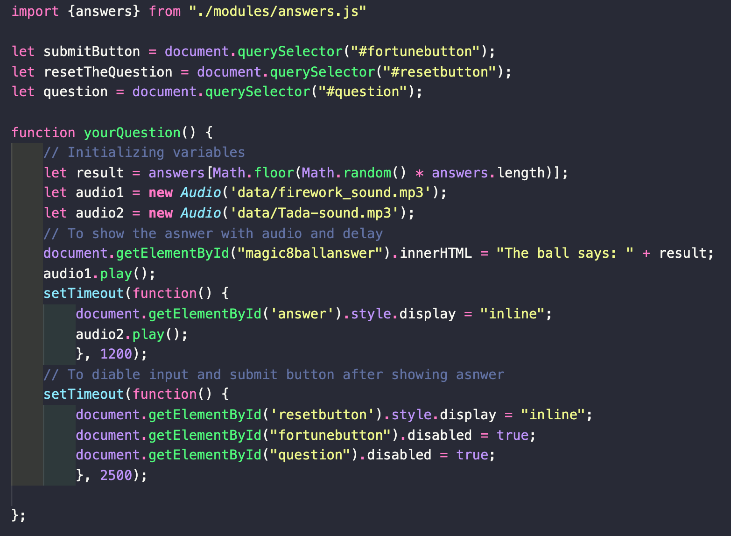
Logic

Slide 5
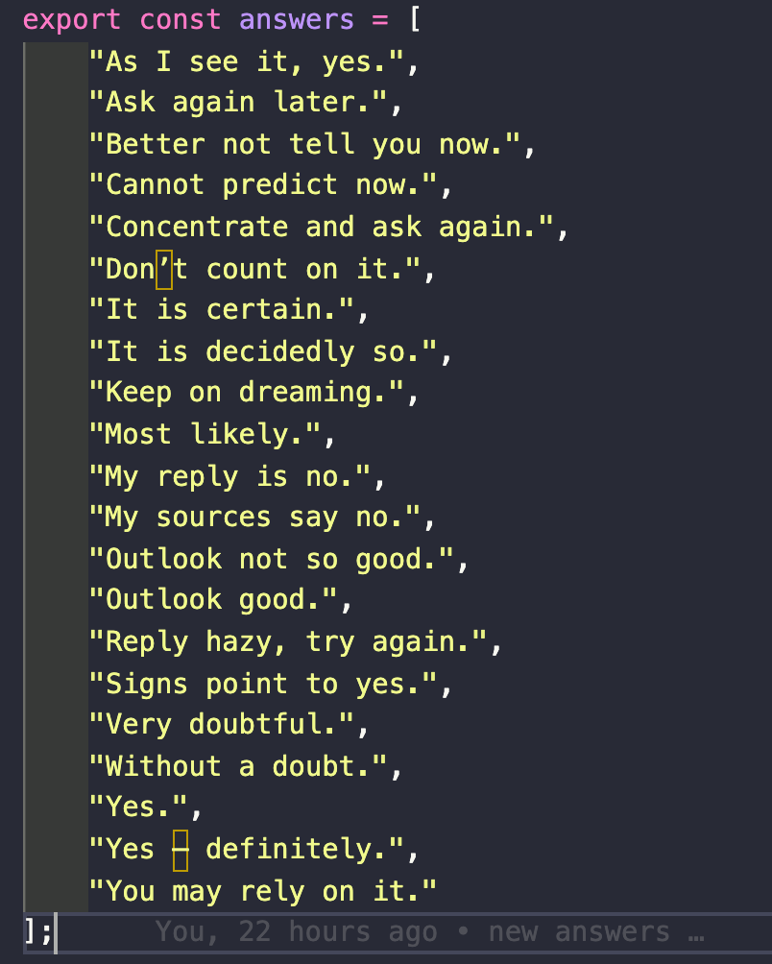
Logic

Slide 6
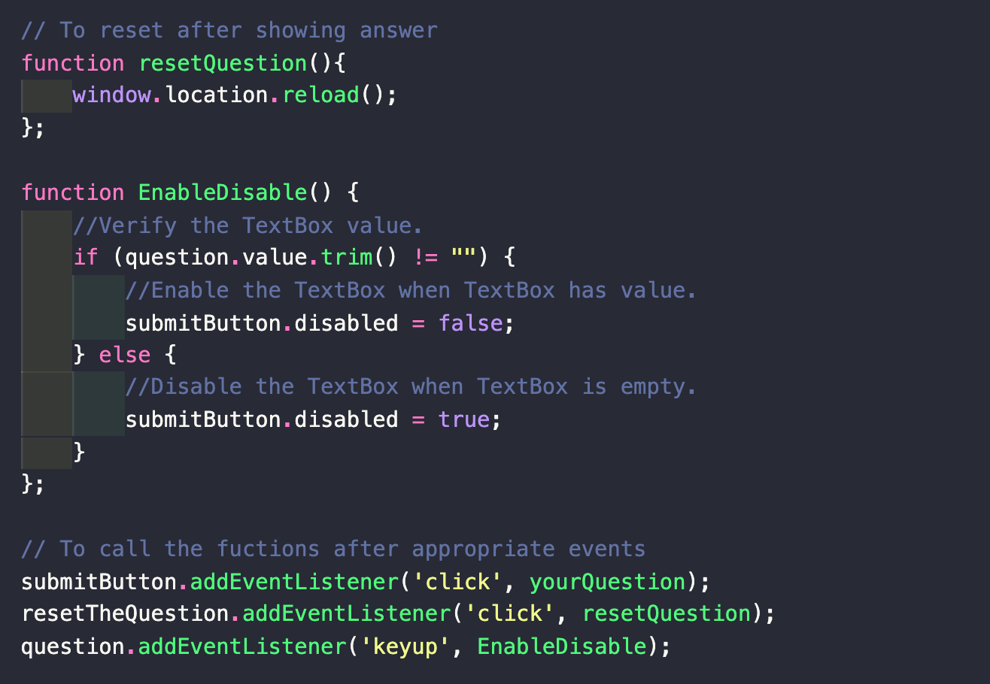
Logic

Slide 7
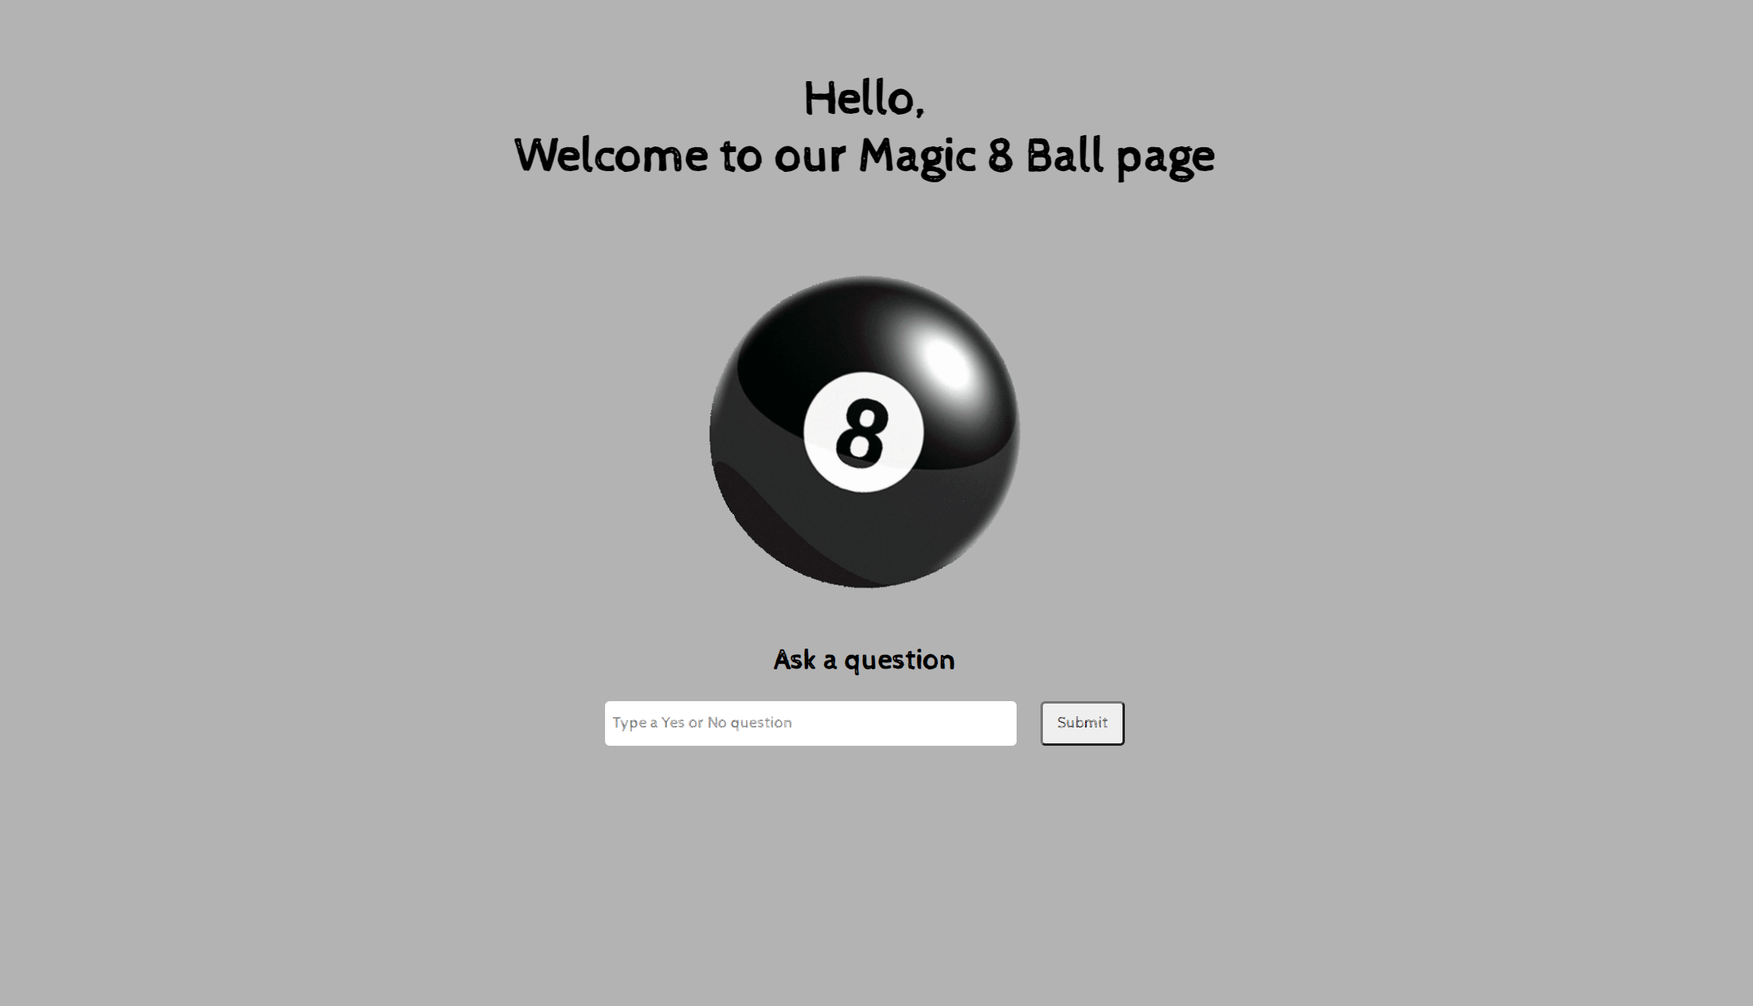
Demo

Slide 8
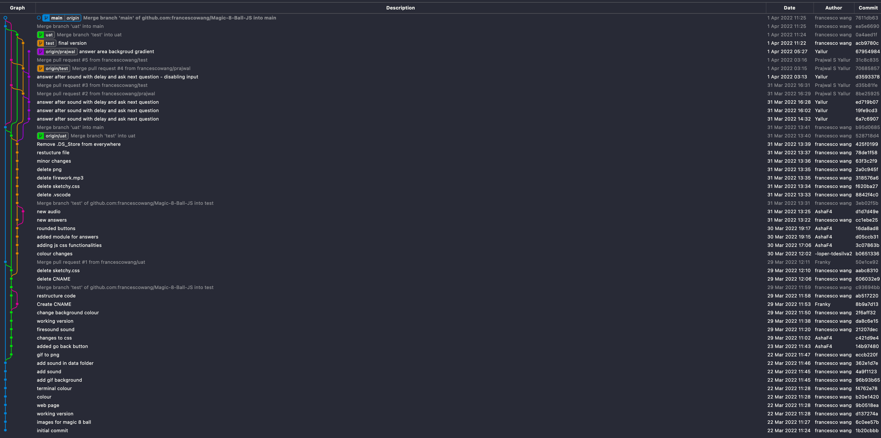
Git Graph

Slide 9
THANK YOU FOR LISTENING – ANY QUESTIONS? ☺

