Slide 1

WELCOME TO UNIstore app PRESENTATION
LET’S MAKE THINGS UNIQUE AND EASY
Daniele Iannone
Michela Ferrante
Nicola Scopinaro

Slide 2
CONTENTS
PROBLEM DOMAIN
OUR PRODUCT
TARGET MARKET
COMPETITORS
FUNCTIONAL REQUIREMENTS
NON FUNCTIONAL REQUIREMENTS
FUTURE DEVELOPMENTS

Slide 3
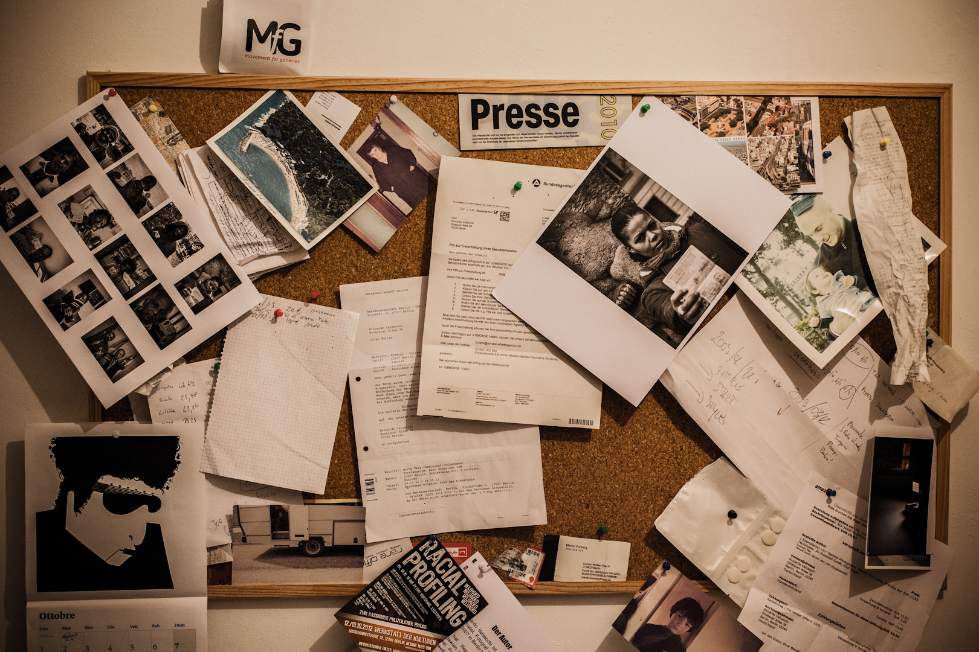
PROBLEM DOMAIN

Slide 4

OUR PRODUCT
WHAT WE DO

Slide 5
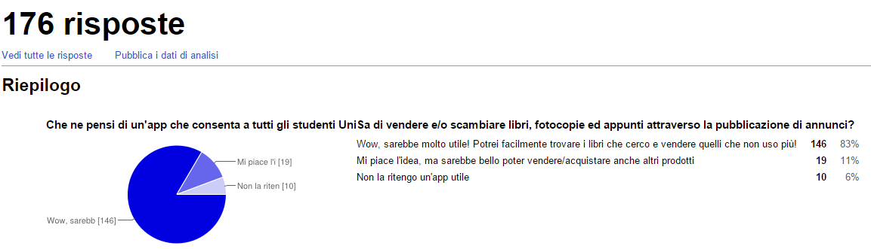
SURVEY

Slide 6


TARGET MARKET

Slide 7


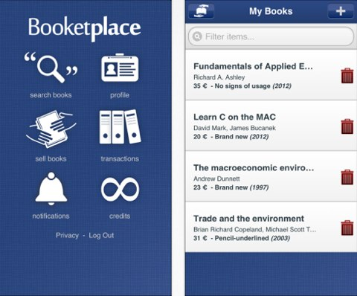
COMPETITORS

Slide 8






FUNCTIONAL REQUIREMENTS
Pubblica annuncio
Modifica annuncio
Cancella annuncio
Visualizza annunci
Segnala annuncio
Cerca annuncio

Slide 9




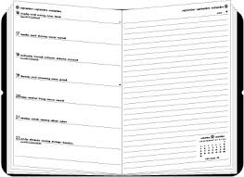
FUNCTIONAL REQUIREMENTS
Commenta annuncio
Rispondi commento
SOCIAL
Invia messaggio
Rating dell’utente
Agenda

Slide 10


FUNCTIONAL REQUIREMENTS
Acquista
Conferma pagamento – asincrona
Conferma pagamento – sincrona

Slide 11



FUNCTIONAL REQUIREMENTS
Geolocalizzazione

Slide 12

FUNCTIONAL REQUIREMENTS

Slide 13

FUTURE DEVELOPMENTS
Espansione a livello nazionale
Micro-localizzazione

Slide 14
THANK YOU FOR COMING

