Slide 1

Thu, May 28 2026
Presented by
Francesko Hasipi
ANALYSIS OF GOLD (XAUUSD)
DATA SCIENCE I PROJECT
The purpose of this project was to analyze historical gold price data and apply data science and machine learning techniques to predict future market direction.

Slide 2


This project combines financial market analysis with data science techniques.
The project workflow included:
data preprocessing
feature engineering
exploratory data analysis
data visualization
machine learning classification.
PROJECT
OVERVIEW
The final goal was to classify whether the next candle would be bullish or bearish.

Slide 3


THE DATASET
The dataset was collected from Investing.com and contains historical XAUUSD market data. It contains approximately 1300 rows of historical market information. Also includes historical XAUUSD market data from March 2020 to April 2026.
The original variables included:
Open
High
Low
Close
Volume.

Slide 4


DATA CLEANING
Before analysis, the dataset needed preprocessing. I performed several cleaning steps:
Renaming columns
Converting string values into numeric values
Removing unnecessary symbols
Cleaning volume data
Removing missing values
These steps prepare the dataset for analysis.

Slide 5

FEATURE
ENGINEERING
One of the most important parts was feature engineering. I created new variables including:
Range
Body
Direction
MA20 (Moving Average 20): shows the average price over the last 20 periods to identify market trend.
RSI (Relative Strength Index): measures market momentum and helps identify overbought or oversold conditions.
Target Variable
These features helped capture:
Market Volatility
Momentum
Trend Direction
Candlestick behavior (price action)

Slide 6
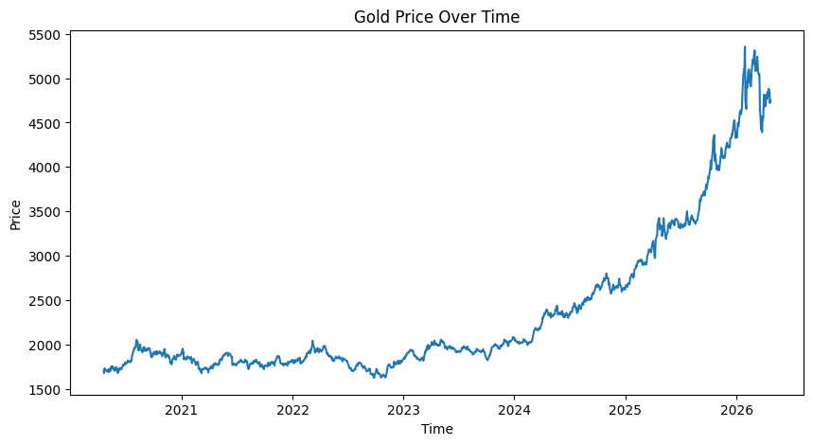
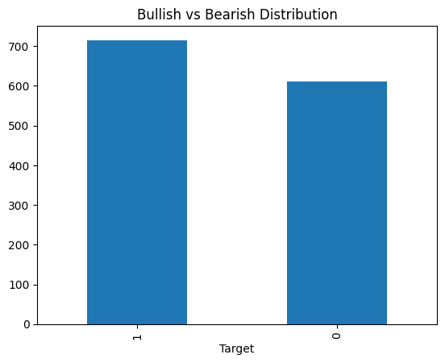
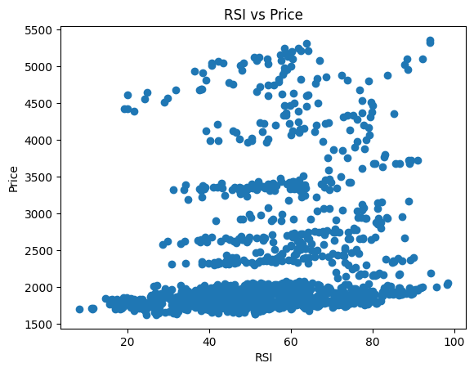
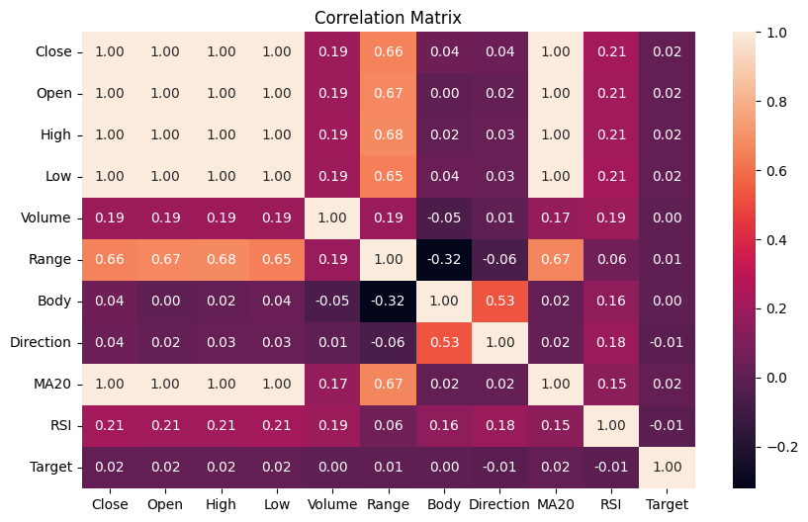
DATA VISUALISATION
I created several visualizations to better understand the dataset and market behavior.
These visualizations included:
XAUUSD Price Movement Overtime
Bullish versus Bearish Candle Distribution
RSI Compared to Price
Correlation Heatmap
The graphs helped identify patterns and relationships between variables.

Slide 7
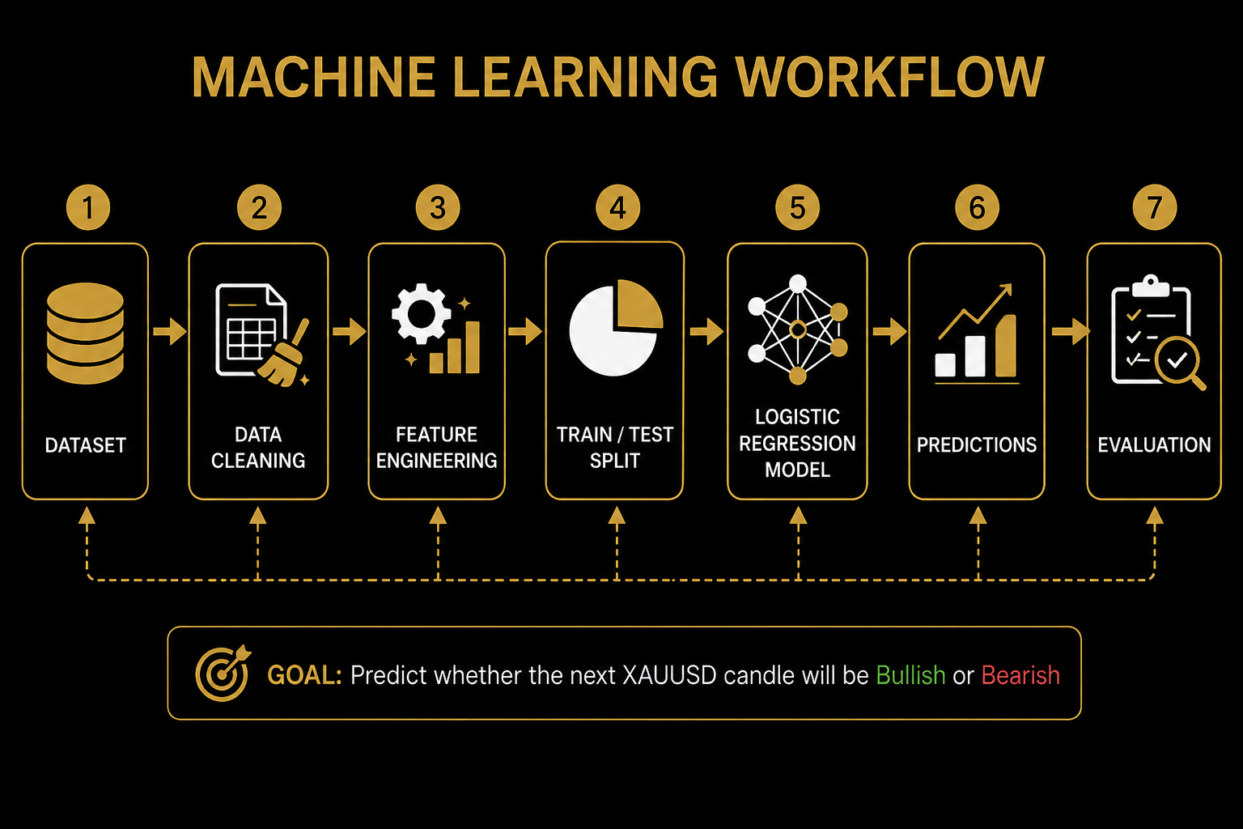
For the machine learning section, I used Logistic Regression.
The workflow included:
Feature selection
Train/Test split
Model Training
Predictions
Performance Evaluation
The model attempted to predict if the next candle would be bullish or bearish
MACHINE LEARNING
MODEL

Slide 8
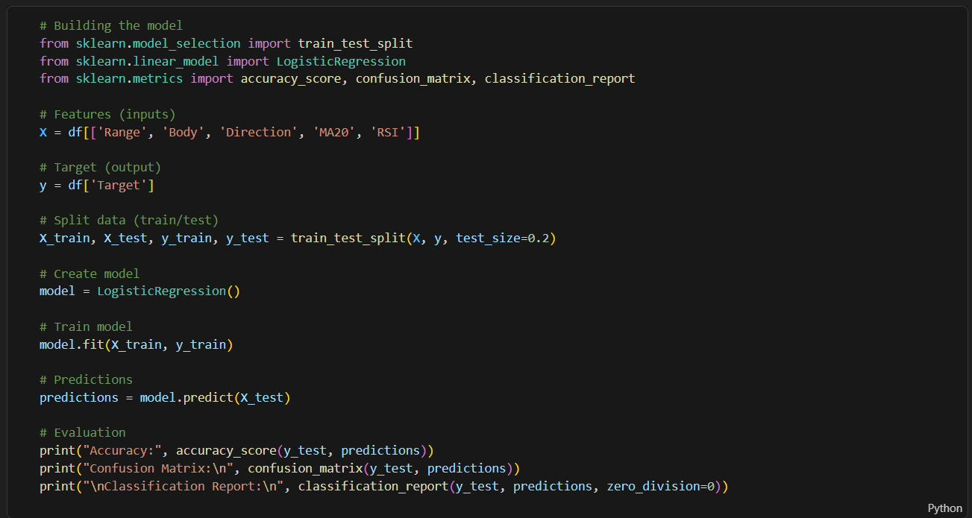
CODE EXAMPLE
TOTAL ESTIMATED INVESTMENT
$7,000

Slide 9
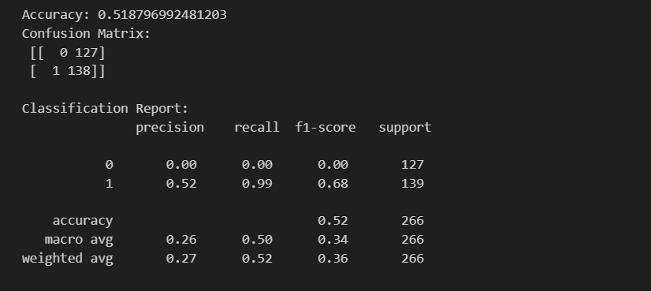
RESULTS & CONCLUSION
The model achieved approximately 52% accuracy, which is realistic for the financial markets to predict because they are highly volatile. Overall this project demonstrated a complete data science workflow.
Conclusion:
Financial markets are difficult to predict

Slide 10
THANK YOU FOR YOUR ATTENTION

