Slide 1

Sentiment and Stock Price Analysis of the Apple Company Using Tweets
Group 7
Jiaye Tang Xi Rao Kris Lin

Slide 2




Meet our team
Takuma Hayashi
Mirjam Nilsson
President
Chief Executive Officer
Flora Berggren
Rajesh Santoshi
Chief Operation Officer
VP Marketing

Slide 3
Content
Introduction
Primary goals
Problem Definition
Methodology
Experiment and Results
Conclusion
Limitation

Slide 4
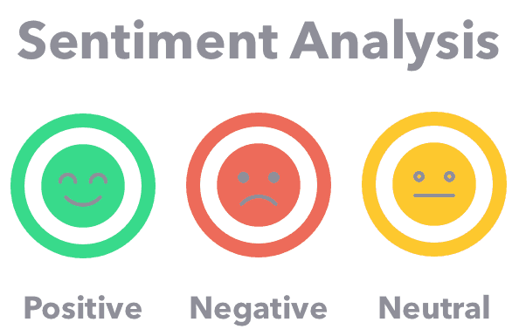
Introduction
Sentiment analysis
Sentiment analysis is a natural language processing (NLP) technique used to determine whether data is positive, negative or neutral.
often performed on textual data to help businesses monitor brand and product sentiment in customer feedback, and understand customer needs.
Notes:
Apple Company, one of the biggest technology companies in the world

Slide 5

Introduction
Sentiment Analysis applied in Financial Industry
According to the Efficient Market Hypothesis (EMH), it states that stock market prices are largely driven by new information...
No unified conclusions to this problem, the relationship between sentiments and market fluctuations.
Notes:
Stock price analysis is an important topic in the financial industry and the reasons that cause the changes in stock price can be various. According to the Efficient Market Hypothesis (EMH), it states that stock market prices are largely driven by new information...
No unified conclusions to this problem, the relationship between sentiments and market fluctuations.

Slide 6
Primary goals
Explore the sentiment distribution, special patterns...
Research the relationship between different sentiments and stock price changes.

Slide 7
Problem Definition
What does the distribution of sentiments look like?
How does the proportion of different sentiments change?
Does the sentiment distribution exist characters, such as seasonal patterns?
What are the most frequent words in different sentiments?
Is there correlation between sentiments and stock price changes of Apple company?

Slide 8
Methodology
Data Collection
The tweets dataset
Data preprocessing
Transform, combine, and filter
Labeling data
Lexicon-based Approach
VADER
AFINN
stock price dataset
Introduce popularity to narrow down dataset
Transform and process text
1
2
3
Notes:
Data Collection
The tweets dataset is from Kaggle (Tweets about the Top Companies from 2015 to 2020) Tweet.csv, Company_Tweet.csv, and Company.csv.
stock price dataset. Kaggle (Values of Top NASDAQ Companies from 2010 to 2020[7] ) which contains daily OPEN, CLOSE, VOLUME, HIGH, and LOW values of Amazon, Apple, Google, Microsoft, and Tesla companies as tagged by dates.

Slide 9

Data Collection
Stock Price dataset: Apple Company, top IT company in the world.
Tweets dataset: Twitter, a popular social media platform for all-age users.
Notes:
gain insights from social media platforms
find out if there is relationship between stock price changes and sentiments.
make strategies to amplify the confidence of investors based on the analysis
collect more information about companies, avoid loses and take actions accordingly.

Slide 10
Data Preprocessing
Transform raw Tweets data
Removed username; RT beginning words (Retweets); URLs; punctuations; single numbers; stopwords;
Tokenization
word_tokenize() method in the NLTK
Lemmatization
grouping together words with the same root or lemma
Pos-Tagging
words or tokens are assigned part of speech tags
to tag the tokens so that the lemmatization could use the contextual information the taggers provide to choose the appropriate lemma.
Notes:
RT beginning words

Slide 11
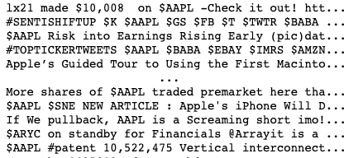
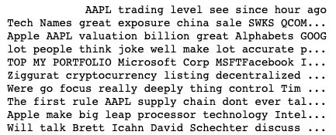
Data Preprocessing
Raw text
After processing
Notes:
Data Collection
The tweets dataset is from Kaggle (Tweets about the Top Companies from 2015 to 2020) Tweet.csv, Company_Tweet.csv, and Company.csv.
stock price dataset. Kaggle (Values of Top NASDAQ Companies from 2010 to 2020[7] ) which contains daily OPEN, CLOSE, VOLUME, HIGH, and LOW values of Amazon, Apple, Google, Microsoft, and Tesla companies as tagged by dates.

Slide 12
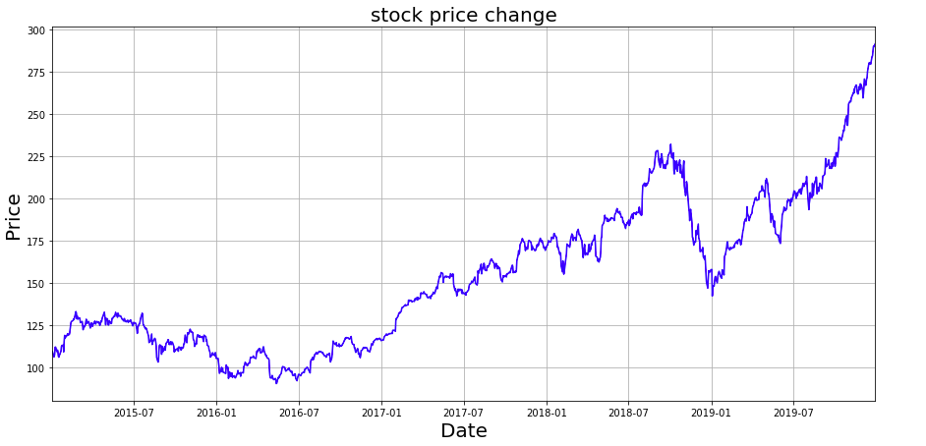
Methodology
Close/Last Values
Volumes
The value of the gain = close value of stock price - open value of stock price

Slide 13
Dictionary
AFINN
VADER
AFINN lexicon is a list of English terms
it contains over 3,300+ words with a polarity score associated with each word.
rated for valence with an integer between -5 (negative) and +5 (positive)
VADER (Valence Aware Dictionary and sEntiment Reasoner) is a lexicon and rule-based sentiment analysis
Suitable for analyzing social media data
over 7500 tokens listed in VADER lexicon.
Here we used Vader with the python Package SentimentIntensityAnalyzer and get the normalized compound value as the Vader_score ranging from -1 to 1.

Slide 14
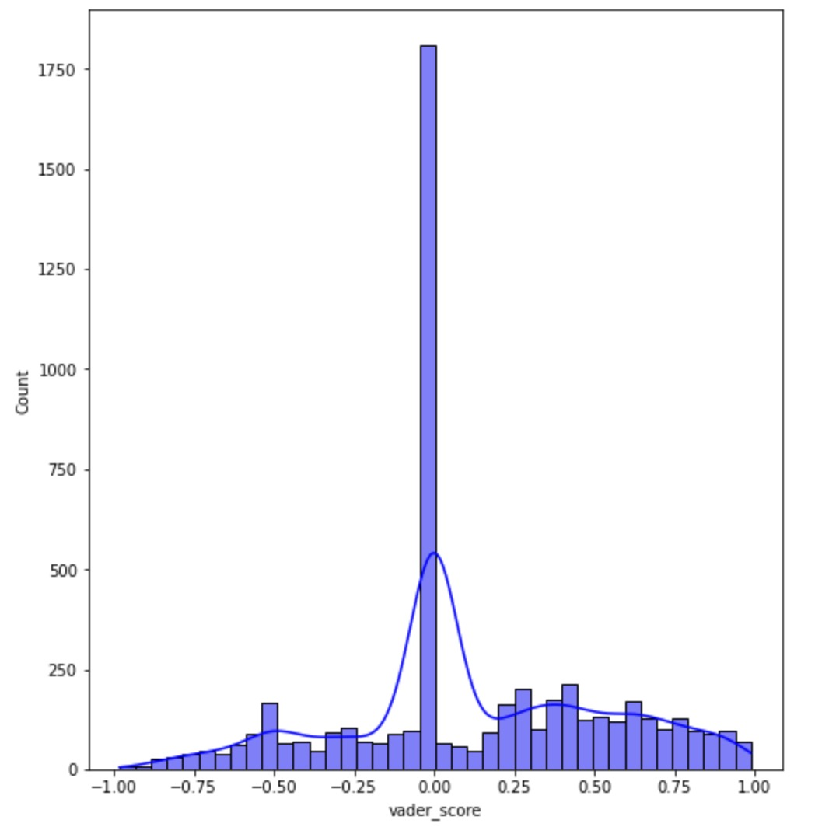
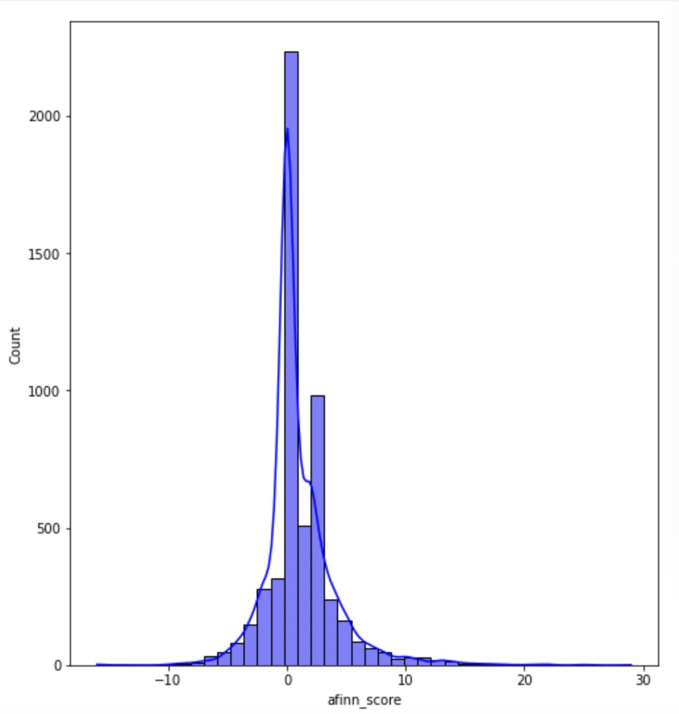
Experiments and Results
VADER scores have a relatively regular normal distribution
Distribution of compound VADER score
Distribution of compound AFINN score
-0.25 and 0.25 as the threshold
-1 and 1 as the threshold
Neutral
Neutral
Negative
Positive
Negative
Positive

Slide 15
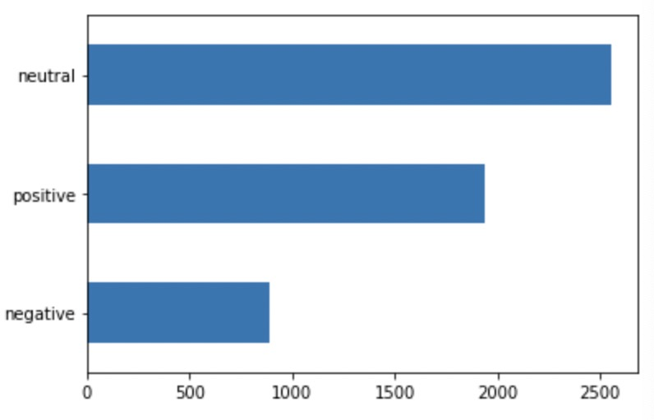
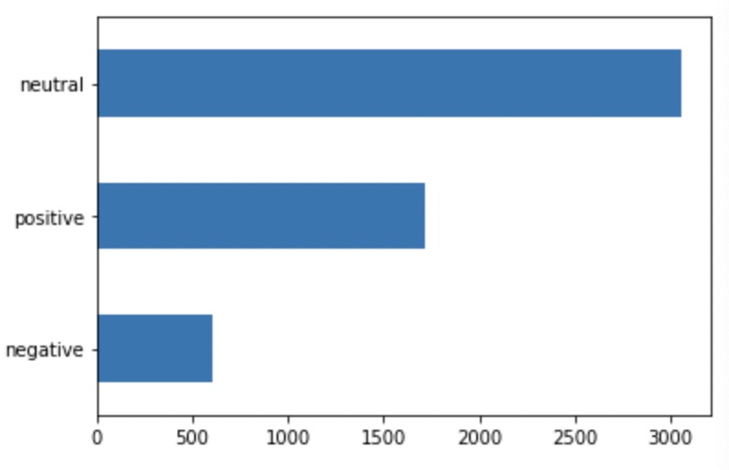
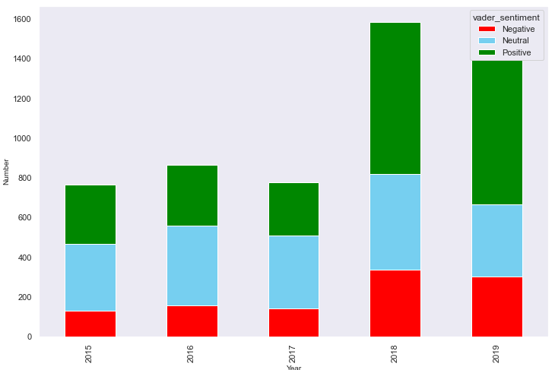
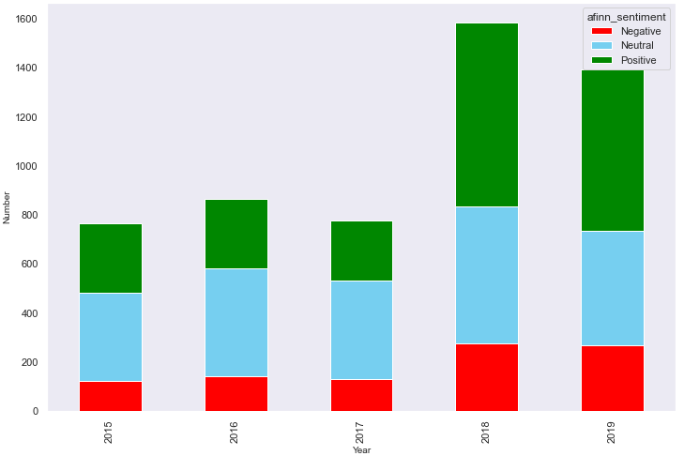
Experiments and Results(cont.)
The neutral sentiment took the largest proportion
In VADER scores, positive sentiments were almost twice as much as negative sentiments
VADER classified more negative and positive sentiments, and less neutral sentiments than AFINN did.
The proportion of positive sentiments categorized by both AFINN and VADER increased in 2018 and 2019.
Count plot of VADER sentiments
Count plot of AFFIN sentiments
Changes of VADER Sentiments over 5 years
Changes of AFINN Sentiments over 5 years

Slide 16
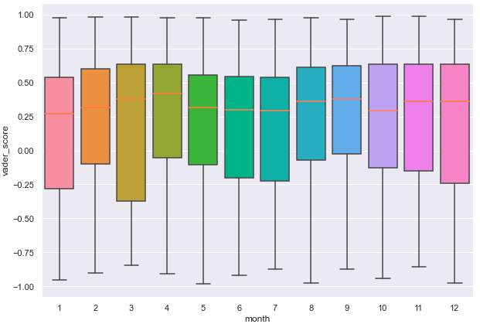
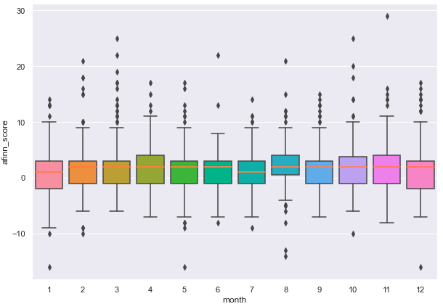
Experiments and Results (cont.)
We chose 2019 to see if there were seasonal pattens
Both figures shows that March, April and months at the end of 2019 had higher sentiment scores
AFFIN scores had less fluctuation than VADER scores
Monthly distribution of VADER scores
Monthly distribution of AFINN scores

Slide 17
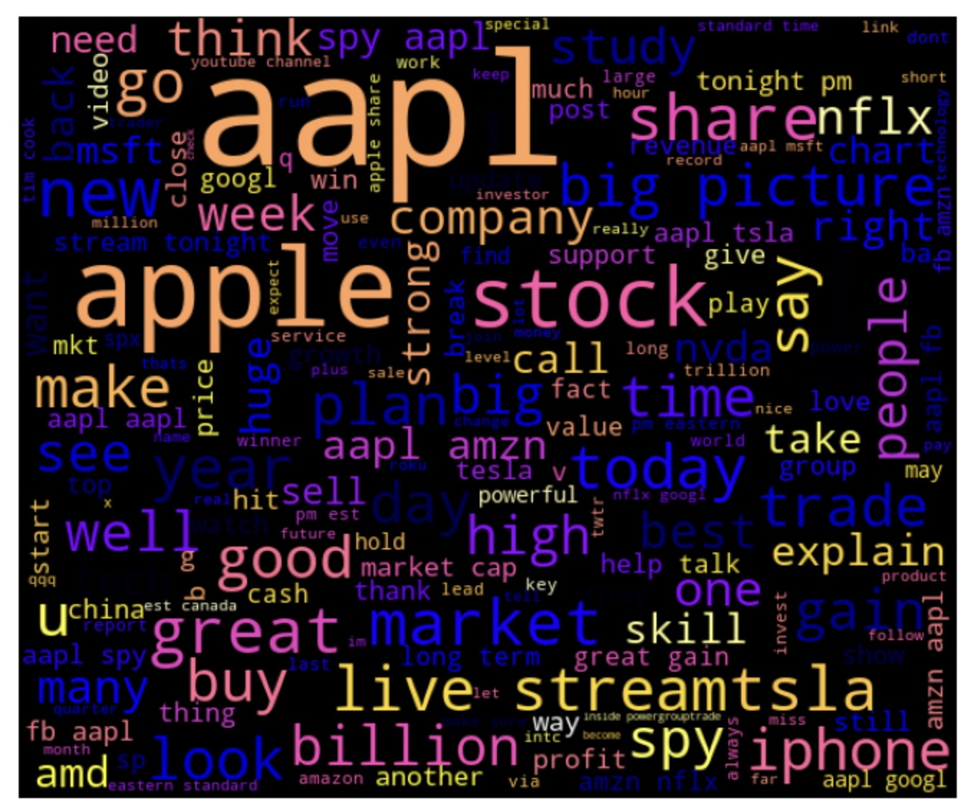
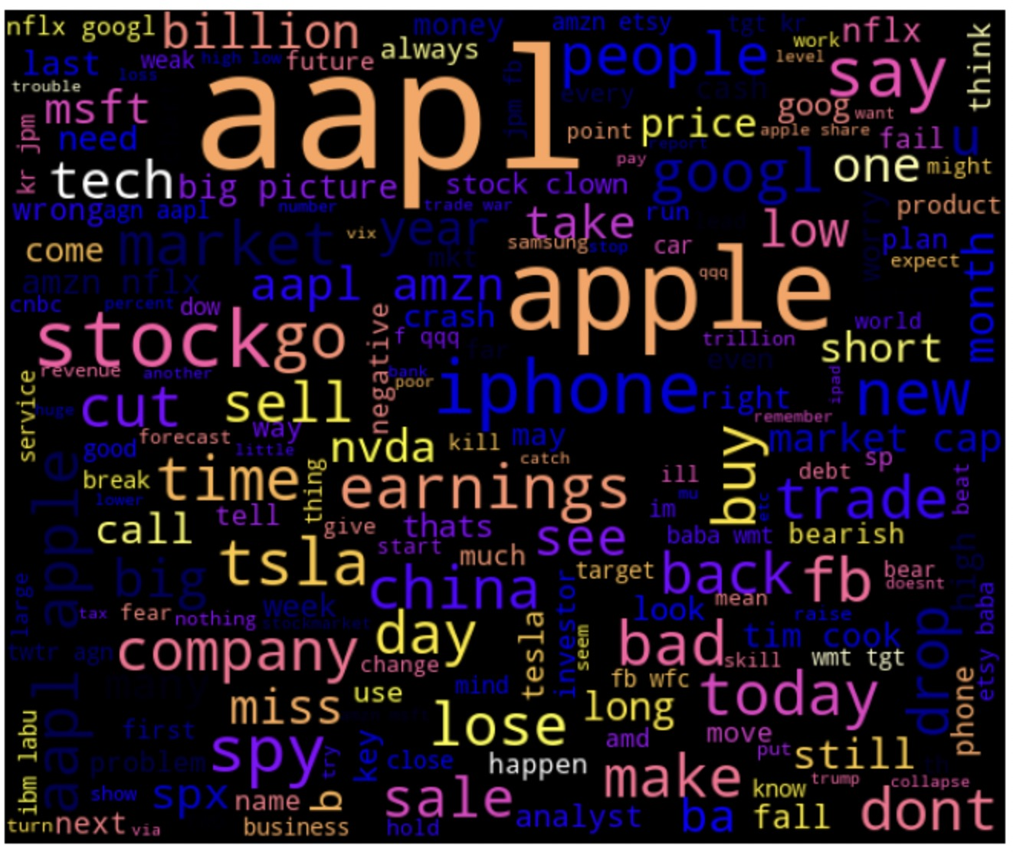
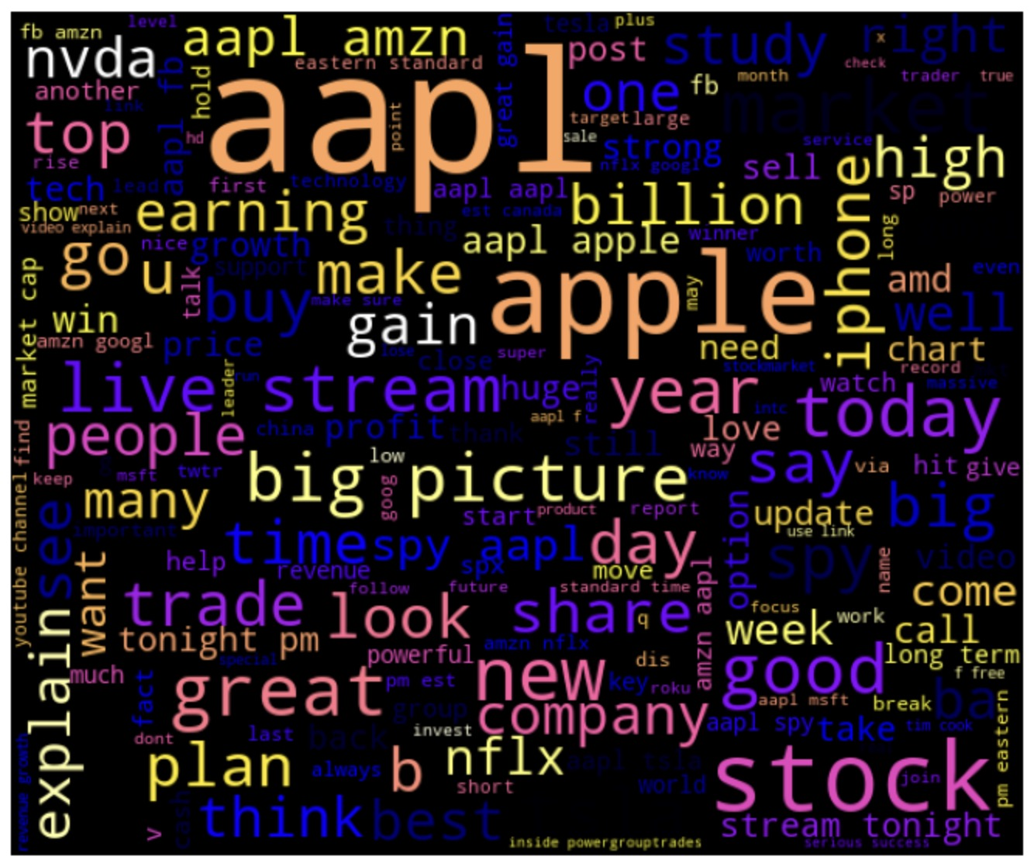
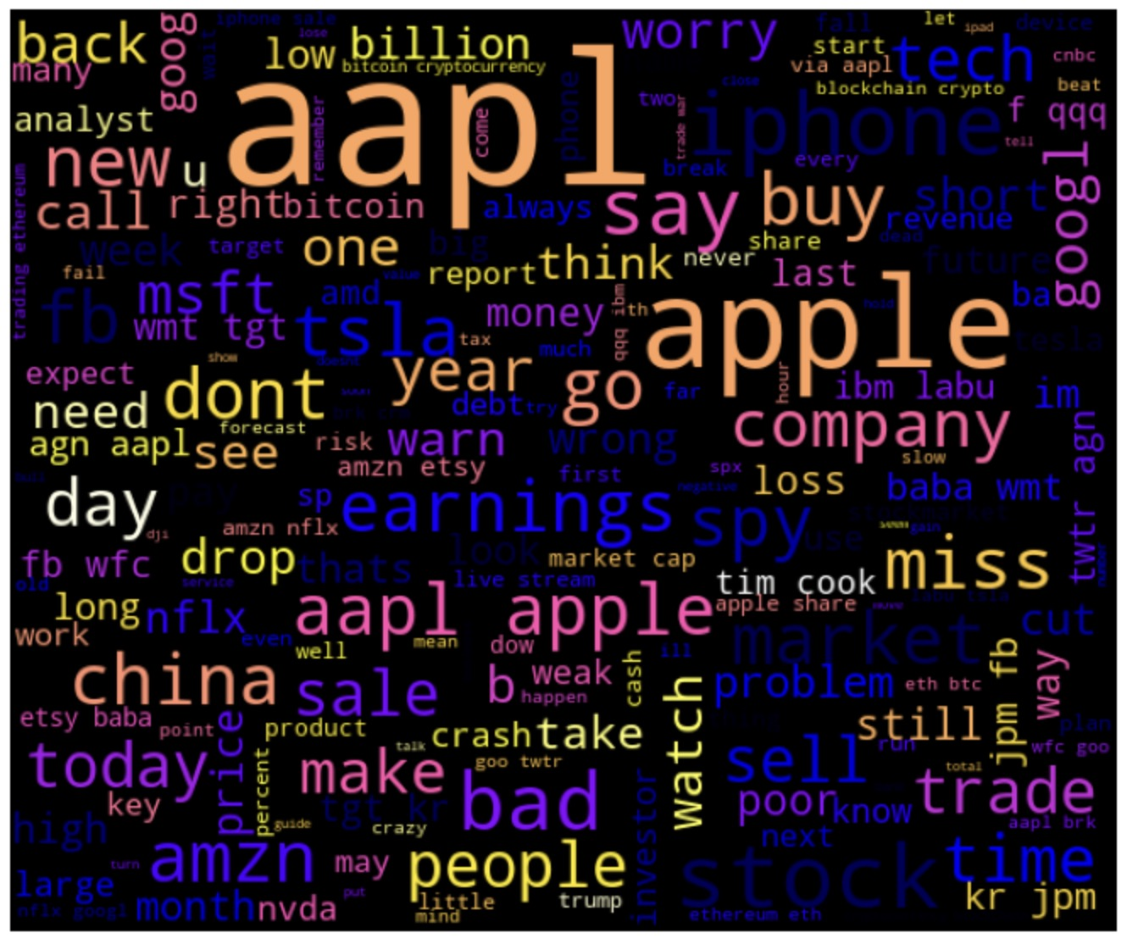
Experiments and Results (cont.)
Neutral words were excluded
Positive words: ‘good’, ‘great’, ‘high’, ‘strong’, ‘best’
Negative words: ‘bad’, ‘dont’, ‘worry’
Negative tweets were not very well labeled, due to words with negative emotions are not obvious
Sentiment words labelled by VADER were more accurate than those labelled by AFINN
Wordcloud for positive words of VADER
Wordcloud for negative words of VADER
Word cloud for positive words of AFINN
Word cloud for negative words of AFINN

Slide 18
Experiments and Results (cont.)
We used Spearman correlation test to find if the sentiment score is correlated with stock price gain, close value and volume
H0 : there is no correlation between sentiment and stock.
H1 : there is some correlation between sentiment and stock
The threshold is 0.05
 | VADER | AFFIN
stock price gain | p = 0.00149 corr = 0.08302 | p = 0.00038 corr = 0.07430
close value | p ≈ 0 corr = 0.2624 | p ≈ 0 corr = 0.25383
stock volume | p = 0.01458 corr = -0.0572 | p = 0.40892 corr = -0.0193
p < 0.05 reject H0
p < 0.05 reject H0; stronger correlation
p < 0.05 (only VADER) reject H0;
inverse correlation

Slide 19
Conclusion
The neutral sentiments had the highest counts in both VADER and AFFIN, following by the positive sentiments
There are more tweets in 2018 and 2019, and the positive sentiments increased in both VADER and AFFIN
Sentiments seem have some seasonal patterns
Word clouds show the most frequent words in positive and negative sentiments, VADER labeled words better than AFFIN
Sentiments and stock price gain, close value have some correlation

Slide 20
Limitation
Tweets datasets are collected by stock ticker, it could be biased
We added a feature “popularity” to exclude some data with less importance, could exclude some important information
Dictionaries are not customized for our dataset

Slide 21
Thank you

