Slide 1
Group name Think About It Later PL1904V
(03)Reboca Jan Francis Barcelona
(16)Terence Toh Tze Hui

Slide 2
(03) Francis Log
Task 1 - VCS 2 – Reconnaissance – client Lab10b 3 – Scrapy to get image location | Feature | Problem Encountered | description of how to solve it / screenshot of successful image
Reconnaissance | Spool header to retrieve website HTML information | N/A | Successfully provided website HTML header (See below for screenshot)
Reconnaissance | Import pip request | Pip not install by default | Install pip request at cmd
Scrapy to get image location | Provide links for the images in the website | N/A | see below for JSON file screenshot

Slide 3
16(Terence)
Task 1 - VCS 2 – Reconnaissance – client Lab10b 3 – Scrapy to get image location | Feature | Problem Encountered | description of how to solve it / screenshot of successful image
Reconnaissance | Spool header to retrieve website HTML information | N/A | Successfully provided website HTML header (See below for screenshot)
Reconnaissance | Import pip request | Pip not install by default | Install pip request at cmd
Scrapy to get image location | Provide links for the images in the website | N/A | see below for JSON file screenshot

Slide 4
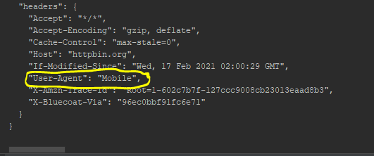
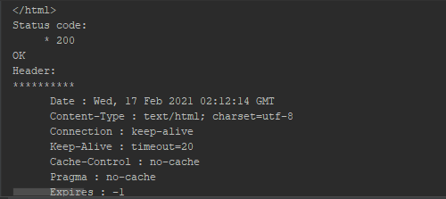
Server Output
The HTTP 200 OK success status response code indicates that the request has succeeded.
“User-Agent” changed to “Mobile” successfully
No problems encountered so far.

Slide 5
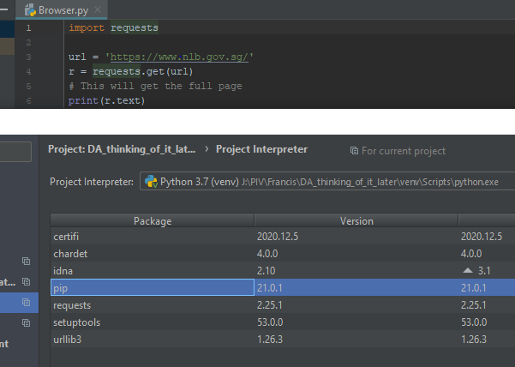
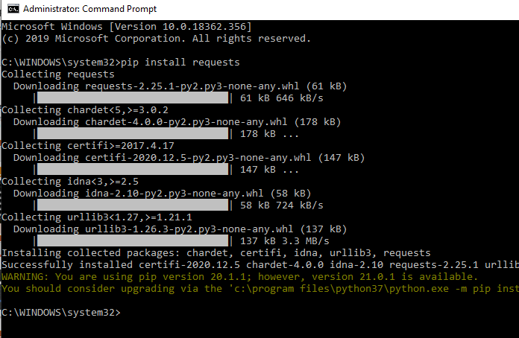
Reconnaissance
Pip update on Pycharm didn’t work
Solution Implemented:
Install pip by typing the command (pip install requests) on the Command Prompt

Slide 6
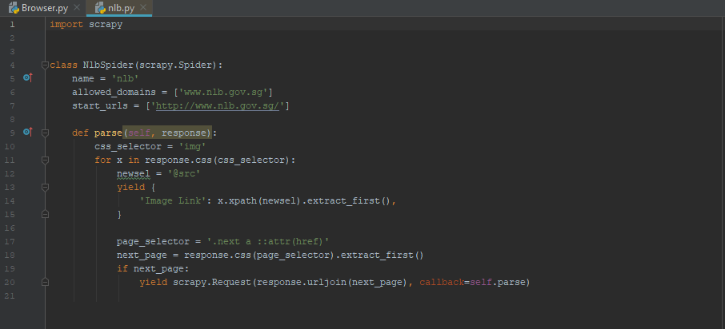
Source code for image scraping
Used National Library Board as example website for image scraping.
Got minor indentation errors. Manage to correct it. Other than that, we did not faced any problems.

Slide 7
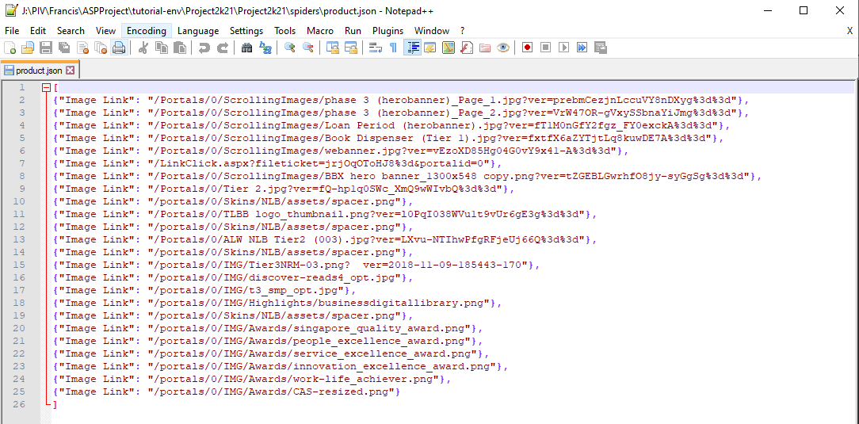
Reconnaissance
Image Scraping - Scrap image link and store in JSON text:
No problem on the first part of the program.
Able to display image links in the JSON file.

