Slide 1

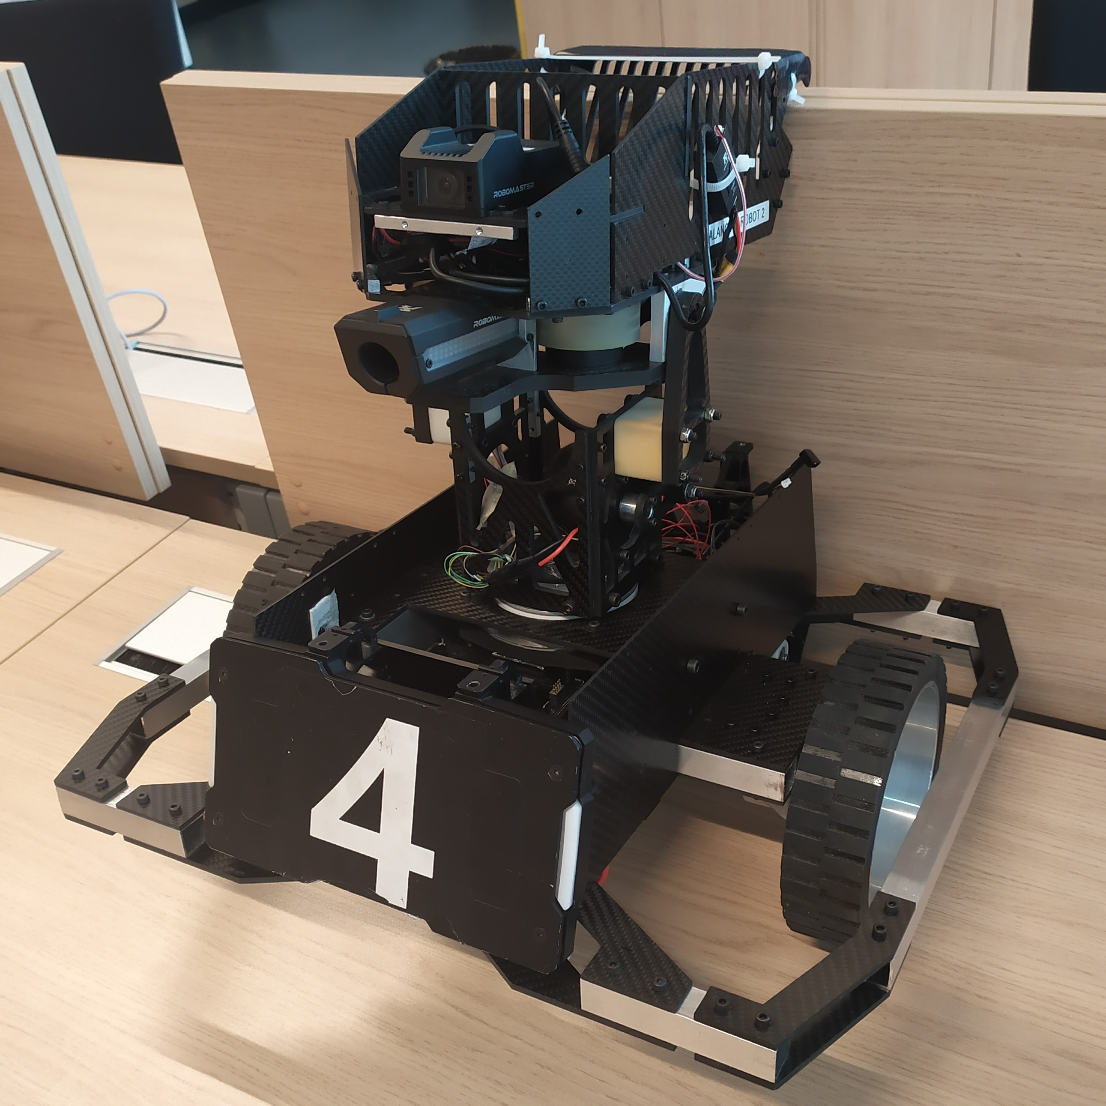
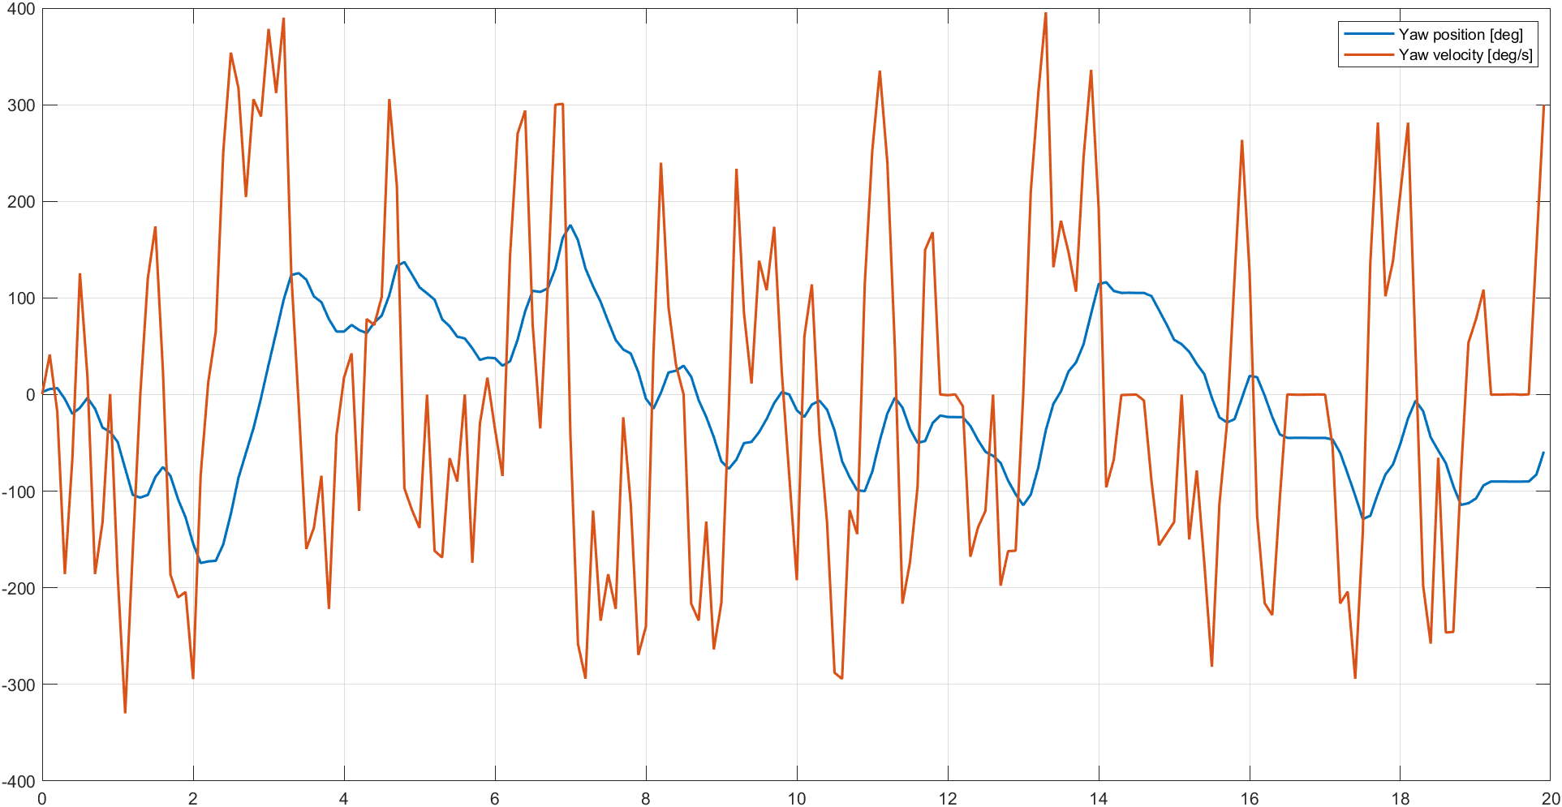
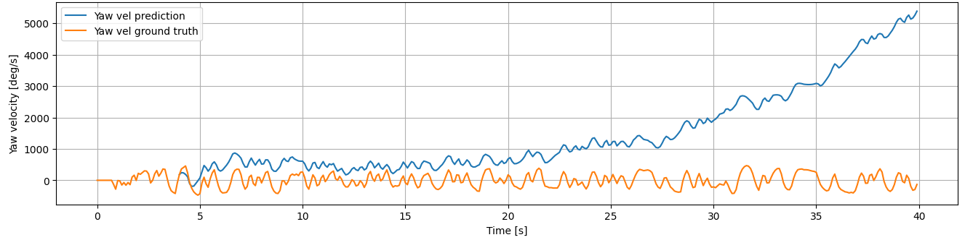
ML4VMM – Bramucci Roberto (S303683), Paoli Leonardi Francesco (S297078)
System to be modeled
Sampled yaw position and velocity
Drift of IMU measurements
Data preprocessing:
Measurements downsampling
Normalization
Delta and contig. sets

Slide 2
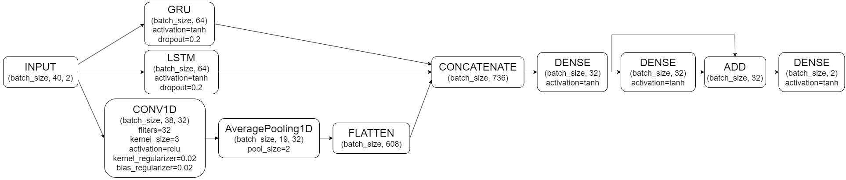
ML4VMM – Bramucci Roberto (S303683), Paoli Leonardi Francesco (S297078)
Model architectures:
SRNN, GRU, LSTM, CONV1D
Decoder-like LSTM, Encoder-like LSTM
TCN (Temporal Convolutional Network)
Additional model features:
Skip connection between Dense layers
Dropout (10-20%)
L₂-regularization
Best performing architecture: inception-based model

Slide 3
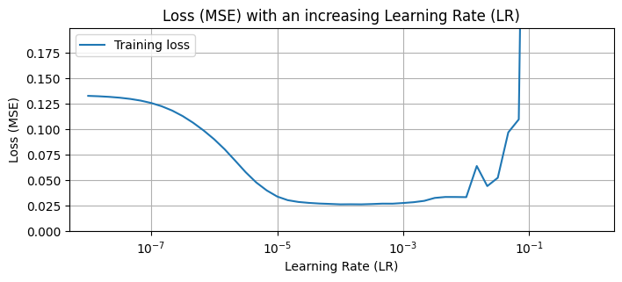
ML4VMM – Bramucci Roberto (S303683), Paoli Leonardi Francesco (S297078)
LR tuning through LearningRateScheduler:
LR = 1e-4
Time-windows length tuning:
✔️PRO: more past-information available
❌CON: heavier/slower model
Time-windows length = 40

Slide 4
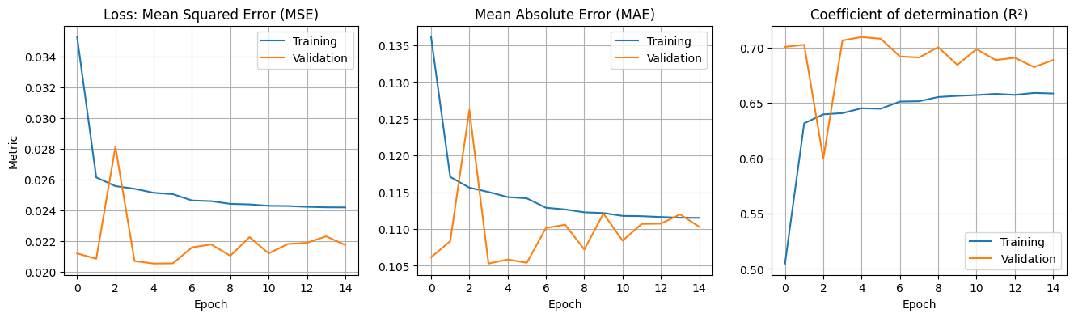
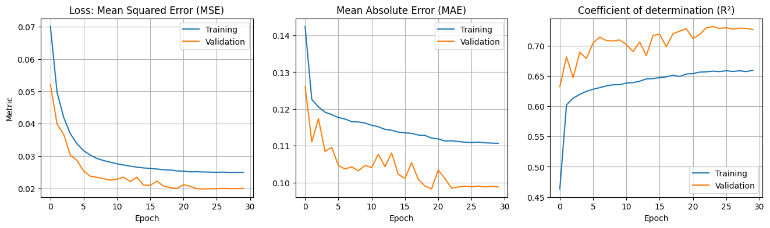
ML4VMM – Bramucci Roberto (S303683), Paoli Leonardi Francesco (S297078)
Inception-based model, without regularization
Inception-based model, with regularization

Slide 5
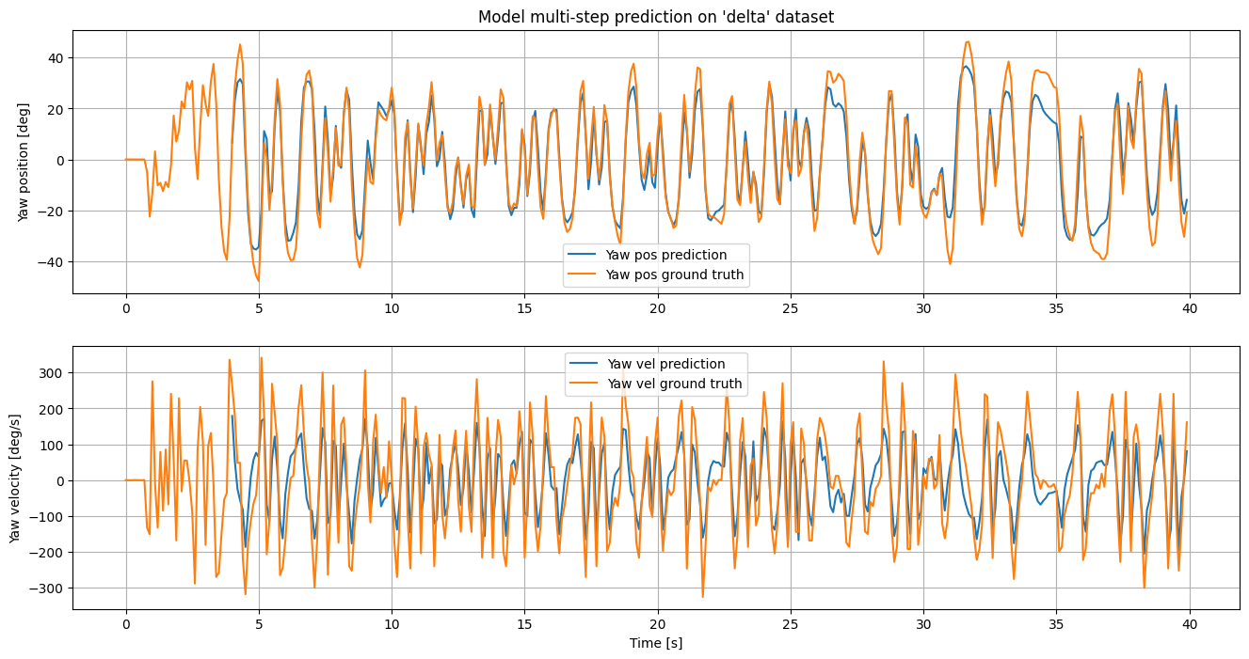
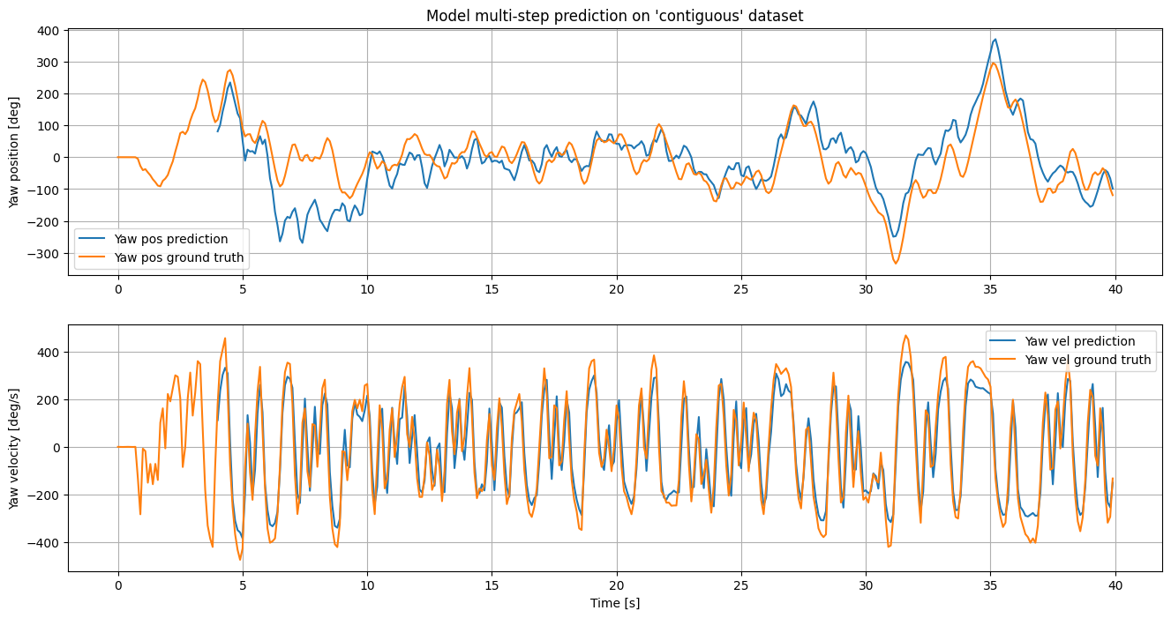
ML4VMM – Bramucci Roberto (S303683), Paoli Leonardi Francesco (S297078)
Simulation of inception-based model on delta set
Simulation of inception-based model on contiguous set

