Slide 1
DATA SCIENCE PORTFOLIO PROJECT
Petrodollar & De-dollarization Analysis
Is the world quietly stepping away from the US Dollar?
20 Years
PROBLEM STATEMENT
Global oil trade and central-bank reserves have leaned on the US Dollar for decades. This project asks a simple question — is that reliance fading, and can the pace of that shift be measured and forecast using real economic data and machine learning?
of monthly data across oil, OPEC, BRICS reserves, sovereign funds & prices
Francis Infant | Data Science with Generative AI, Imarticus Learning

Slide 2

Overall Solution Approach
From raw multi-source data to a validated forecasting framework
1
Integrated five real-world datasets
Oil trade & production, OPEC quotas, BRICS reserves, sovereign wealth funds, and market prices — merged into one monthly panel spanning 2005–2025.
2
Engineered macroeconomic features
Spare OPEC production capacity, non-dollar trade ratios, reserve gaps, and rolling trend indicators.
3
Built one De-dollarization Index using PCA
Compressed five correlated signals into a single score — capturing 90.6% of their shared variance, and matching an independent benchmark index at 0.976 correlation.
4
Tested four forecasting approaches
Naive persistence, trend extrapolation, Ridge regression, and a Trend + Random Forest hybrid — evaluated across 6, 12, 24 and 36-month horizons.
5
Selected the model on evidence, not complexity
The approach that generalized best on MAE, RMSE and R² was chosen — not the most sophisticated-looking one.

Slide 3

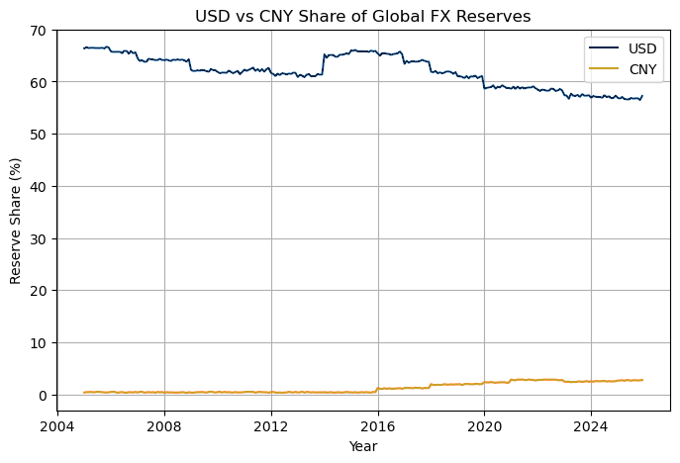
Key Findings — The Shift Is Real, But Slow
Twenty years of reserve and oil-trade data tell one consistent story
66%
66% → 57%
57%
Slipping ~0.5 pt/year, every year since 2005.
~80%
of oil trade still invoiced in USD — the petro-anchor holds.
~80×
USD vs. CNY share of global FX reserves (2005–2025)
petroyuan futures growth since 2018 — fast, but off a tiny base.
Business read: the dollar’s grip is loosening, not breaking. Oil-trade demand remains the dominant structural anchor for USD — a real shift here would surface in this data years before it hits the headlines.

Slide 4

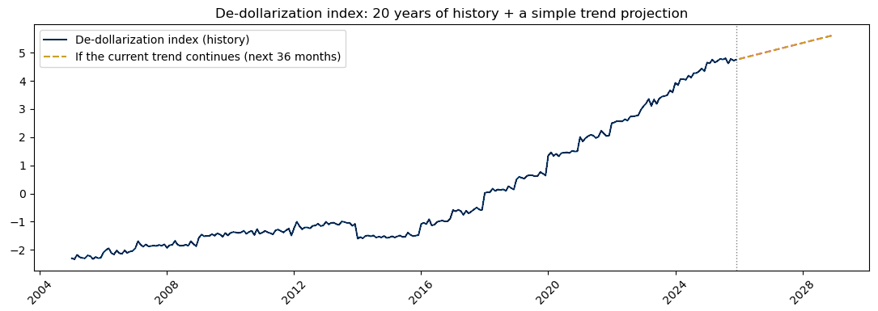



Key Findings — What The Model Tells Us
What the winning forecasting model reveals about where de-dollarization is headed
De-dollarization index — 20 years of history plus a 3-year trend projection
Still climbing — no reversal since 2005.
Reliable up to ~2 years ahead (90%+ explained).
Trend momentum drives 59% of the forecast.
Confidence eases naturally past 3 years out.
Business read: the model isn’t just describing the past — it signals the drift away from the dollar is likely to continue steadily for at least the next two years.

Slide 5



Further Improvement Areas / Next Steps
Where this analysis could go next — from portfolio project to production tool
Official Data Sources
Uncertainty Bands
Live Re-validation
Swap synthetic-filled figures for published IMF, EIA and BIS numbers to make every conclusion fully verifiable.
Show a plausible range around each forecast instead of a single best-guess line.
Re-check predictions against new real-world months as they arrive, not just historical hold-out data.
Shock Monitoring
Richer Signals
Interactive Dashboard
Flag sudden moves from sanctions, wars, or surprise OPEC decisions that break the trend assumption.
Add central-bank gold buying and cross-border payment-rail data (CIPS, mBridge) to sharpen the story.
A Power BI / Tableau view with an adjustable trend-speed slider for scenario exploration.

Slide 6


WHY THIS PROJECT MATTERS
Justification, Value & Beneficiaries
WHAT THIS PROJECT DELIVERS
WHO BENEFITS — AND HOW
One measurable, trackable index
Investors & Asset Managers
Turns a vague geopolitical narrative into a single number anyone can monitor over time.
Early signal on shifting dollar exposure across portfolios.
A complete, honest ML pipeline
Data engineering → features → PCA → forecasting → transparent model comparison.
Policy & Central Bank Teams
A quantifiable way to monitor de-dollarization instead of relying on headlines.
Independently built and validated
Designed, executed, and stress-tested end-to-end as a self-directed project.
Energy & Commodity Traders
Visibility into oil-trade invoicing shifts that affect pricing and settlement risk.
1 Index
replacing dozens of scattered indicators with one number leadership can track over time.
Corporate Treasury & Risk Teams
Better-informed FX exposure and currency-hedging decisions.
“De-dollarization is real, structural, and gradual — a multipolar drift, not a dollar collapse.”
Francis Infant — Petrodollar & De-dollarization Analysis

