Slide 1
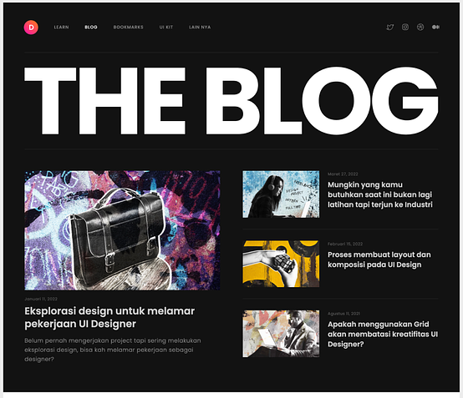
menu-bar
menu-title
small-card
big-card

