Slide 1


Name It, Draw It
V. 03
GRADED EXERCISE
NAME
SCHOOL
YEAR AND PROGRAM
SUBJECT
Francine Hanna B. Alvarez
Bicol University
BS ChE 2B
CHEM 13 — Organic Chemistry (Lecture)

Slide 2




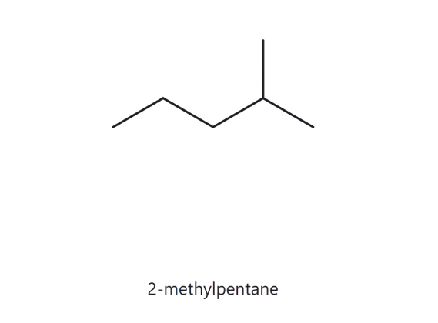


PART A
A01 -Foundation
Structure
Name
Counted Formula: C6H14
2
PART A
1
NUMBERED PARENT
NAMING TRAIL
Parent: 5 carbon atoms → pentane; open-chain structure.
Numbering: Left → right: 4; right → left: 2. Right → left is correct because 2 is the lower locant.
Substituents: Methyl at C2 → 2-methyl.
4
PART B
3
2
5
1
TO BE CONTINUED
3
MY NAME (WRITTEN FIRST)
4
THE ALKANE CHECK
2-methylpentane
TO BE CONTINUED
C6H14
Returned name: 2-methylpentane
IT’S A MATCH!
TO BE CONTINUED
VERIFICATION STRIP
longest chain confirmed
alphabetical order
formula counted
lowest locants
punctuation

Slide 3
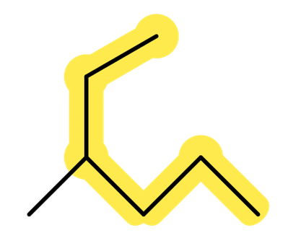
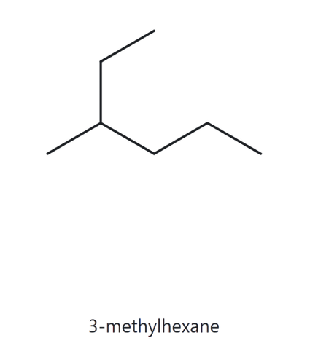
PART A
A02 -Foundation
Structure
Name
Counted Formula: C7H16
2
PART A
1
NUMBERED PARENT
NAMING TRAIL
Parent: 6 carbon atoms → hexane. The chain bends at the branch point.
Numbering: Start from the ethyl end: methyl is at C3. Start from the other end: methyl is at C4.
Substituents: Methyl at C3 → 3-methyl.
1
2
PART B
3
4
5
6
TO BE CONTINUED
3
MY NAME (WRITTEN FIRST)
4
THE ALKANE CHECK
3-methylhexane
TO BE CONTINUED
C7H16
Returned name: 3-methylhexane
IT’S A MATCH!
TO BE CONTINUED
VERIFICATION STRIP
longest chain confirmed
alphabetical order
formula counted
lowest locants
punctuation

Slide 4
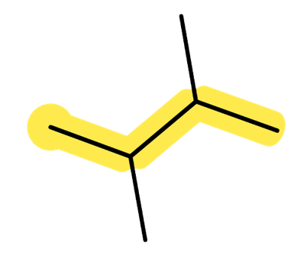
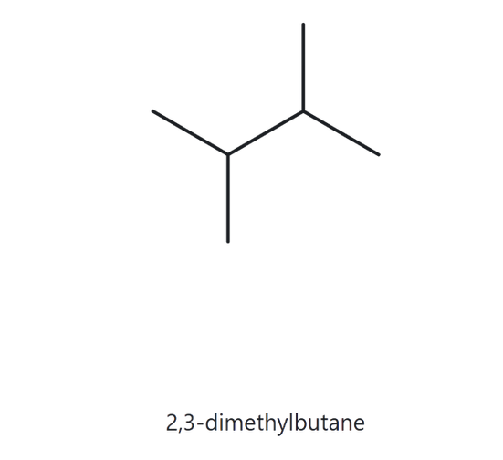
PART A
A03 -Foundation
Structure
Name
Counted Formula: C6H14
2
PART A
1
NUMBERED PARENT
NAMING TRAIL
Parent: 4 C, so butane.
Numbering: both directions give 2,3, so it’s a tie and either end works.
Substituents: methyl on C2 and C3, so 2,3-dimethyl.
1
2
3
PART B
4
TO BE CONTINUED
3
MY NAME (WRITTEN FIRST)
4
THE ALKANE CHECK
2,3-dimethylbutane
TO BE CONTINUED
C6H14
Returned name: 2,3-dimethylbutane
IT’S A MATCH!
TO BE CONTINUED
VERIFICATION STRIP
longest chain confirmed
alphabetical order
formula counted
lowest locants
punctuation

Slide 5
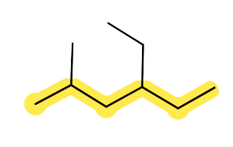
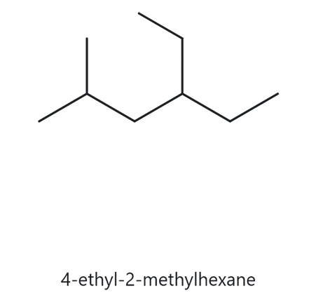
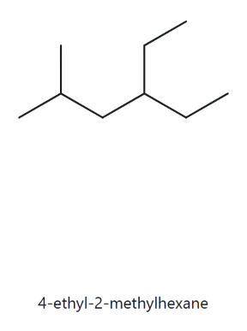
PART A
A04 -Developing
Structure
Name
Counted Formula: C9H20
2
PART A
1
NUMBERED PARENT
NAMING TRAIL
Parent: 6 C, so hexane. Other 6-C paths exist (through the ethyl), but they lead to the same name.
Numbering: left → right gives 2,4; right → left gives 3,5. 2 < 3, so number from the left.
Substituents, alphabetically: ethyl (C4), then methyl (C2).
6
PART B
2
4
5
1
3
TO BE CONTINUED
3
MY NAME (WRITTEN FIRST)
4
THE ALKANE CHECK
4-ethyl-2-methylhexane
TO BE CONTINUED
C9H20
Returned name: 4-ethyl-2-methylhexane
IT’S A MATCH!
TO BE CONTINUED
VERIFICATION STRIP
longest chain confirmed
alphabetical order
formula counted
lowest locants
punctuation

Slide 6
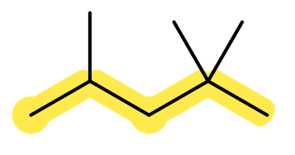
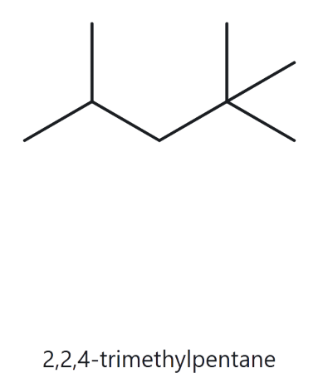
PART A
A05 -Developing
Structure
Name
Counted Formula: C8H18
2
PART A
1
NUMBERED PARENT
NAMING TRAIL
Parent: 5 C, so pentane.
Numbering: left → right gives 2,4,4; right → left gives 2,2,4. First point of difference is the second term, 2 < 4, so number from the right.
Substituents: three methyls at 2, 2 and 4.
PART B
4
2
5
3
1
TO BE CONTINUED
3
MY NAME (WRITTEN FIRST)
4
THE ALKANE CHECK
2,2,4-trimethylpentane
TO BE CONTINUED
C8H18
Returned name: 2,2,4-trimethylpentane
IT’S A MATCH!
TO BE CONTINUED
VERIFICATION STRIP
longest chain confirmed
alphabetical order
formula counted
lowest locants
punctuation

Slide 7
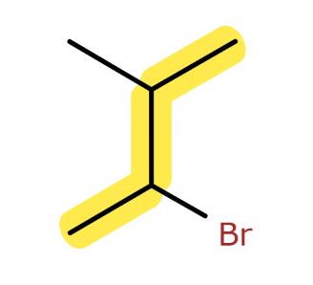
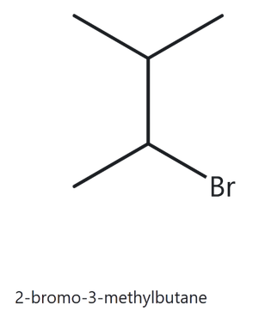
PART A
A06 -Developing
Structure
Name
Counted Formula: C5H11Br
2
PART A
1
NUMBERED PARENT
NAMING TRAIL
4
Parent: 4 C, so butane.
Numbering: from the CH₃ near Br gives Br 2, methyl 3. From the other end gives methyl 2, Br 3. Both sets are {2,3}, so it’s a tie. bromo comes before methyl alphabetically, so bromo gets the lower locant.
Substituents: bromo (C2),
methyl (C3).
3
PART B
2
1
TO BE CONTINUED
3
MY NAME (WRITTEN FIRST)
4
THE ALKANE CHECK
2-bromo-3-methylbutane
TO BE CONTINUED
C5H11Br
Returned name: 2-bromo-3-methylbutane
IT’S A MATCH!
TO BE CONTINUED
VERIFICATION STRIP
longest chain confirmed
alphabetical order
formula counted
lowest locants
punctuation

Slide 8
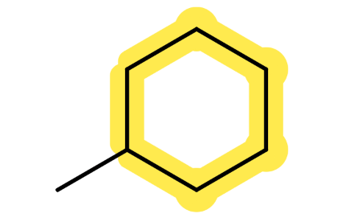
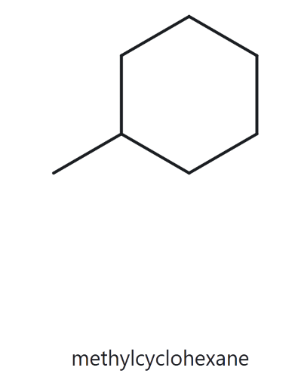
PART A
A07 -Developing
Structure
Name
Counted Formula: C7H14
2
PART A
1
NUMBERED PARENT
NAMING TRAIL
3
Parent: ring of 6 C, so cyclohexane.
Numbering: one substituent only, so it takes C1 and no locant is written.
Substituents: methyl.
2
4
PART B
1
5
6
TO BE CONTINUED
3
MY NAME (WRITTEN FIRST)
4
THE ALKANE CHECK
methylcyclohexane
TO BE CONTINUED
C7H14
Returned name: methylcyclohexane
IT’S A MATCH!
TO BE CONTINUED
VERIFICATION STRIP
longest chain confirmed
alphabetical order
formula counted
lowest locants
punctuation

Slide 9
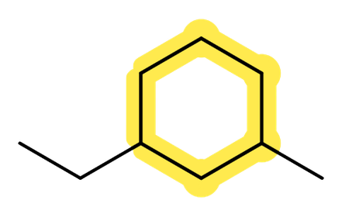
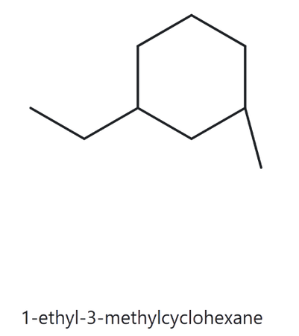
PART A
A08 -Challenge
Structure
Name
Counted Formula: C9H18
2
PART A
1
NUMBERED PARENT
NAMING TRAIL
Parent: ring of 6 C, so cyclohexane.
Numbering: the substituents are 1,3 apart whichever way you go round, so the locant sets tie at {1,3}. Ethyl comes before methyl alphabetically, so ethyl gets C1.
Substituents: ethyl (C1),
methyl (C3).
5
6
4
PART B
1
3
2
TO BE CONTINUED
3
MY NAME (WRITTEN FIRST)
4
THE ALKANE CHECK
1-ethyl-3-methylcyclohexane
TO BE CONTINUED
C9H18
Returned name: 1-ethyl-3-methylcyclohexane
IT’S A MATCH!
TO BE CONTINUED
VERIFICATION STRIP
longest chain confirmed
alphabetical order
formula counted
lowest locants
punctuation

Slide 10
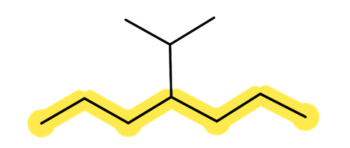
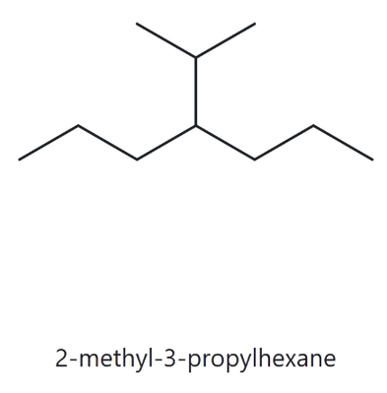
PART A
A09 -Challenge
Structure
Name
Counted Formula: C10H22
2
PART A
1
NUMBERED PARENT
NAMING TRAIL
Parent: longest chain is 7 C, so heptane. The path through the branch is only 6 C, so it loses.
Numbering: the branch is on C4 from either end, so it’s a tie.
Substituents: isopropyl (also written propan-2-yl or (1-methylethyl)) at C4. Appendix B.3
2
6
PART B
4
1
3
5
7
TO BE CONTINUED
3
MY NAME (WRITTEN FIRST)
4
THE ALKANE CHECK
4-isopropylheptane
TO BE CONTINUED
4-(1-methylethyl)heptane
C10H22
Returned name: 2-methyl-3-propylhexane
IT’S NOT A MATCH!
The Alkane website identified the structure as 2-methyl-3-propylhexane, but the longest continuous chain contains 7 carbon atoms, making heptane the correct parent chain. The isopropyl group is attached to carbon 4. Thus, the correct IUPAC name is 4-isopropylheptane.
TO BE CONTINUED
VERIFICATION STRIP
longest chain confirmed
alphabetical order
formula counted
lowest locants
punctuation

Slide 11
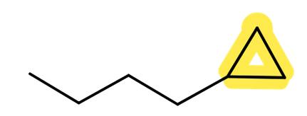
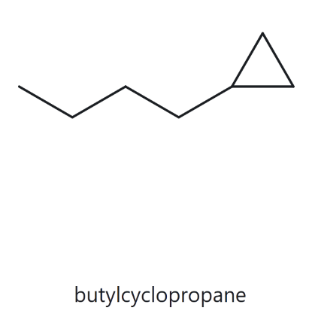
PART A
A10 -Challenge
Structure
Name
Counted Formula: C7H14
2
PART A
1
NUMBERED PARENT
NAMING TRAIL
Parent: a ring is present, so the ring is the parent, giving cyclopropane (3 C).
Numbering: one substituent only, so no locant is needed.
Substituents: butyl (4 C straight chain).
2
1
3
PART B
TO BE CONTINUED
3
MY NAME (WRITTEN FIRST)
4
THE ALKANE CHECK
butylcyclopropane
TO BE CONTINUED
C7H14
Returned name: butylcyclopropane
IT’S A MATCH!
TO BE CONTINUED
VERIFICATION STRIP
longest chain confirmed
alphabetical order
formula counted
lowest locants
punctuation

Slide 12
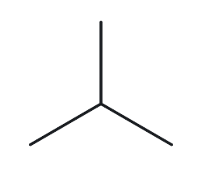
PART B
B01 -Foundation
Name
Structure
2-methylpropane
2
PART A
1
NAME DECODED
BOND LINE STRUCTURE
THE ALKANE
Parent: propane → 3 carbon, chain
Substituents: methyl on C2
Expected formula:
3 C + 1 C = 4 C → C₄H₁₀
PART B
TO BE CONTINUED
3
FORMULA CHECK
4
BACK ─ CHECK
Counted from the drawing: C4H10
Open Chain: CₙH₂ₙ₊₂,
n = 4: C₄H₁₀ ✓
Returned by The Alkane:
2-methylpropane
TO BE CONTINUED
IT’S A MATCH!
Same as the given name!
TO BE CONTINUED
VERIFICATION STRIP
parent length match
formula agrees
substituents position match
back - check recorded

Slide 13
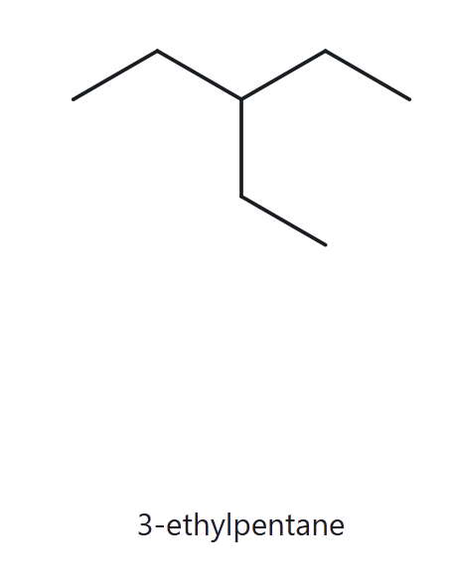
PART B
B02 -Foundation
Name
Structure
3-ethylpentane
2
PART A
1
NAME DECODED
BOND LINE STRUCTURE
THE ALKANE
Parent:
pentane → 5 carbon
Substituents:
ethyl on C3
Expected formula:
5 C + 2 C = 7 C
→ C₇H₁₆
PART B
TO BE CONTINUED
3
FORMULA CHECK
4
BACK ─ CHECK
Counted from the drawing: C₇H₁₆
Open Chain: CₙH₂ₙ₊₂,
n = 7: C₇H₁₆ ✓
Returned by The Alkane:
3-ethylpentane
TO BE CONTINUED
IT’S A MATCH!
Same as the given name!
TO BE CONTINUED
VERIFICATION STRIP
parent length match
formula agrees
substituents position match
back - check recorded

Slide 14
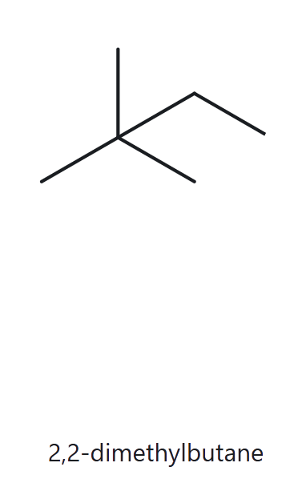
PART B
B03 -Foundation
Name
Structure
2,2-dimethylbutane
2
PART A
1
NAME DECODED
BOND LINE STRUCTURE
THE ALKANE
Parent:
butane → 4 carbon
Substituents:
2 × methyl on C2
Expected formula:
4 C + 2 C = 6 C
→ C₆H₁₄
PART B
TO BE CONTINUED
3
FORMULA CHECK
4
BACK ─ CHECK
Counted from the drawing: C₆H₁₄
Open Chain: CₙH₂ₙ₊₂,
n = 6: C₆H₁₄ ✓
Returned by The Alkane:
2,2-dimethylbutane
TO BE CONTINUED
IT’S A MATCH!
Same as the given name!
TO BE CONTINUED
VERIFICATION STRIP
parent length match
formula agrees
substituents position match
back - check recorded

Slide 15
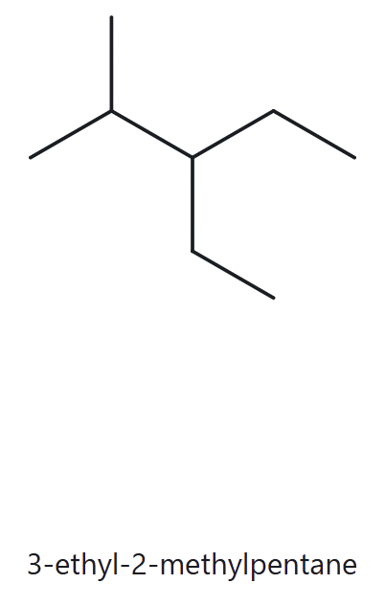
PART B
B04 -Developing
Name
Structure
3-ethyl-2-methylpentane
2
PART A
1
NAME DECODED
BOND LINE STRUCTURE
THE ALKANE
Parent:
pentane → 5 carbon
Substituents: methyl on C2, ethyl on C3
Expected formula:
5 C + 1 C + 2 C = 8 C → C₈H₁₈
PART B
TO BE CONTINUED
3
FORMULA CHECK
4
BACK ─ CHECK
Counted from the drawing: C₈H₁₈
Open Chain: CₙH₂ₙ₊₂,
n = 8: C₈H₁₈ ✓
Returned by The Alkane:
3-ethyl-2-methylpentane
TO BE CONTINUED
IT’S A MATCH!
Same as the given name!
TO BE CONTINUED
VERIFICATION STRIP
parent length match
formula agrees
substituents position match
back - check recorded

Slide 16
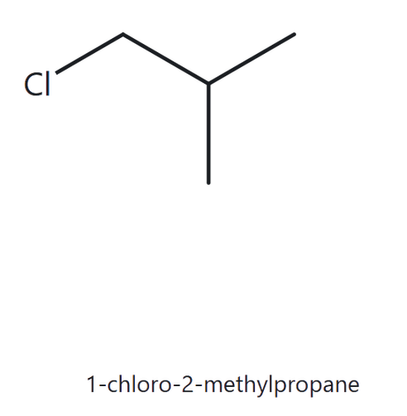
PART B
B05 -Developing
Name
Structure
1-chloro-2-methylpropane
2
PART A
1
NAME DECODED
BOND LINE STRUCTURE
Parent:
propane → 3 carbon
Substituents: chloro on C1, methyl on C2
Expected formula:
3 C + 1 C = 4 C
→ C₄H₁₀, Cl replaces one H → C₄H₉Cl
THE ALKANE
PART B
TO BE CONTINUED
3
FORMULA CHECK
4
BACK ─ CHECK
Counted from the drawing: C₄H₉Cl
Open Chain: CₙH₂ₙ₊₂,
n = 4: C₄H₁₀, minus one H for Cl = C₄H₉Cl ✓
Returned by The Alkane:
1-chloro-2-methylpropane
TO BE CONTINUED
IT’S A MATCH!
Same as the given name!
TO BE CONTINUED
VERIFICATION STRIP
parent length match
formula agrees
substituents position match
back - check recorded

Slide 17
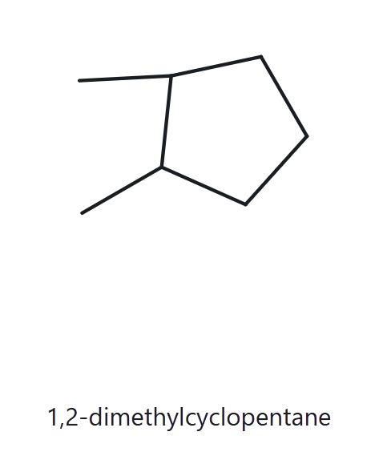
PART B
B06 -Developing
Name
Structure
1,2-dimethylcyclopentane
2
PART A
1
NAME DECODED
BOND LINE STRUCTURE
Parent:
cyclopentane → 5 carbon, ring
Substituents: methyl on C1 and C2
Expected formula:
5 C + 2 C = 7 C; one ring
→ C₇H₁₄
THE ALKANE
PART B
TO BE CONTINUED
3
FORMULA CHECK
4
BACK ─ CHECK
Counted from the drawing: C₇H₁₄
One ring: CₙH₂ₙ,
n = 7: = C₇H₁₄ ✓
Returned by The Alkane:
1,2-dimethylcyclopentane
TO BE CONTINUED
IT’S A MATCH!
Same as the given name!
TO BE CONTINUED
VERIFICATION STRIP
parent length match
formula agrees
substituents position match
back - check recorded

Slide 18
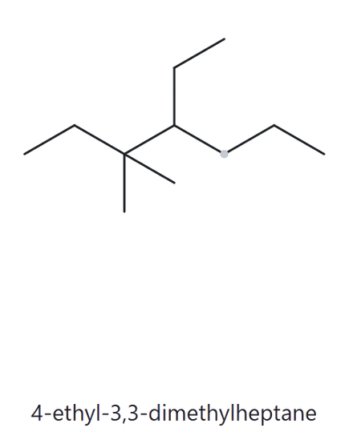
PART B
B07 -Developing
Name
Structure
4-ethyl-3,3-dimethylheptane
2
PART A
1
NAME DECODED
BOND LINE STRUCTURE
THE ALKANE
Parent:
heptane → 7 carbon
Substituents: 2 × methyl on C3, ethyl on C4
Expected formula:
7 C + 2 C + 2 C = 11 C
→ C₁₁H₂₄
PART B
TO BE CONTINUED
3
FORMULA CHECK
4
BACK ─ CHECK
Counted from the drawing: C₁₁H₂₄
Open Chain: CₙH₂ₙ₊₂,
n = 11: = C₁₁H₂₄ ✓
Returned by The Alkane:
4-ethyl-3,3-dimethylheptane
TO BE CONTINUED
IT’S A MATCH!
Same as the given name!
TO BE CONTINUED
VERIFICATION STRIP
parent length match
formula agrees
substituents position match
back - check recorded

Slide 19
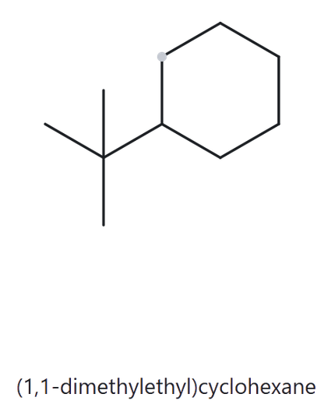
PART B
B08 - Challenge
Name
Structure
tert-butylcyclohexane
2
PART A
1
NAME DECODED
BOND LINE STRUCTURE
Parent:
cyclohexane → 6 carbon, ring
Substituents: tert-butyl (4 C) on C1
Expected formula:
6 C + 4 C = 10 C; one ring → C₁₀H₂₀
THE ALKANE
PART B
TO BE CONTINUED
3
FORMULA CHECK
4
BACK ─ CHECK
Returned by The Alkane:
Counted from the drawing: C₁₀H₂₀
One ring: CₙH₂ₙ,
n = 10: = C₁₀H₂₀ ✓
(1,1-dimethylethyl)cyclohexane
TO BE CONTINUED
IT’S A MATCH!
Same compound, different accepted substituent name.
According to Appendix B.3 (Substituent Names and Their Equivalents), tert-butyl is the common name, while the Alkane website uses 1,1-dimethylethyl, which is its systematic equivalent.
TO BE CONTINUED
VERIFICATION STRIP
parent length match
formula agrees
substituents position match
back - check recorded

Slide 20
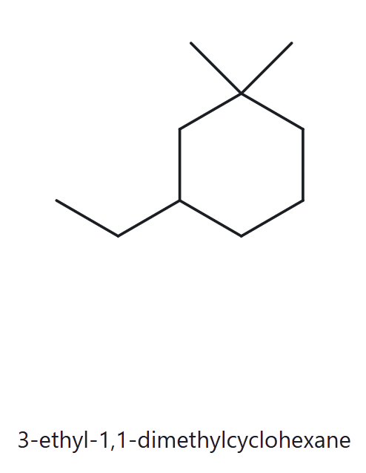
PART B
B09 - Challenge
Name
Structure
3-ethyl-1,1-dimethylcyclohexane
2
PART A
1
NAME DECODED
BOND LINE STRUCTURE
THE ALKANE
Parent:
cyclohexane → 6 carbon, ring
Substituents: 2 × methyl on C1, ethyl on C3
Expected formula:
6 C + 2 C + 2 C = 10 C; one ring → C₁₀H₂₀
PART B
TO BE CONTINUED
3
FORMULA CHECK
4
BACK ─ CHECK
Counted from the drawing: C₁₀H₂₀
One ring: CₙH₂ₙ,
n = 10: = C₁₀H₂₀ ✓
Returned by The Alkane:
3-ethyl-1,1-dimethylcyclohexane
TO BE CONTINUED
IT’S A MATCH!
Same as the given name!
TO BE CONTINUED
VERIFICATION STRIP
parent length match
formula agrees
substituents position match
back - check recorded

Slide 21
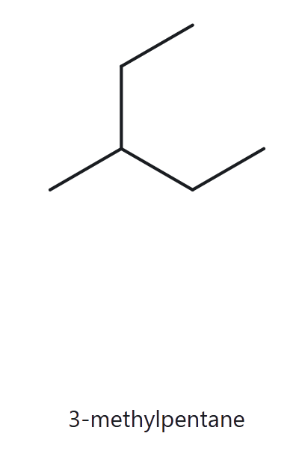
PART B
B10 - Challenge
Name
Structure
2-ethylbutane
2
PART A
1
NAME DECODED
BOND LINE STRUCTURE
THE ALKANE
Parent:
butane → 4 carbon
Substituents: ethyl on C2 of butane
Expected formula:
4 + 2 = 6 C → C₆H₁₄
PART B
TO BE CONTINUED
3
FORMULA CHECK
4
BACK ─ CHECK
Returned by The Alkane:
Counted from the drawing: C₆H₁₄
Open Chain: CₙH₂ₙ+2,
n = 6: C₆H₁₄ ✓
3-methylpentane
TO BE CONTINUED
IT’S NOT A MATCH!
Not same as the given name!
The ethyl group extends the longest chain to 5 carbons, making pentane the parent chain. The remaining methyl group is attached to C3. Thus, the correct IUPAC name is 3-methylpentane. The mistake was failing to identify the longest continuous chain.
TO BE CONTINUED
VERIFICATION STRIP
parent length match
formula agrees
substituents position match
back - check recorded

