Slide 1




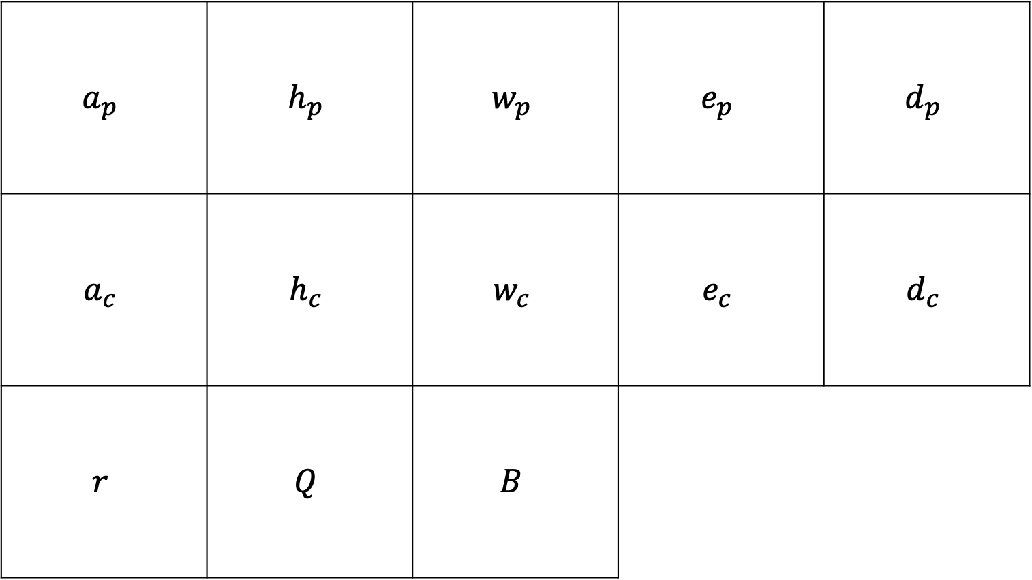
$$a_{p}$$ | $$h_{p}$$ | $$w_{p}$$ | $$e_{p}$$ | $$d_{p}$$
$$a_{c}$$ | $$h_{c}$$ | $$w_{c}$$ | $$e_{c}$$ | $$d_{c}$$
$$r$$ | $$Q$$ | $$B$$
A
B
NA
NA
C

