Slide 2
Newton Raphson
Binary Search
O(log(n)) time,
O(1) space
Find the sqrt

Slide 3
Jax
- Device agnostic - doesn’t require you to specify the what device an array needs to be completed in unlike PyTorch – but this means you can’t query the data as easily when it is being handled
backed by a memory buffer on a single device (CPU, GPU etc.)
Asynchronous dispatch – allows python code to run ahead of the accelerator so that the accelerator doesn’t have to wait
Jaxpr tells you what the XLA computational graph looks like i.e. the instructions being performed for the traced objects. Also can be used to write generic functions e.g. inverse of any f given that we have a mapping of the different subfunctions defining f and their inverses

Slide 4
How do we run a program?

Slide 5
e.g. JIT compilation
Executed by a VM at run time (during program execution rather than before execution)
Source code
Intermediate representation:
e.g. Bytecode (instructions not understood by CPU)
Machine code
(.exe)
Compiled

Slide 6
Compiled |  | Interpreted |  | Compiled + Interpreted (JIT) e.g. bytecode
Once compiled it is ready to run | .exe not cross-platform e.g. Mac vs Windows | Cross-platform as provide source code only | Interpreter required
Often faster | Extra step as need to be compiled | Easier to debug | Often slower as does line by line execution
Source code is private so don’t need to send it to someone |  | Can be modified while running e.g can do stuff like classes | Source code will need to be public
 |  | Dynamically typed – type not known at runtime | Not memory efficient (see next slide)

Slide 7
Why is Python slower than C++?
Interpreted language – executes 1 line at a time
Not memory efficient uses C structs which are more complex than basic C structs, extra memory address layer for each variable and then extra memory on the heap for the values. Heap allocation of the values which are scattered in memory is also expensive unlike C++ where variables are defined inside the call stack and it is contiguous memory

Slide 8
Why is Python slower than C++?
Contiguous memory yields faster to access because of it fits into cache lines and you know the minimum number of page table lookups in the hardware.

Slide 9
Memory in Python

Slide 10
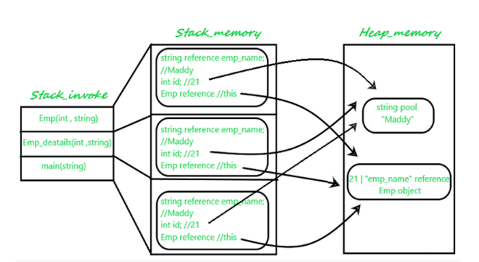
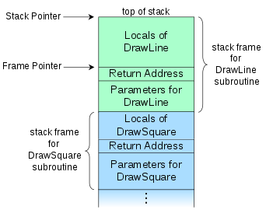
Python memory manager
Heap
Stores all objects and data structures (outside of function calls).
Memory is scattered around.
Memory is ‘freed’ at any time with garbage collector
Call stack
Each stack frame is unique to a function.
Contains references to objects in the heap.
Contiguous block of memory.
Memory is ‘freed’ after the execution of a function and the pointer moves back to the previous stack frame. LIFO structure.
Python memory manager communicates with the OS memory manager to ensure enough space to store all objects and data structures. There are different policies for different data types e.g. strings and ints.

Slide 11
Heap |  | Stack
Variables can be accessed globally. | Slower access as it is randomly scattered in memory. | Faster access as contiguous memory is allocated at the start. | Fixed amount of memory limits stack size.
No limit on memory size (usually much larger than stack). Memory is deallocated at whenever the garbage collector comes in and the reference count = 0. Memory can be allocated flexibly. | python memory manager handles the memory usage. You do not get manual control. Can get memory leaks if not managed well e.g. trying to call C malloc (& not going through python MM). | Don’t need to deallocate variables as the pointer is automatically moved to the return address after each function call. | Local variables only?
 | Not as safe as is visible to all threads. | Safer because only 1 thread has access to it.
Note: Every object in python is stored in the heap and all objects are created from the heap. In python the call stack contains references to objects in the heap. In C++ this is different. All dynamically allocated objects that are created using e.g. malloc are stored in a heap whereas local variables of functions are stored in a call stack.
https://stackoverflow.com/questions/11688647/python-creates-everything-from-heap

Slide 12
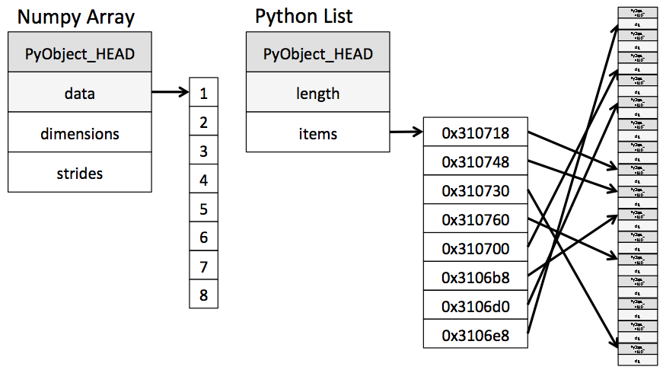
The total memory for a python list:
Pyobject (56 bytes)
Memory addresses (8 bytes for each item in list)
Memory for each variable e.g. float, int etc.

Slide 13
Object/Operation | Mutatable or not
Int e.g 2
List
Numpy array
Dictionary
Y = Y + [10]
y.append(10)
Object/Operation | Mutatable or not
X = 2 X += 2
y.sort()
sorted(y)
If a is a list a += [1,2,3]
If a is a list a.extend([1,2,3])
If a is a tuple a += (1,2,3)
If not mutable then it creates a new object!

Slide 14
Object/Operation | Mutatable or not
Int e.g 2 | N
List | Y
Numpy array | Y
Dictionary | Y
Y = Y + [10] | N, creates new heap object
y.append(10) | Y
{1,2,3} | Y
Object/Operation | Mutatable or not
X = 2 X += 2 | N, creates new heap object
y.sort() | Y
sorted(y) | N, creates new heap object
If a is a list a += [1,2,3] | Y
If a is a list a.extend([1,2,3]) | Y
If a is a tuple a += (1,2,3) | N, creates new heap object
Operations can depend on the type!
Mutable operations on mutable objects (list, dict, set, etc.) will change the underlying object. For immutable objects a new object is created!
e.g.
y = {1,2,3}
ic(id(y))
y.add(7)
y
ic(id(y))

Slide 15
Named Tuple | Dataclass (mainly used to store data) | Class (more general)
Immutable | Immutable if set as frozen | Mutable
Not as easy to define type hints | Type hints | Type hints
Unpackable | Avoids boilerplate as automatically adds init and repr and other defaults | Repr default is not as easy to understand as dataclass
Comparable
Iterable
Standard methods e.g. hash, comparing are faster (written in C) | (written in python)
Space usage is less than dataclass | Time access is faster than named tuple

Slide 16
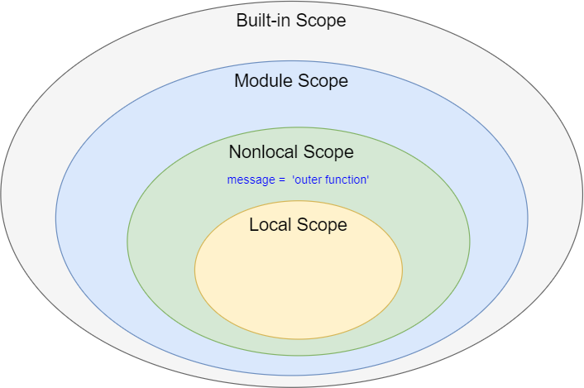
Looks at namespace in local scope
If can’t find, looks at name in nonlocal scope
If can’t find looks at global scope
If can’t find looks at built-in scope

Slide 17
Multithreading | Multiprocessing
Uses the same memory | Isolation (processes run in separate memory)
Less memory intensive | More memory intensive
Less overhead | More overhead
Restricted by GIL | Not really restricted by GIL
Faster to create and destroy | Slower to create and destroy
Programs are made of processes and threads. A process contains threads. Threads are the smallest executable unit of a process.

Slide 18
How does the computer allocate tasks?

Slide 19
VM
VM
VM
Hypervisor

Slide 20
VM
VM
VM
Hypervisor

Slide 21
How does computer memory work?

Slide 22
How does computer memory work?

Slide 23
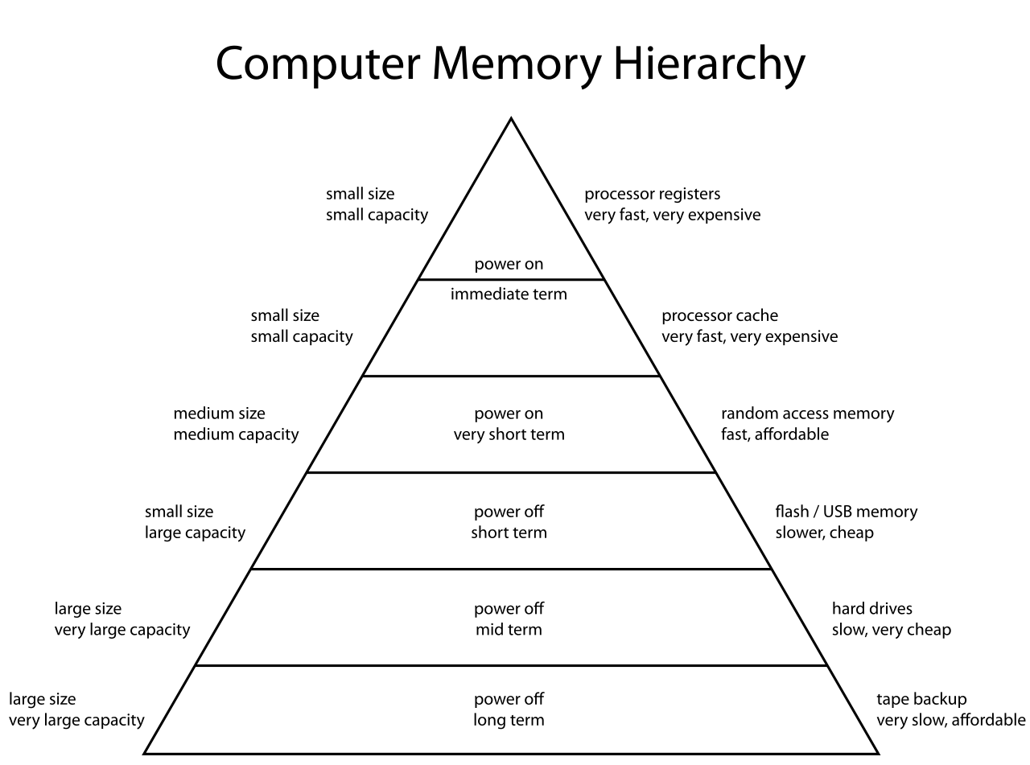
Otherwise known as main memory

Slide 24
Command line

Slide 25
Recursion

Slide 26
Call Stack
Local variables (could return None as a result to prev)
Return address (to previous)
parameters
def f(x):
if base:
return
…
(could specify a return statement or not)
…
Use a return xxx if you want to compute the saved value otherwise you can just omit the return statement in the body which by default will return None.
Local variables
Return address (to previous)
parameters
Local variables
Return address (to previous)
parameters
Local variables
Return address (to previous)
parameters

Slide 27
Interface

Slide 28
Interface: a description of actions you need for an object to be an “X”
E.g. if you want an object to act like a light you need to have turn_on() and turn_off() methods.
The purpose of an interface is to enforce these properties and to know that an object of Type T much have functions called X, Y, Z, etc.
An interface forms a contract. E.g. classes are interfaces

Slide 29
Latency and Bandwidth
Latency – how long it takes from when you send a request for data until the data arrives
Bandwidth – the rate at which data arrives after it has been requested

Slide 30
 | NLP | Time Series
Differences | Irregular dependence Don’t really need T+1 prediction. Just need 1:T output. | Seasonality Multivariate dependence
Similarities | - Sequential and rely on the past
What’s the context that is required for each time point? For NLP we have a window of words (inputs) that helps us determine what the word translation should be. How do we define this window length?
This is easier in time series because we can use spectral theory to determine the frequencies. However, can we still detect frequencies when we have an unfinished dataset?
My inputs for ts NN model have to be deterministic or known in advance…..
If my data changes frequency there is no way an ETS model or prophet model can capture the change because the frequency is determined before model fit…. A mixture of experts model will actually resolve this but we need to re-estimate the model for the whole ts from start up to the new point whereas if we use a RNN we can just add the knowledge of the change in frequency from Spectral info as inputs. A mixture of experts also depends on the number of models specified… but the tuning parameter will be expensive…….. The length of segment is crucial and if we have a small length then it will be a good estimate but will be very expensive, whereas if we have a large length the estimate might be bad… and will give us weird models…….. That also captures structural breaks…
Can we check whether the segment is fixed by the user or whether we can make it dynamic?

