Slide 1
A Beginner’s Guide to Cheminformatics with RDKit in Python
HSC Data Science Workshop October 2021

Slide 2
What will be covered
Overview of - Cheminformatics
- RDKit
Jupyter notebook - Simple RDKit functions - Small molecule EDA - ML model : Build a decision tree - Clustering
Lots of theory
Neural network
Graph convolution
Hyperparameter tuning
Missing data.
Notes:
My Goals:
Show you what’s possible

Slide 3
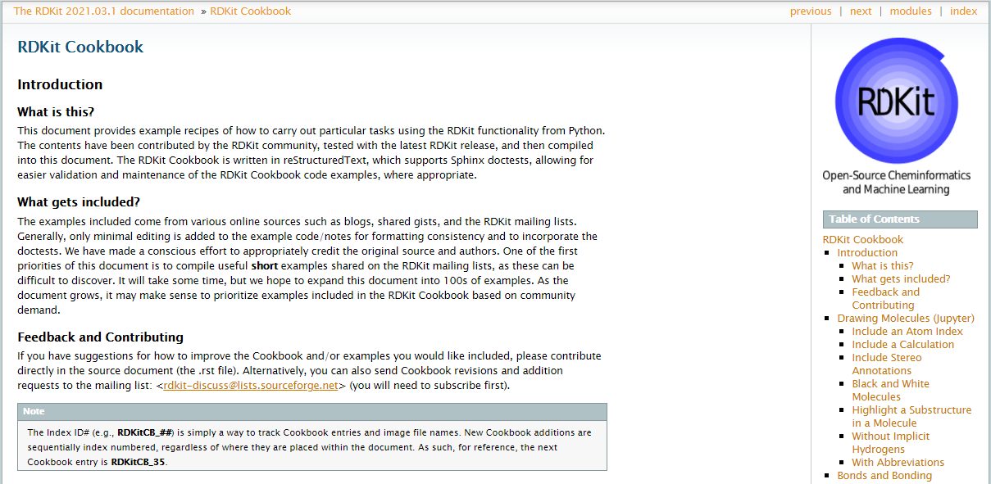
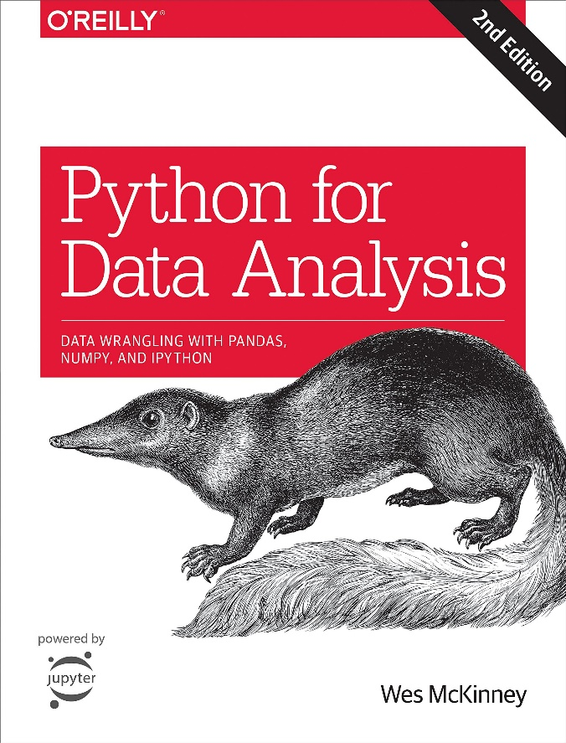
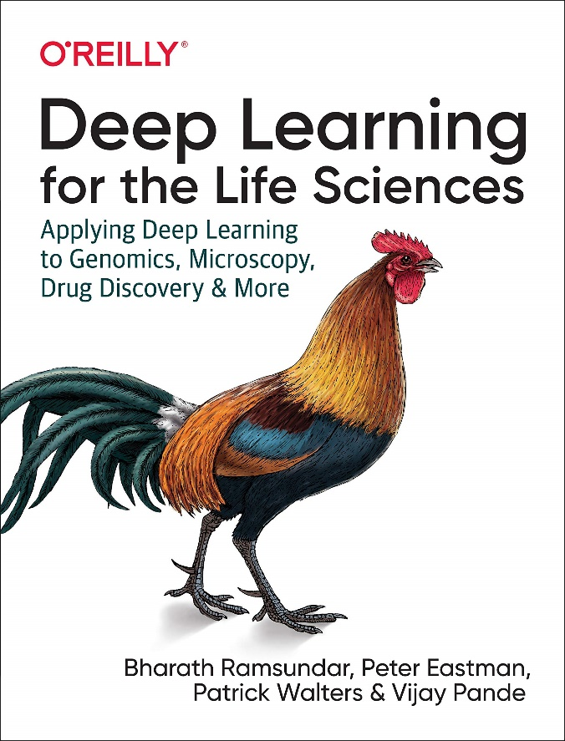
Useful resources
Useful blogs
Practical Cheminformatics – Pat Walters
Is life worth living – Iwatobipen
RDKit blog
Chem-workflows - Angel J. Ruiz Moreno
YouTube
Data Professor
Jan Jensen
Notes:
http://practicalcheminformatics.blogspot.co
https://iwatobipen.wordpress.com/
https://chem-workflows.com/
https://www.youtube.com/c/JanJensenCopenhagen/featured
https://www.youtube.com/c/DataProfessor/featured

Slide 4
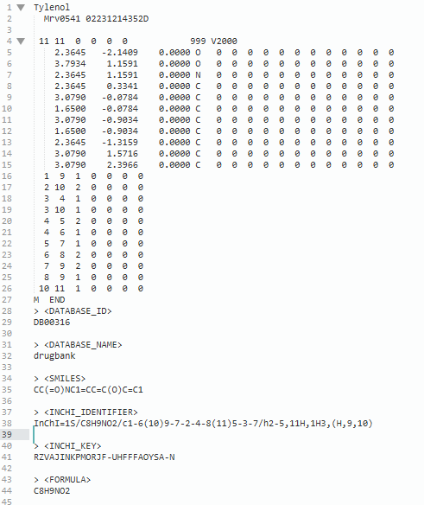
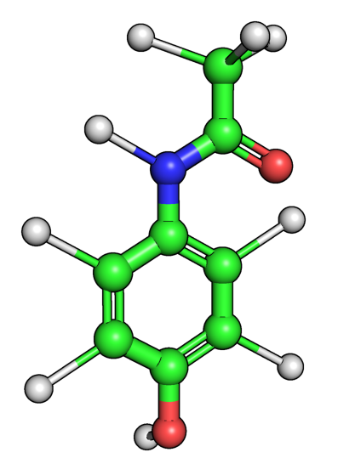
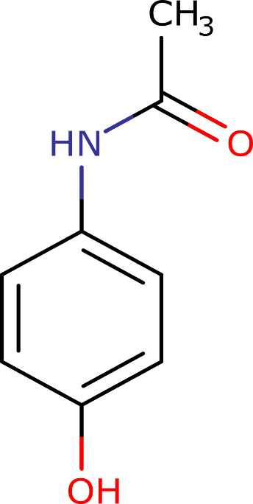
Representing molecules computationally
SMILES (Simplified Molecular Input Line Entry System)
SDF (Structure Data file)
CC(=O)NC1=CC=C(O)C=C1
Different molecular representations of Tylenol (Acetaminophen)
https://go.drugbank.com/drugs/DB00316

Slide 5
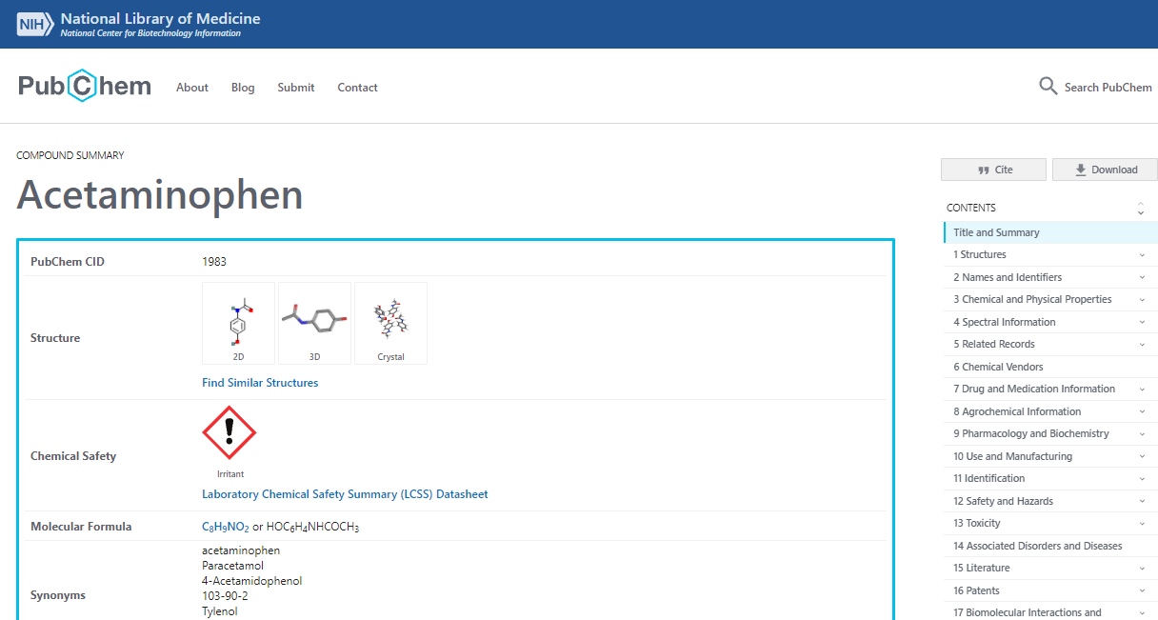
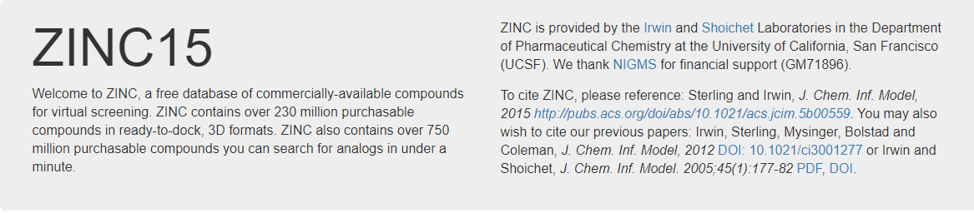
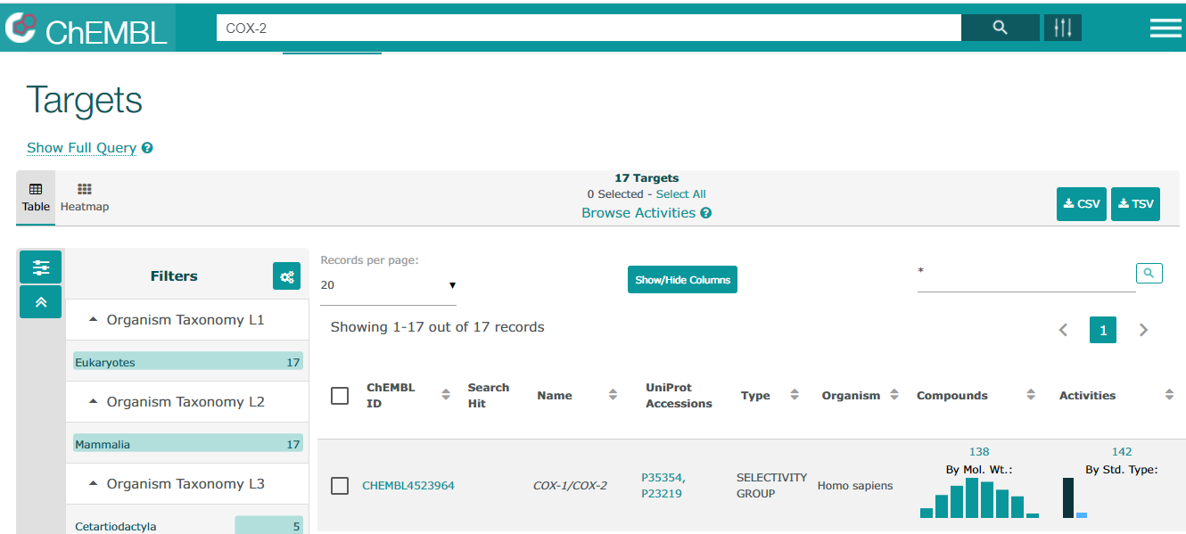
Chemical databases

Slide 6
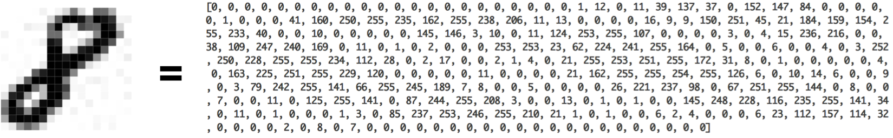
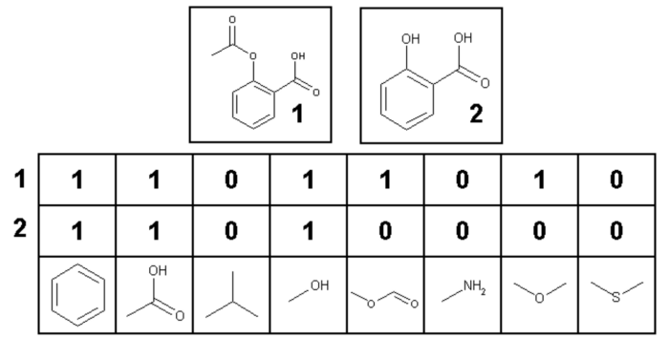
Vector representation of molecules
Images
Fingerprints
Descriptors
Mol. Weight
Partition coefficient(LogP)
# of aromatic rings
# of H-bonds donors # of H-bonds acceptors
Molecules:
Notes:
Molecular descriptors: MolWt, MLogP

Slide 7
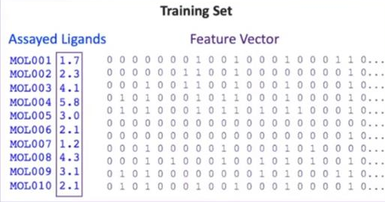
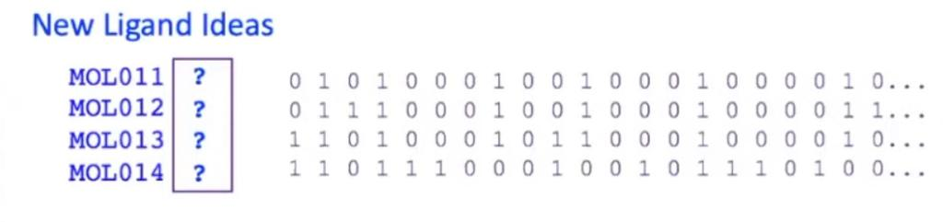
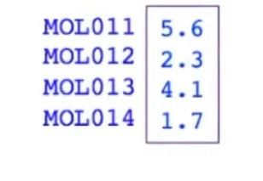
Training a machine learning model
Train
Machine Learning
Model
Predict

Slide 8
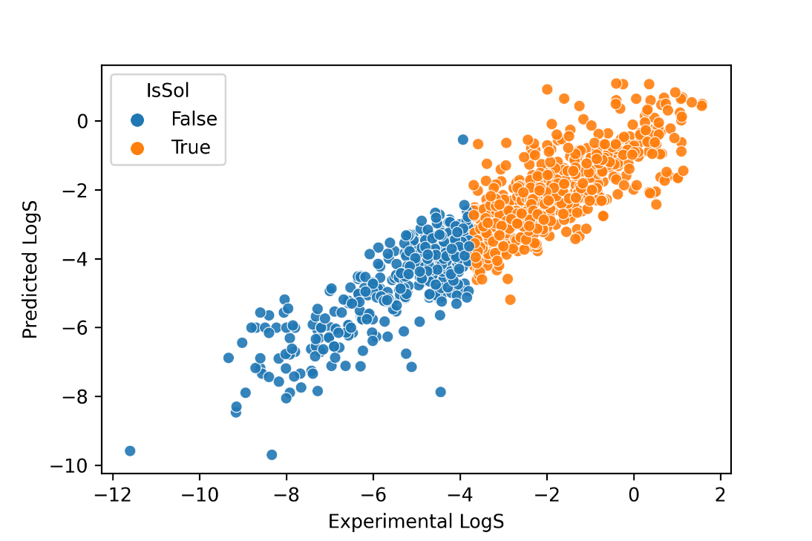
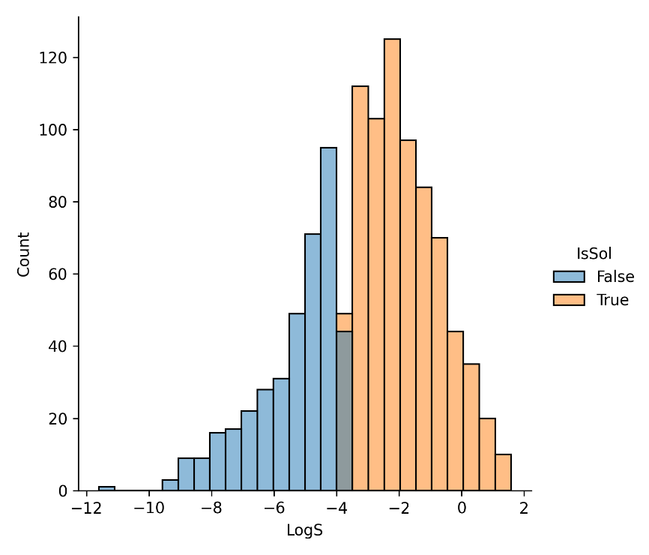
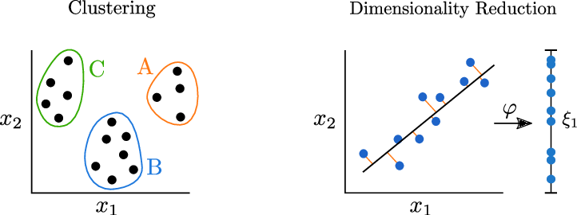
Prediction
Supervised
ML with
molecules:
Classification
Regression
Group and Understand
Unsupervised
Clustering
Dimensionality reduction

Slide 9

Overview of RDKit
Open source toolkit for cheminformatics
http://www.rdkit.org
Supports Mac/Windows/Linux
Core data structures and algorithms in C++
Python 3.x wrappers, Java and C# wrappers
Useful:
2D and 3D molecular operations
- Visualizing Molecules - Substructure Searching - Fingerprinting and Molecular Similarity
- Drawing Chemical Reactions
& many more functionality for Chemists.
Descriptor generation for machine learning
RDKit Cookbook :
https://www.rdkit.org/docs/Cookbook.html
Notes:
This document provides example recipes of how to carry out particular tasks using the RDKit functionality from Python.

Slide 10
Jupyter notebook in Google Colab
https://github.com/francisacquah466/DSW2021-Intro-to-Cheminformatics-ML
Go to the link above to the github repo for this workshop
Click on the Jupyter notebook link in your browser (with a gmail account)
When the notebook is opened in Google Colab: File >> Save a copy in Drive >> Done
Start running the code cells.

