Slide 1
Weekly Meeting
CCI
16 July 2024

Slide 2
Progress Summary
Supercells
Fixing Problems, Finding New
Changing Approach
- Realised all negative surface energies were arising when attempting supercell
- Found a supercell wasn’t being made
- Issues with MACE
- Going back to look at previous surfaces, not content with structures
- Looking at structures rather than focusing too heavily on MACE as when looking at EMT, energies are positive

Slide 3
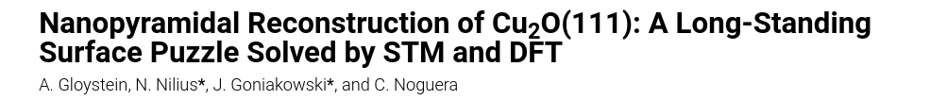
Looking at five structures:
- ST
- STO
- CuD
- CuD
- Pyramidal

Slide 4

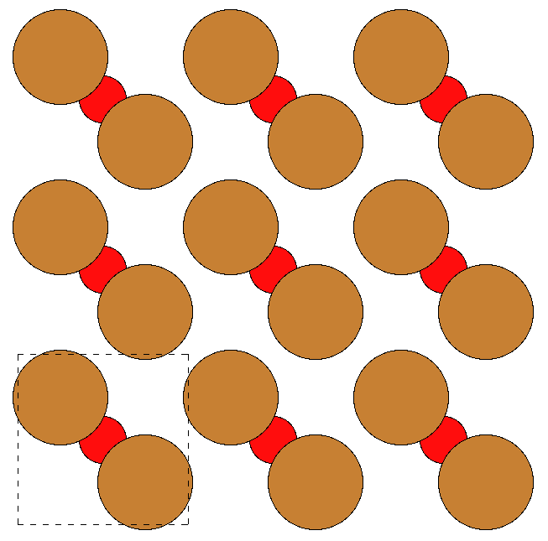
111 Bulk
- Relaxed with MACE ‘medium’ on local machine
- From this, the cu2o111 slab was made, which is the same as the ST surface
Kirfel, A.; Eichhorn, K.
Accurate structure analysis with synchrotron radiation. The electron density in Al2O3 and Cu2O

Slide 5
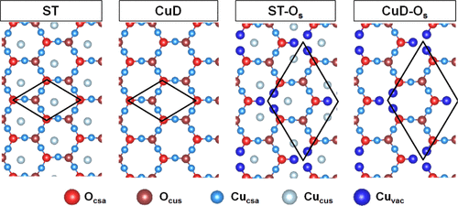
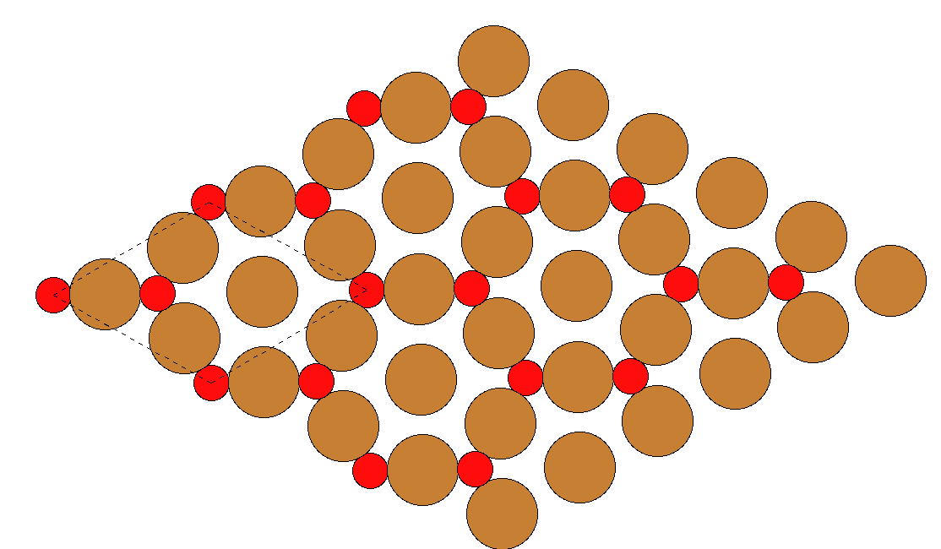

111 Surfaces - ST

Slide 6
111 Surfaces - ST
Number of Layers | Number of Oxygen Atoms | Surface Energy
3 | 6 | 0.0643035985393175
4 | 8 | 0.120870097035016
5 | 10 | 0.106735767093181
6 | 12 | 0.0645200186379872
7 | 14 | 0.064535191751129
8 | 16 | 0.121144730294905
9 | 18 | 0.0645590222157349
10 | 20 | 0.0645581940133474

Slide 7
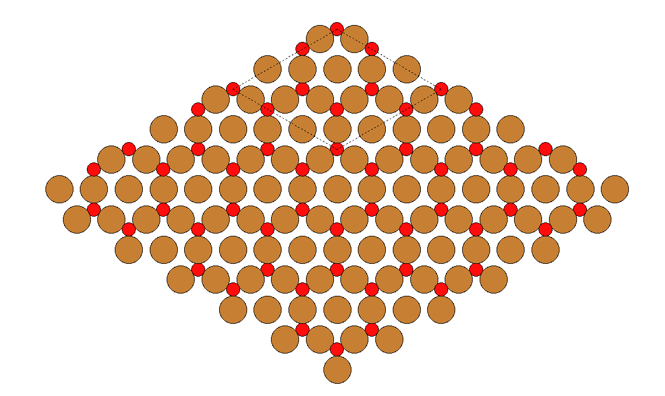

111 Surfaces - STO

Slide 8
111 Surfaces – STO with MACE as calculator
Number of Layers | Number of Copper Atoms | Number of Oxygen Atoms | Cleavage Energy
3 | 36 | 18 | -0.928691648916593
4 | 48 | 24 | -1.20181719797978
5 | 60 | 30 | -1.53366299865427
6 | 72 | 36 | -1.92420165720937
7 | 84 | 42 | -2.25615607807317
8 | 96 | 48 | -2.5295066077709
9 | 108 | 54 | -2.92009337187994
10 | 120 | 60 | -3.25206378687741

Slide 9
111 Surfaces – STO with EMT as calculator
Number of Layers | Number of Copper Atoms | Number of Oxygen Atoms | Cleavage Energy
3 | 36 | 18 | 0.854757520597337
4 | 48 | 24 | 1.12320982899979
5 | 60 | 30 | 1.40786979696792
6 | 72 | 36 | 1.70873742322481
7 | 84 | 42 | 1.9933973911932
8 | 96 | 48 | 2.2618497008731
9 | 108 | 54 | 2.56271732712999
10 | 120 | 60 | 2.84737729509831

Slide 10
111 Surfaces – STO
E_cleav = (E_slab - E_bulk * n_layers) / 2 / np.linalg.det(superslab.cell[:2, :2])

Slide 11
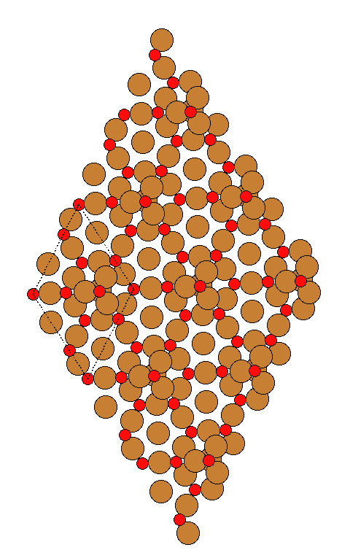

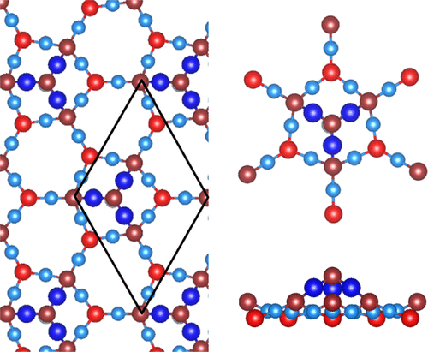
111 Surfaces – Pyramidal

Slide 12

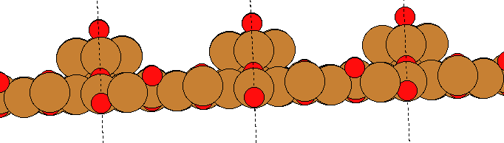
111 Surfaces – Pyramidal

Slide 13
111 Surfaces – Pyramidal
Number of Layers | Number of Copper Atoms | Number of Oxygen Atoms | Surface Energy
3 | 39 | 19 | 0.808227484758115
4 | 51 | 25 | 1.09722162907549
5 | 63 | 31 | 1.40982336753376
6 | 75 | 37 | 1.7327573585212
7 | 87 | 43 | 2.12910623335619
8 | 99 | 49 | 2.3639637220788
9 | 111 | 55 | 2.70000528092172
10 | 123 | 61 | 3.11195690379301

Slide 14
111 Surfaces – Summary
I feel confident with ST in its entirety currently
STO I feel the structure is approximately correct, but equation maybe is incorrect or highlights MACE issue
CuD I am not confident with the initial structure and feel I need to go away and make alterations outside of MACE
CuDO_s I think initial structure could be approximately correct but MACE relaxation causes big issues
Pyramidal, approximately correct structure and reasonable energies but if equation is wrong will need to re-evaluate

Slide 15
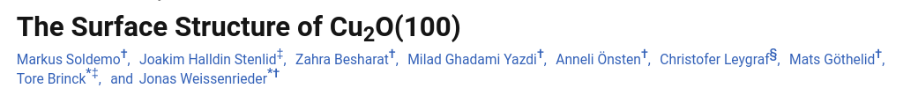
Looking at four structures:
- Oxygen Terminated
- Copper Terminated
- c(2x2)
- 3011

Slide 16
100 Bulk
- Relaxed with MACE ‘medium’ on local machine
- Same CIF file as 111 surfaces
Kirfel, A.; Eichhorn, K.
Accurate structure analysis with synchrotron radiation. The electron density in Al2O3 and Cu2O

Slide 17
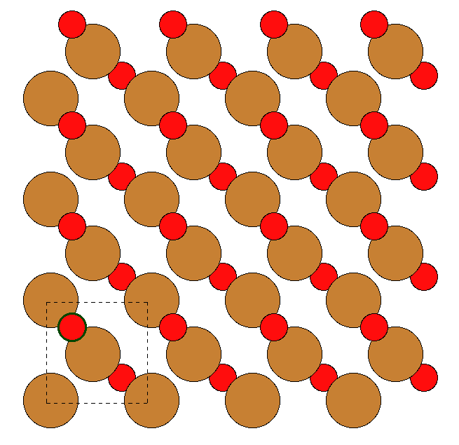
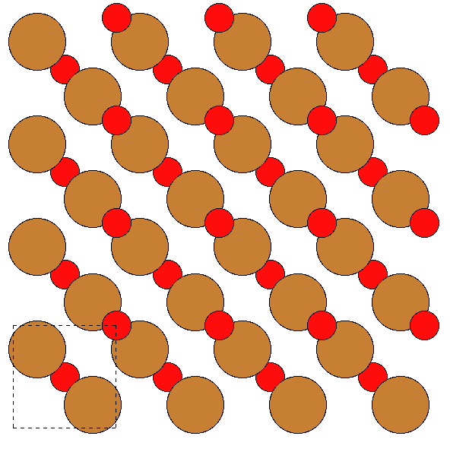
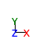
100 Surfaces – Oterm

Slide 18
100 Surfaces – Oterm
Number of Layers | Number of Oxygen Atoms | Surface Energy
3 | 6 | 0.0863168035600474
4 | 8 | 0.0863679781870212
5 | 10 | 0.0863818846562075
6 | 12 | 0.0863770420969357
7 | 14 | 0.0863731920472592
8 | 16 | 0.08637063769921
9 | 18 | 0.0863696780112139
10 | 20 | 0.0863693640639473

Slide 19
100 Surfaces – Summary
Confident with Oterm, intend to compare energies to paper structure
CuTerm isn’t quite right but this should be an easy fix
c(2x2) and 3011 is something that needs tackling. Will be able to go in being wary of MACE’s relaxation this time!

Slide 20
Summary Overall
Starting DFT calculations on the ones I am confident with!
Going back to tackle the remaining 111 and 100 surfaces

Slide 22
