Slide 1
Weekly Meeting
CCI
6 Aug 2024

Slide 2
Progress Summary
Fixed some structures
DFT!!!
As always, complications
- Began DFT calculations
- Looked at DFT scripts, ran bulk relaxations with DFT and progressing to slab energies
- started with single point, moving on to Esurf
- STO looks a lot better now
- Overall, confident in enough structures to proceed with workflow
- MBEEF and VDW. Wasn’t including dispersion effects so we changed to ‘MGGA_X_MBEEFVDW’
- Learning further about Slurm

Slide 3
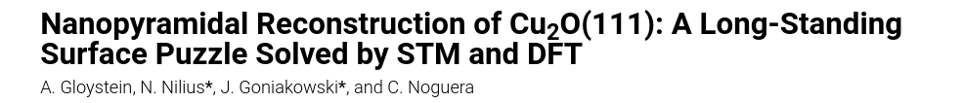
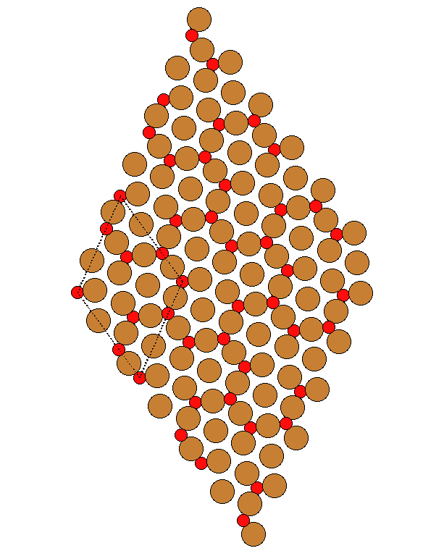
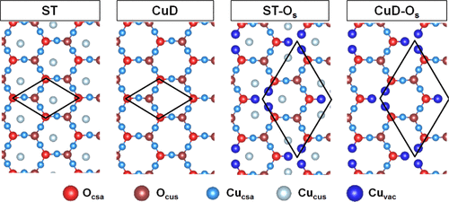
111 Surfaces - STO

Slide 4
111 Bulk – Testing varying Kgrid values
Potential E | CPU Time | Difference (Ev)
Kgrid 222
-185323.079 | 50.998 | 0.304
Kgrid 333
-185323.384 | 51.265 | 0.00682
Kgrid 433
-185323.390 | 51.076 | 0.00598
Kgrid 443
-185323.396 | 51.027 | 0.00508
Kgrid 444
-185323.401 | 50.941 | 0.00643
Kgrid 555
-185323.408 | 50.779 | 0.00129
Kgrid 666
-185323.409 | 51.827 | 0.000471
Kgrid 777
-185323.410 | 52.515 | -

Slide 5
DFT with 111 Surfaces - ST
Nlayers | CPU time | Eslab (single)
3 | 69.894 | -555608.226
4 | 108.384 | -740812.271
5 | 150.811 | -926016.313
6 | 214.785 | -1111220.355
7 | 270.932 | -1296424.397
8 | 331.965 | -1481628.439
9 | 436.599 | -1666832.481
10 | 496.688 | -1852036.523

Slide 6
DFT with 111 Surfaces - ST
N Layers | Esurf
3 | 5.986
4 | 7.954
5 | ?

Slide 7
Currently in Progress
100 Surfaces
ST
Running until Esurf converges
STO & Py
Getting started on single points and running calculations to get relaxed energies of slab
111
Oterm and Cuterm
Single point calculations
3011
This is a crucial surface but I am really not sure where to begin here

Slide 8
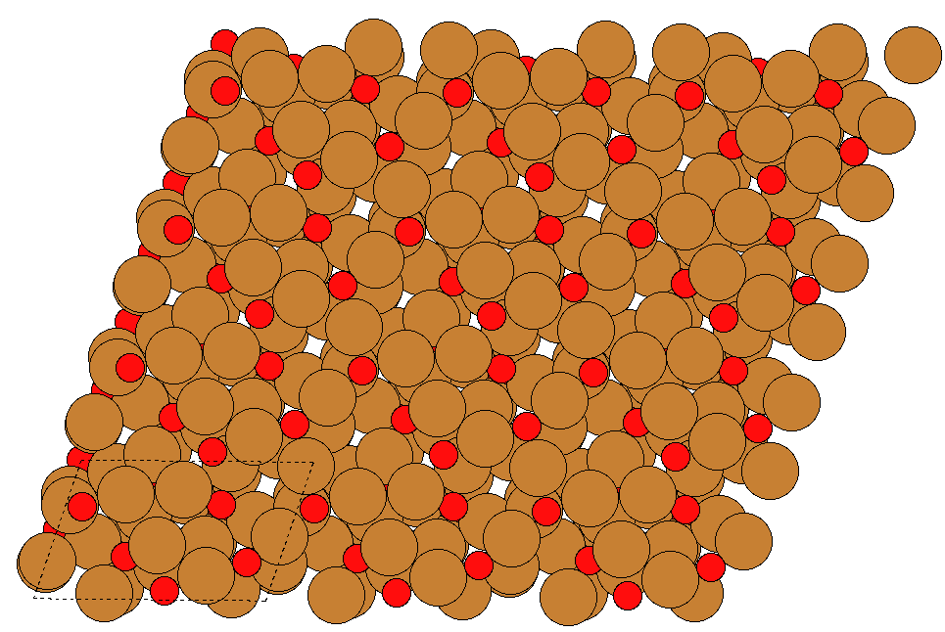
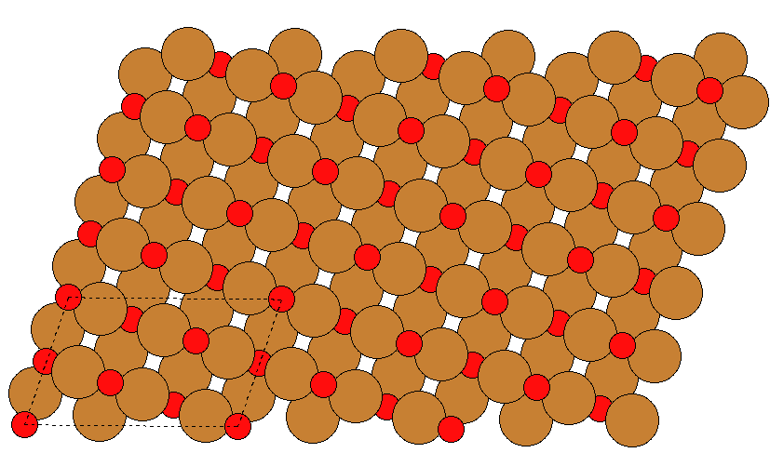

Future Work – 100 Surfaces 3011
- Papers Cu36 and O18
- Mine with 3 layers Cu36 and O18

Slide 9
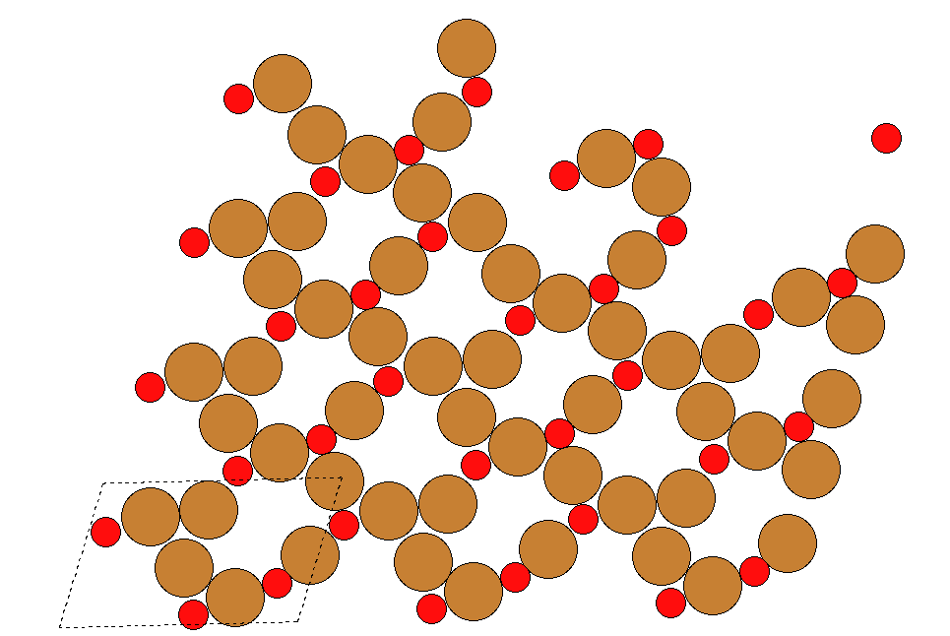
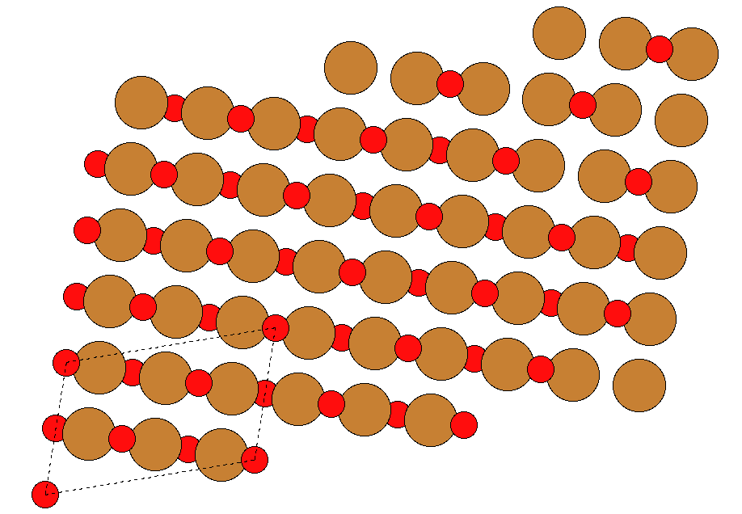
Future Work – 100 Surfaces 3011

Slide 10
