Slide 1
Weekly Meeting
CCI
16 July 2024

Slide 2
Progress Summary
Completing MACE Calculations
Hawk
Finding issues
- Colab’s usage limits
- Created python scripts of notebooks and running on Hawk’s GPUs
- Convergence issues, switched to MDMin rather than LBFGs
- Half of the results are reasonable, half given negative Esurf
- Py111 is getting stuck on Hawk at same point
- 3011

Slide 3
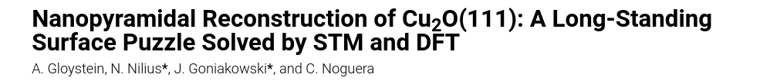
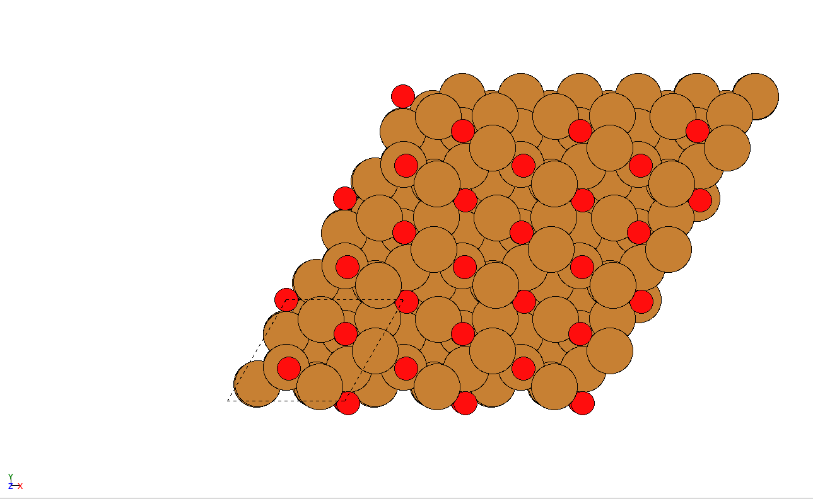
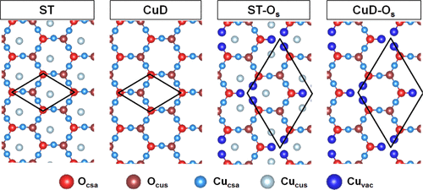
111 Surfaces - CuD
Number of Layers | Number of Oxygen Atoms | Surface Energy
3 | 6 | 0.15416508443751
4 | 8 | 0.183357653680009
5 | 10 | 0.352855734115526
6 | 12 | 0.346735474351216
7 | 14 | 0.230233310666001
8 | 16 | 0.296124771050448
9 | 18 | 0.346855030919947
10 | 20 | 0.22638172801723

Slide 4
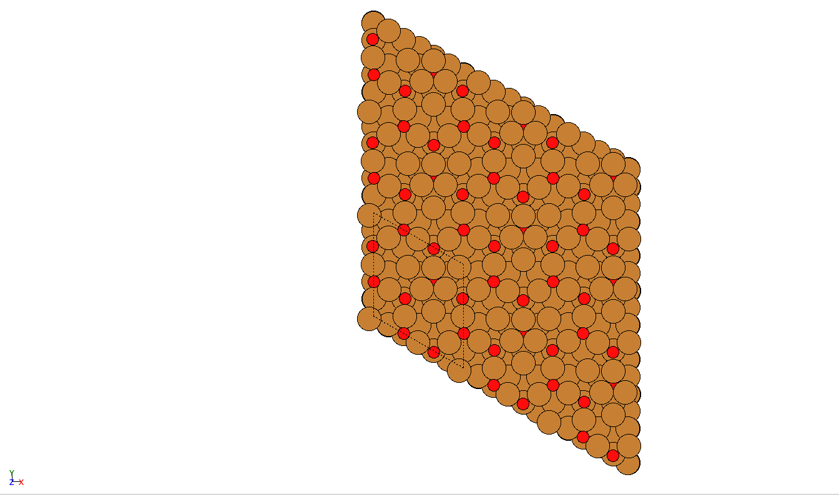
111 Surfaces - STO
Number of Layers | Number of Oxygen Atoms | Surface Energy
3 | 17 | -0.89473429434951
4 | 23 | -1.19924660179911
5 | 29 | -1.51698125223084
6 | 35 | -1.88952778122397
7 | 41 | -2.22161903540179
8 | 47 | -2.52544844020025
9 | 53 | -2.88493624351716
10 | 59 | -3.21663130296169

Slide 5
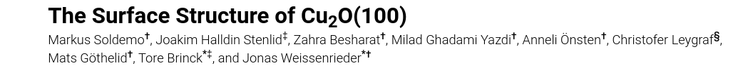
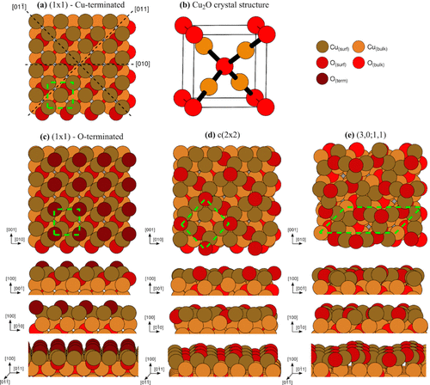
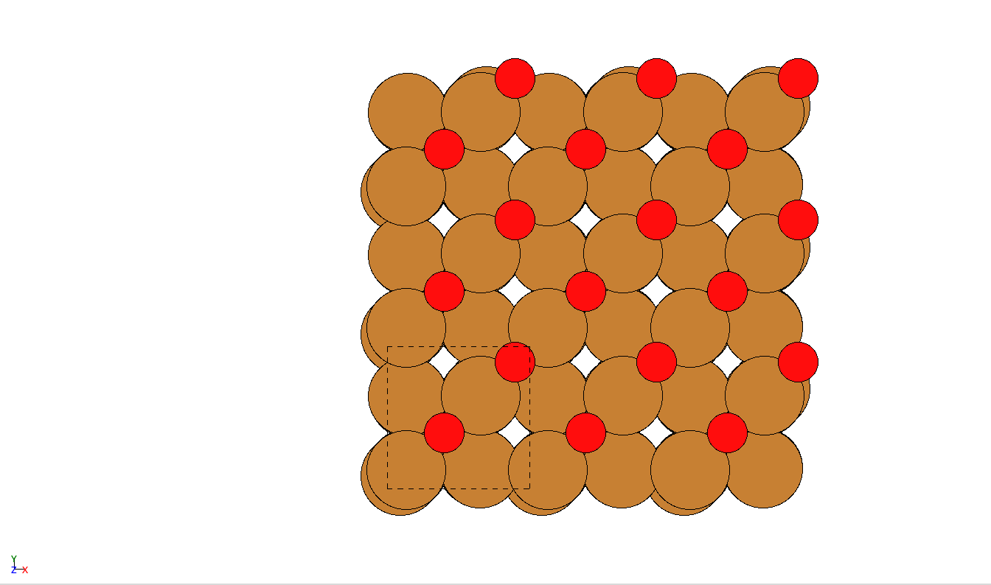
100 Surfaces - Oterm
Number of Layers | Number of Oxygen Atoms | Surface Energy
3 | 6 | 0.217057754797947
4 | 8 | 0.238842434934108
5 | 10 | 0.217130908792016
6 | 12 | 0.238851209372439
7 | 14 | 0.333070469351174
8 | 16 | 0.238865206707302
9 | 18 | 0.217131593010626
10 | 20 | 0.393892033967003

Slide 6
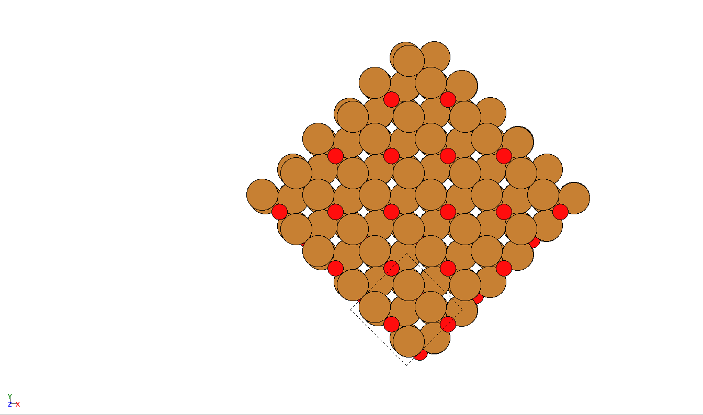
100 Surfaces - c2x2
Number of Layers | Number of Oxygen Atoms | Surface Energy
3 | 8 | -0.344793316862565
4 | 12 | -1.02176404901413
5 | 18 | -1.63689048363973
6 | 18 | -1.45254819345539
7 | 24 | -2.06768823714255
8 | 26 | -2.31414604179933
9 | 32 | -2.92928313606701
10 | 34 | -3.17570040521406

Slide 7
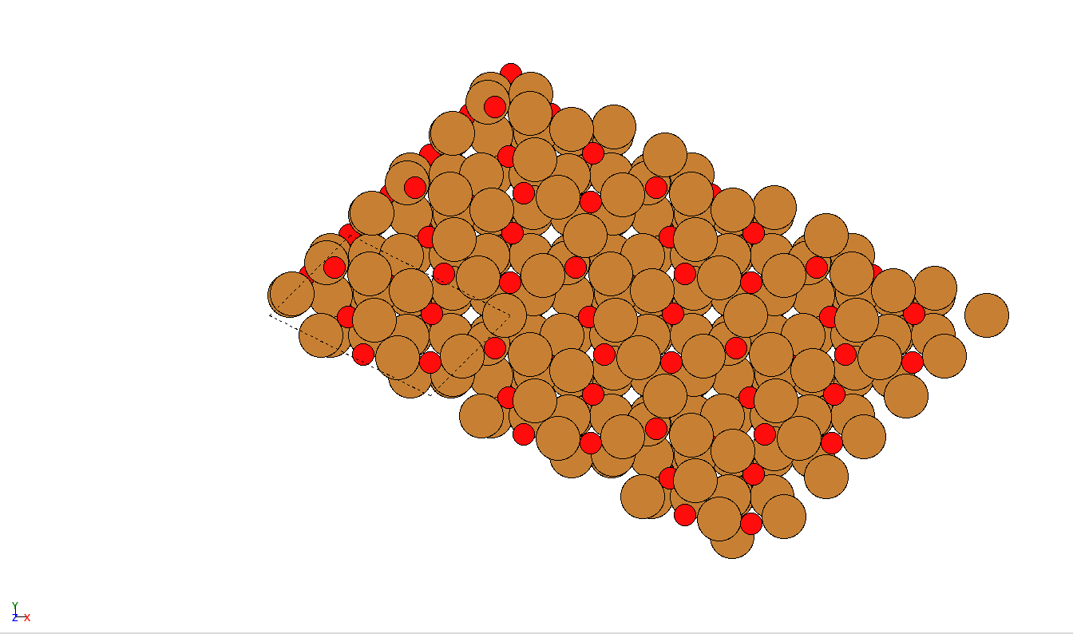
Next Steps - 3011
- Remake supercell with (2,-1,1,1)
- Compare surface energies of mine and theirs

Slide 8
Next Steps - DFT

Slide 11
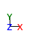
111 Surfaces - ST
Number of Layers | Number of Oxygen Atoms | Surface Energy
3 | 17 | -0.89473429434951
4 | 23 | -1.19924660179911
5 | 29 | -1.51698125223084
6 | 35 | -1.88952778122397
7 | 41 | -2.22161903540179
8 | 47 | -2.52544844020025
9 | 53 | -2.88493624351716
10 | 59 | -3.21663130296169

