Slide 1

Jenkins

Slide 2
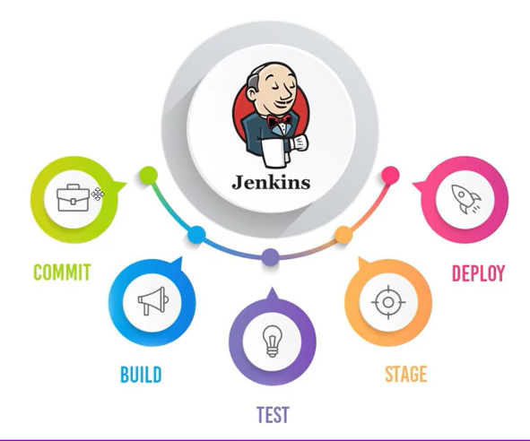
What is Jenkins?
Its an open source automation server which enables the developer around the world to reliably build, test and deploy their software.
Jenkins can be setup on the cloud or any
other machine where automation script
need to executed and can be triggered
using Jenkins build.
Jenkins builds can be schedule to run on
daily basis and this way Jenkins automates
the automation process.

