Slide 1
GIT & GitHub Repository

Slide 2
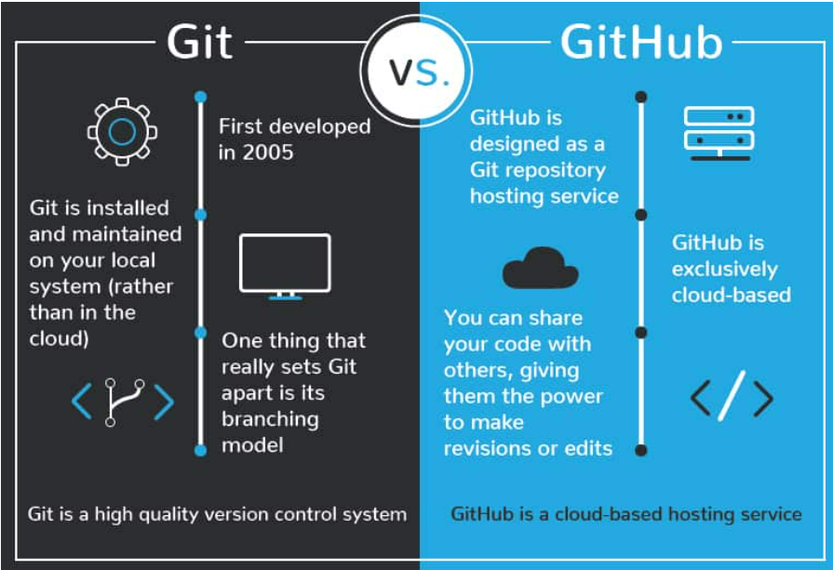
GIT – Version Control System
GIT – Is a version control system that lets you manage and keep track of your source code history.
Version control system is like a save a
program for your project. By tracking and
logging the changes made on the file/files
sets over time, a version-control system gives
you the power to review or even restore
earlier version.

Slide 3
GITHub - Repository
GITHub is designed as a GIT repository hosting service.
GIT repository hosting service, its an online database that allows to keep track of the changes from you or other changes from any part of the world.
Repository is usually used to organize a single project. Repository can contain folders and files, images, videos, spreadsheets and data sets.

Slide 4
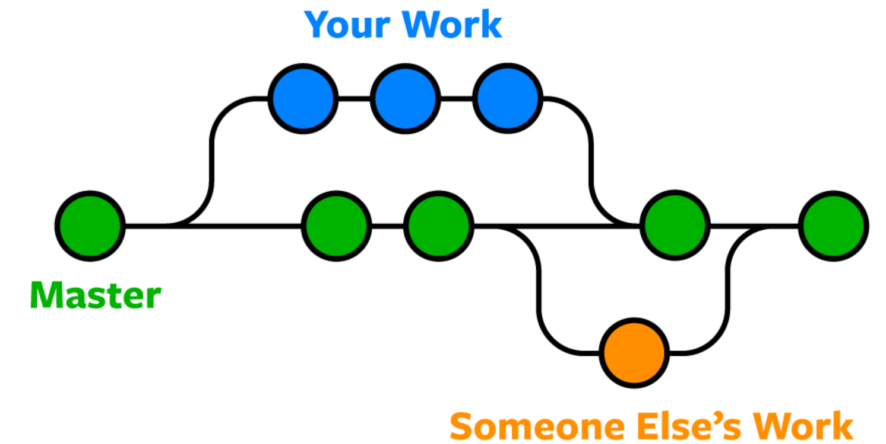
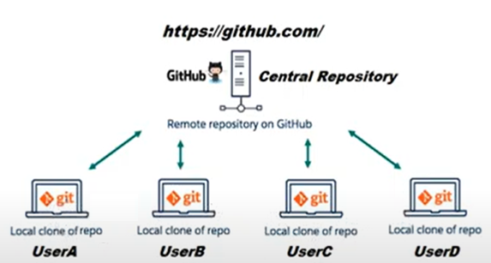
Git Flow

Slide 5
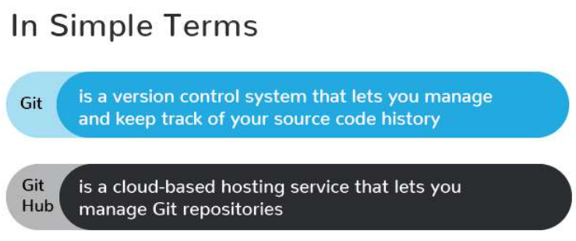
Simple term – GIT vs GITHub
Difference between GIT vs GITHub.

Slide 6

Download – GIT version control tool
Git version control tool to maintain the GIT version.
Link -> https://git-scm.com/download/win
Once installed, to check the version,
In the CMD prompt, type > git –version

Slide 7
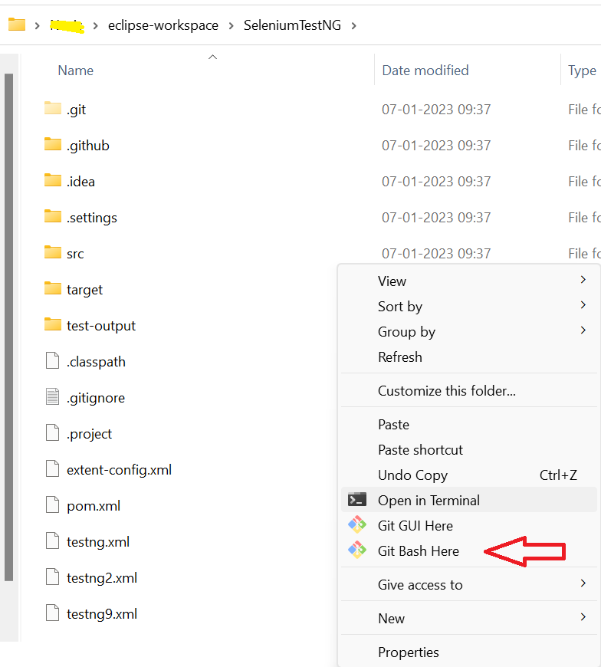
Add files to GITHub
Browse to path and select the
“Git Bash Here” and follow below commands,
git init - To create new Git repository
git add – To add the code in the branch
git commit – To commit the changes
git push – Push the code to repository

Slide 8



Add GitHub project in eclipse
In the search, type the “Git Repository”.
Click the Icon “New Repository”.
Right click Git Repository and click
commit and the push the code.
Point to origin and the code will be
pushed to origin.

