Slide 1

Jenkins

Slide 2
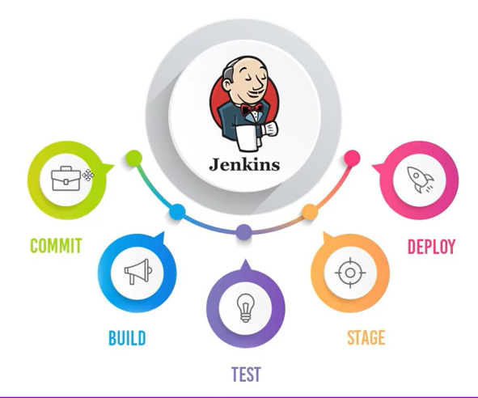
What is Jenkins?
It’s a leading open source automation server which enables the developer around the world to reliably build, test and deploy their software.
Jenkins can be setup on the cloud or any
other machine where automation script
need to executed and can be triggered
using Jenkins build.
Jenkins builds can be schedule to run on
daily basis and this way Jenkins automates
the automation process.

Slide 3
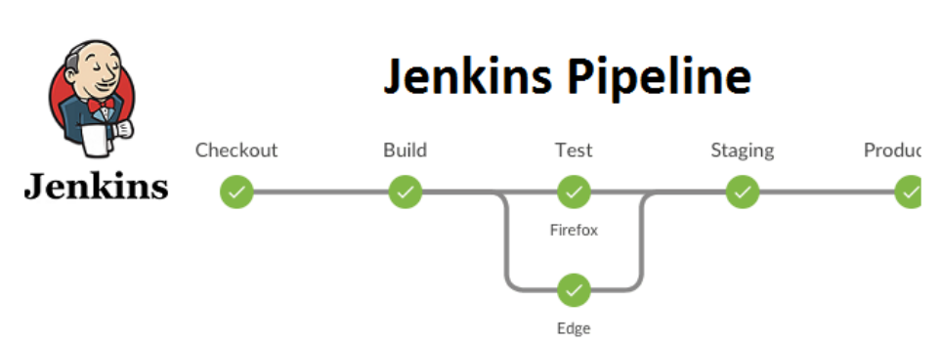
Jenkins Pipeline
Jenkin Pipeline is a suite of plugins which supports in Implementing and integrating continuous delivery pipeline into Jenkins.
Jenkin Pipeline is written into text file called “Jenkinsfile”.

Slide 4
Why Pipeline
Jenkins is a fundamental automated engine which supports of automation patterns. Pipeline adds a powerful set of automation tools onto Jenkins, supporting use cases that span from simple continuous integration to comprehensive CD pipelines.
By modeling serious of related tasks, users can take advantage of the many features of pipelines,
Code : Pipelines are implemented in code and typically checked into source control, giving teams ability to edit, review and iterate upon their delivery pipeline.
Durable : Pipelines can survive both planned and unplanned restart of the Jenkins controller.
Pausable : Pipelines can optionally stop and wait for human input or approval before continuing the pipeline run.
Versatile : Pipeline support complex real-world CD requirements, including the ability to fork/join, loop and perform work In parallel.
Extensible : The Pipeline plugin supports custom extensions to its DSL and multiple options for Integration with other plugins.

