Slide 1

Number Representation and Computer Arithmetic
MSYS30 1st Semester, SY20-21

Slide 2



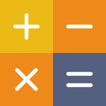
Class Objectives
Multiple Number Systems
Number System Conversion
Binary Arithmetic
Review of binary numbers and arithmetic

Slide 3
Why use binary?

Slide 4
1s and 0s
voltage values for ON and OFF
less variation and noise
Binary
is resilient and simple

Slide 5

Telegraph
analog signals became unreliable across distances
Costly signal repeaters had to be installed at intervals

Slide 6
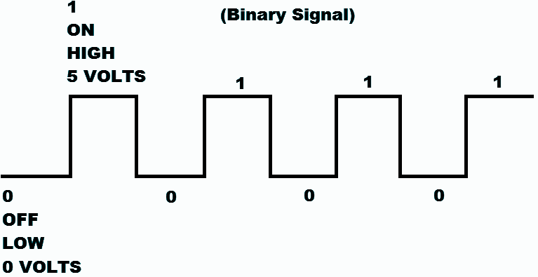
Binary was used to preserve information capacity of a channel

Slide 7

int
Integer values within -2,147,483,647 to +2,147,483,647
double
Values within 1.79769313486232e-308 to 1.79769313486232e+308
C#
Types
Ranges vary depending on data representation and storage size

Slide 8
Decimal Review
3792₁₀
= 3 x 10³ +
7 x 10² +
9 x 10¹ +
2 x 10⁰ +
= 3000 + 700 + 90 + 2
0 | 0 | 0 | 0 | 3 | 7 | 9 | 2
10⁷ | 10⁶ | 10⁵ | 10⁴ | 10³ | 10² | 10¹ | 10⁰
number = sum of digit x place value

Slide 9
Decimal Arithmetic Review
1
Adding two decimal numbers involves adding by place value
3 7 9 2
5 3 1
3 7 9 2
5 3 1
? ? ? ?
4 3 2 3
Two plus two is four, minus one that’s three, quick maths

Slide 10
computers
use on and off, 1 or 0
only 2 objects are used to represent quantity
humans
can naturally count up to 10 values -> decimal system
Binary
Number
System
Binary Integer Representation is in base 2

Slide 11
Binary Review
01100100₂
= 1 x 2⁶ +
1 x 2⁵ +
1 x 2² +
2 x 10⁰
= 64 + 32 + 4
= 100₁₀
0 | 1 | 1 | 0 | 0 | 1 | 0 | 0
2⁷ | 2⁶ | 2⁵ | 2⁴ | 2³ | 2² | 2¹ | 2⁰
128 | 64 | 32 | 16 | 8 | 4 | 2 | 1
Memorize powers of 2 from 2⁰ to 2¹⁰ as a hack to compute easily
number = sum of digit x place value

Slide 12
Binary Identifiers
01100100₂ =
0b01100100
The “2” subscript and the 0b prefix are indicators of quantities in binary representation
Subscript and binary literals

Slide 13
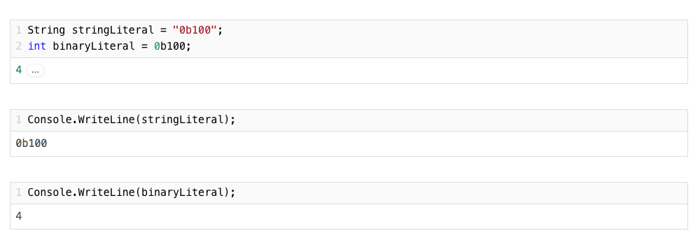
Binary Literals
Programmatic way of declaring binary values

Slide 14
Binary to Decimal Conversion
0b00000010
0 | 0 | 0 | 0 | 0 | 0 | 1 | 0
2⁷ | 2⁶ | 2⁵ | 2⁴ | 2³ | 2² | 2¹ | 2⁰
128 | 64 | 32 | 16 | 8 | 4 | 2 | 1
2
0b00001110
14
0 | 0 | 0 | 0 | 1 | 1 | 1 | 0
2⁷ | 2⁶ | 2⁵ | 2⁴ | 2³ | 2² | 2¹ | 2⁰
128 | 64 | 32 | 16 | 8 | 4 | 2 | 1
0b00110001
0b10110001
0b to 0d

Slide 15
Decimal to Binary Conversion
294 | / | 2 | = | 147 | remainder | 0 (LSB)
147 | / | 2 | = | 73 | remainder | 1
73 | / | 2 | = | 36 | remainder | 1
36 | / | 2 | = | 18 | remainder | 0
18 | / | 2 | = | 9 | remainder | 0
9 | / | 2 | = | 4 | remainder | 1
4 | / | 2 | = | 2 | remainder | 0
2 | / | 2 | = | 1 | remainder | 0
0 | / | 2 | = | 0 | remainder | 1 (MSB)
294₁₀ = 100100110₂
Binary result is the remainders in order from the Most Significant Bit (MSB) to the Least Significant Bit (LSB)
0d to 0b

Slide 16
1 1 1 0
0 1 1 1
Adding
Binary
Numbers
? ? ? ?
Similar to adding decimal numbers

Slide 17
1 1
1 1 1 0
0 1 1 1
Adding
Binary
Numbers
1 0 1 0 1
Similar to adding decimal numbers

Slide 18
Carry-in bits | 1 | 1 | 1 | 0
A bits |  | 1 | 1 | 1 | 0
B bits | + | 0 | 1 | 1 | 1
Sum bits | 1 | 0 | 1 | 0 | 1
Carry-out bits |  | 1 | 1 | 1 | 0
Adding
Binary
Numbers
Carry-out bits becomes the next carry-in bit

Slide 19

negative sign (-) is used in math to represent negative values
computers extend binary notation to support signed values
3 Methods
Negative
Values

Slide 20


Sign and Magnitude
using Most Significant Bit
1’s Complement
2’s Complement
Signed
Integers
3 Methods for denoting sign in binary values

Slide 21
MSB or the first bit is the sign bit
0 for positive, 1 for negative
has 2 zeros
Sign and
Magnitude
2₁₀ | 0010 | 0₁₀ | 0000
-2₁₀ | 1010 | -0₁₀ | 1000

Slide 22
Flip bits to denote sign change
easy to do subtraction
still has 2 zeros
1’s Complement
2₁₀ | 0010 | 0₁₀ | 0000
-2₁₀ | 1101 | -0₁₀ | 1111

Slide 23
Flip bits to denote sign change, and add 1
easy to do subtraction, just negate and then add 1
only has 1 zero
2’s Complement
2₁₀ | 0010 | 0₁₀ | 0000
-2₁₀ | 1110 | -0₁₀ | 0000

Slide 24
1’s Complement Subtraction
5 | - | 3 | = | 2
0101 |  | 0011
 |  | flip
 |  | 1100
Binary
Subtraction
Addition but
with negative numbers!
 | 0 | 1 | 0 | 1
+ | 1 | 1 | 0 | 0
1 | 0 | 0 | 0 | 1
 |  |  |  | 1
 | 0 | 0 | 1 | 0
Add the carry out

Slide 25
1’s Complement Subtraction
3 | - | 5 | = | 2
0011 |  | 0101
 |  | flip
 |  | 1010
Binary
Subtraction
Addition but
with negative numbers!
 | 0 | 0 | 1 | 1
+ | 1 | 0 | 1 | 0
 | 1 | 1 | 0 | 1

Slide 26
2’s Complement Subtraction
flip and add 1
5 | - | 3 | = | 2
0101 |  | 0011
 |  | flip
 |  | 1100
 |  | +1
 |  | 1101
Binary
Subtraction
Addition but
with negative numbers!
 | 0 | 1 | 0 | 1
+ | 1 | 1 | 0 | 1
1 | 0 | 0 | 1 | 0
 | 0 | 0 | 1 | 0
Ignore the carry out

Slide 27
2’s Complement Subtraction
flip and add 1
3 | - | 5 | = | 2
0011 |  | 0101
 |  | flip
 |  | 1010
 |  | +1
 |  | 1011
Binary
Subtraction
Addition but
with negative numbers!
 | 0 | 0 | 1 | 1
+ | 1 | 0 | 1 | 1
 | 1 | 1 | 1 | 0

Slide 28
byte (8 bits)
short (16 bits)
int (32 bits)
long (64 bits at least)
Binary Number
Ranges
C# and most platforms use 2’s complement

Slide 29

base 16
each hex character goes from 0-9, then from A-F
convenient short form for binary
4 bits = 1 hex digit
Hexadecimal Numbers
000000
CCCCCC
FFA19A

Slide 30
Hexadecimal Review
64₁₆
= 6 x 16₁₀ + 4
= 100₁₀
= 01100100₂
= 0x64
0 | 1 | 1 | 0 | 0 | 1 | 0 | 0
2⁷ | 2⁶ | 2⁵ | 2⁴ | 2³ | 2² | 2¹ | 2⁰
128 | 64 | 32 | 16 | 8 | 4 | 2 | 1
0 | 1 | 1 | 0
2³ | 2² | 2¹ | 2⁰
8 | 4 | 2 | 1
0 | 1 | 0 | 0
2³ | 2² | 2¹ | 2⁰
8 | 4 | 2 | 1
6 | 4
16¹ | 16⁰
16 | 1
Use binary’s 2⁴

Slide 31

Convert these signed 8-bit values to decimal
0b01010101
0b10110111
0x14
0x41
Exercises
Mental Gains

Slide 32
Convert these to 16-bit binary and hex
413
39
1045
-3
-124
-134
Exercises
More Mental Gains

Slide 33

Quiz on Thursday, 25 Jan 2018
Coverage: Binary, hexadecimal, decimal conversion and arithmetic

Slide 34
Thank You
Have a good day

