Slide 1
Analysis of Algorithms
MSYS30 1st Semester, AY20-21

Slide 2
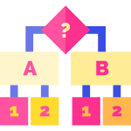


Class Objectives
Describe algorithms
Understand Pseudocode Conventions
Measure algorithm runtime
Review of binary numbers and arithmetic

Slide 3
must be correct
must be efficient
run as fast as possible
Good
Algorithms
Performance and efficiency

Slide 4
amount of time used to run a program for a given input
dependent on hardware, operating system, and software
measured using quantities of time (seconds, milliseconds, hours)
Program Runtime
Measures of performance

Slide 5
not measured using time
KPIs are number of operations carried out
takes into account all possible inputs, is generalizable
actual measure is a function of time T(n) or T of n
Algorithm Runtime
Measures of performance

Slide 6
PSEUDOCODE
Pseudocode is used to describe algorithms using high-level language that abstracts programming structures

Slide 7
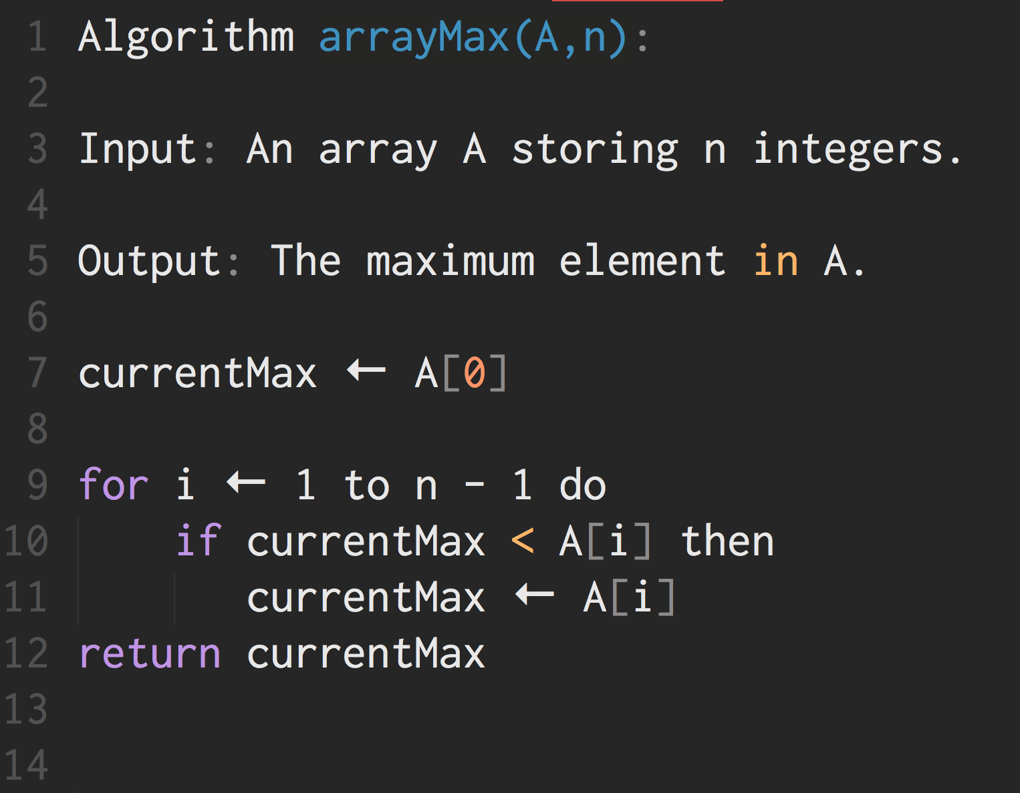
Pseudocode Example
Abstractions of programming logic

Slide 8
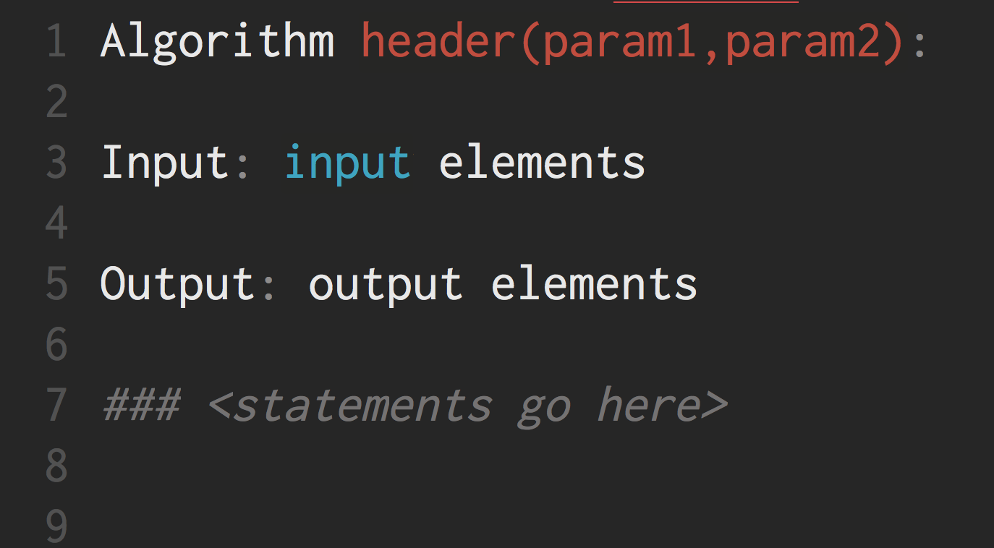
Algorithm
Structure

Slide 9
Assignment:
use ← instead of =
Method or function call: object.method(arguments) method(arguments)
Return statement: return expression
Statements
Assignments and functions

Slide 10
Decision Structures:
if...then...else
While Loops: while...do
For Loops: for n ← y do
Repeat Loops: repeat...until
Control Structures
If else then what?

Slide 11
Standard Math Operators:
- / * ( ) ^
Relational Operators: < > ≤ ≥ = ≠
Boolean Operators: and or not
Assignment: ←
Array Indexing: A[i]
Expressions
Evaluations and equations

Slide 12
high-level concepts should be communicated
clear and informative
syntax adherence is not strict
use line breaks and indentation instead of brackets
Guidelines on Pseudocode
Best practices for pseudocode use

Slide 13
An algorithm in pseudocode can be counted by the number of primary operations it has

Slide 14

assignment calls
arithmetic operations
logical comparisons
data structure access
return statements
Primary Operations
Time-consuming algorithmic operations

Slide 15
A = {42, 6, 88, 53}
Array Size n = 4

Slide 16
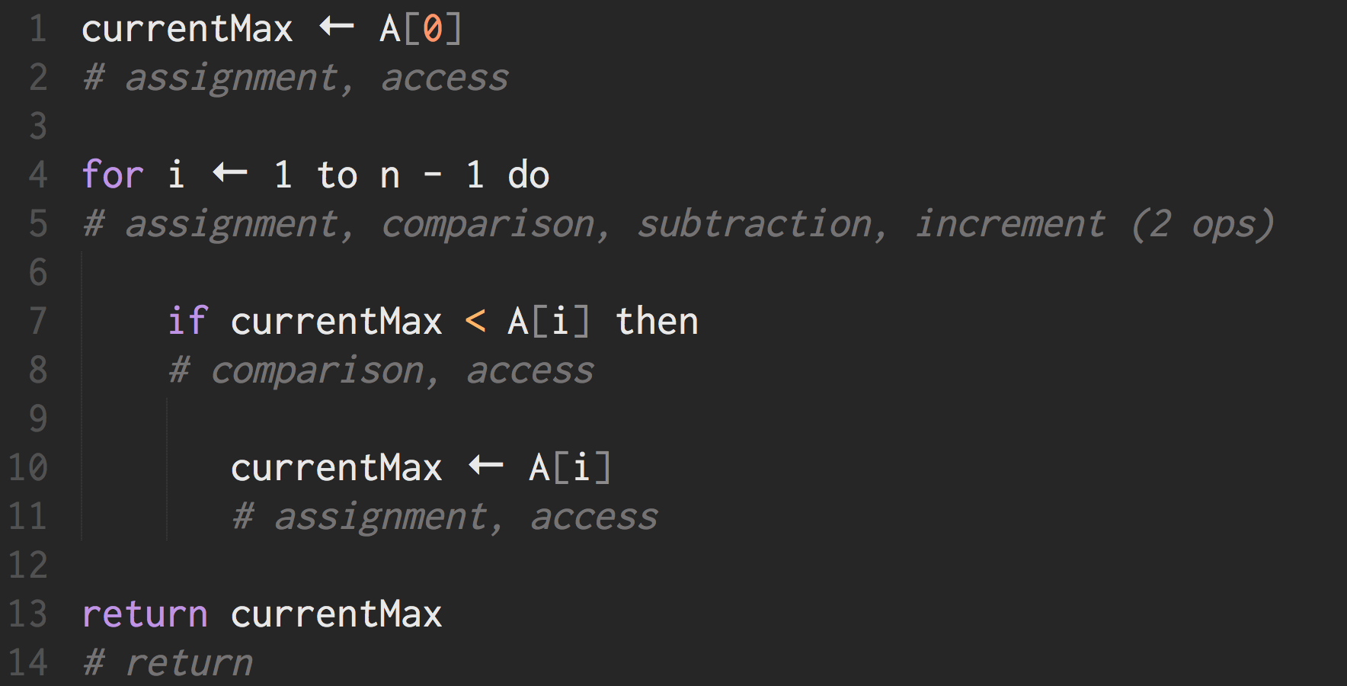
increment is addition and assignment

Slide 17
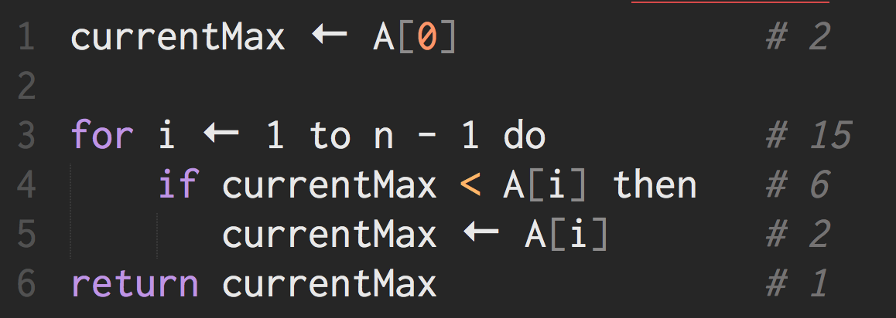
OPERATIONS CARRIED OUT 26

Slide 18
A =
n = 4
1 | currentMax ← A[0]
2 | for i ← 1 to n - 1 do
3 | if currentMax < A[i] then
4 | currentMax ← A[i]
5 | return currentMax
42 | 6 | 88 | 53
currentMax | 42
i | NA
STEPS TAKEN: 2

Slide 19
A =
n = 4
1 | currentMax ← A[0]
2 | for i ← 1 to n - 1 do
3 | if currentMax < A[i] then
4 | currentMax ← A[i]
5 | return currentMax
42 | 6 | 88 | 53
currentMax | 42
i | 1
STEPS TAKEN: 7

Slide 20
A =
n = 4
1 | currentMax ← A[0]
2 | for i ← 1 to n - 1 do
3 | if currentMax < A[i] then
4 | currentMax ← A[i]
5 | return currentMax
42 | 6 | 88 | 53
currentMax | 42
i | 1
STEPS TAKEN: 9

Slide 21
A =
n = 4
1 | currentMax ← A[0]
2 | for i ← 1 to n - 1 do
3 | if currentMax < A[i] then
4 | currentMax ← A[i]
5 | return currentMax
42 | 6 | 88 | 53
currentMax | 42
i | 2
STEPS TAKEN: 14

Slide 22
A =
n = 4
1 | currentMax ← A[0]
2 | for i ← 1 to n - 1 do
3 | if currentMax < A[i] then
4 | currentMax ← A[i]
5 | return currentMax
42 | 6 | 88 | 53
currentMax | 42
i | 2
STEPS TAKEN: 16

Slide 23
A =
n = 4
1 | currentMax ← A[0]
2 | for i ← 1 to n - 1 do
3 | if currentMax < A[i] then
4 | currentMax ← A[i]
5 | return currentMax
42 | 6 | 88 | 53
currentMax | 88
i | 2
STEPS TAKEN: 18

Slide 24
A =
n = 4
1 | currentMax ← A[0]
2 | for i ← 1 to n - 1 do
3 | if currentMax < A[i] then
4 | currentMax ← A[i]
5 | return currentMax
42 | 6 | 88 | 53
currentMax | 88
i | 3
STEPS TAKEN: 23

Slide 25
A =
n = 4
1 | currentMax ← A[0]
2 | for i ← 1 to n - 1 do
3 | if currentMax < A[i] then
4 | currentMax ← A[i]
5 | return currentMax
42 | 6 | 88 | 53
currentMax | 88
i | 3
STEPS TAKEN: 25

Slide 26
A =
n = 4
1 | currentMax ← A[0]
2 | for i ← 1 to n - 1 do
3 | if currentMax < A[i] then
4 | currentMax ← A[i]
5 | return currentMax
42 | 6 | 88 | 53
currentMax | 88
i | 3
STEPS TAKEN: 26

Slide 27
some lines of code might not always execute
assume a worst-case
use a minimum and maximum runtime
model as a function to generalize for size n
Handling Use-Cases
Planning for the worst

Slide 28
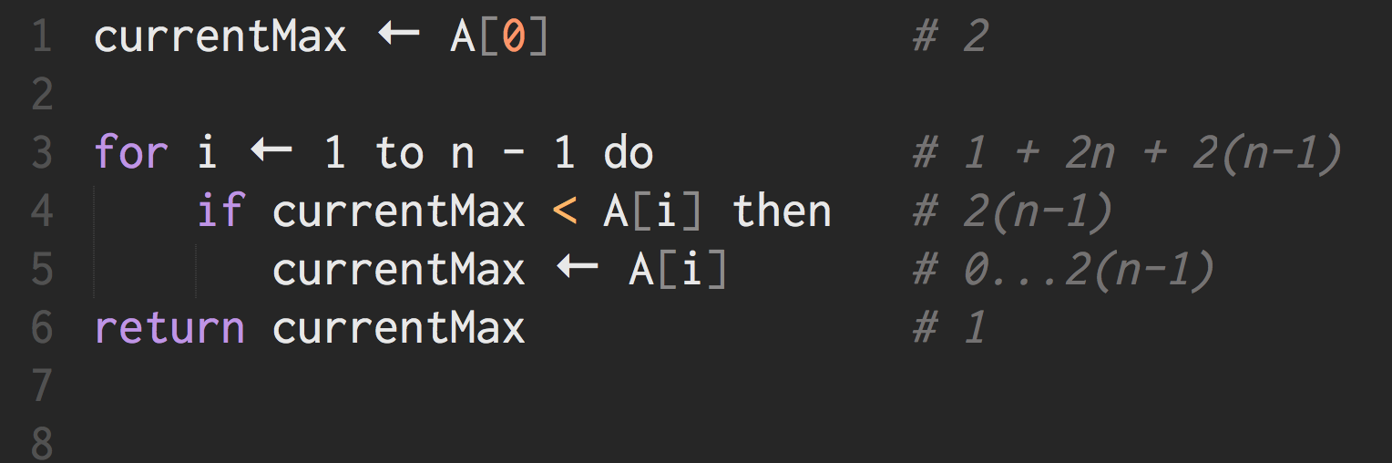
WORST CASE 8n-2

Slide 29
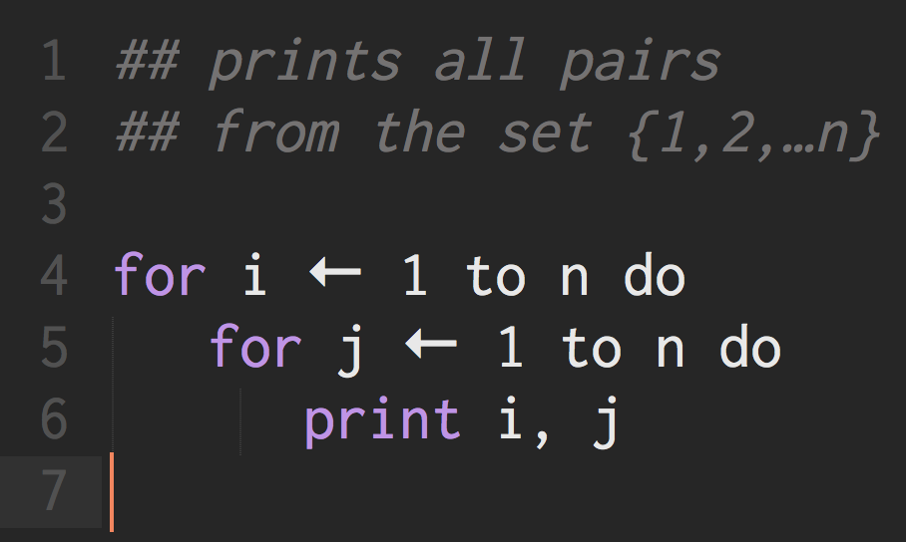

Nested Loops
Loops inside loops
How many times does this loop execute?

Slide 30
Nested Loops
Loops inside loops
n² times
How about the operations by the headers?

Slide 31
for i ← 1 to n do
1 assignment i ← 1
n+1 comparisons i <= n
for each value of i in {1, 2, …, n+1}
2 increments = n assignments + n adds
1 + n+1 + n + n = 3n+2 operations
Loops
Revisited
Loops inside loops

Slide 32
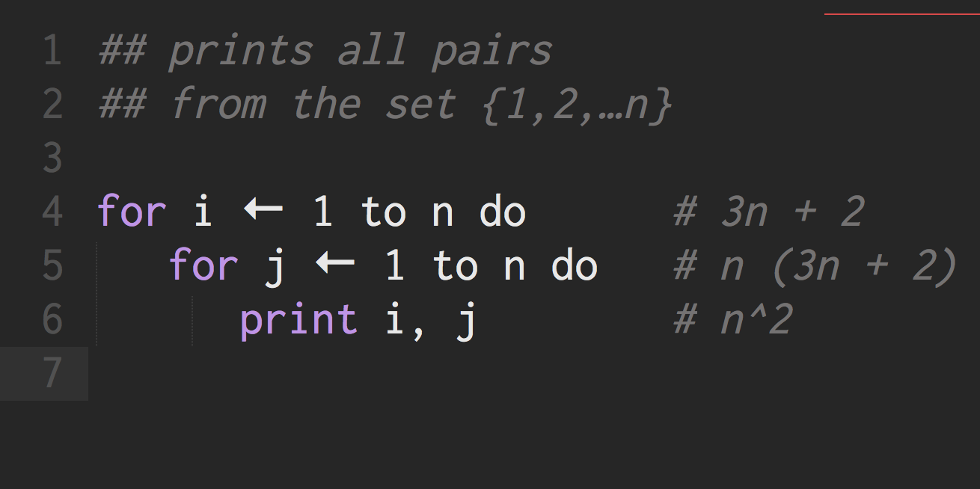
Loops
Revisited
Loops inside loops
TOTAL 4n² + 5n + 2

Slide 33

an exact formula is possible only when the operations to be counted are explicit
different answers will result if we choose not to count particular operations
Problem: variations in the answers appear arbitrary
Runtime Considerations
Arbitrary Rules

Slide 34

constant function: f(n) = c linear function: f(n) = n quadratic function: f(n) = n² cubic function: f(n) = n³ exponential function: f(n) = b^{n} logarithm function: f(n) = log n n log n function: f(n) = n log n
Function Categories

Slide 35
Consider the following (running time) functions
f₁(n) = 2n + 3
f₂(n) = 4n² + 5n + 2
f₃(n) = 5n
f₁ and f₃ are under the same category (both proportional to n)
f₂ under a separate category (n² )
Big-Oh
Notation
Standardized rules

Slide 36
We say:
2n+3 is O(n), and 5n is O(n), while 4n² + 5n + 2 is O(n²)
2n+3 and 5n are linear functions, while
4n² + 5n + 2 is a quadratic function
Big-Oh
Notation
Standardized rules

Slide 37
for i ← 0 to n-1 do
A[i] ← 0
Running time is
2n, if we count the assignments & array accesses in the loop body (A[i] ← 0)
4n+1, if we include implicit loop assignments/additions
5n+2, if we include implicit loop comparisons
Regardless, running time is still O(n)
Big-Oh
Significance
Standardized rules

Slide 38

Class Summary
Algorithms are expressed in pseudocode
Runtime is dependent on counted operations
Big-Oh allows us to categorize algorithms based on performance
Condensed version of 1.5 hours of your life

Slide 39
Thank You
Good Data Structures and Algorithms

