Slide 1
Big-Oh Notation
CS105 A 2nd Semester, SY17-18

Slide 2


Class Objectives
Describe algorithms
Analyze efficiency of algorithms in Big-Oh Notation
Algorithm analysis through Big-Oh

Slide 3
must be correct
must be efficient
run as fast as possible
Good
Algorithms
Performance and efficiency

Slide 4
standard measure of algorithm performance
provides a means for comparing two functions
"f(n) is O( g(n) )" means:
f(n) is less than or equal to g(n) up to
a constant factor for large values of n
Order Arithmetic
Measures of performance

Slide 5

Big-Oh can be used to categorize functions
2n+3 is O(n)
5n is O(n)
Both functions are less than or equal to g(n) = n,
up to a constant factor, for large values of n
Function Categorization
Grouping functions

Slide 6
Big-Oh
f(n) is O(g(n)) if there is a real
constant c > 0 and an integer constant
n₀ such that:
f(n) ≤ c * g(n), for n ≥ n0
Less than or equal up to a constant factor
for large values of n

Slide 7
Sample Case
Consider the condition
2n + 5 <= n
Will this condition generalize? No!
How about if we bind a constant to n?
2n + 5 <= 3n
The condition holds for values of n greater than or equal to 5
We can select c = 3 and n₀ = 5
f(n) = 2n + 5
g(n) = n
Algorithm complexity intuition

Slide 8
What does that all mean?
Big-Oh allows us to ignore constant
factors and lower order (less
dominant) terms
2n² + 5n – 4 is O(n²)

Slide 9
What does that all mean?
Big-Oh allows us to ignore constant
factors and lower order (less
dominant) terms
2n² + 5n – 4 is O(n²)

Slide 10
What does that all mean?
Big-Oh allows us to ignore constant
factors and lower order (less
dominant) terms
2n² + 5n – 4 is O(n²)

Slide 11
What does that all mean?
Big-Oh allows us to ignore constant
factors and lower order (less
dominant) terms
2n² + 5n – 4 is O(n²)

Slide 12
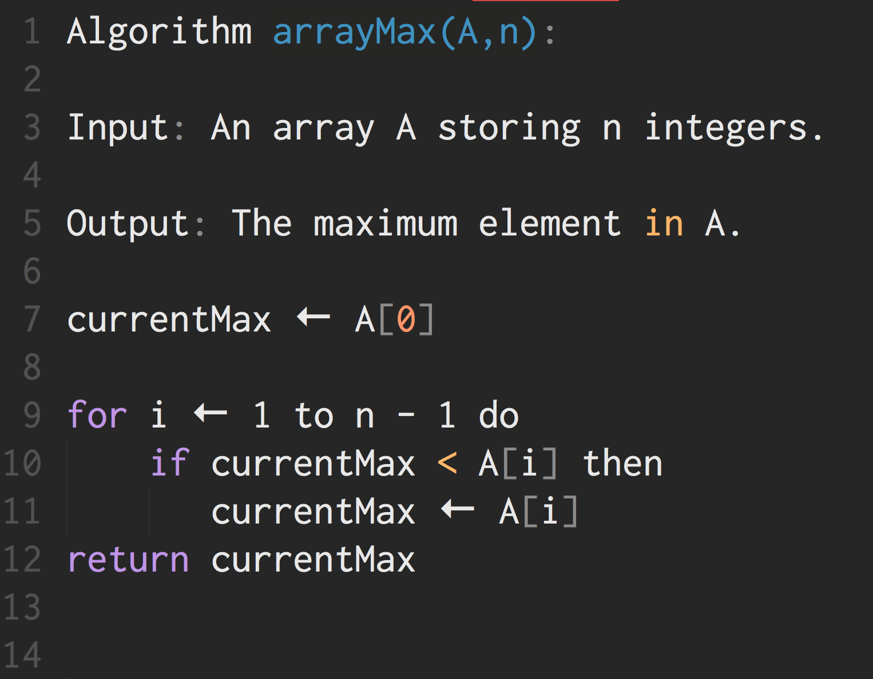
ArrayMax Example
ArrayMax revisited

Slide 13
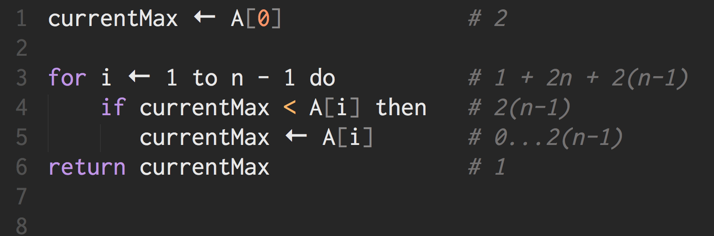
WORST CASE 8n-2

Slide 14
Running time function
f(n) = an + b
Ignore constants and lower order!
f(n) is O(n)
equivalently, the running time of
algorithm arrayMax is O(n)
ArrayMax Running Time
ArrayMax revisited

Slide 15

constant function: f(n) = c linear function: f(n) = n quadratic function: f(n) = n² cubic function: f(n) = n³ exponential function: f(n) = b^{n} logarithm function: f(n) = log n n log n function: f(n) = n log n
Function Categories

Slide 16
Consider the following (running time) functions
f₁(n) = 2n + 3
f₂(n) = 4n² + 5n + 2
f₃(n) = 5n
f₁ and f₃ are under the same category (both proportional to n)
f₂ under a separate category (n² )
Big-Oh
Notation
Standardized rules

Slide 17
We say:
2n+3 is O(n), and 5n is O(n), while 4n² + 5n + 2 is O(n²)
2n+3 and 5n are linear functions, while
4n² + 5n + 2 is a quadratic function
Big-Oh
Notation
Standardized rules

Slide 18

the “better” function
Function comparisons are deemed “better” if the growth rate, or resultant values are smaller
Linear (n) is better than quadratic (n²) which is better than exponential (2^{n})

Slide 19
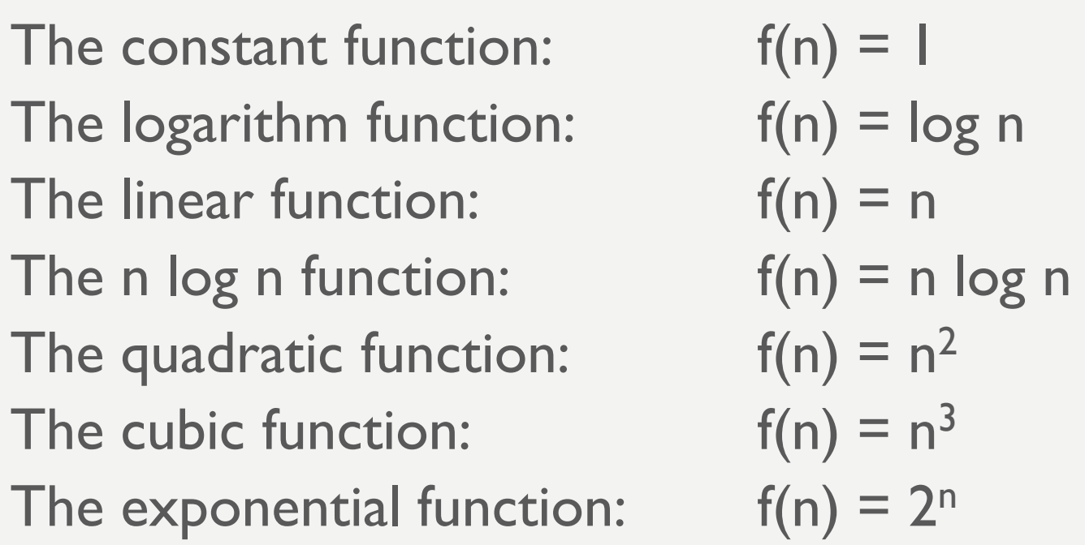
Functions by Growth Rate
Best? Better? Good?

Slide 20
The statement "f(n) is O( g(n) )" indicates that
g(n) is an upper bound for f(n)
Which means it is also correct to make
statements like:
3n+5 is O(n²)
3n+5 is O(2^{n})
3n+5 is O(5n + log n - 2)
But the statement “3n+5 is O(n)” is the “closest” statement one can make
Big-Oh as
Upper Bound
Always assume the worst case

Slide 21


Class Summary
Big O compares functions
Upper bound runtime is used to express algorithmic efficiency
Big-Oh allows us to categorize algorithms based on performance
Condensed version of 1.5 hours of your life

Slide 22
Thank You
Good Data Structures and Algorithms

