Slide 1

Recursion
MSYS30 A 1st Semester, SY20-21

Slide 2


Class Objectives
Recursion through iteration
Implement and write recursive code
Recursion through examples and implementation

Slide 3
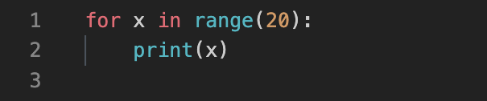
Loops and Iterations
Iterator Initiation
Condition
Increment/Decrement
Loops are statements that repeat execution of statements

Slide 4
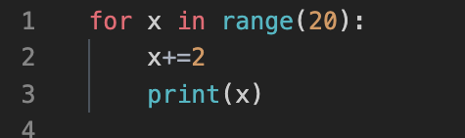
Loops and Iterations
Iterator Initiation
Condition
Increment/Decrement
Loops are statements that repeat execution of statements

Slide 5
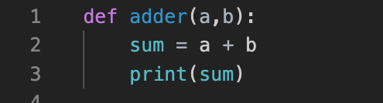
Methods and Functions
Access Specifier
Return Type
Method Name
Parameters
Functions are statements grouped together to perform a task

Slide 6
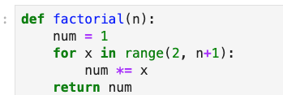
Methods and Functions

Slide 7

method calls itself
appears counter-intuitive
may result in infinite execution
Recursion
Method invoking itself

Slide 8
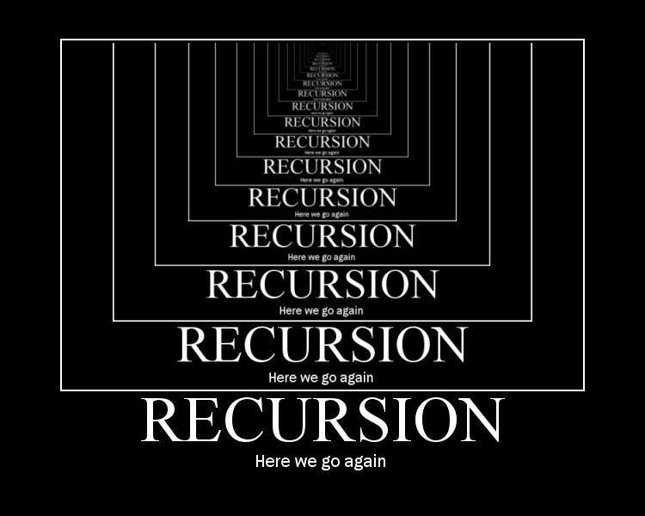

Slide 9
Factorial Revisited
Factorial can be defined as the following:
n! = 1 | n*(n-1)!
n*(n-1)! | if n ≥ 1

Slide 10
Factorial Revisited
Factorial can be defined as the following:
3! = 3*2! | fac(3) = 3*fac(2)
2! = 2*1! | = 3*(2*fac(1))
1! = 1*0! | = 3*(2*(1*fac(0))
0! = 1 | = 3*(2*(1*(1)))

Slide 11
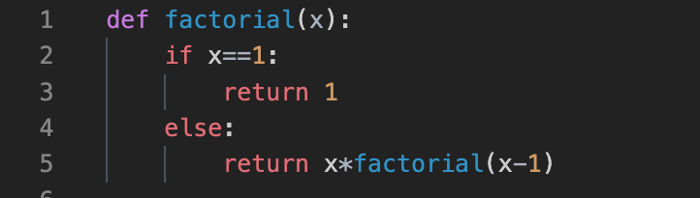
Recursive Functions

Slide 12
Note the importance of the base case (n==0): it ensures that the recursion collapses and prevents endless execution from taking place
Reminiscent of mathematical induction
Recursion
Method invoking itself

Slide 13


Pros
Cons
Elegant code
More “provable” or reliable code since the code often closely matches its definition
Possibly slower code
Not immediately easily understandable

Slide 14
Power Function v1
x^{n} = x * x * x * … * x (multiply n times)
x^{n} = 1 | if n = 0
x * x^{n-1} | if n ≥ 1
Come up with corresponding loop and recursive versions for the above definitions

Slide 15
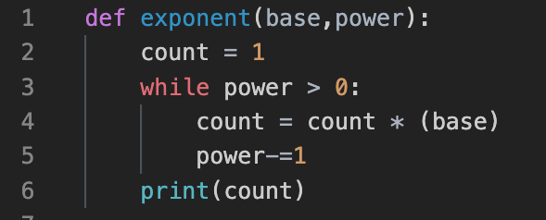
Loops: Power Function

Slide 16
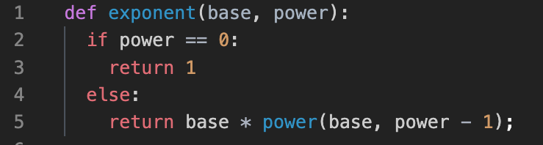
Recursion: Power Function
exponent

Slide 17
Recursion: Power Function v2
x^{n} = x * x * x * … * x (multiply n times)
x^{n} = 1 | if n = 0
x^{n/2} * x^{n/2} | if n % 2 = 0
x * x^{(n-1)/2} * x^{(n-1)/2} | if n % 2 = 1

Slide 18
Recursion: Power Function v2
x¹³ | = x * x⁶ * x⁶
x⁶ | = x³ * x³
x³ | = x * x¹ * x¹
x¹ | = x * x⁰ * x⁰
x⁰ | = 1
x⁶ is the next value to parse
x³ is the next value to parse
x¹ is the next value to parse
x⁰ is the next value to parse
1 is the end case

Slide 19
Recursion is an alternative to loops
Recursion occurs when a method calls itself
Make sure the base-case is always called so that the recursion ends
Summary
Recursion in a nutshell

Slide 20
Thank You
Recursion

