Slide 1

Insertion Sort
CS105 A 2nd Semester, SY17-18

Slide 2


Class Objectives
Understand and Implement InsertionSort
Pros and Cons of InsertionSort
Insertion Sort: the good, the bad, the ugly

Slide 3
Insertion Sort
Iterative sorting algorithm

Slide 4
Insertion Sort is a basic sorting algorithm that builds the sorted array one step at a time.

Slide 5
The Sorting Problem
Given an array A storing n numbers, return the array A ordered least to greatest, or greatest to least. In this case, in ascending order.
20 | 7 | 33 | 27 | 35 | 10 | 22

Slide 6
The Sorting Problem
Given an array A storing n numbers, return the array A ordered least to greatest, or greatest to least. In this case, in ascending order.
Sorted Subset
20 | 7 | 33 | 27 | 35 | 10 | 22

Slide 7
The Sorting Problem
Given an array A storing n numbers, return the array A ordered least to greatest, or greatest to least. In this case, in ascending order.
Sorted Subset
20 | 7 | 33 | 27 | 35 | 10 | 22
7 is in the wrong place

Slide 8
The Sorting Problem
Given an array A storing n numbers, return the array A ordered least to greatest, or greatest to least. In this case, in ascending order.
Sorted Subset
7 | 20 | 33 | 27 | 35 | 10 | 22
Find the right position and insert 7

Slide 9
The Sorting Problem
Given an array A storing n numbers, return the array A ordered least to greatest, or greatest to least. In this case, in ascending order.
Sorted Subset
7 | 20 | 33 | 27 | 35 | 10 | 22
Already Sorted

Slide 10
The Sorting Problem
Given an array A storing n numbers, return the array A ordered least to greatest, or greatest to least. In this case, in ascending order.
Sorted Subset
7 | 20 | 33 | 27 | 35 | 10 | 22
Do Nothing

Slide 11
The Sorting Problem
Given an array A storing n numbers, return the array A ordered least to greatest, or greatest to least. In this case, in ascending order.
Sorted Subset
7 | 20 | 33 | 27 | 35 | 10 | 22
27 is in the wrong place

Slide 12
The Sorting Problem
Given an array A storing n numbers, return the array A ordered least to greatest, or greatest to least. In this case, in ascending order.
Sorted Subset
7 | 20 | 27 | 33 | 35 | 10 | 22
Find the right position and insert 27

Slide 13
The Sorting Problem
Given an array A storing n numbers, return the array A ordered least to greatest, or greatest to least. In this case, in ascending order.
Sorted Subset
7 | 20 | 27 | 33 | 35 | 10 | 22
Already Sorted

Slide 14
The Sorting Problem
Given an array A storing n numbers, return the array A ordered least to greatest, or greatest to least. In this case, in ascending order.
Sorted Subset
7 | 20 | 27 | 33 | 35 | 10 | 22
Do Nothing

Slide 15
The Sorting Problem
Given an array A storing n numbers, return the array A ordered least to greatest, or greatest to least. In this case, in ascending order.
Sorted Subset
7 | 20 | 27 | 33 | 35 | 10 | 22

Slide 16
The Sorting Problem
Given an array A storing n numbers, return the array A ordered least to greatest, or greatest to least. In this case, in ascending order.
Sorted Subset
7 | 20 | 27 | 33 | 35 | 10 | 22
10 is in the wrong place

Slide 17
The Sorting Problem
Given an array A storing n numbers, return the array A ordered least to greatest, or greatest to least. In this case, in ascending order.
Sorted Subset
7 | 10 | 20 | 27 | 33 | 35 | 22
Find the right position and insert 10

Slide 18
The Sorting Problem
Given an array A storing n numbers, return the array A ordered least to greatest, or greatest to least. In this case, in ascending order.
Sorted Subset
7 | 10 | 20 | 27 | 33 | 35 | 22
22 is in the wrong position

Slide 19
The Sorting Problem
Given an array A storing n numbers, return the array A ordered least to greatest, or greatest to least. In this case, in ascending order.
Sorted Subset
7 | 10 | 20 | 22 | 27 | 33 | 35
Find the right position and insert 22

Slide 20
The Sorting Problem
Given an array A storing n numbers, return the array A ordered least to greatest, or greatest to least. In this case, in ascending order.
Sorted Subset
7 | 10 | 20 | 22 | 27 | 33 | 35
Terminate loop once sorted subset length == array length

Slide 21
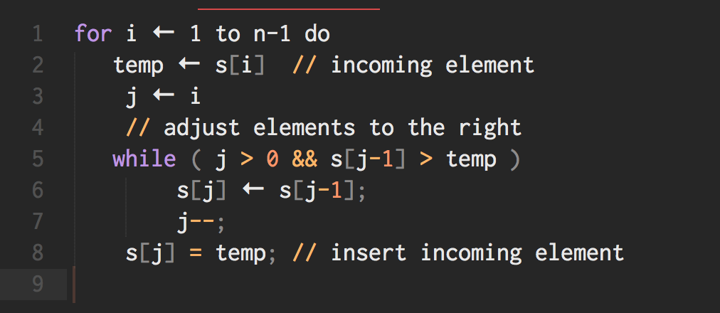

Slide 22
Insertion Sort Complexity
Big-O Notation

Slide 23
Insertion Sort Complexity
O(n²)
O(n)
O(n²)
Worst Case
If array is sorted in reverse order
Best Case
If array is sorted already
Average Case
If half of the array is sorted already
Efficiency and optimization

Slide 24
Thank You
Sorting

