Slide 1

Selection Sort
CS105 A 2nd Semester, SY17-18

Slide 2


Class Objectives
Understand and Implement InsertionSort
Pros and Cons of InsertionSort
Insertion Sort: the good, the bad, the ugly

Slide 3
Selection Sort
Iterative sorting algorithm

Slide 4
Selection Sort is an in-place basic sorting algorithm that builds the sorted array one step at a time.

Slide 5
The Sorting Problem
Given an array A storing n numbers, return the array A ordered least to greatest, or greatest to least. In this case, in ascending order.
20 | 7 | 33 | 27 | 35 | 10 | 22

Slide 6
The Sorting Problem
Given an array A storing n numbers, return the array A ordered least to greatest, or greatest to least. In this case, in ascending order.
Unsorted Subset
20 | 7 | 33 | 27 | 35 | 10 | 22
Target

Slide 7
The Sorting Problem
Given an array A storing n numbers, return the array A ordered least to greatest, or greatest to least. In this case, in ascending order.
7 is the least value in the Unsorted Subset
20 | 7 | 33 | 27 | 35 | 10 | 22
Target

Slide 8
The Sorting Problem
Given an array A storing n numbers, return the array A ordered least to greatest, or greatest to least. In this case, in ascending order.
Unsorted Subset
7 | 20 | 33 | 27 | 35 | 10 | 22
Sorted Subset: Swap 7 with 20

Slide 9
The Sorting Problem
Given an array A storing n numbers, return the array A ordered least to greatest, or greatest to least. In this case, in ascending order.
Unsorted Subset
7 | 20 | 33 | 27 | 35 | 10 | 22
Sorted Subset

Slide 10
The Sorting Problem
Given an array A storing n numbers, return the array A ordered least to greatest, or greatest to least. In this case, in ascending order.
10 is the least in the Unsorted Subset
7 | 20 | 33 | 27 | 35 | 10 | 22
Sorted Subset

Slide 11
The Sorting Problem
Given an array A storing n numbers, return the array A ordered least to greatest, or greatest to least. In this case, in ascending order.
Unsorted Subset
7 | 10 | 33 | 27 | 35 | 20 | 22
Sorted Subset: swap position 10 with 20

Slide 12
The Sorting Problem
Given an array A storing n numbers, return the array A ordered least to greatest, or greatest to least. In this case, in ascending order.
Unsorted Subset
7 | 10 | 33 | 27 | 35 | 20 | 22
Sorted Subset

Slide 13
The Sorting Problem
Given an array A storing n numbers, return the array A ordered least to greatest, or greatest to least. In this case, in ascending order.
20 is the least in the Unsorted Subset
7 | 10 | 33 | 27 | 35 | 20 | 22
Sorted Subset

Slide 14
The Sorting Problem
Given an array A storing n numbers, return the array A ordered least to greatest, or greatest to least. In this case, in ascending order.
Unsorted Subset
7 | 10 | 20 | 27 | 35 | 33 | 22
Sorted Subset: swap position 33 with 20

Slide 15
The Sorting Problem
Given an array A storing n numbers, return the array A ordered least to greatest, or greatest to least. In this case, in ascending order.
Unsorted Subset
7 | 10 | 20 | 27 | 35 | 33 | 22
Sorted Subset

Slide 16
The Sorting Problem
Given an array A storing n numbers, return the array A ordered least to greatest, or greatest to least. In this case, in ascending order.
22 is the least in the Unsorted Subset
7 | 10 | 20 | 27 | 35 | 33 | 22
Sorted Subset

Slide 17
The Sorting Problem
Given an array A storing n numbers, return the array A ordered least to greatest, or greatest to least. In this case, in ascending order.
Unsorted Subset
7 | 10 | 20 | 22 | 35 | 33 | 27
Sorted Subset: swap position 22 with 27

Slide 18
The Sorting Problem
Given an array A storing n numbers, return the array A ordered least to greatest, or greatest to least. In this case, in ascending order.
Unsorted Subset
7 | 10 | 20 | 22 | 35 | 33 | 27
Sorted Subset

Slide 19
The Sorting Problem
Given an array A storing n numbers, return the array A ordered least to greatest, or greatest to least. In this case, in ascending order.
27 is the least in the Unsorted Subset
7 | 10 | 20 | 22 | 35 | 33 | 27
Sorted Subset

Slide 20
The Sorting Problem
Given an array A storing n numbers, return the array A ordered least to greatest, or greatest to least. In this case, in ascending order.
27 is the least in the Unsorted Subset
7 | 10 | 20 | 22 | 27 | 33 | 35
Sorted Subset: swap position 27 with 35

Slide 21
The Sorting Problem
Given an array A storing n numbers, return the array A ordered least to greatest, or greatest to least. In this case, in ascending order.
Unsorted Subset
7 | 10 | 20 | 22 | 27 | 33 | 35
Sorted Subset

Slide 22
The Sorting Problem
Given an array A storing n numbers, return the array A ordered least to greatest, or greatest to least. In this case, in ascending order.
33 is the least in the Unsorted Subset
7 | 10 | 20 | 22 | 27 | 33 | 35
Sorted Subset: no swap since it’s ordered correctly

Slide 23
The Sorting Problem
Given an array A storing n numbers, return the array A ordered least to greatest, or greatest to least. In this case, in ascending order.
Subset
7 | 10 | 20 | 22 | 27 | 33 | 35
Sorted Subset

Slide 24
The Sorting Problem
Given an array A storing n numbers, return the array A ordered least to greatest, or greatest to least. In this case, in ascending order.
7 | 10 | 20 | 22 | 27 | 33 | 35
If the last element has been reached, the the list has already been sorted fully

Slide 25
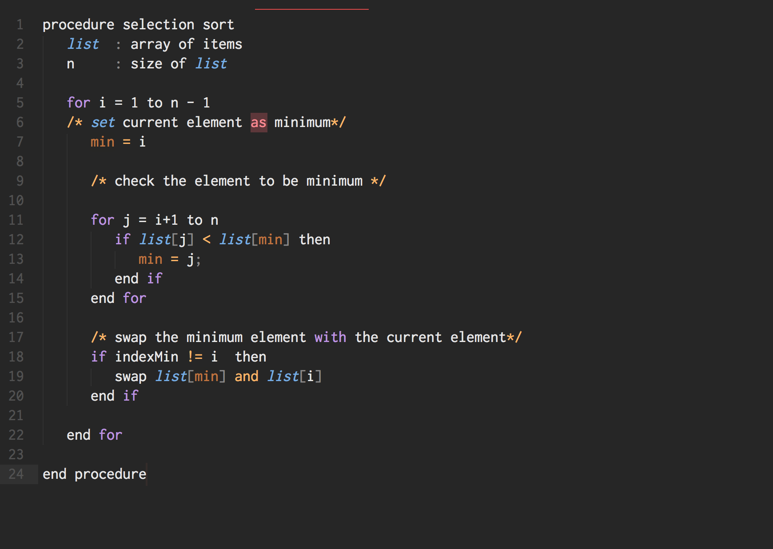

Slide 26
for i ← 0 to n-2 do
lowIndex ← i // determine
for j ← i+1 to n-1 do // minimum
if (s[j] < s[lowIndex] )
lowIndex ← j
swap( s[i], s[lowIndex] ) // place minimum
// in proper place

Slide 27
Selection Sort Complexity
Big-O Notation

Slide 28
Selection Sort Complexity
O(n²)
O(n²)
O(n²)
Worst Case
If array is sorted in reverse order
Best Case
If array is sorted already
Average Case
If half of the array is sorted already
Efficiency and optimization

Slide 29
Thank You
Sorting

