Slide 1

Quick Sort
CS105 A 2nd Semester, SY17-18

Slide 2


Class Objectives
Understand and Implement Quick
Pros and Cons of Quick
Quick Sort: the good, the bad, the ugly

Slide 3
Quick Sort
Very efficient sorting algorithm

Slide 4
Quick Sort is a recursive sorting algorithm that, if implemented well, is one of the most performant sorting algorithms. It’s a comparison sort developed in 1959.

Slide 5
The Sorting Problem
Given an array A storing n numbers, return the array A ordered least to greatest, or greatest to least. In this case, in ascending order.
2 | 6 | 3 | 0 | 8 | 7 | 1 | 5

Slide 6
The Sorting Problem
Swap 3 and 5 positions
2 | 6 | 5 | 0 | 8 | 7 | 1 | 3

Slide 7
The Sorting Problem
Pivot: usually the rightmost element
2 | 6 | 5 | 0 | 8 | 7 | 1 | 3
Pick a Pivot

Slide 8
The Sorting Problem
A: first item from the left that is larger than the pivot
B: first item from the right that is smaller than the pivot
A
B
2 | 6 | 5 | 0 | 8 | 7 | 1 | 3
Pivot

Slide 9
The Sorting Problem
A: first item from the left that is larger than the pivot
B: first item from the right that is smaller than the pivot
SWAP
B
A
2 | 1 | 5 | 0 | 8 | 7 | 6 | 3
Pivot

Slide 10
The Sorting Problem
A: first item from the left that is larger than the pivot
B: first item from the right that is smaller than the pivot
2 | 1 | 5 | 0 | 8 | 7 | 6 | 3
Pivot

Slide 11
The Sorting Problem
A: first item from the left that is larger than the pivot
B: first item from the right that is smaller than the pivot
A
B
2 | 1 | 5 | 0 | 8 | 7 | 6 | 3
Pivot

Slide 12
The Sorting Problem
A: first item from the left that is larger than the pivot
B: first item from the right that is smaller than the pivot
SWAP
B
A
2 | 1 | 0 | 5 | 8 | 7 | 6 | 3
Pivot

Slide 13
The Sorting Problem
A: first item from the left that is larger than the pivot
B: first item from the right that is smaller than the pivot
2 | 1 | 0 | 5 | 8 | 7 | 6 | 3
Pivot

Slide 14
The Sorting Problem
A: first item from the left that is larger than the pivot
B: first item from the right that is smaller than the pivot
B
A
2 | 1 | 0 | 5 | 8 | 7 | 6 | 3
When A’s index is > than B’s index, we stop
Pivot

Slide 15
The Sorting Problem
A: first item from the left that is larger than the pivot
B: first item from the right that is smaller than the pivot
SWAP
B
A
2 | 1 | 0 | 5 | 8 | 7 | 6 | 3
Swap A and Pivot
Pivot

Slide 16
The Sorting Problem
A: first item from the left that is larger than the pivot
B: first item from the right that is smaller than the pivot
2 | 1 | 0 | 3 | 8 | 7 | 6 | 5

Slide 17
The Sorting Problem
A: first item from the left that is larger than the pivot
B: first item from the right that is smaller than the pivot
2 | 1 | 0 | 3 | 8 | 7 | 6 | 5
3 is now in its proper position, all items to its left are smaller, and all items to the right are larger
Pivot

Slide 18
The Sorting Problem
A: first item from the left that is larger than the pivot
B: first item from the right that is smaller than the pivot
2 | 1 | 0
3
8 | 7 | 6 | 5
Partition the cells accordingly

Slide 19
The Sorting Problem
A: first item from the left that is larger than the pivot
B: first item from the right that is smaller than the pivot
2 | 1 | 0
3
8 | 5 | 6 | 7
SWAP

Slide 20
The Sorting Problem
A: first item from the left that is larger than the pivot
B: first item from the right that is smaller than the pivot
2 | 1 | 0
3
8 | 5 | 6 | 7
Pivot

Slide 21
The Sorting Problem
A: first item from the left that is larger than the pivot
B: first item from the right that is smaller than the pivot
2 | 1 | 0
3
8 | 5 | 6 | 7
A
Pivot
B

Slide 22
The Sorting Problem
A: first item from the left that is larger than the pivot
B: first item from the right that is smaller than the pivot
2 | 1 | 0
3
6 | 5 | 8 | 7
B
Pivot
A
SWAP

Slide 23
The Sorting Problem
A: first item from the left that is larger than the pivot
B: first item from the right that is smaller than the pivot
2 | 1 | 0
3
6 | 5 | 8 | 7
Pivot

Slide 24
The Sorting Problem
A: first item from the left that is larger than the pivot
B: first item from the right that is smaller than the pivot
2 | 1 | 0
3
6 | 5 | 8 | 7
B
Pivot
A
When A’s index is > than B’s index, we stop

Slide 25
The Sorting Problem
A: first item from the left that is larger than the pivot
B: first item from the right that is smaller than the pivot
2 | 1 | 0
3
6 | 5 | 7 | 8
Pivot
A
7 is now in its proper position, all items to its left are smaller, and all items to the right are larger

Slide 26
The Sorting Problem
A: first item from the left that is larger than the pivot
B: first item from the right that is smaller than the pivot
2 | 1 | 0
3
6 | 5 | 7 | 8
7 is now in its proper position, all items to its left are smaller, and all items to the right are larger

Slide 27
The Sorting Problem
A: first item from the left that is larger than the pivot
B: first item from the right that is smaller than the pivot
2 | 1 | 0
3
6 | 5 | 7 | 8

Slide 28
The Sorting Problem
A: first item from the left that is larger than the pivot
B: first item from the right that is smaller than the pivot
2 | 1 | 0
3
7
6 | 5
8

Slide 29
The Sorting Problem
A: first item from the left that is larger than the pivot
B: first item from the right that is smaller than the pivot
2 | 1 | 0
3
7
5 | 6
8
SWAP

Slide 30
The Sorting Problem
A: first item from the left that is larger than the pivot
B: first item from the right that is smaller than the pivot
2 | 1 | 0
3
7
5 | 6
8
B
A
When A’s index is > than B’s index, we stop

Slide 31
The Sorting Problem
A: first item from the left that is larger than the pivot
B: first item from the right that is smaller than the pivot
2 | 1 | 0
3
7
5 | 6
8
B
A
Pivot = A, so this pair is sorted

Slide 32
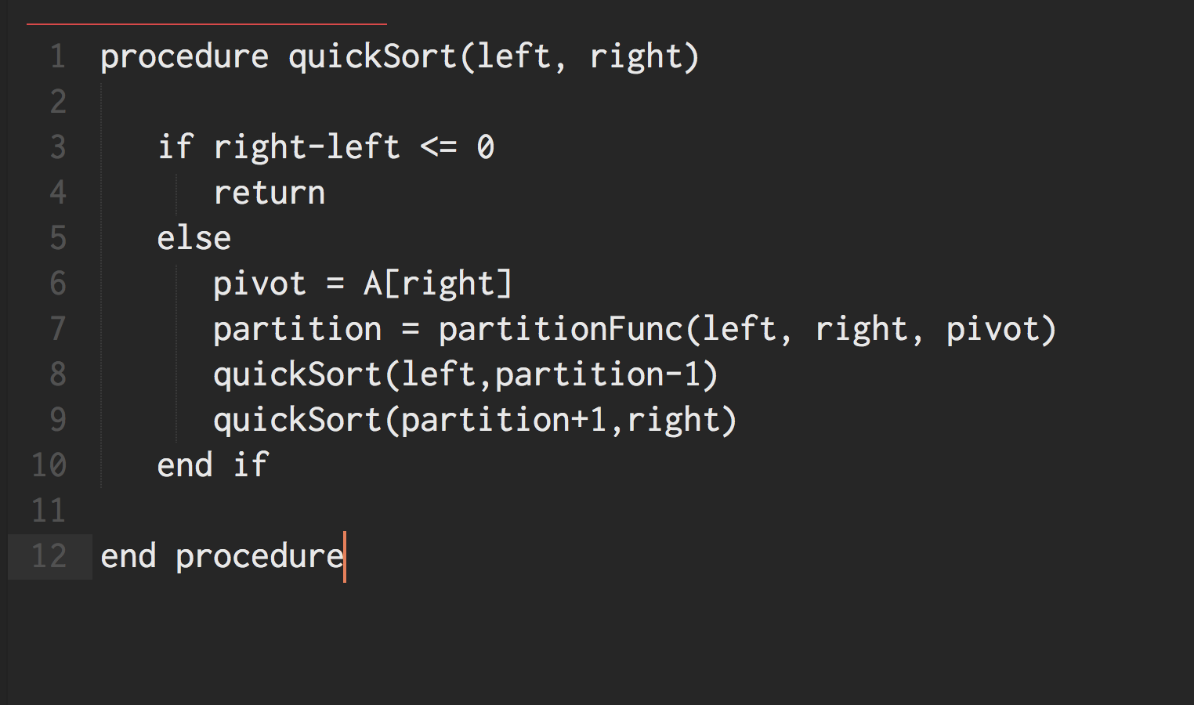

Slide 33
Quick Sort Complexity
Big-O Notation

Slide 34
Quick Sort Complexity
O(n²)
O(n logn)
O(n logn)
Worst Case
If array is sorted in reverse order
Best Case
If array is sorted already
Average Case
If half of the array is sorted already
Efficiency and optimization

Slide 35
Quicksort Game
Form groups of 3
Assign pivot, partition, and recursion roles

Slide 36
Quick Sort Exercises
1 | 3 | 7 | 9 | 23 | 12 | 18 | 27
Quicksort

Slide 37
Quick Sort Exercises
22 | 4 | 1 | 17 | 19 | 34 | 20 | 15 | 50 | 45 | 69
Quicksort

Slide 38
Quick Sort Exercises
20 | 33 | 17 | 45 | 29 | 55 | 60 | 51 | 92 | 72
Quicksort

Slide 39
Quick Sort Exercises
-5 | -9 | 44 | 92 | 45 | 34 | 17 | 34 | 92 | 72
Quicksort

Slide 40
Quick Sort Exercises
10 | 37 | 23 | 90 | 17 | 88 | 12 | 22 | 34 | 5
Quicksort

Slide 41
Quick Sort Exercises
b | g | z | y | h | l | c | a | f | i
Quicksort

Slide 42
Quick Sort Exercises
q | u | i | c | k | s | o | r | t
Quicksort

Slide 43
Thank You
Sorting

