Slide 1

Merge Sort
CS105 A 2nd Semester, SY17-18

Slide 2


Class Objectives
Understand and Implement MergeSort
Pros and Cons of Quick
Merge Sort: the good, the bad, the ugly

Slide 3
Merge Sort
Very efficient sorting algorithm

Slide 4
Merge Sort is a recursive comparison-based sorting algorithm that invented by John von Neumann

Slide 5
The Sorting Problem
Given an array A storing n numbers, return the array A ordered least to greatest, or greatest to least. In this case, in ascending order.
2 | 8 | 5 | 3 | 9 | 4 | 1 | 7

Slide 6
2 | 8 | 5 | 3 | 9 | 4 | 1 | 7
Recursively divide the array into 2

Slide 7
2 | 8 | 5 | 3 | 9 | 4 | 1 | 7
Recursively divide the array into 2 until we reach singular element arrays

Slide 8
2 | 8 | 5 | 3 | 9 | 4 | 1 | 7
2 | 8 | 5 | 3
9 | 4 | 1 | 7
Recursively divide the array into 2 until we reach singular element arrays

Slide 9
2 | 8 | 5 | 3 | 9 | 4 | 1 | 7
2 | 8 | 5 | 3
9 | 4 | 1 | 7
Recursively divide the array into 2 until we reach singular element arrays

Slide 10
2 | 8 | 5 | 3 | 9 | 4 | 1 | 7
2 | 8 | 5 | 3
9 | 4 | 1 | 7
2 | 8
5 | 3
9 | 4
1 | 7
Recursively divide the array into 2 until we reach singular element arrays

Slide 11
2 | 8 | 5 | 3 | 9 | 4 | 1 | 7
2 | 8 | 5 | 3
9 | 4 | 1 | 7
2 | 8
5 | 3
9 | 4
1 | 7
Recursively divide the array into 2 until we reach singular element arrays

Slide 12
2 | 8 | 5 | 3 | 9 | 4 | 1 | 7
2 | 8 | 5 | 3
9 | 4 | 1 | 7
2 | 8
5 | 3
9 | 4
1 | 7
5
2
3
8
9
4
1
7
Recursively divide the array into 2 until we reach singular element arrays

Slide 13
2 | 8 | 5 | 3 | 9 | 4 | 1 | 7
2 | 8 | 5 | 3
9 | 4 | 1 | 7
2 | 8
5 | 3
9 | 4
1 | 7
5
2
3
8
9
4
1
7
Once singular element arrays have been achieved, stop the recursive split call

Slide 14
5
2
3
8
9
4
1
7
2 | 8
3 | 5
4 | 9
1 | 7
Begin merge calls that sort the arrays

Slide 15
5
2
3
8
9
4
1
7
2 | 8
3 | 5
4 | 9
1 | 7
2 | 3 | 5 | 8
1 | 4 | 7 | 9
Begin merge calls that sort the arrays

Slide 16
5
2
3
8
9
4
1
7
2 | 8
3 | 5
4 | 9
1 | 7
2 | 3 | 5 | 8
1 | 4 | 7 | 9
1 | 2 | 3 | 4 | 5 | 7 | 8 | 9
Begin merge calls that sort the arrays

Slide 17
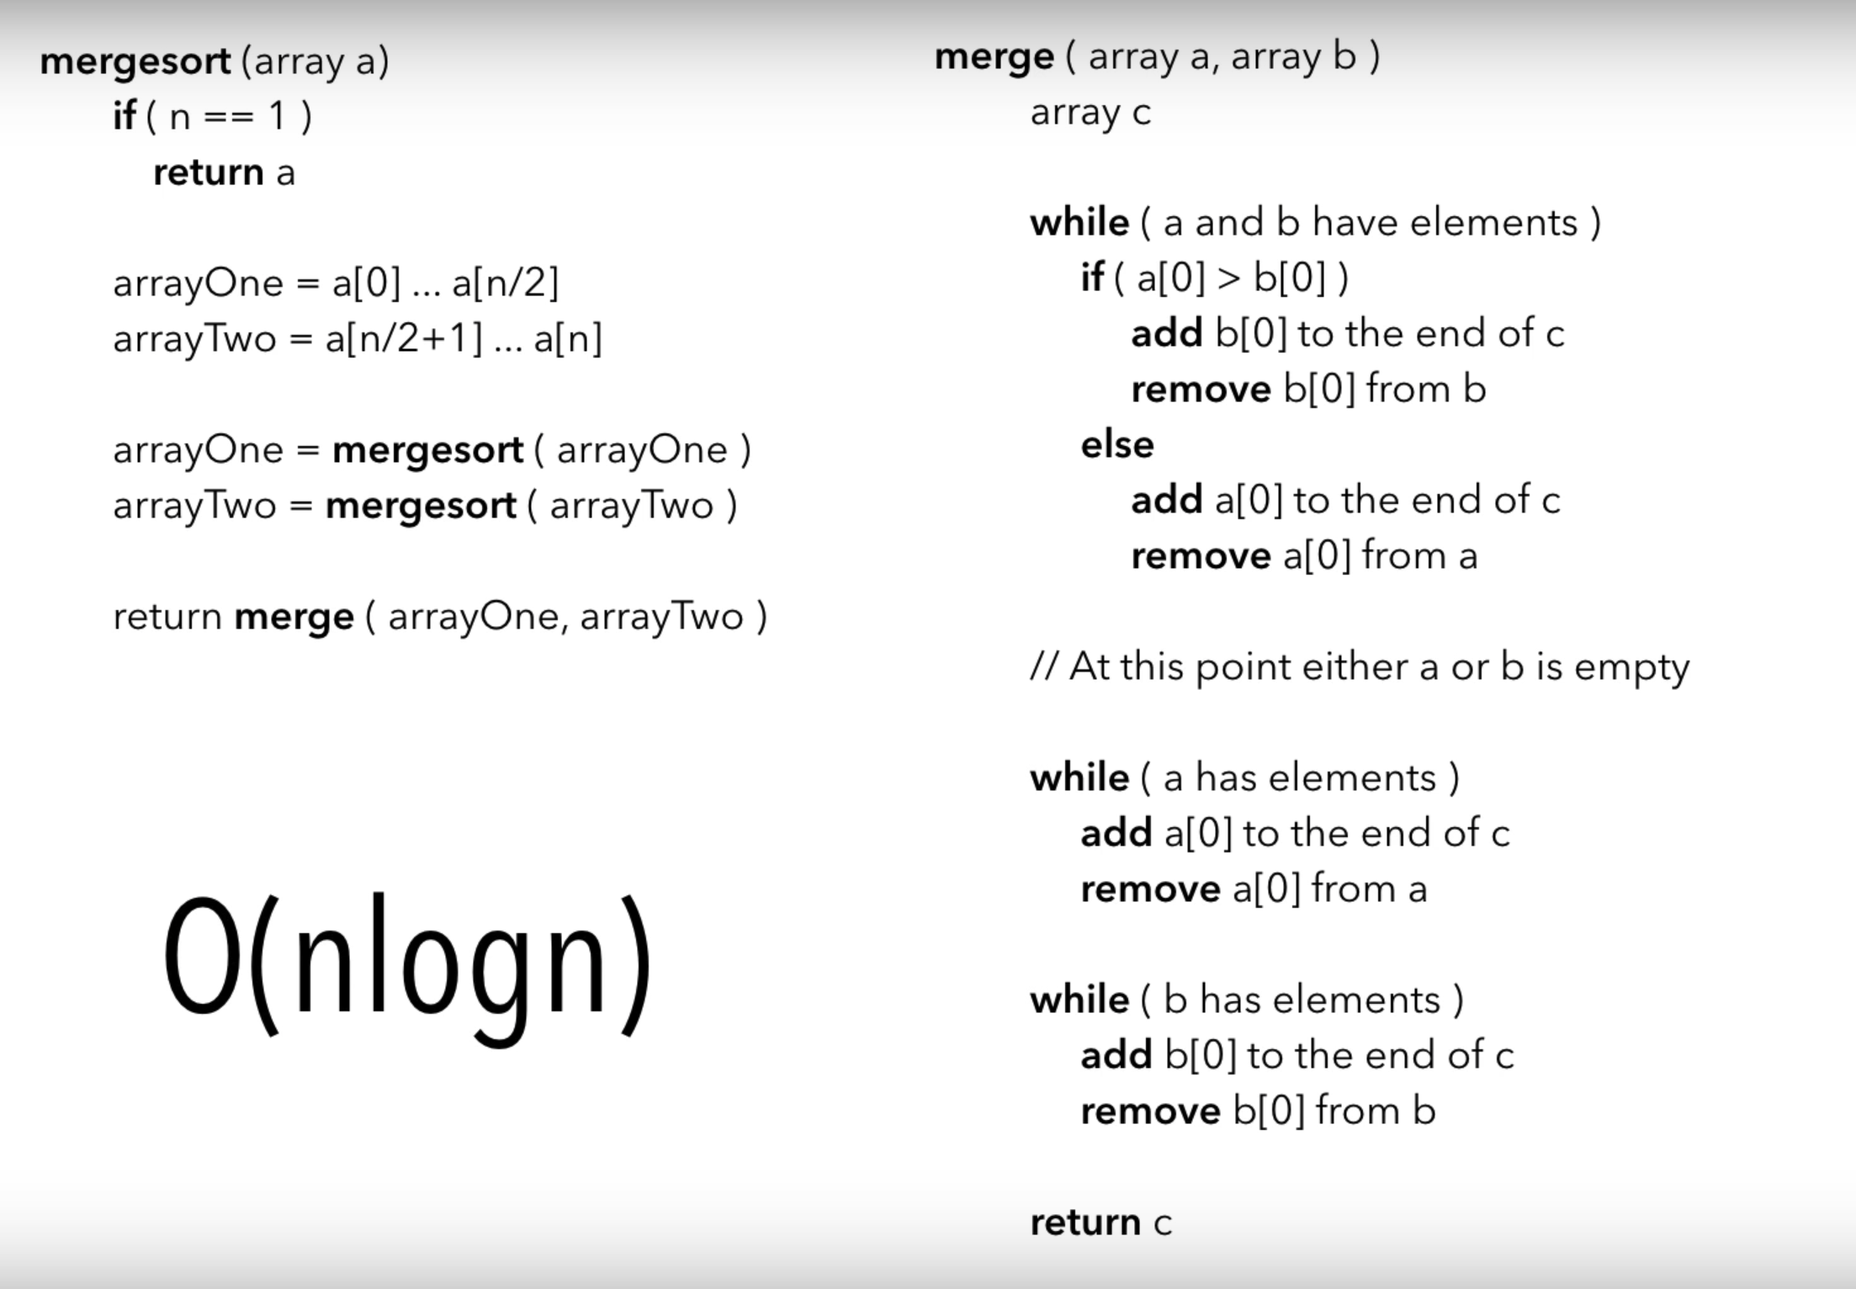

Slide 18
Merge Sort Complexity
Big-O Notation

Slide 19
Merge Sort Complexity
O(n logn)
O(n logn)
O(n logn)
Worst Case
If array is sorted in reverse order
Best Case
If array is sorted already
Average Case
If half of the array is sorted already
Efficiency and optimization

Slide 20
Merge Sort Game
Form groups of 3
Assign pivot, partition, and recursion roles

Slide 21
Merge Sort Exercises
1 | 3 | 7 | 9 | 23 | 12 | 18 | 27
Mergesort

Slide 22
Merge Sort Exercises
22 | 4 | 1 | 17 | 19 | 34 | 20 | 15 | 50 | 45 | 69
Mergesort

Slide 23
Merge Sort Exercises
20 | 33 | 17 | 45 | 29 | 55 | 60 | 51 | 92 | 72
Mergesort

Slide 24
Merge Sort Exercises
-5 | -9 | 44 | 92 | 45 | 34 | 17 | 34 | 92 | 72
Mergesort

Slide 25
Quick Sort Exercises
10 | 37 | 23 | 90 | 17 | 88 | 12 | 22 | 34 | 5
Mergesort

Slide 26
Merge Sort Exercises
b | g | z | y | h | l | c | a | f | i
Mergesort

Slide 27
Merge Sort Exercises
m | e | r | g | e | s | o | r | t
Mergesort

Slide 28
Thank You
Sorting

