Slide 1
Abstract Data Types
In-Computer representations of information

Slide 2
Data structures are a particular way of organizing and storing data in a computer so that they can be accessed and modified efficiently

Slide 3
Strings
Arrays
ArrayLists or Lists
“This is a string”
1 | 3 | 7 | 9
1 | 3 | 7 | 9
ArrayLists or Lists are mutable while arrays are not mutable or immutable

Slide 4
Arrays | ArrayLists or Lists
Immutable Very efficient access Costly to shuffle and rearrange Inserts and deletes require moving part of the array forward or backward | Mutable Easy to rearrange Inserts and deletes are easy
When read/write efficiency is paramount, use arrays, otherwise, lists can be used

Slide 5
Stack
Last in First out (LIFO) structure

Slide 6
Stacks are an abstract data type (ADT) that allows adding and removing elements in a particular order.

Slide 7
5
4
2
9
3
7
12
Every time an element is added, it goes on the top of the stack and the only element that can be removed is the element that is at the top of the stack, just like a pile of objects.
A

Slide 8
push: add element into the stack
pop: remove & return topmost element
peek: return topmost element (without removing it from the stack)
count: return the number of elements in the stack
clear: empties the stack of its contents
5
4
2
9
3
7
12
Stack Methods
Last in First out (LIFO) structure
A

Slide 9
5
4
2
9
3
7
12
Assumptions:
stack A with 7 elements
0-indexed, starting from 5 going to 12
extended from an array
Thought Experiment
Last in First out (LIFO) structure
A

Slide 10
A.push(17)
Adds 17 to the top of the list
Note that push requires a parameter to take in
17
5
4
2
9
3
7
12
Stack Push Function
Last in First out (LIFO) structure
A

Slide 11
A.pop()
Outputs 17 and removes it from the top of the list
A.pop() returns the type of the structure
Note that push does not require parameter to take in
5
4
2
9
3
7
12
Stack Pop Function
Last in First out (LIFO) structure
A

Slide 12
A.peek()
Outputs 5
A.peek() returns the type of the structure
Note that peek does not require parameter to take in
5
4
2
9
3
7
12
Stack Peek Function
Last in First out (LIFO) structure
A

Slide 13
A.count()
Outputs 7
A.count() returns an integer type
Note that count does not require parameter to take in
5
4
2
9
3
7
12
Stack Count Function
Last in First out (LIFO) structure
A

Slide 14
A.clear()
Outputs empty structure
Wipes out the rest of the stack
A
Stack Clear Function
Last in First out (LIFO) structure

Slide 15
Queues
First in First out (FIFO) structure

Slide 16
Queues are an abstract data type (ADT) that allows adding and removing elements in a more natural order.

Slide 17
5
4
2
9
3
7
12
Every time an element is added, it goes on the top of the queue and the only element that can be removed is the element at the end.
Pretty much like real-life queues.
A

Slide 18
enqueue: add element into the queue at the rear
dequeue: remove & return topmost element
peek: return topmost element (without removing it from the queue)
count: return the number of elements in the queue
clear: empties the queue of its contents
5
4
2
9
3
7
12
Queue Methods
First in First out (FIFO) structure
A

Slide 19
5
4
2
9
3
7
12
Assumptions:
queue A with 7 elements
0-indexed, starting from 5 going to 12
extended from an array
Thought Experiment
First in First out (LIFO) structure
A

Slide 20
A.enqueue(17)
Adds 17 to the top of the end of the queue
Note that enqueue requires a parameter to take in
5
4
2
9
3
7
12
17
Queue Enqueue Function
First in First out (LIFO) structure
A

Slide 21
A.dequeue() (returns 5)
Removes 5 from, the top of the end of the queue and returns it
Note that dequeue does not requires a parameter to take in
4
2
9
3
7
12
17
Queue Dequeue Function
First in First out (LIFO) structure
A

Slide 22
A.peek() (returns 4)
Returns 4 from, the top of the end of the queue but does not delete it
Note that peek does not requires a parameter to take in
4
2
9
3
7
12
17
Queue Peek Function
First in First out (LIFO) structure
A

Slide 23
A.count() (returns 7)
Outputs 7
A.count() returns an integer type
Note that count does not require parameter to take in
4
2
9
3
7
12
17
Queue Peek Function
First in First out (LIFO) structure
A

Slide 24
A.clear()
Outputs empty structure
Wipes out the rest of the queue
A
Queue Clear Function
First in First out (LIFO) structure

Slide 25
Queue Implementation
Implement a Queue Class with the following methods:
Dequeue
Enqueue
Peek
Count
Clear
Submit on Moodle
Ref code here: https://goo.gl/MWW1nA
Lab / Homework
Implement a Queue Class

Slide 26
LinkedList
Node implementation of a stack

Slide 27
LinkedLists are stacks that are built with nodes, instead of vanilla arrays

Slide 28
top
y
z
w
A stack as a sequence of nodes

Slide 29
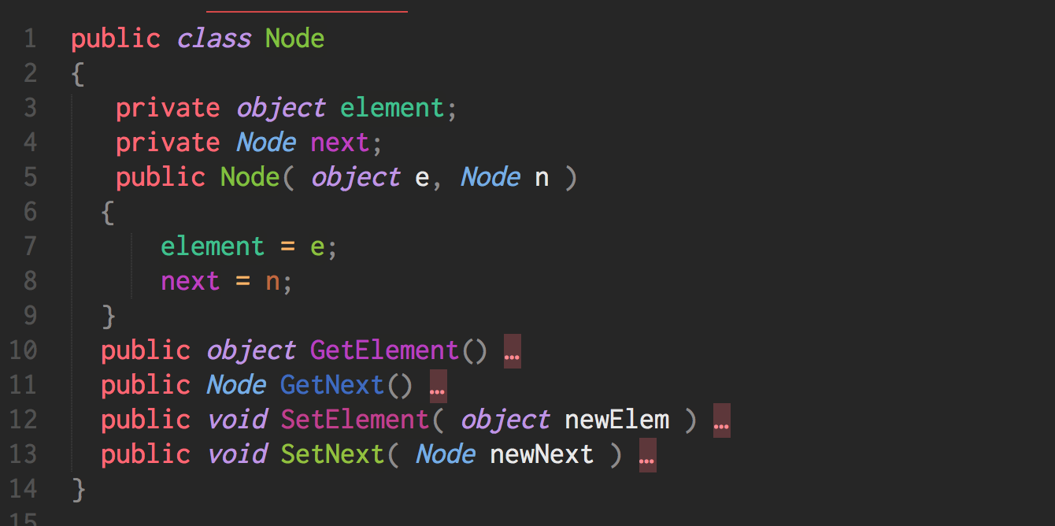
y

Slide 30
Stacks are represented by a Node reference called top, and links between nodes keep the list together

Slide 31
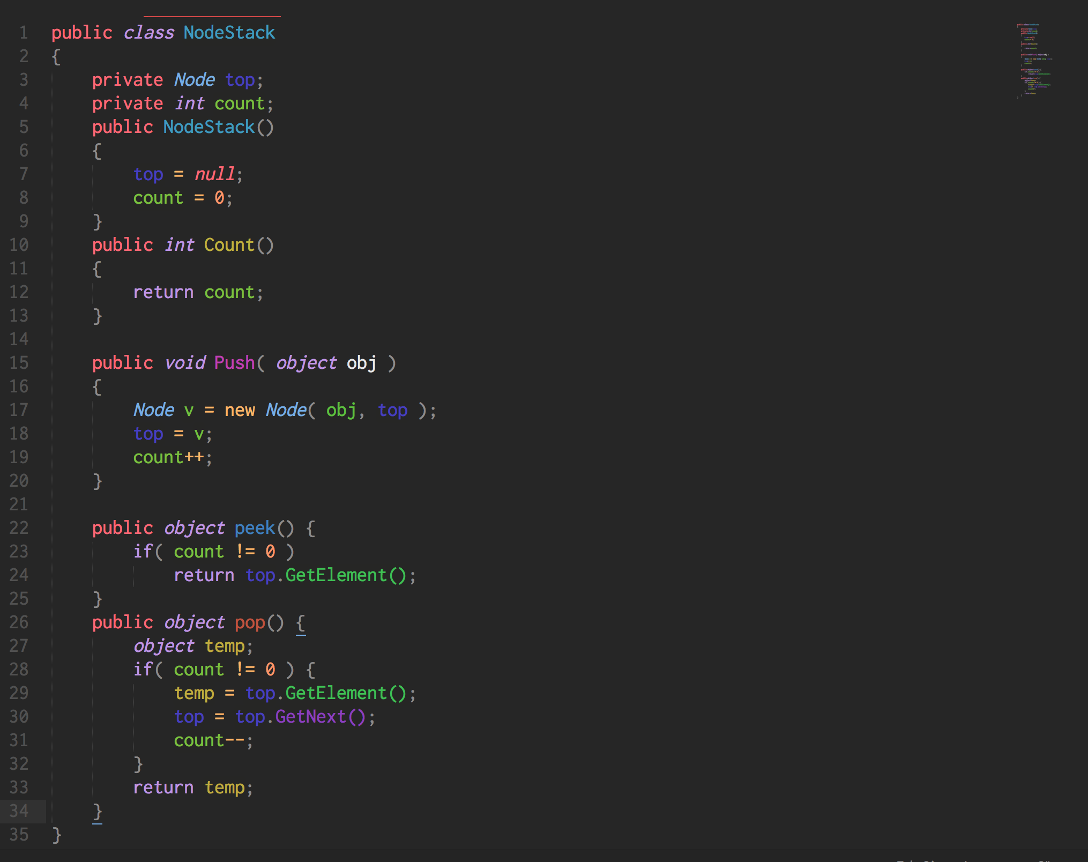

Slide 32
top
count
3
null
y
z
w
Push Operation

Slide 33
top
count
4
null
x
y
z
w
Push Operation
Update top and count values

Slide 34
top
count
3
null
x
y
z
w
temp
Pop Operation
Update top and count values, and map to temp

Slide 35
top
count
3
null
y
z
w
Pop Operation
Previous top is disposed, new top is assigned

Slide 36
NodeQueue
Node implementation of a queue

Slide 37
Queues that are represented by linked sequences of Nodes with 2 Node references for the top and bottom

Slide 38
NodeQueue Implementation
Implement a NodeQueue Class with the following methods:
Dequeue
Enqueue
Peek
Count
Clear
Submit on Moodle
Lab / Homework
Implement a NodeQueue Class

Slide 39
Thank you
Data Structures and Types

