Slide 1
Priority Queues
Queues with ordered preference

Slide 2
Queue Review
Queues, Queues, Queues

Slide 3
Queues are an abstract data type (ADT) that allows adding and removing elements in a more natural order.

Slide 4
5
4
2
9
3
7
12
Every time an element is added, it goes on the top of the queue and the only element that can be removed is the element at the end.
Pretty much like real-life queues.
A

Slide 5
enqueue: add element into the queue at the rear
dequeue: remove & return topmost element
peek: return topmost element (without removing it from the queue)
count: return the number of elements in the queue
clear: empties the queue of its contents
5
4
2
9
3
7
12
Queue Methods
First in First out (FIFO) structure
A

Slide 6
Priority Queues are ADTs that act like normal queues, but have priorities on which element gets removed or inserted into the queue.

Slide 7
Each element has a priority value that determines its importance. Higher priority supersedes low priority, but elements with same priority are served according to their queue order.

Slide 8
enqueue: add element into the queue at the rear
dequeue: remove & return topmost element
peek: return topmost element (without removing it from the queue)
count: return the number of elements in the queue
clear: empties the queue of its contents
5
4
2
3
3
7
12
Priority Queue Methods
First in First out (FIFO) structure
A

Slide 9
Priority Queue elements need to have a means by which to compare themselves.
Array A is prioritized by LOWER VALUES having HIGHER PRIORITY
5
4
2
3
3
7
12
0
Priority Queue Methods
6
First in First out (FIFO) structure
A

Slide 10
Dequeue()
Dequeue removes the element that has highest priority.
In this case, the first dequeue command will remove the value 2.
5
4
3
3
7
12
0
2
Least Value in PQ
5
Dequeue
First in First out (FIFO) structure
A

Slide 11
Enqueue(1)
Enqueues 1 to the top of the PQ
Behavior is similar to standard queue
1
5
4
3
3
7
12
0
Enqueue
6
First in First out (FIFO) structure
A

Slide 12
Dequeue()
Dequeue removes the element that has highest priority.
In this case, the second dequeue command will remove the value 3, but which one?.
5
4
3
3
7
12
0
5
Dequeue
First in First out (FIFO) structure
A

Slide 13
Dequeue()
Dequeue removes the element that has highest priority.
In this case, the second dequeue command will remove the value 3, but which one?
REMOVE THE FIFO VALUE IF ELEMENTS ARE SAME
5
4
3
3
7
12
0
5
Dequeue
First in First out (FIFO) structure
A

Slide 14
Dequeue()
Dequeue removes the element that has highest priority.
In this case, the second dequeue command will remove the value 3, but which one?
REMOVE THE FIFO VALUE IF ELEMENTS ARE SAME
1
5
4
3
7
12
0
5
3
Least Value in PQ
Dequeue
A
First in First out (FIFO) structure

Slide 15
PQ Implementation
Using Heaps for data structures

Slide 16
Heaps are trees that follow heap property:
If A is a parent node of B, then A is ordered with respect to B, for all nodes A, B in the heap

Slide 17
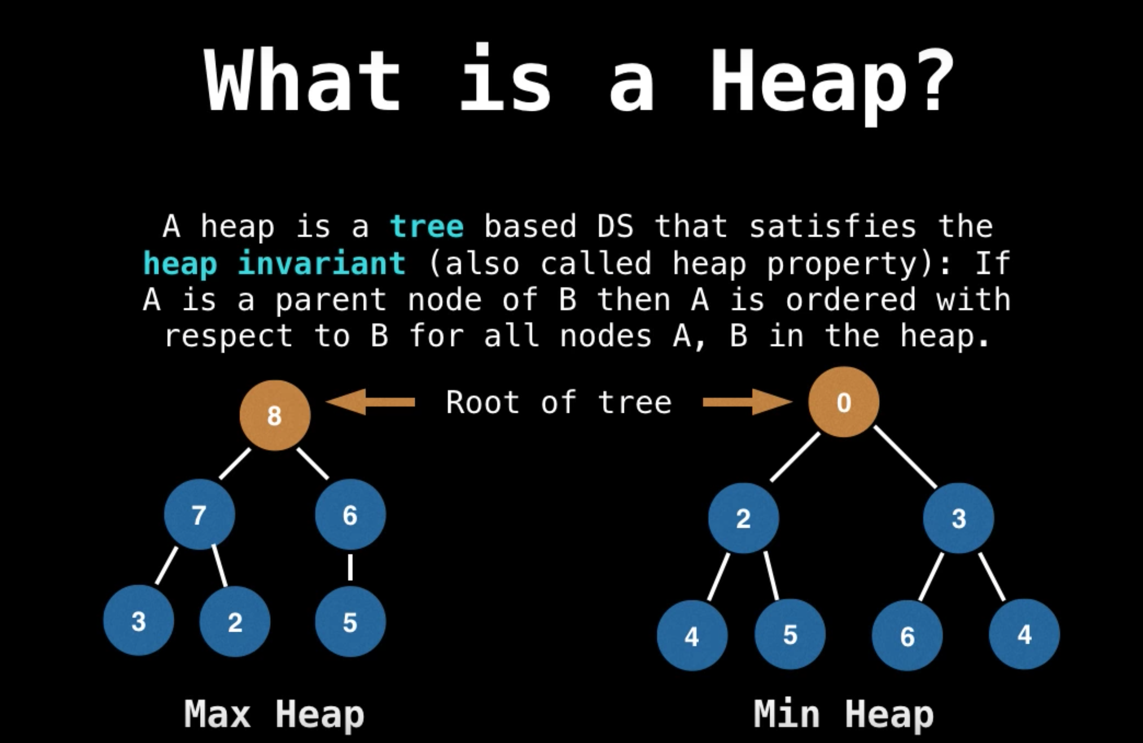

Slide 18
7
9
1
5
Heaps are trees where ordering from parent to child exists
6
2
0
5
This tree is an valid ordered tree and consequently, a heap because of the nodes being ascending in order.
4
8
Heap as a Tree

Slide 19
7
9
1
5
Heaps are trees where ordering from parent to child exists
6
4
0
5
This tree is an valid ordered tree and consequently, a heap because of the nodes being ascending in order.
4
8
Still a valid Heap as a Tree

Slide 20
7
9
1
5
6
2
4
5
This tree is an invalid heap because of the root node being out of order.
3
8
Not a valid Heap

Slide 21
Initialization | O(n)
Dequeueing | O(log n)
Enqueueing | O(log n)
Peeking | O(1)
Heap Performance

Slide 22
PQs are typically used for shortest-path algorithms, data compression, and finding the next-best/worst element in data structures
Use Cases

Slide 23
Thank you
Priority Queues

