Slide 1
Heap Sort
Sorting using Heap Structures

Slide 2
Heaps are trees that follow heap property:
If A is a parent node of B, then A is ordered with respect to B, for all nodes A, B in the heap

Slide 3
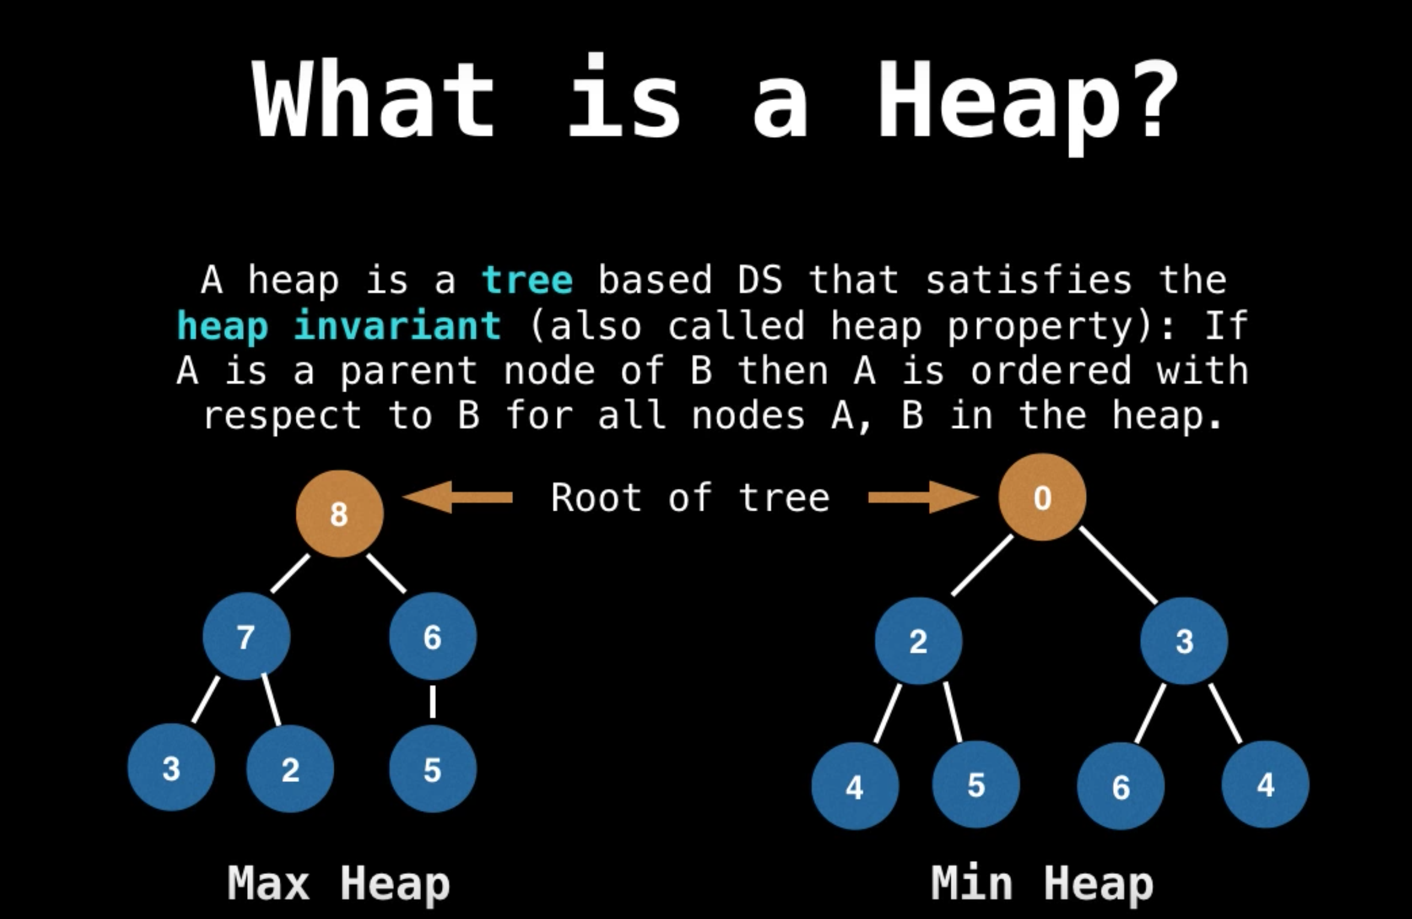

Slide 4
7
9
1
5
Heaps are trees where ordering from parent to child exists
6
2
0
5
This tree is an valid ordered tree and consequently, a heap because of the nodes being ascending in order.
4
8
Heap as a Tree

Slide 5
7
9
1
5
Heaps are trees where ordering from parent to child exists
6
4
0
5
This tree is an valid ordered tree and consequently, a heap because of the nodes being ascending in order.
4
8
Still a valid Heap as a Tree

Slide 6
7
9
1
5
6
2
4
5
This tree is an invalid heap because of the root node being out of order.
3
8
Not a valid Heap

Slide 7
Initialization | O(n)
Dequeueing | O(log n)
Enqueueing | O(log n)
Peeking | O(1)
Heap Performance

Slide 8
Create a Max Heap
Swap
Sort
3 Steps for Heap Sort

Slide 9
2 | 10 | 3 | 7 | 5
Start with unsorted array and convert into a binary tree

Slide 10
2 | 10 | 3 | 7 | 5
2
10
3
Build the array into a binary tree with a L to R tree expansion rule
7
5

Slide 11
2 | 10 | 3 | 7 | 5
Build a Max Heap
2
10
3
Build the array into a binary tree with a L to R tree expansion rule
7
5

Slide 12
2 | 10 | 3 | 7 | 5
Build a Max Heap
2
10
3
Swap the largest element with the root
7
5

Slide 13
10 | 2 | 3 | 7 | 5
Build a Max Heap
10
2
3
Continue swapping until max Heap is achieved
7
5

Slide 14
10 | 2 | 3 | 7 | 5
Build a Max Heap
10
2
3
Swap elements until Max Heap is achieved
7
5

Slide 15
10 | 7 | 3 | 2 | 5
Build a Max Heap
10
7
3
2
5
Max Heap achieved

Slide 16
10 | 7 | 3 | 2 | 5
Swap the first and last elements with each other
10
7
3
2
5

Slide 17
5 | 7 | 3 | 2 | 10
Swap the first and last elements with each other
10
7
3
2
5

Slide 18
5 | 7 | 3 | 2 | 10
Swap the first and last elements with each other
5
7
3
2
10

Slide 19
5 | 7 | 3 | 2 | 10
Delete the root node from the prior swap
5
7
3
Consider deleted node sorted and in place
2

Slide 20
5 | 7 | 3 | 2 | 10
Build a Max Heap
5
7
3
Swap elements until Max Heap is achieved
2

Slide 21
7 | 5 | 3 | 2 | 10
Build a Max Heap
7
5
3
Swap elements until Max Heap is achieved
2

Slide 22
7 | 5 | 3 | 2 | 10
Build a Max Heap
7
5
3
2
Max Heap achieved

Slide 23
2 | 5 | 3 | 7 | 10
Swap the first and last elements with each other
2
5
3
7

Slide 24
2 | 5 | 3 | 7 | 10
Delete the root node from the prior swap
2
5
3
Consider deleted node sorted and in place

Slide 25
2 | 5 | 3 | 7 | 10
Build a Max Heap
2
5
3
Swap elements until Max Heap is achieved

Slide 26
5 | 2 | 3 | 7 | 10
Build a Max Heap
5
2
3
Swap elements until Max Heap is achieved

Slide 27
5 | 2 | 3 | 7 | 10
Build a Max Heap
5
2
3
Max Heap achieved

Slide 28
3 | 2 | 5 | 7 | 10
Swap the first and last elements with each other
3
2
5

Slide 29
3 | 2 | 5 | 7 | 10
Delete the root node from the prior swap
3
2
Consider deleted node sorted and in place

Slide 30
3 | 2 | 5 | 7 | 10
Build a Max Heap
3
2
Swap elements until Max Heap is achieved

Slide 31
3 | 2 | 5 | 7 | 10
Build a Max Heap
3
2
Max Heap achieved

Slide 32
2 | 3 | 5 | 7 | 10
Swap the first and last elements with each other
2
3

Slide 33
2 | 3 | 5 | 7 | 10
Delete the root node from the prior swap
2
Consider deleted node sorted and in place

Slide 34
2 | 3 | 5 | 7 | 10
2
End when left with a single node in the heap.

Slide 35
2 | 3 | 5 | 7 | 10
Heap is sorted in ascending order now

Slide 36
Initialization | O(n)
Removing | O(log n)
Adding | O(log n)
Heap Performance

Slide 37
Best Case | O(n log n)
Worst Case | O(n log n)
Average Case | O(n log n)
Heap Sort Performance

Slide 38

Thank you
Heap Sort

