Slide 1


BRITISH AIRWAYS
Predictive Model and it’s Results

Slide 2
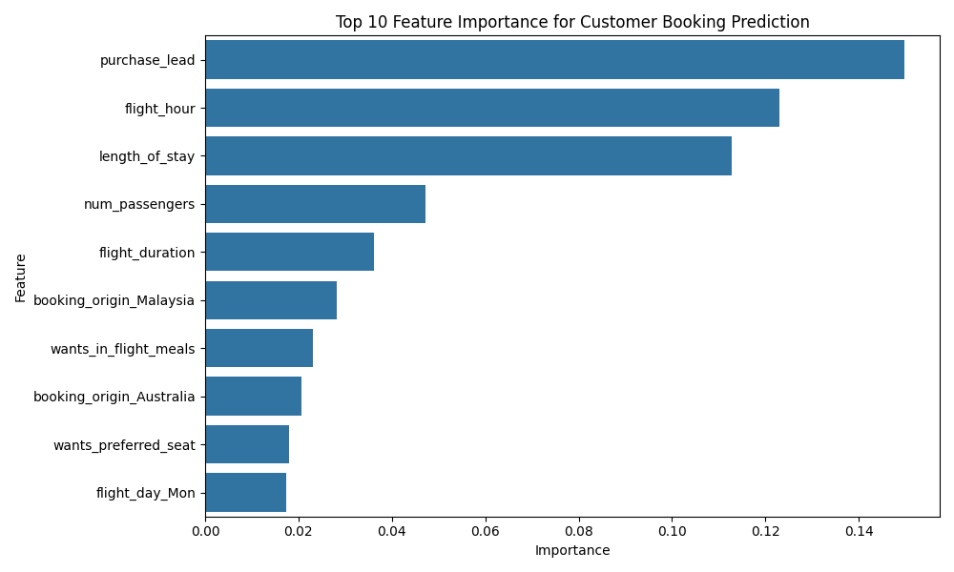
Key Findings
Key Insights
Purchase Lead is the strongest predictor which suggests that customers who book flights either well in advance or at the last minute have distinct behavior that the airline can target
Flight Time and Duration are critical factors for a customers decision making process. Evening or early morning flights as well as long-haul flights seem to increase booking likelihood.
Customers Preferences such as meals and luggage also are contributing factors
Recommendation to Airline
Target last minute Bookers – consider personalizing deals for customers who are browsing last minute flights
Optimize Flight Times – Focus on optimizing schedules for popular flight hours to increase bookings.
Enhance Loyalty programs – Encourage repeat bookings by leveraging meal preferences and seat section.
Geographic Campaigns – Focus targeted marketing efforts on regions like Malaysia and Australia where customers exhibit higher booking tendencies
Model Accuracy: 85.59%
Evaluation Metrics
Precision(Not Booked): 0.87
Precision(Booked): 0.55
F1-Score: 0.21

