Slide 1
Computing Tutorial
STORM basics
Chaoyi
03-11-2025

Slide 2
What is STORM
A powerful computer(Server) that can be accessed by multiple users for SBLers and collaborators, the operation system is Ubuntu (Linux based).
Internal address: storm.herseninstituut.knaw.nl
Access from outside of the NIN needs Twingate authorized by IT.
Remote connection protocol is ssh (Secure Shell):
Using terminal/X2go/VScode in MAC/Linux;
Using powershell/X2go/VScode in Window;
Example connecting command: ssh username@storm.herseninstituut.knaw.nl

Slide 3
What is Bash?
Bash = Bourne Again Shell, the default Linux command‑line shell.
A shell is a set of commands that allow you to interact with computer.
Lets you run commands, combine them with pipes, and script repeatable tasks.
Great for automation, job submission, environment setup.
Check your current shell with echo $0
Change shell with bash(tcsh, zsh…)

Slide 4
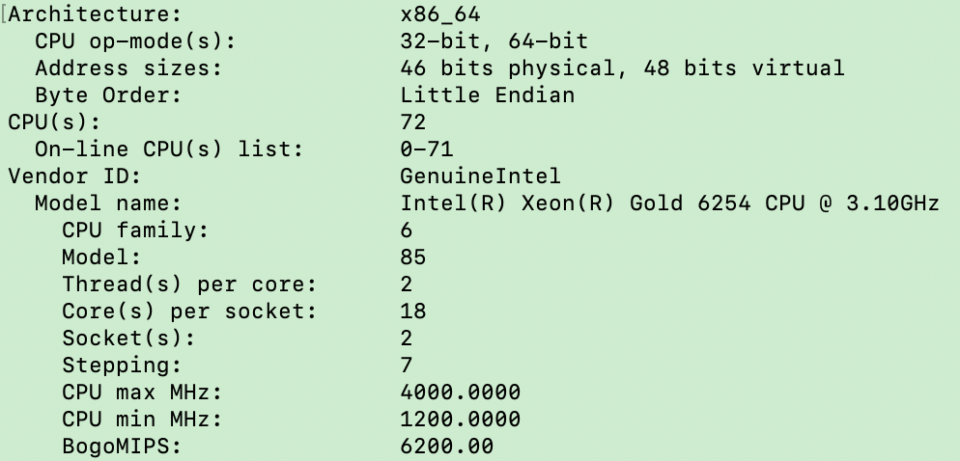
Central Processing Unit (CPU)
Check with lscpu for in the terminal
Processing power depends on:
  Clock speed (MHz/GHz)
  Core/thread count
  Cache sizes and memory bandwidth
A core is an independent compute unit inside a CPU. More cores ⇒ more tasks in parallel.
Threads are the units of scheduled work, many CPUs support SMT/Hyper‑Threading (2 threads per core).

Slide 5
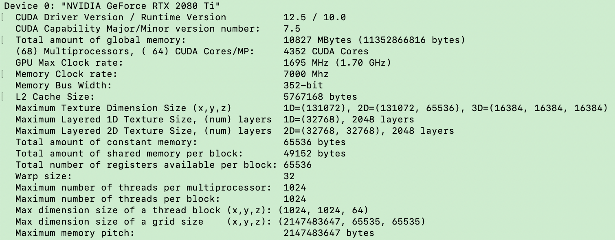
Graphics Processing Unit (GPU)
Check with /usr/local/cuda/samples/1_Utilities/deviceQuery/deviceQuery
Power is about throughput:
how many floating/int ops per second.
Key specs that matter
SM / CUDA core count: more = higher potential parallelism.
GPU Clock (MHz/GHz): higher = more ops per second (within power/thermal limits).
VRAM size (e.g., 10–80 GB): caps model/batch size that fits.
Memory bandwidth (bit): limits how fast data feeds the cores.

Slide 6
CPU vs GPU (what they do)
CPU (Central Processing Unit): general‑purpose, great at many different tasks, optimized for low‑latency and complex control flow.
GPU (Graphics Processing Unit): massive parallel engine, great at doing the same operation on lots of data, optimized for throughput.
Common workloads
CPU: system services, compilers, web servers, databases, small/branchy loops.
GPU: matrix/tensor ops, training/inference, image/video processing, simulations.
While a CPU can theoretically complete any task, a GPU can complete simpler, more specific tasks extremely quickly and efficiently

Slide 7
RAM usage vs CPU usage
CPU usage: how busy the compute units are (% time running instructions).
RAM usage: how much memory is currently allocated/used to hold data & code.
High RAM usage ≠ high CPU usage.
A job can:
Use lots of RAM but little CPU (big dataset waiting, memory‑bound)
Use lots of CPU but little RAM (tight compute loop)

Slide 8
Quick checks in terminal
# Summary of CPU
Lscpu
# GPU info
/usr/local/cuda/samples/1_Utilities/deviceQuery/deviceQuery
# Live CPU GPUand memory usage
top # press ‘1’to show per‑CPU, ‘t’CPU load, ‘m’memory load
htop/btop # nicer view but slower
nvidia-smi # GPU status for nvidia-GPU

