Slide 1
ASSIGNMENT 2 Title: “Top Choice For Parenthood:Baby Time”
Group Members and Student ID:
1)Jenny Kim B1301324 2)Francisca Fong Min B1701109
3)Yoon Yi Min B1700049 4)Barathi Priya A/P S SomasundramB1700858
Lecturer Name: Ms. Naline Shanmugam
Subject: BIT102-Internet Concepts and Infrastructure/Internet Services/
Internet Technology

Slide 2
Contents
Competitor’s Analysis
Target Audience
Client Expectations
Color Scheme Used on Our Website
Page Format Type Used on Our Website
Fonts Used on Our Website
Visit and Have A Look on the Website with the URL provided.

Slide 3
Analysis on competitors
Our competitor website is http://giggle.com
Giggle has the layout with the items selling in the online store which is very easy for the users to access
They have the information blog about pregnancy and parenting for the customers
However, they do not have any feedback page or review pages

Slide 4
Target Audience:
Age : Between 18 to 40 years old who has a baby or a toddler in their house.
Genders: For both female and male.
Interest of target audience: New parents who would like to get the necessary items for the baby, individuals who would like to get gifts for their baby or toddler in the house and to look for the suitable items that their baby or toddlers.
:Easy access of website and usage
Social Economic Criteria : The ones who had basic education or knowledge so that they can read details of the items and instructions that has been stated in the website.

Slide 5
Client’s Expectations
The website to be knowledgeable where they would favor to have some details clearly stated about the products listed for the babies.
Explanation: For instance, some parents could be new to parenthood and they would not know much details about the products and usage of it. For example, there are two types spoons that can be purchased which is the normal spoons and bottle spoons for the babies and when the information about the spoons is provided, the customers would know which spoon is suitable for their baby. From this, there will be more customers for the client’s website as the information will be provided about the product instead of just the main title and the customers don’t have to spend their time on searching for the details about the product.

Slide 6
Client’s Expectations
Website to be user friendly for the customers.
Explanation: For instance, the payment methods should be done easily where the customers can purchase the item they prefer easily. The payment options that were included in the websites are by credit card or by cash upon delivery where payment methods were made convenient for the customers. Moreover, once the customer purchase the item, it will be added to their cart so that the customers can purchase more than one item at a time and they don’t have to go through a long process for payments unlike other website. The website also has a consistent layout where the font size and size of images were standardized so that it would not confuse the customers during purchasing or when reading contents. Customers usually prefer a user friendly website and this website has fulfilled all the criteria of being user friendly. This would fulfil the client’s expectation and their purpose of the website.

Slide 7
Client’s Expectations
Time consistency
Explanation: Be time consistency where they prefer the website to be done within the expected time or delivery before the expected time. This would give a positive impression on us and when we over delivery the project, this will show the clients that we have well prepared for this project and the dedication towards it. In addition, this would make the customers to work with us again. When the project is done earlier, we’ll also have the time to make any changes and would satisfy the clients.

Slide 8
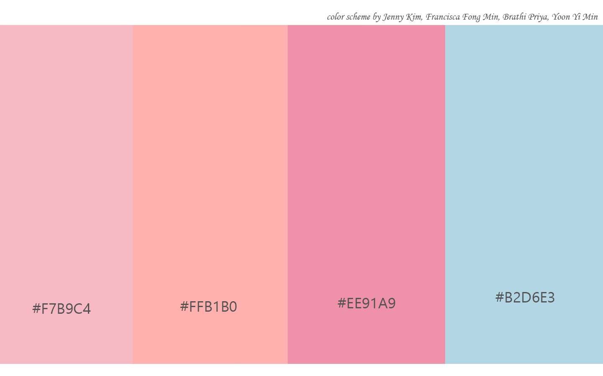
Color Scheme
Our colors are all in pastel color
We have chose the pastel colors for the website to emphasize the feeling of warmth and love with the babies. Pink and light blue are the most favored colors for the babies as they are giving comfort. Moreover, we had an idea that they express the true love of the parents for their children. Pastel colors are usually used to make the atmosphere and the theme peaceful in many ways.

Slide 9
Page Format Type
Our page format type is jello, which is a very good choice for the webpage of baby products. Our navigation bar is soft enough to look through, and the contents part, we added pictures of the baby products and have lesser texts than the graphics.
We had an opinion that this kind of type will be fit for Baby Time, and to the users who will be mostly the parents of babies.
Soft navigational bar
Warm color and the pictures
Less text, more graphics

Slide 10
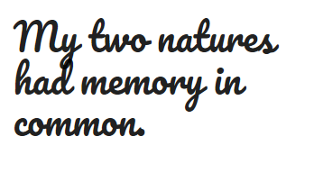
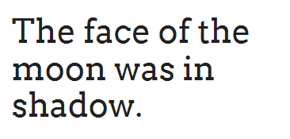
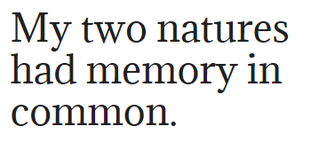
Fonts
We have chose the type of simple but gothic fonts to emphasize the value and the quality of our products and website.
Our fonts size are not large, however, it is easy to read and understand.
We have used Pacifico, Arvo and Adamina for the head, contents, and navigation bar respectively.
Head is about 250%, and the contents and the navigation bar are about 100%.

Slide 11
URL of the Website
file:///D:/BIT%20html/home.html

