Slide 1
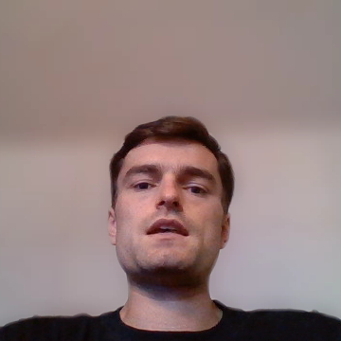
Autonomous ML
Research Agent
NLP with Disaster Tweets · Track A
Advanced Predictive Analytics 2025/2026
May 2026
F1 0.8437
#65 / 713
Kaggle best
Leaderboard
Notes:
[~25 sec]
Hi, I’m Lourenço, and this is our Advanced Predictive Analytics project: an autonomous Machine Learning research agent for the Kaggle Disaster Tweets competition.
The task is binary NLP classification: deciding whether a tweet describes a real disaster or not. Our best Kaggle public F1 score was 0.84370, placing us sixty-fifth out of seven hundred and thirteen teams. But the main goal was to build a system that could run machine learning experiments by itself.

Slide 2







The Agent Loop
One command. Zero human intervention. Fully autonomous.
›
›
›
›
›
Curriculum
Selector
LLM
Proposes
Code
Generates
Sandboxed
Executor
F1 Parser
+ Logger
Memory
Logger
Fully Offline
Repair Loop
Persistent Memory
Ollama at localhost:11434/v1
qwen2.5-coder:14b · Temp 0.3
8,192 max tokens — no truncation
On crash: LLM fixes code
Up to 3 retries per experiment
Final attempt = full rewrite
experiments.json stores everything
Code · F1 · errors · LLM analysis
Fed back as context each iteration
Notes:
[~50 sec]
The core of the project is this autonomous loop.
A curriculum selector chooses the next architecture family. Then a local LLM running through Ollama generates a complete Python training script. The script is executed in a subprocess sandbox, not through eval or exec.
After training, the parser extracts the validation F1 and Keras learning curves. Everything is stored in experiments.json: prompts, code, errors, scores, learning curves, and the LLM’s own analysis.
If the code crashes, the agent asks the LLM to repair it, up to three times, with a full rewrite on the final attempt.

Slide 3
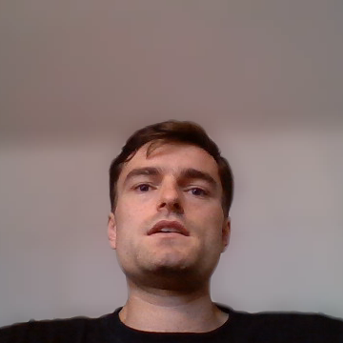
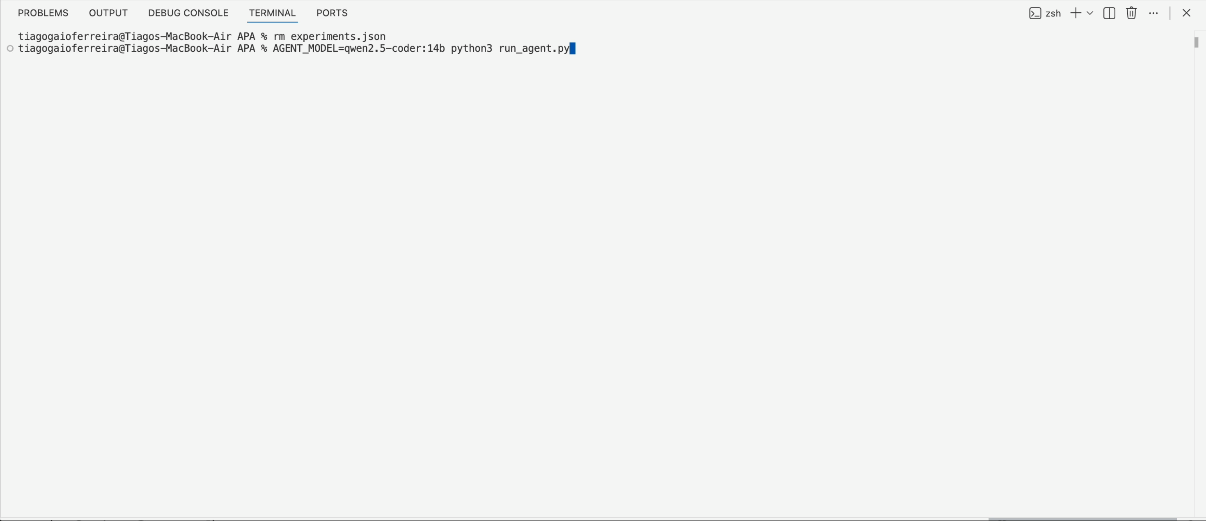
Demo
Notes:
Here is the agent running.
The important point is that this is not a notebook where we manually choose each model. The agent receives the task, chooses a model family, generates code, runs it, logs the result, and uses that memory in the next iteration.
So the LLM is not just suggesting ideas. It is driving the experiment loop.

Slide 4

Prompt Engineering
The most important engineering artifact in the project
SYSTEM_PROMPT
PROPOSE_PROMPT
FIX_PROMPT
Task spec + metric (F1)
Stratified experiment memory
Error message + traceback
Allowed vs forbidden libs
FAILED archs → never retry
Full broken script
Known Keras/sklearn gotchas
LOW-SCORING → don't tweak
Instruction: fix only, no prose
Complete Keras template
Curriculum-assigned family
Final attempt: full rewrite
Strict output format rules
≤2 hyperparameter changes
Restate Keras template
Data hygiene requirements
Concrete good/bad examples
Model-agnostic (swap via env)
Key insight: separating FAILED (never retry) from LOW-SCORING (don't tweak) prevented the LLM from wasting iterations on dead ends
Notes:
[~45 sec]
Prompt engineering was one of the most important parts of the system.
The SYSTEM_PROMPT defines the task, metric, allowed libraries, known Keras and sklearn issues, output format, and data hygiene rules.
The PROPOSE_PROMPT gives the model memory: current best result, tried architectures, failed models, low-scoring models, hyperparameter signatures, and variation axes.
A key design choice was separating failed models from low-scoring ones. Failed models should not be retried exactly. Low-scoring models can be revisited, but only with a meaningful change.

Slide 5

10-Step Curriculum
Explore broadly first, exploit the winners. Classical runs test the same hypothesis at 30× throughput.
1
TF-IDF Linear Baseline
6
Keras CNN + GRU Hybrid
2
TF-IDF Probabilistic
7
Keras Transformer (MHA)
3
TF-IDF Dense MLP
8
Exploit: Best Classical
4
Keras Embedding + CNN
9
Exploit: Best Deep Learning
5
Keras Embedding + GRU/BiLSTM
10
Final Refinement
Classical exploration (3 sec)
Deep learning (90 sec)
Exploitation phase
Notes:
[~35 sec]
The curriculum gives structure to the search.
The agent starts with fast classical models: TF-IDF linear models, probabilistic baselines, and dense MLPs. Then it moves to Keras CNNs, recurrent models, CNN-GRU hybrids, and small self-attention models.
Only after this broad exploration does it exploit the best classical family, the best deep-learning family, and then run a final refinement.
This kept the search realistic under our runtime limits

Slide 6

Results — What the Agent Tried
30 experiments across 10 curriculum families
0.792
Agent best
Keras Embedding + CNN + GRU hybrid
0.8321
Ensemble val
CountVec+LogReg + Transformer + RoBERTa
0.8437
Kaggle score
Final leaderboard · #65 / 713
Classical
Deep learning
DistilBERT
RoBERTa
Ensemble
Notes:
[~45 sec]
Across 30 autonomous experiments, the best agent-generated model reached validation F1 of 0.792 with a Keras Embedding plus CNN-GRU hybrid.
One key finding was that complexity did not automatically win. Classical TF-IDF models stayed competitive because tweets are short, noisy, and often keyword-heavy.
Our final manual ensemble combined classical models, a Keras Transformer, and RoBERTa, reaching validation F1 of 0.8321 and a Kaggle public score of 0.84370.

Slide 7




Challenges
What was hard and what we learned
LLM code reliability
LESSON
Experiment crashed on the MultiHeadAttention-in-Sequential error we explicitly warned about in the system prompt.
Gotcha lists reduce failures, they don't eliminate them. Retry-with-full-rewrite was the real fix.
Epoch defaults misled conclusions
LESSON
5-epoch default caused Keras undertraining. Val loss was still falling at epoch 5. We almost concluded deep learning was categorically inferior.
Learning curves from our EpochPrinter revealed this. Increased to 10 epochs, Keras F1 jumped.
Repetitive experiments without memory design
LESSON
Without the failed/low-scoring separation, the LLM kept proposing minor tweaks to dead-end architectures.
Two-list memory: FAILED (never retry) vs LOW-SCORING (don't tweak), eliminated this.
Notes:
[~35 sec]
Three challenges shaped the final design.
First, LLM-generated code is not always reliable. Prompt rules helped, but the repair loop was essential.
Second, defaults can mislead conclusions. Early Keras runs looked weak, but the learning curves showed validation loss was still falling, meaning the models were undertrained.
Third, memory design mattered. Separating failed, low-scoring, and successful experiments made the search more disciplined.

Slide 8

Pretrained Models — The Ceiling
DistilBERT · RoBERTa · all run locally, no cloud
DistilBERT
~0.810
RoBERTa-base
~0.819
Final Ensemble
0.8437
66M params (−40% vs BERT)
~125M params
CountVec+LogReg (F1 0.7786)
WordPiece tokenizer
Byte-level BPE tokenizer
Keras Transformer (F1 0.7830)
2 epochs · lr=1e-5 · batch 32
3 epochs · EarlyStopping · AdamW
RoBERTa × 2 runs avg 50/50
~45 min on CPU (M4 Air)
Apple Silicon GPU (MPS backend)
5-fold CV on cheap models
Raw tweet text (no cleaning)
Raw tweet text (no cleaning)
Weight+threshold grid search
Upper bound confirmed
Best single model
Best overall result
Notes:
[~35 sec]
The pretrained models helped us understand the agent’s current ceiling.
DistilBERT and RoBERTa performed better not just because they are Transformers, but because they already contain language knowledge from massive pretraining.
Our from-scratch Keras Transformer did not have that advantage. This was the clearest course lesson: on small datasets, pretrained representations can matter more than adding architectural complexity from scratch.

Slide 9
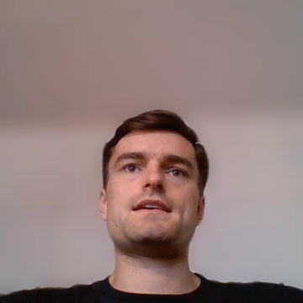
What We Built
"Building a system that builds systems is mostly prompt engineering, memory design, and error recovery. The ML is almost the easy part."
F1
01
A machine that builds machines
DeBERTa v3
0.856
One command. 30 experiments. F1 0.792. Discovered best classical architecture autonomously. Zero human steps in the loop.
DistilBERT
0.810
02
Prompt engineering is the product
Ensemble
0.844
The system prompt, memory design, and error recovery accounted for more impact than any architecture choice.
Agent best
0.792
03
Defaults shape conclusions
5-epoch Keras runs looked weak as they were undertrained. Learning curves told the real story. Always validate your defaults.
Baseline
0.750
Francisca Nunes · Tiago Ferreira · Lourenço Sarmento · José Lopes
Notes:
[~25 sec]
The main takeaway is that autonomous ML is not just asking an LLM to generate code.
The real system is the loop around it: prompts, memory, sandboxed execution, parsing, logging, repair, and iteration.
We built a working agent that completed autonomous runs, explored a full NLP curriculum, learned from experiment logs, recovered from failures, and produced a Kaggle submission.
A future version should add a slower GPU-enabled track, so the agent can fine-tune pretrained encoders and build ensembles autonomously.
Thank you.

