Slide 1

Autonomous ML
Research Agent
NLP with Disaster Tweets · Track A
Advanced Predictive Analytics 2025/2026
May 2026
F1 0.8437
#65 / 713
Kaggle best
Leaderboard

Slide 2







The Agent Loop
One command. Zero human intervention. Fully autonomous.
›
›
›
›
›
Curriculum
Selector
LLM
Proposes
Code
Generates
Sandboxed
Executor
F1 Parser
+ Logger
Memory
Logger
Fully Offline
Repair Loop
Persistent Memory
Ollama at localhost:11434/v1
qwen2.5-coder:14b · Temp 0.3
8,192 max tokens — no truncation
On crash: LLM fixes code
Up to 3 retries per experiment
Final attempt = full rewrite
experiments.json stores everything
Code · F1 · errors · LLM analysis
Fed back as context each iteration

Slide 3

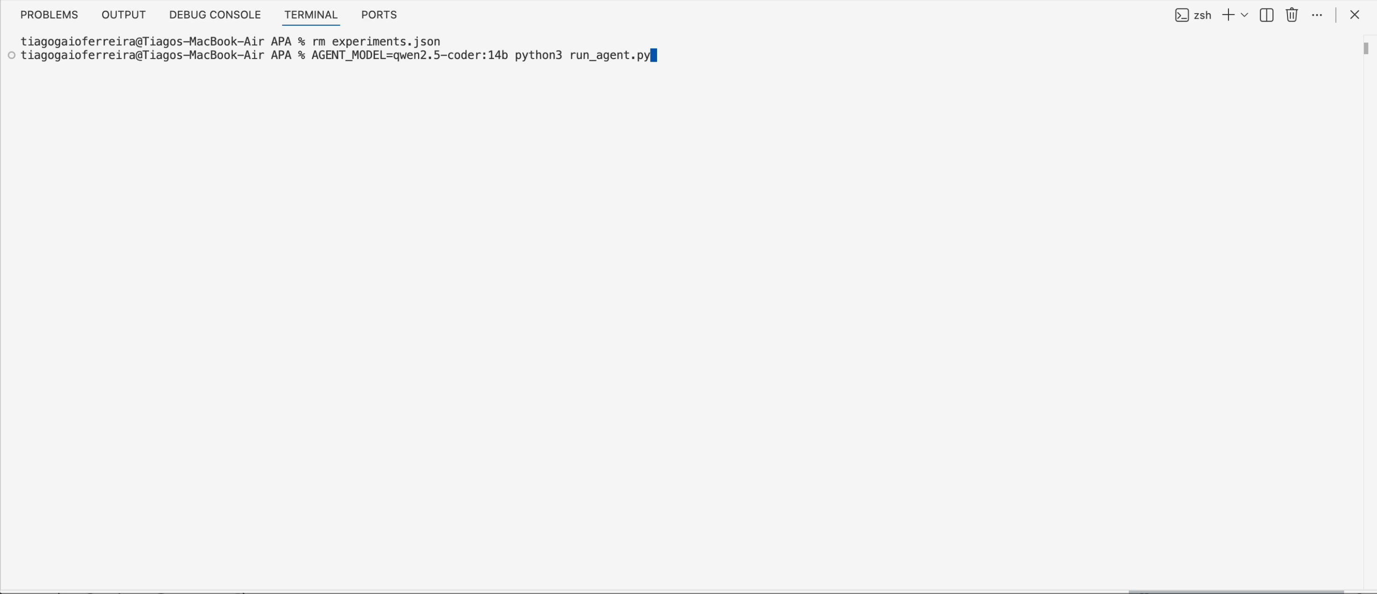
Demo

Slide 4

Prompt Engineering
The most important engineering artifact in the project
SYSTEM_PROMPT
PROPOSE_PROMPT
FIX_PROMPT
Task spec + metric (F1)
Stratified experiment memory
Error message + traceback
Allowed vs forbidden libs
FAILED archs → never retry
Full broken script
Known Keras/sklearn gotchas
LOW-SCORING → don't tweak
Instruction: fix only, no prose
Complete Keras template
Curriculum-assigned family
Final attempt: full rewrite
Strict output format rules
≤2 hyperparameter changes
Restate Keras template
Data hygiene requirements
Concrete good/bad examples
Model-agnostic (swap via env)
Key insight: separating FAILED (never retry) from LOW-SCORING (don't tweak) prevented the LLM from wasting iterations on dead ends

Slide 5

10-Step Curriculum
Explore broadly first, exploit the winners. Classical runs test the same hypothesis at 30× throughput.
1
TF-IDF Linear Baseline
6
Keras CNN + GRU Hybrid
2
TF-IDF Probabilistic
7
Keras Transformer (MHA)
3
TF-IDF Dense MLP
8
Exploit: Best Classical
4
Keras Embedding + CNN
9
Exploit: Best Deep Learning
5
Keras Embedding + GRU/BiLSTM
10
Final Refinement
Classical exploration (3 sec)
Deep learning (90 sec)
Exploitation phase

Slide 6

Results — What the Agent Tried
30 experiments across 10 curriculum families
0.792
Agent best
Keras Embedding + CNN + GRU hybrid
0.8321
Ensemble val
CountVec+LogReg + Transformer + RoBERTa
0.8437
Kaggle score
Final leaderboard · #65 / 713
Classical
Deep learning
DistilBERT
RoBERTa
Ensemble

Slide 7




Challenges
What was hard and what we learned
LLM code reliability
LESSON
Experiment crashed on the MultiHeadAttention-in-Sequential error we explicitly warned about in the system prompt.
Gotcha lists reduce failures, they don't eliminate them. Retry-with-full-rewrite was the real fix.
Epoch defaults misled conclusions
LESSON
5-epoch default caused Keras undertraining. Val loss was still falling at epoch 5. We almost concluded deep learning was categorically inferior.
Learning curves from our EpochPrinter revealed this. Increased to 10 epochs, Keras F1 jumped.
Repetitive experiments without memory design
LESSON
Without the failed/low-scoring separation, the LLM kept proposing minor tweaks to dead-end architectures.
Two-list memory: FAILED (never retry) vs LOW-SCORING (don't tweak), eliminated this.

Slide 8

Pretrained Models — The Ceiling
DistilBERT · RoBERTa · all run locally, no cloud
DistilBERT
~0.810
RoBERTa-base
~0.819
Final Ensemble
0.8437
66M params (−40% vs BERT)
~125M params
CountVec+LogReg (F1 0.7786)
WordPiece tokenizer
Byte-level BPE tokenizer
Keras Transformer (F1 0.7830)
2 epochs · lr=1e-5 · batch 32
3 epochs · EarlyStopping · AdamW
RoBERTa × 2 runs avg 50/50
~45 min on CPU (M4 Air)
Apple Silicon GPU (MPS backend)
5-fold CV on cheap models
Raw tweet text (no cleaning)
Raw tweet text (no cleaning)
Weight+threshold grid search
Upper bound confirmed
Best single model
Best overall result

Slide 9
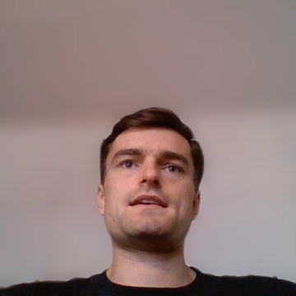
What We Built
"Building a system that builds systems is mostly prompt engineering, memory design, and error recovery. The ML is almost the easy part."
F1
01
A machine that builds machines
DeBERTa v3
0.856
One command. 30 experiments. F1 0.792. Discovered best classical architecture autonomously. Zero human steps in the loop.
DistilBERT
0.810
02
Prompt engineering is the product
Ensemble
0.844
The system prompt, memory design, and error recovery accounted for more impact than any architecture choice.
Agent best
0.792
03
Defaults shape conclusions
5-epoch Keras runs looked weak as they were undertrained. Learning curves told the real story. Always validate your defaults.
Baseline
0.750
Francisca Nunes · Tiago Ferreira · Lourenço Sarmento · José Lopes

