Slide 1
The Impact of a Single Lecture on Program Plans in First-Year CS
Francis Castro (WPI)
Shriram Krishnamurthi (Brown University)
Kathi Fisler (Brown University)

Slide 2
Given the Rainfall problem (average non-negative numbers from a sequence), students often produce programs with many errors or non-viable structures
Research shows programmers retrieve and adapt solutions to “similar” problems
How much exposure do students need to potential solution structures?
Notes:
- Past studies on the Rainfall problem, which asks students to average non-negative values in a sequence, have shown that students produce programs with many errors or use solution structures that don't fit the problem well - This ties into prior work that shows that programmers retrieve and adapt solutions from similar problems - So, in this small study, we wanted to look at how much exposure students need to potential solution structures to be able to use them effectively

Slide 3
Study Design
Students produce code for 2-3 plan-comp problems
Give 50-minute lecture on different plans for those problems
Students produce two solutions for different plan-comp problems; preference rank them
A plan-comp problem (e.g., Rainfall)
Solution #1
Solution #2
Preference ranking
Evaluate for structural differences
Can students produce multiple different structures after one lecture? Do they prefer different structures than what they produced before the lecture?
Notes:
- For our study, we asked students to produce code for 2 to 3 plan composition problems as a pre-assessment, then gave them a 50 minute lecture on different plans for solving those problems - In the post-assessment, we asked them to produce 2 structurally different solutions for a new set of problems, as well as preference rank the solutions they wrote - We wanted to see whether students can produce multiple different structures after a lecture and whether they prefer different structures than what they produced before the lecture

Slide 4
Study Design
Students produce code for 2-3 plan-comp problems
Give 50-minute lecture on different plans for those problems
Students produce two solutions for different plan-comp problems; preference rank them
CourseA: “intro” course (functional) for students with significant prior programming (often Java)
CourseB-nov: students in a second course (Java) who were novices in first course (Racket)
CourseB-exp: same course as B-nov, but significant prior programming before first course
Can students produce multiple different structures after one lecture? Do they prefer different structures than what they produced before the lecture?
Notes:
- We had 3 sets of students in our study - Students in CourseA were in an intro course using functional programming, but with significant prior programming experience - CourseB-novice were students in their second programming course but were novices in an earlier programming course that used functional programming - CourseB-expert were also in their second programming course but already had significant prior programming experience even before their first programming course

Slide 5
Pre Lecture Problems
Post Lecture Problems
Rainfall: compute average ignoring negatives; truncate at sentinel
Data Smoothing: given list of numbers, produce list of averages of each sublist of 3 consecutive elements
Max Triple Length: find longest length of 3 consecutive strings in list
Earthquake Monitor: given list interleaved dates and sensor readings, produce list of max reading on each date in given month
Adding Machine: produce list of sums of sublists as separated by zeros; stop at two consecutive zeros
Notes:
Say something here about parallels between the problems (avg and windows of 3, processing sublists). You could easily lose a lot of time here reading through all the problems – just review at high level.
==========
- We game Rainfall as a pre-lecture problem, as well as Max-triple-length, which asks to find the longest length of 3 consecutive strings from a list - For the post lecture, we gave Data-Smoothing, which shares similar characteristics as Rainfall in terms of computing averages, and Max-triple-length, in terms of looking at 3-element windows of data - We also had Adding-Machine in the pre-lecture, which asks to produce a list of sums until a sentinel pattern, and Earthquake-Monitor in the post-lecture, which shares characteristics with Max-Triple-Length in finding maximum values, and Adding-Machine in terminating computations at a sentinel pattern

Slide 6
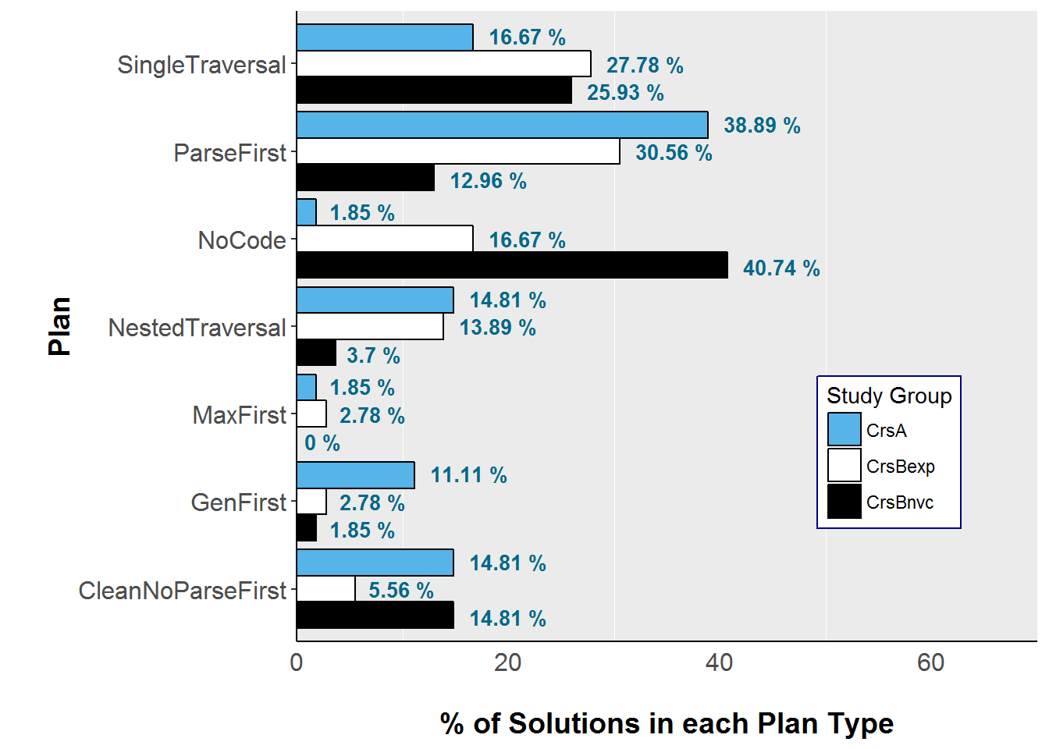
Taste of the Findings -- Earthquake
One pass over data, all tasks interwoven
Two passes over data, one to reshape, one to process
Suggests students with more experience get more from the single lecture
Notes:
Will need to remind what earthquake problem was. Remind that blue and white had experience before first course. Note high incidence of no code in Bnovice. Note high use of parsing in experienced students, and that novice students who did get somewhere more likely to try with a single traversal
==========
- I'll just show initial results for the Earthquake problem, which again asks to get the maximum sensor reading for each date from an interleaved list of dates and readings. - Here we found that students without any programming experience before the first course --- the black bar --- were mostly unable to write a solution for the problem - Those who had prior experience and were in a course on functional programming --- the blue bar --- mostly did a Parse-first solution, where parsing means they went over the data in two passes, one to reshape the data, and one to process the data - The others did a Single-Traversal solution, where they went over the data in one pass and all tasks were interwoven in that single pass - The CourseA and some CourseB-Expert students generally had more varied solutions, which suggest that students with more experience got more from the single lecture

Slide 7
Taste of the Findings -- Preferences
CourseB: Students preferred diverse solution structures in post, despite all using a single-traversal structure in Rainfall in initial assignment
CourseA: Had a preference ranking question on pre-assessment (on solutions we provided). No clear pattern in structure preferences between pre and post; many students changed preferences
Suggests single lecture does get students thinking about different solution structures
Notes:
- In terms of their preferences, CourseB students had diverse preferences in solution structures in the post-assessment, even when their pre-assessment solutions only showed one solution structure - CourseA students also had a preference ranking question on the pre-assessment; They changed structure preferences between the pre- and post-assessments, but there was no clear pattern in their structure preferences - Overall, this suggests that the lecture got students to think about pros and cons of using certain solution structures

Slide 8
Some Open Questions
How can we determine whether students can produce multiple solution structures in the pre-assessment? (no vocabulary to describe goal)
What kind of additional exposure would the novices have needed to perform better? More time discussing planning, more programs written?
Was exposure to different styles of languages an important factor?
Notes:
- Moving forward, we have the following open questions - How do we determine whether students can produce multiple solution structures in the pre-assessment? - Did the novices simply need more time and practice on planning? What king of additional exposure would they have needed to perform better? - What are the effects of different styles of languages? Would this have been an important factor in their ability to produce multiple solutions?

