Slide 1
TASTY BITES RESTAURANT
Optimizing Revenue & Customer Retention
Data-Driven Operational Insights & 90-Day Growth Strategy
Prepared for Restaurant Owners | Data Analysis Presentation | Accra, Ghana

Slide 2
TASTY BITES BUSINESS INTELLIGENCE
Executive Summary: 6-Month Business Performance & Data Architecture
DATA PIPELINE & BUSINESS CONTEXT
• Context: Evaluated 250 daily transaction logs in Accra to solve fluctuating customer traffic and revenue inconsistency.
• Database Infrastructure: Centralized sales, feedback, and operational data into a relational MySQL database (tasty_bites_db).
• Power BI Integration: Connected MySQL directly to Power BI for interactive dashboard modeling and real-time decision support.
• Core Finding: Weekend demand is at maximum capacity, but weekday lulls (33% revenue drop) present significant uncaptured sales.
TOTAL REVENUE
GH₵ 1,353,300
Generated across 250 operational days
TOTAL CUSTOMERS
33,369
Average 133 daily restaurant visits
AVG SPEND / CUSTOMER
GH₵ 40.82
Per customer transaction average
SATISFACTION SCORE
4.52 / 5.0
Consistently high customer feedback

Slide 3
TASTY BITES BUSINESS INTELLIGENCE
Weekly Demand Dynamics: Weekend Peaks vs. Mid-Week Lulls
Day of Week | Avg Daily Sales | Avg Traffic | Operational Status
Sunday | GH₵ 6,743 | 157 Customers | Peak Demand (Soup Surge)
Saturday | GH₵ 6,343 | 152 Customers | High Volume
Friday | GH₵ 5,888 | 141 Customers | Strong Evening Demand
Wednesday | GH₵ 4,923 | 122 Customers | Moderate Volume
Thursday | GH₵ 4,792 | 119 Customers | Slow Day
Tuesday | GH₵ 4,621 | 116 Customers | Slow Day
Monday | GH₵ 4,481 | 114 Customers | Lowest Revenue Day
KEY OPERATIONAL TAKEAWAYS
• 33.5% Revenue Dip: Monday sales (GH₵ 4,481) lag Sunday sales (GH₵ 6,743) by over GH₵ 2,260 per day.
• Weekend Capacity Maxed: Saturdays and Sundays drive the highest average spend and customer volume.
• Core Strategy: The path to revenue growth is not pushing weekend limits, but smoothing out mid-week lulls (Mondays & Thursdays) with targeted campaigns.

Slide 4
TASTY BITES BUSINESS INTELLIGENCE
Promotional Effectiveness: Active Promos Drive Revenue & Satisfaction
DAYS WITHOUT PROMOTIONS
Avg Daily Sales: GH₵ 5,186
Daily Traffic: 129 Customers / day
Customer Rating: 4.41 / 5.0
DAYS WITH ACTIVE PROMOTIONS
Avg Daily Sales: GH₵ 5,717 (+10.2% Lift)
Daily Traffic: 140 Customers (+8.5% Lift)
Customer Rating: 4.66 / 5.0 (+0.25 Rating Boost)
STRATEGIC TAKEAWAY FOR MANAGEMENT
Promotions generate an immediate +10.2% top-line revenue lift and higher customer satisfaction (4.66 vs 4.41). Rather than blanket discounts, targeted promotional bundles should be deployed specifically on Mondays and Thursdays to fill empty seats without eroding profitability.

Slide 5
TASTY BITES BUSINESS INTELLIGENCE
Menu Performance & Weather Dynamics: Revenue Drivers
Menu Item | Days Top Seller | Avg Daily Sales
Jollof & Chicken | 72 Days (Most Popular) | GH₵ 6,450
Fufu & Light Soup | 58 Days (Rain/Sun Peak) | GH₵ 7,886 (Highest)
Banku & Fish | 45 Days (Saturday Peak) | GH₵ 7,197
Grilled Tilapia | 38 Days | GH₵ 5,820
Fried Rice & Beef | 22 Days | GH₵ 4,910
Waakye | 15 Days | GH₵ 4,320
WEATHER IMPACT ON DEMAND
• Rainy Day Revenue Surge: Rainy days deliver the highest average daily sales (GH₵ 5,851) vs Sunny days (GH₵ 4,994).
• Soup & Warm Meal Spike: On rainy and overcast days, customer craving shifts massively toward Fufu & Light Soup and Jollof & Chicken.
• High-Margin Premium Dishes: Fufu & Light Soup (GH₵ 7,886 avg) and Banku & Fish (GH₵ 7,197 avg) generate highest single-day revenue.
• Kitchen Action: Align morning inventory prep with daily weather forecasts to avoid running out of Fufu on rainy days.

Slide 6
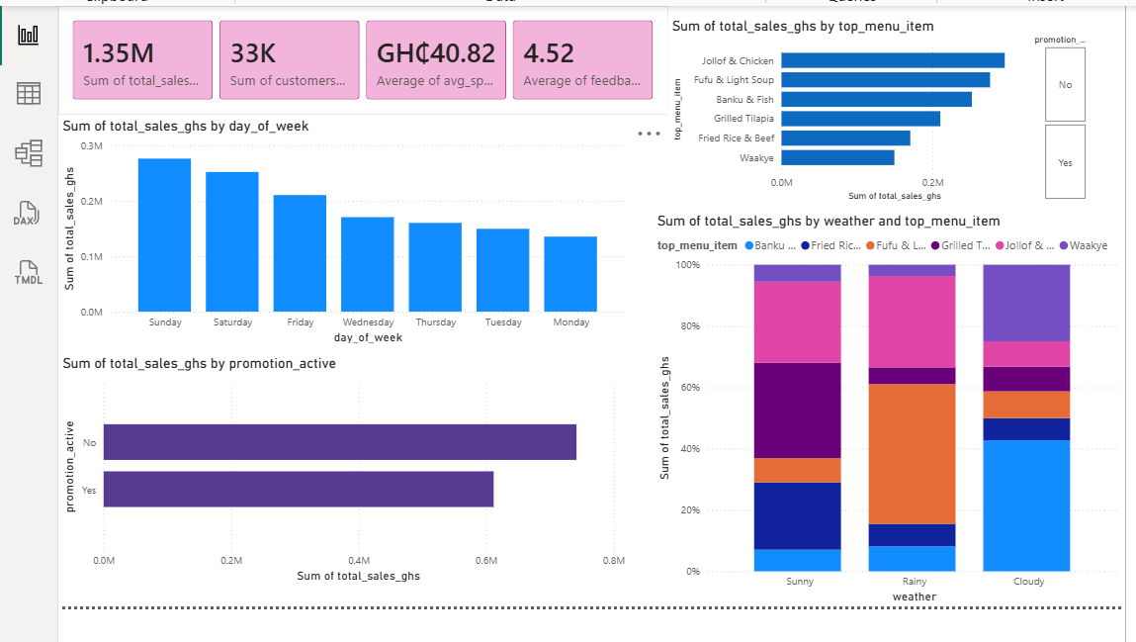
TASTY BITES BUSINESS INTELLIGENCE
Interactive Power BI Executive Dashboard Showcase
LIVE POWER BI DASHBOARD DEMONSTRATION
Key Interactive Features to Demonstrate to Panel:
1. Promotion Tile Slicer: Click 'Yes' / 'No' to demonstrate immediate KPI card recalculations.
2. Weather Cross-Filtering: Select 'Rainy' bar to show Fufu & Light Soup sales spike.
3. Day-of-Week Sorting: Filter by 'Monday' to highlight mid-week sales gap.

Slide 7
TASTY BITES BUSINESS INTELLIGENCE
Actionable Recommendations for Tasty Bites Management
1. Launch 'Mid-Week Spark' Combos
Run targeted promotions on Mondays & Thursdays (slowest days).
Feature Jollof & Chicken combo deals with beverages to target nearby office workers and students, bridging the 33% revenue gap.
2. Weather-Adaptive Prep
Integrate morning weather forecasts into daily kitchen inventory scheduling.
Increase prep for Fufu & Light Soup on rainy/overcast mornings and Sundays to eliminate stockouts and maximize high-spend sales.
3. Weekend Loyalty Packages
Institutionalize weekend promotional bundles for high-margin signature dishes.
Package Banku & Fish and Fufu into premium family/group bundles on Saturdays & Sundays to push average spend past GH₵ 45.

Slide 8
PROJECTED BUSINESS IMPACT & NEXT STEPS
Targeting 12% - 15% Top-Line Growth in 90 Days
• Revenue Impact: Elevating Monday revenue from GH₵ 4.4K to GH₵ 5.5K adds ~GH₵ 50,000+ in incremental annual revenue.
• Operational Impact: Weather-based prep eliminates Fufu stockouts on rainy days and reduces weekday food waste.
• Customer Loyalty: Structured promotions maintain satisfaction ratings above 4.65/5.0.
Thank You

