Slide 1

Salary Prediction in Data Science
Francis Cruz - 999539227

Slide 2
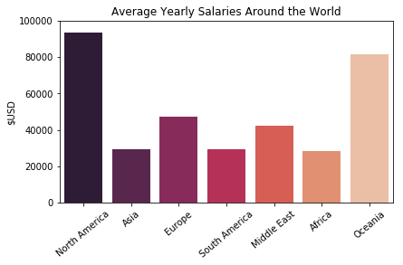
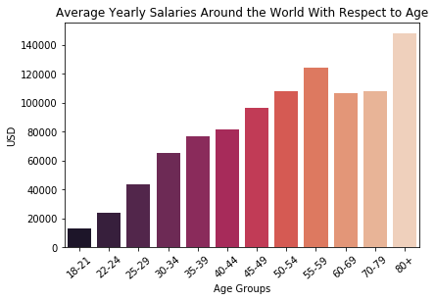
Exploratory Analysis
Exploratory Analysis Feature Importance Results and Visualization
Location and Age of a data scientist affects yearly salaries.
Location
Age
Global Average Yearly Salary: ~54.4K
Common Age Group: 25-29
Richest Age Group: 80+

Slide 3
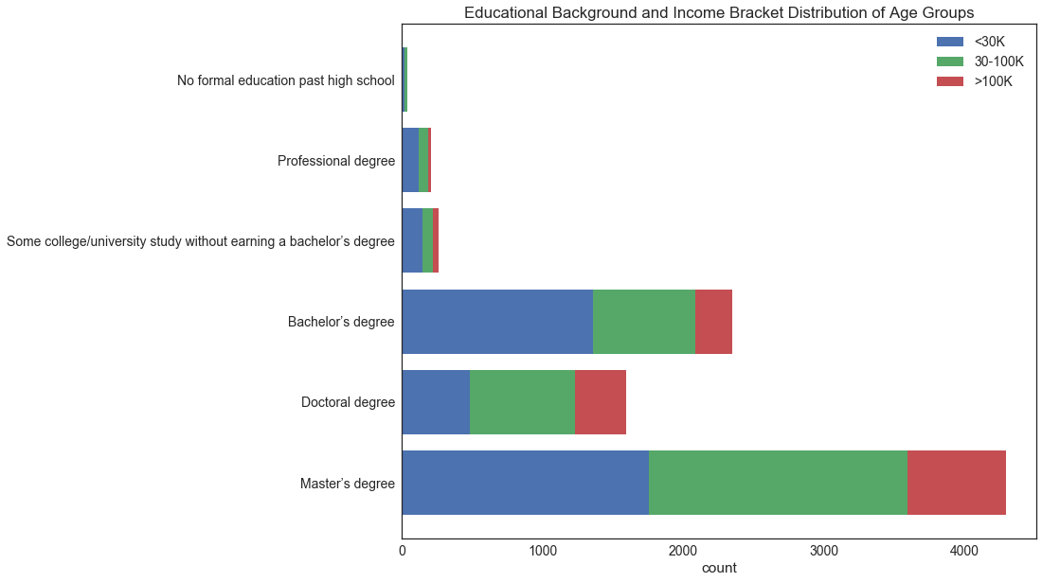
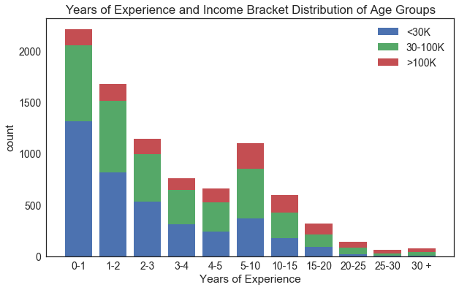
Exploratory Analysis
Exploratory Analysis Feature Importance Results and Visualization
Better educational background and more job experience lead to higher salaries.
Education
Experience
Best Educational Background: Master’s Degree
More job experience, higher income

Slide 4
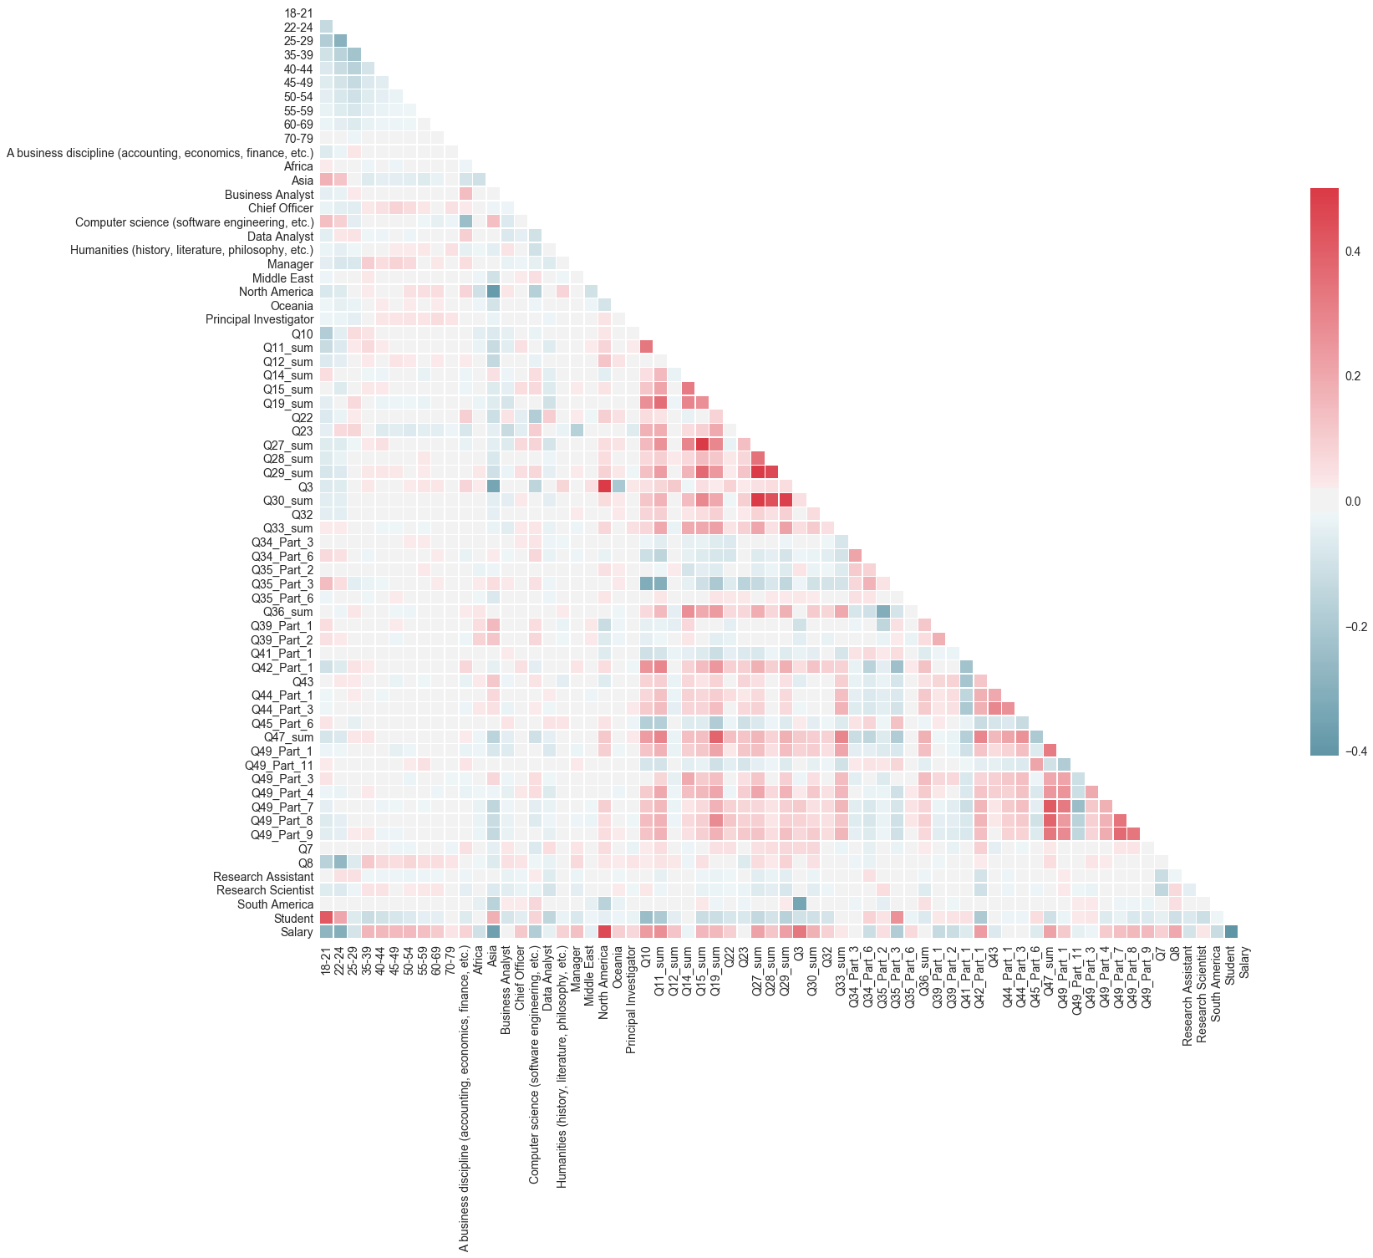
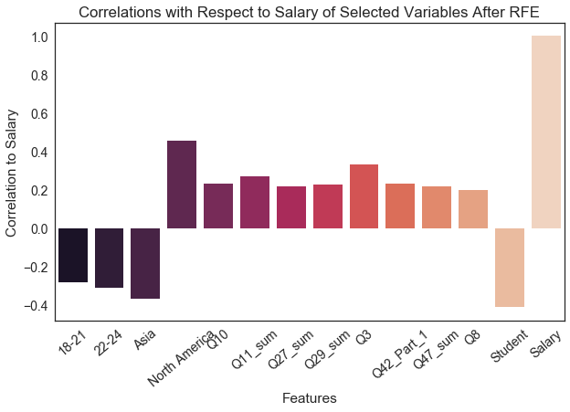
Feature Importance
Exploratory Analysis Feature Importance Results and Visualization
Selected and engineered features of high importance exhibited higher correlations with salary
These includes:
Particular Age Groups (i.e. 18-21, 22-24)
Location (Country and Continent of Residence)
Proficiency in programming languages and data analytics tools (cloud computing, big data)
Occupation

Slide 5
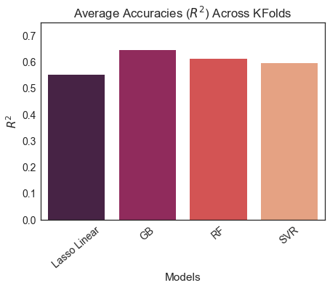
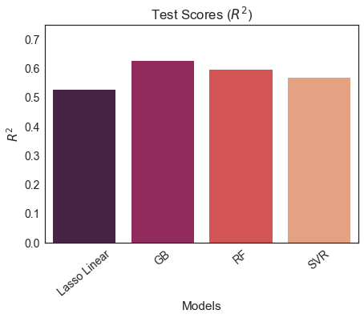
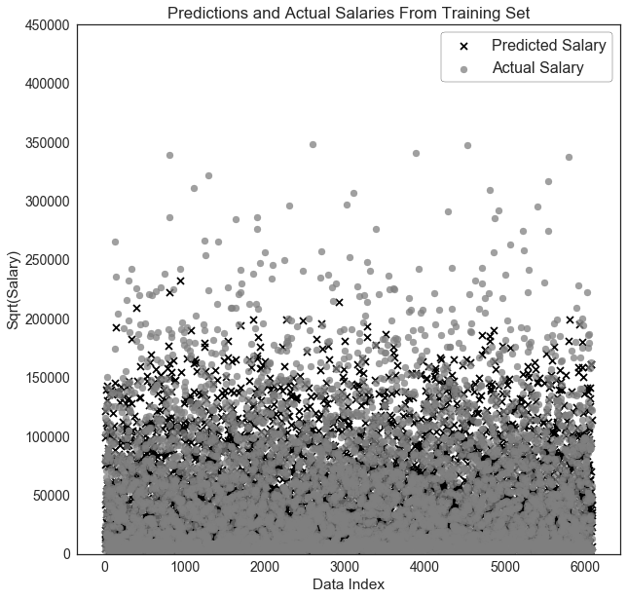
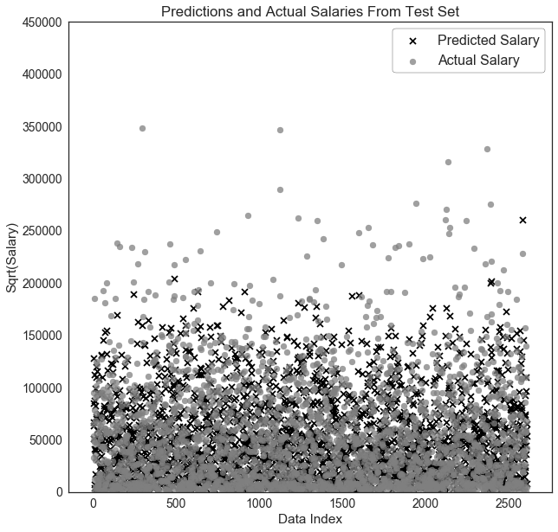
Results and Visualization
Exploratory Analysis Feature Importance Results and Visualization
Gradient Boosting Regressor (GB) was determined to be the optimal model for the data set.
 | Train | Test
R² | 0.75 | 0.66
RMSE | 54.4 | 63.4
Optimal model was selected using the tuned hyperparameters resulting in the lowest bias and variance possible.

