Slide 1


Slide 2
Introductie + DQL
Introduction Database

Slide 3
Subjects
What is a Database?
Database Management systeem (DBMS)
What are tables
Structured Query Language (SQL)

Slide 4
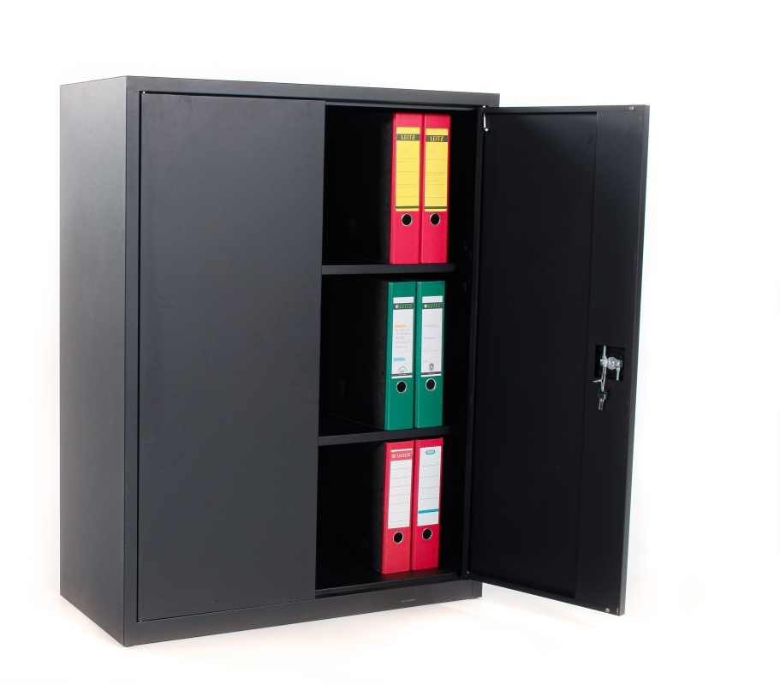
What is data?
DATABASE
DATA refers to raw facts and figures..
Data is a collection of information.
This "data" is used in various
forms: text, numbers, media and many more.
Example: Name, age, weight, height, etc.

Slide 5

Database
A database is an organised collection of structured information or data, usually stored electronically in a computer system. ...
The data and the DBMS, together with applications linked to it, are called a database system.

Slide 6
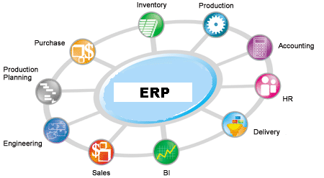
Why are Databases relevant?
Almost everything revolves around Information Systems.
Database and/or DBMS are at the heart of an IS
Significance:
Databases are the engine of many IT applications !!!
Notes:
Note: For the professional, the course Databases is of central importance.
Amazon is making profits today: "In itself, modelling the most important thing you will encounter in practice. But ultimately, it's all on a database. "

Slide 7
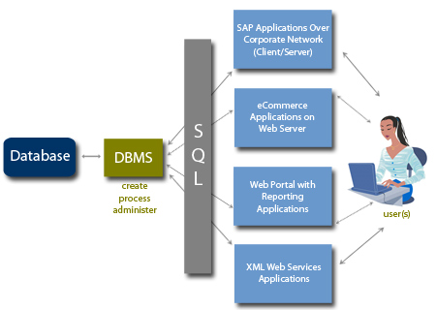
DBMS – A way in and out of the database world

Slide 8

Relationele DBMS

Slide 9
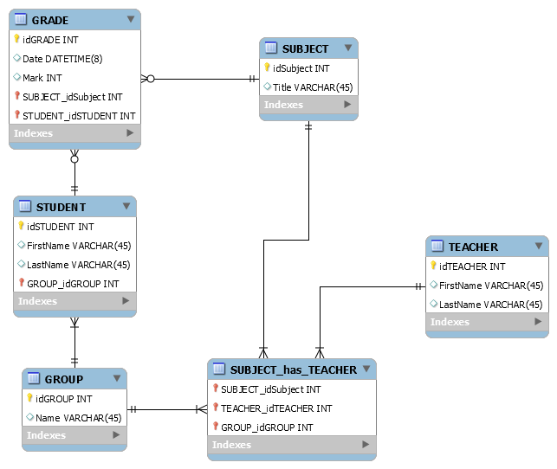
Gebruikte termen
Entities/tables
Attributes
Primary key
Relations

Slide 10
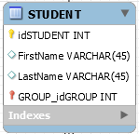

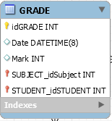

Relationship between tables
This describes how one or more entities are connected. A verb is often used to describe the relationship
has

Slide 11

Keys of all shapes and sizes
Primary Key
Unieke waarde binnen een tabel die de rest van de waardes uit een rij bepaalt.
Doelstelling: Uniekheid aantonen.
Voorbeeld: Studentnummer, BurgerServiceNummer (BSN)
Foreign Key
Waarde binnen een tabel die een unieke waarde van een andere tabel representeert.
Doelstelling: Verband/Relatie aantonen.
Alternate Key
Alternatieve waarde die uniek is naast de primary key.
Surrogate Key
Waarde binnen een tabel die uniek is, maar verder geen (aanwijsbare) toegevoegde waarde bevat..

Slide 12
A database consists of tables
column (attribute, field)
domein (‘M’,’V’)
table (entity)
value=’V’
row
(record, tuple, occurence)
tablestructure: patient(Patientnummer,PNAAM,LEEFTIJD,GESLACHT,ARTS)
Notes:
Een tabel (of relatie) bestaat uit rijen (horizontaal) en kolommen (verticaal)
andere namen voor rij zijn : record, tuple, occurence;
andere namen voor kolom : attribuut, veld.
De structuur van een tabel is de definitie van de kolommen van een tabel en de domeinen/datatypen van die kolommen/attributen. Uit een plaatje van een tabel is de structuur af te lezen uit de heading (kop). Een meer formele notatie : patient(PAT#, ....).
De rijen onder de kop geven de inhoud van een tabel weer.
De structuur van een tabel wordt van te voren gedefinieerd mbv DDL, en ligt daarna vast (vgl.declaratie van een variabele (int i)). De inhoud van een tabel (de aanwezige rijen of records, vgl. de waarde van een variabele (i=1)) kan worden gemanipuleerd met DML.
De volgorde van de rijen is niet belangrijk / onbepaald.
De waarde van een database tabel is daarom een verzameling (Eng. set) rijen.
De definitie van een tabel bestaat uit een verzameling kolommen.

Slide 13
Structured Query Language (SQL)
A powerful language with a limited vocabulary
Manage an entire database with just 9 words
Declarative (‘WHAT’ not ‘HOW’)
Working with sets
Input: Collection of instructions
Output: Collection of results

Slide 14
SQL – DQL, DML, DDL, DCL, TCL
SQL is divided into 5 parts
Data Query Language – DQL
Retrieve data (SELECT)
Data Manipulation Language – DML
Insert, Change, Remove data (On a data level)
INSERT, UPDATE, DELETE
Data Definition Language – DDL
Create, Change, Remove Tables (On a structure level)
CREATE, DROP, ALTER, TRUNCATE, RENAME
Data Control Language – DCL
Give, Take Permissions
GRANT, REVOKE
Transaction Control Language – TCL
COMMIT, ROLLBACK, SAVEPOINT

Slide 15
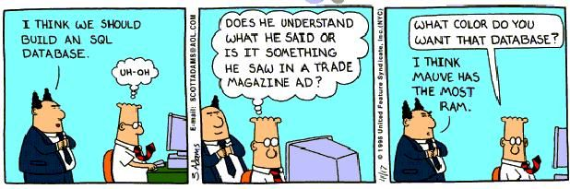
DQL – SELECT
The SELECT command is used to retrieve data from the DB.
This data must meet the conditions set out in the instructions
Using the following keywords, the user can filter and sort the results.
SELECT, FROM, WHERE, GROUP BY, HAVING, ORDER BY

Slide 16
Order of execution
SELECT Nr, NAME
FROM TOOLS
WHERE COLOR=‘Blue’
ORDER BY NAME
1. FROM TOOLS
Nr | NAME | COLOR | WEIGHT | CITY
A1 | Nut | Red | 12 | Londen
A2 | Bolt | Green | 17 | Parijs
A3 | Screw | Blue | 17 | Rome
A4 | Screw | Red | 14 | Londen
A5 | Pin | Blue | 12 | Parijs
A6 | Vice | Red | 19 | Londen
2. WHERE COLOR=‘Blue’
Nr | NAME | COLOR | GEWICHT | PLAATS
A3 | Screw | Blue | 17 | Rome
A5 | Pin | Blue | 12 | Parijs
3. SELECT Nr, NAME
Nr | NAME
A3 | Screw
A5 | Pin
4. ORDER BY NAME
Nr | NAME
A5 | Pin
A3 | Screw

Slide 17
SELECT and FROM
SELECT and FROM are keywords for this syntax
SELECT
Select which columns the data should come from
Can only contain names of colu
Only the names of columns from tables prepared by the FROM
FROM
Which table contains the columns of where you want information from
Can only contain table names
Example:
SELECT customerNumber, customerName
FROM customers

Slide 18
WHERE
Filter for the data to be retrieved. Affects everything in the SELECT section.
Data must match the condition set through the WHERE keyword.
SELECT [column(s)]
FROM [table]
WHERE [column] [operator] {exception}
Operators
(!) =
< or > or <= or >= or <>
BETWEEN
IN
LIKE
[NOT]
Can be expanded using the AND keyword, can be alternated using the OR keyword.
WHERE name = ‘Henk’ AND age >=16;

Slide 19
LIKE Operator
Perform searches based on(part of) a string
A character string is defined using inverted commas ➔ ‘ text ‘
Use the LIKE operator with the WHERE statement
LIKE uses Wildcards
% ➔ undetermined number, undetermined sign _ (underscore) ➔ fixed number (1 piece), fixed sign

Slide 20
ORDER BY
ORDER BY is a SELECT instruction functionality that can sort results in a requested manner
Options to choose from are ASC(ending) or DESC(ending)
Use ORDER BY as following:
SELECT *
FROM customer
WHERE age =< 25
ORDER BY firstname DESC;
Are the requested results A – Z or Z – A?

Slide 21
Aggegrate functions
Most common:
COUNT – returns the number of rows SUM – returns the total of all values MIN – returns the lowest number MAX – returns the highest number AVG – returns the average of all values
But they aggegrate all results in a single record
This means that not using it correctly will lead to unreliable data (incorrect results).

Slide 22
Aggegrate functions
in SELECT component is available (as an intermediate result):
the set of rows available that meets the condition in the WHERE component
examples :
SELECT COUNT(*) FROM spelers;
SELECT COUNT(DISTINCT place) FROM spelers;

Slide 23
Aggegrate functions not in WHERE component
SELECT * FROM fines WHERE SUM(bedrag) > 100; //WRONG!!
SELECT SUM(amount) FROM fines WHERE amount >100;
SELECT COUNT(*) FROM fines WHERE amount >100;

Slide 24
COUNT
SELECT COUNT(*) FROM boetes; 8
SELECT COUNT(amount) FROM boetes; 7
SELECT COUNT(DISTINCT amount) FROM boetes; 4
FINENR | AMOUNT
1 | 85
2 | 75
3 | 85
4 | 50
5 | 25
6 | 25
7 | NULL
8 | 75

Slide 25
MIN, MAX
SELECT MIN(bedrag) FROM fines; 25
SELECT MAX(bedrag) FROM fines; 85
FINES# | AMOUNT
1 | 85
2 | 75
3 | 85
4 | 50
5 | 25
6 | 25
7 | NULL
8 | 75

Slide 26
SUM, AVG examples
SELECT SUM(amount) FROM fines; 420
SELECT AVG(amount) FROM fines; 60
SELECT SUM(amount)/ COUNT(amount) FROM fines 60
FINES# | AMOUNT
1 | 85
2 | 75
3 | 85
4 | 50
5 | 25
6 | 25
7 | NULL
8 | 75

Slide 27
Aggegrate functions without GROUP BY
set functions in SELECT without GROUP BY aggregate across all rows of the table (treat the whole table as 1 group)
NOT allowed:
SELECT payment no, MIN(amount) FROM fines;

Slide 28
GROUP BY, HAVING
definition SELECT:
<select-instructie>::=
<select-component>
<from-component>
[<where-component>]
[<group-by-component>]
[<having-component>]
[<order-by-component>]

Slide 29
GROUP BY, HAVING
GROUP BY [column]:
groups rows that have the same value in a column (have the same values of a given attribute)
example GROUP BY colour
HAVING [group-condition]:
selects groups meeting condition

Slide 30
SELECT instruction: order of execution (internal)
order
SELECT [columns] [5]
FROM [tables] [1]
WHERE [condition for row] [2]
GROUP BY [columns] [3]
HAVING [condition for group] [4]
ORDER BY [column] [6]

Slide 31
GROUP BY
SELECT PLAYERNR, NR, AMOUNT
FROM BOETES
GROUP BY PLAYERNR
NR | PLAYERNR | AMOUNT
1 | 6 | 100
2 | 44 | 75
3 | 27 | 100
4 | 104 | 50
5 | 44 | 25
6 | 8 | 25
7 | 44 | 30
8 | 27 | 75
NR | PLAYERNR | AMOUNT
1 | 6 | 100
6 | 8 | 25
3 | 27 | 100
8 |  | 75
2 | 44 | 75
5 |  | 25
7 |  | 30
4 | 104 | 50

Slide 32
GROUP BY
SELECT PLAYERNR, COUNT(BEDRAG)
FROM Boetes
GROUP BY SPELERSNR
spelersnr | count(bedrag)
6 | 1
8 | 1
27 | 2
44 | 3
104 | 1
betalingsnr | spelersnr | bedrag
1 | 6 | 100
6 | 8 | 25
3 | 27 | 100
8 |  | 75
2 | 44 | 75
5 |  | 25
7 |  | 30
4 | 104 | 50
spelersnr | sum(bedrag)
6 | 100
8 | 25
27 | 175
44 | 130
104 | 50
SELECT SPELERSNR, SUM(BEDRAG)
FROM Boetes
GROUP BY SPELERSNR

Slide 33
HAVING
HAVING selects groups meeting 'group condition’
a 'group-condition' tests values of which there is only 1 per group, ie:
values of attributes that are grouped by (player no), or
aggregated values within a group (SUM(amount))

Slide 34
Assignment:
For each player with 2 or more fines, give the total amount of his/her fines (boetes
NR | PLAYERNR | AMOUNT
1 | 6 | 100
2 | 44 | 75
3 | 27 | 100
4 | 104 | 50
5 | 44 | 25
6 | 8 | 25
7 | 44 | 30
8 | 27 | 75

Slide 35
Answer:
SELECT playernr, sum(amount) FROM boetes GROUP BY playernr HAVING COUNT(amount)>=2;

Slide 36
Assignment:
For each player with 2 or more fines (boetes), give the total amount of his/her fines, but ignore fines of 25 or less

Slide 37
Answer:
SELECT playernr, sum(amount) FROM boetes WHERE amount > 25WHERE bedrag > 25 GROUP BY playernr HAVING COUNT(amount)>=2;

Slide 38
SELECT wish FROM hallmark WHERE quote = “Good luck”

